Slide 1
Centering IDEAA and Cultural Humility in Professional Development and Instructional Design Frameworks
Presenters:
Karen Chow, ASCCC Area B Representative
Monica Esquivel, Pasadena City College, ASCCC Equity and Diversity Action Committee
Janue Johnson, San Diego Mesa College, ASCCC Equity and Diversity Action Committee
Mitra Sapienza, ASCCC North Representative

Slide 2
Breakout Description
In what ways can we center IDEAA (Inclusion, Diversity, Equity, Anti-racism, and Accessibility) and cultural humility in our professional development and instructional design practices? We will discuss professional development planning that supports IDEAA and culturally responsive teaching, creates inclusive and equitable learning environments, and explores specific frameworks and strategies that we can use to do so. We welcome dialogue with participants about professional development activities and instructional design support their colleges are offering and developing.

Slide 3
What we’ll cover today
Types of professional development centering IDEAA
A framework for developing IDEAA centered professional development
How assessing cultural humility can be a transformative journey for those who participate
Lessons learned from creating and presenting Equity Roadshows to campus departments and programs
What is gained from an IDEAA-centered yearlong bimonthly 3-hour Seminar for New Faculty

Slide 4
In what areas is there a need for IDEAA centered Professional Development?
Culturally Responsive Practices & Pedagogy (Instruction & Student Services) Across Various Modalities (Online, Hybrid, Face to Face)
Trauma-informed pedagogy
Humanizing Online Courses
Instructional Design (Universal Design for Learning Framework)
Equity centered Processes for:
Hiring (EEO best practices) & Retaining Faculty,
Shared Governance & Decisionmaking,
Institutional Processes/Evolution,
Program Review
DEIA/IDEAA in Faculty Evaluations
Equity-informed Data Coaching
Recognizing Bias
How to embed IDEAA in….
What are other areas where IDEAA centered PD is happening??

Slide 5
IDEAA-centered PD can generate these powerful impactful outcomes:
Building trust through building relationships
Valuing Cultural Humility as a continuous journey of becoming aware of one’s own cultural lens and biases and being open to understanding other cultural perspectives
Growth mindset of accepting that mistakes will be made and are part of a journey of learning and growing to be more equity-centered
Moving from deficit-based thinking to asset-based thinking about students and education
Moving from individualistic mindset to collaborative mindset

Slide 6
Framing Professional Learning
Equity through the lens of bell hooks emphasized the self-actualization journey of the instructor (or education professional) to expand their knowledge and to engage in praxis–‘reflection upon the world to change it’ (hooks, Teaching to Transgress, p.14).”

Slide 7
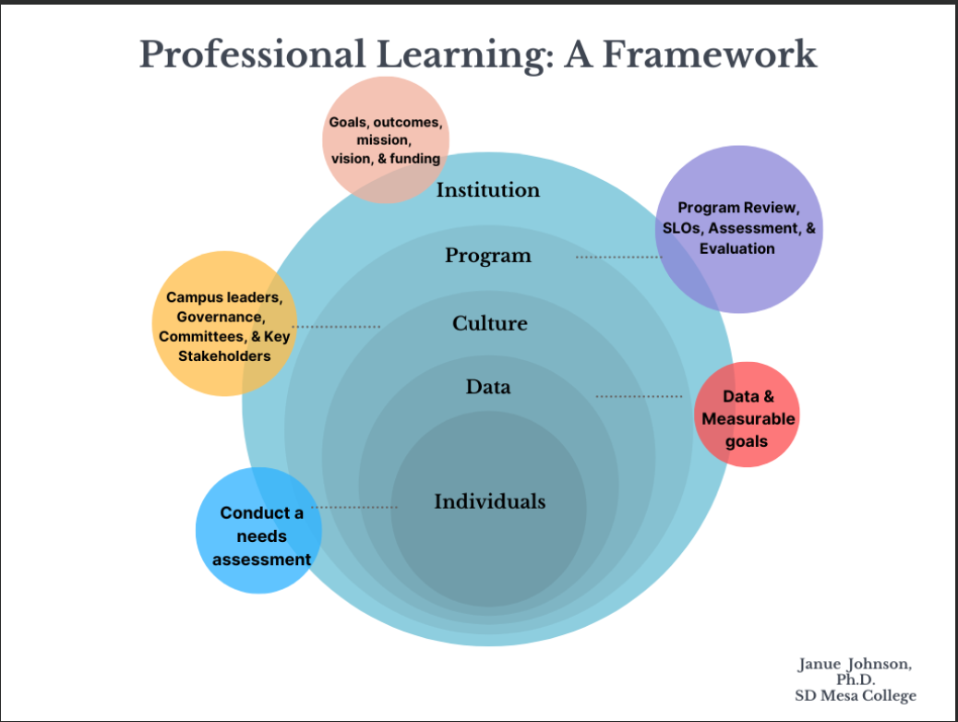
Framing Professional Learning 2

Slide 8
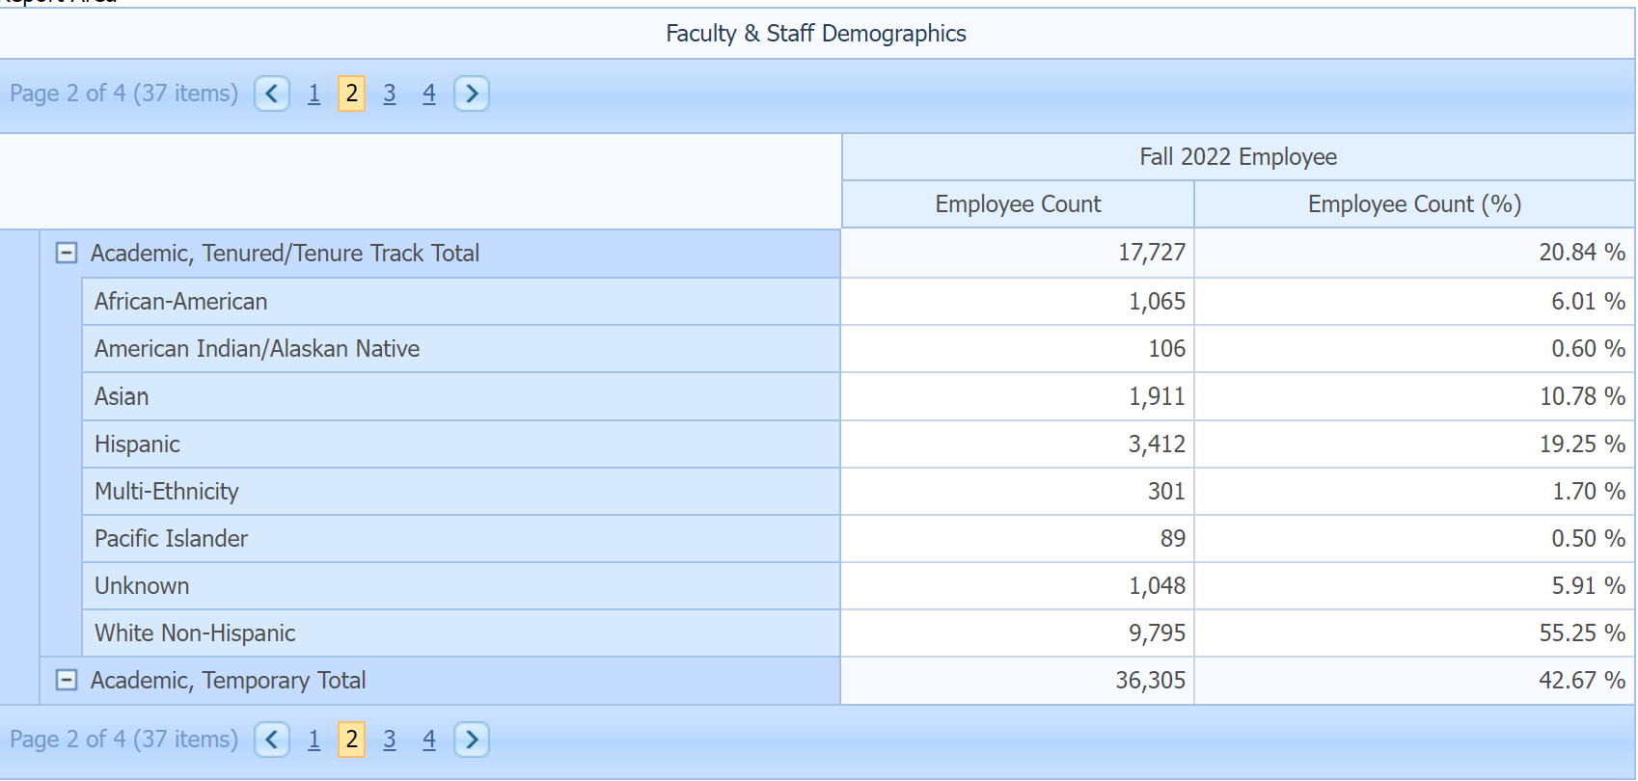
Who are your
campus constituents?
The Individuals
What are the demographics of the campus community?
What are their interests?
How can you support their needs?
Sample Demographic Data:

Slide 9
How can PL
support the annual
program review process?
“Program review provides an opportunity to align courses and services with program outcomes and overall program outcomes with institutional learning outcomes. The process identifies the learning environment, content, and pedagogy that contributes to successful learning.”
Example:
A1. How does your area help foster equity and excellence across the campus?
Starting point: successful course completion in introductory or gateway courses.
Patton, J., Davison, D., Eng, M., Hanna, K., Grimes-Hillman, M., Walton, I., Jackson, J. and Vazquez, U., 2009. Program Review: Setting a Standard. The Academic Senate for California Community Colleges, [online] Available at: <https://www.asccc.org/sites/default/files/publications/Program-review-spring09_0.pdf>.

Slide 10
What is the campus climate?
The Culture
“College culture is university subculture, and a unique organization culture form created, discovered, and developed from long-term teaching management practice, generally accepted, recognized, and followed by teachers and students of college/ school/ department.”
Example:
Consensus
Process focused
Collaborative
Anarchical
Birnbaum, R. (1988). How colleges work. The cybernetics of academic organization and leadership. San Francisco: Jossey-Bass Publishers.

Slide 11
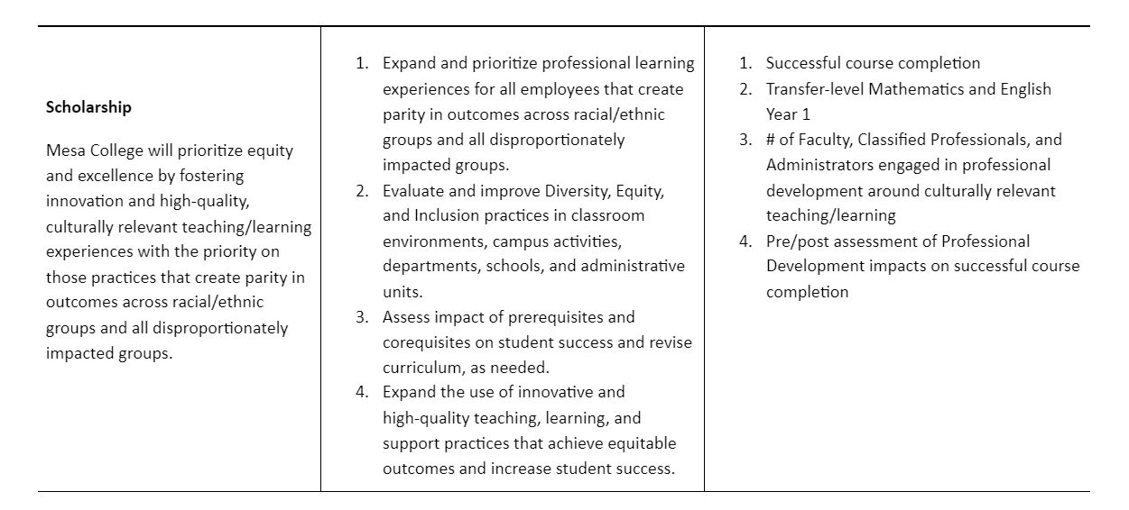
Who are the institutional
objectives?
The Institution
“Building a robust professional learning program can start with assessing or reviewing the institutional goals, strategic goals, mission or the institution’s ten year plan.”
Example:

Slide 12
What is the students learning
experience?
The Data
1. What does the data tell us?
2. Why do we see these trends or patterns?
3. How can we take action based on this information?
Example:
Drop, fail, and withdraw rates in gateway courses disaggregated by race, gender, Pell-eligibility, first-generation, etc.

Slide 13
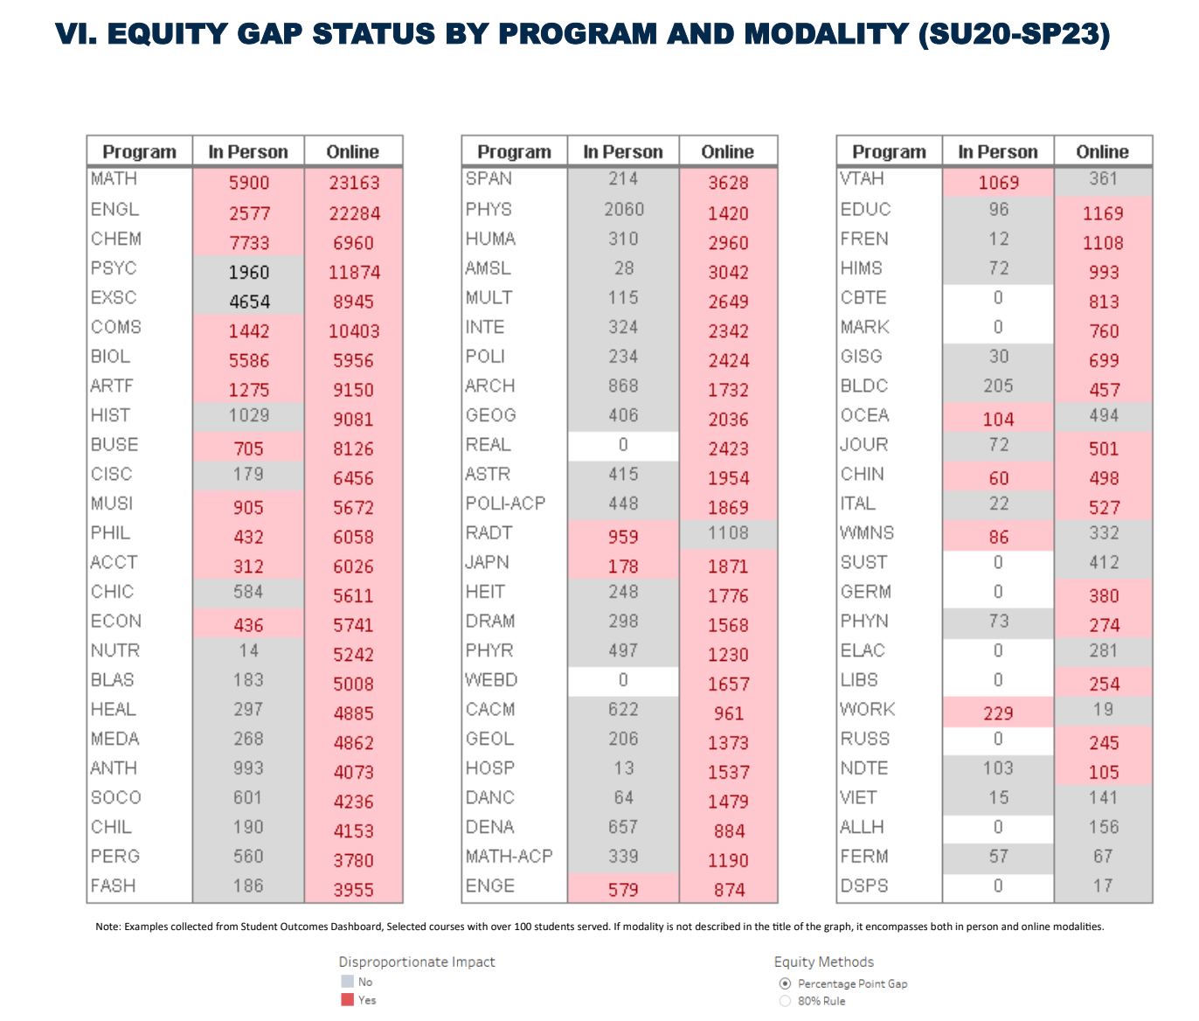
Screenshot of chart of equity gap status by program and modality (Su20-Sp23)

Slide 14
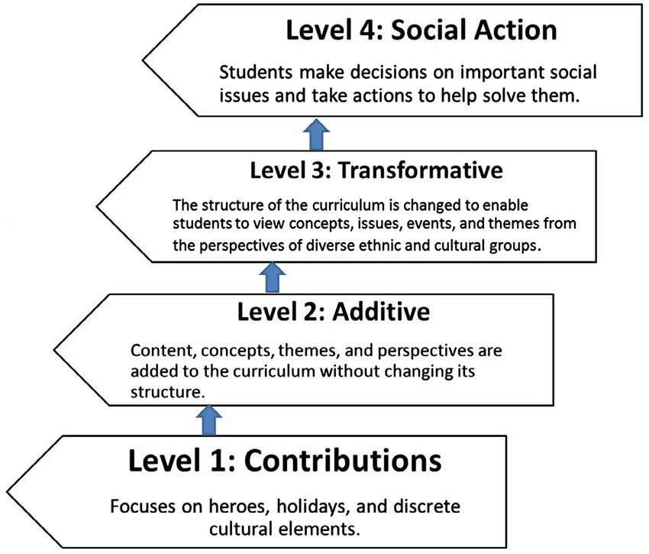
How can students inform the process?
The
Student
Voice
Banks, James A. (1989) "Approaches to Multicultural Curriculum Reform," Trotter Review: Vol. 3: Iss. 3, Article 5.

Slide 15
Process for creating IDEAA-informed PD
Examine and revise the Course Outline of Record (juxtaposed to Curriculum) with an equity lens (anti-racist learning objectives, inclusive texts, CRT practices etc.)
Analyze and review course success data and to identify equity gaps.
Construct (a) course materials, (b) active learning activities, (c) clear learning objectives, and (d) engagement strategies that are connected to culturally relevant pedagogy practices.
Add one? [Meet participants where they are and customize their learning experiences.]
Institutional Connection:
Pre/Post assessment of CEER
How many faculty within the next 5 years?
Recruit entry level instructors for Math & English?
Deliverables:
COR Analysis

Slide 16
Professional Development Activities For Campuswide Equity Engagement
Cultural Humility Toolkit for Developing a Cultural Humility Inventory & Plan of Action
Equity Roadshow
New Faculty Year-long Seminar

Slide 17
Why Cultural Humility?
What is cultural humility?
“a lifelong process of self-reflection and self-critique whereby the individual not only learns about another’s culture, but one starts with an examination of her/his own beliefs and cultural identities.” –National Institute of Health
--cultural humility is not cultural competence, where the main goal is to learn about another’s culture but has no self-reflection component.
--cultural humility requires historical awareness of legacies of violence and oppression against certain groups of people. In the U.S., there are legacies of violence and oppression against non-white people and immigrants, LGBTQ+ identified people, and women.
Engaging with the ASCCC Cultural Humility toolkit
encourages developing activities to establish some baseline of relationship and trust building through sharing stories and understanding each other’s positionality.

Slide 18
Cultural Humility Inventory Domains
Inventory Criteria:
Awareness of Bias
Inclusion, Diversity, Equity, Anti-Racism, & Accessibility
Acknowledgement of Diverse Perspectives of Thinking
Understanding of Race Consciousness
Commitment to Disrupt Microaggressions
Commitment to Behavioral & Policy Change for IDEAA & Antiracist Practices
Commitment to Relate to Diverse Lived Experiences
Key Info:
Transformative work through self-assessment and self-awareness
Courageous conversations can be sparked
Criteria used in the inventory provide framework to cultural humility supported by resources to begin transformative work for each criteria (domain)

Slide 19
Cultural Humility Inventory screenshot

Slide 20
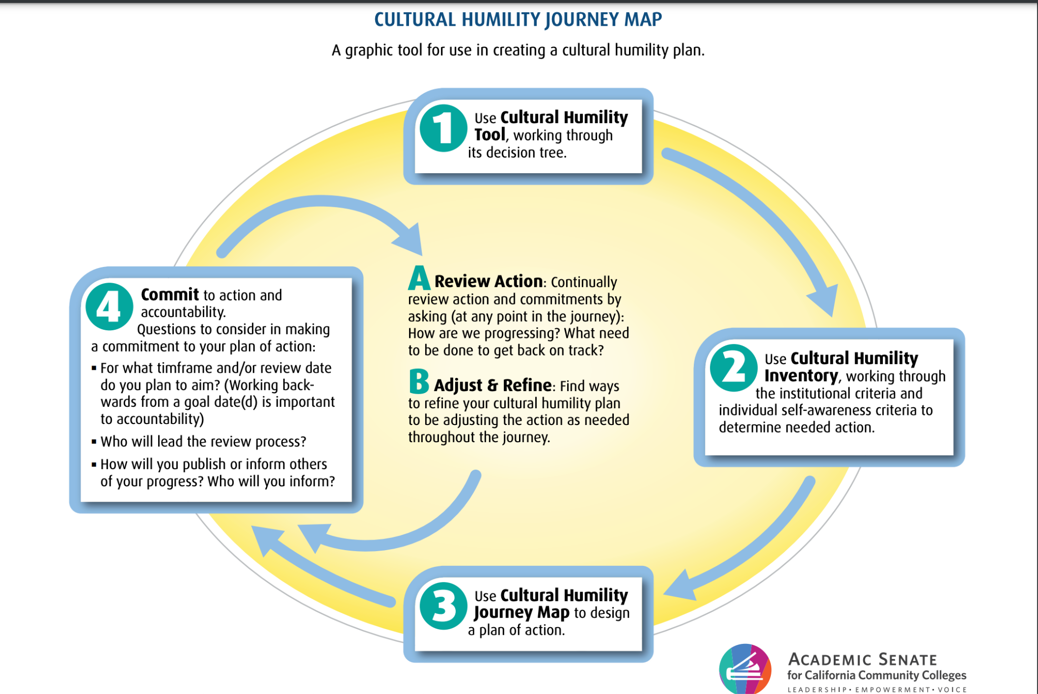
Cultural Humility Journey Map screenshot

Slide 21
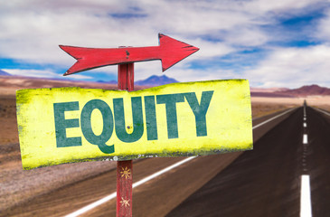
Equity Roadshow
Discussing Equity Data one department and program at a time.
Presented by the City College of San Francisco the Office of Student Equity, the Student Equity Strategies Committee, and the Office of Research and Planning.

Slide 22
CCSF Equity Roadshow
Objectives
Explore ways to intentionally institutionalize equity as a core, data-informed planning value
Support all college stakeholders in developing promising practices designed to close opportunity gaps.
Showcase CCSF resources that support Equity groups
Build the capacity of college constituencies to access, analyze and track data.
Learn more about departments and programs and how the data aligns with educator experiences
Outcomes
Fall 2019 and through Spring 2023
36 departments/programs
537 college employees and students
dialogue addressing systemic barriers, microaggressions, implicit bias, anti-racist practices and ways that we can all do better in supporting students
Changes to syllabus, course policies, meeting facilitation, improved communication
Goals: pre-survey,
improve ongoing
outreach, more
connections to
program review,
hiring and faculty
eval processes.

Slide 23
Equity road show feedback
We tried implementing peer groups for intro students during COVID. We eventually transitioned from peer groups to having dedicated face-to-face intro tutors.
We revised our prerequisite challenge test to be more flexible and less tricky.
We produced a document of recommendations around deadlines and grading in an effort to make department practices more equitable.
We're in the process of making a similar document of recommendations around teaching neurodivergent students.
We have a lot of trouble retaining female students.
How are peers trained? Onboarded? Supported in an ongoing way? Do peers, tutors and supervisors have foundational understanding of educational equity?
Have you considered why you need this exam to begin with? Is the updated exam still inclusive in it’s examples? Are there other ways you could measure student skill levels?
How are these policies communicated to students? Are there other elements of the course syllabus that you could revise? How do you make these values clear to students?
What PD have instructors done in exploring their own bias? What kind of conversations do you build around looking at data and aligning gaps with instructional choices?
Do you include female examples in curriculum, bring in more female/non-binary/BIPOC examples, guest speakers, etc.?

Slide 24
IDEAA Centered PD That Builds Community
The following slides will cover:
What is New Faculty Seminar at Pasadena City College
Structure.
Examples of reading materials.
How the information received has been applied.

Slide 25
New Faculty Seminar at PCC
The New Faculty Seminar at Pasadena City College provides you with a yearlong Seminar experience dedicated to enriching your first-year as a full-time, tenure track faculty member at PCC.
Partnered with the Office of Equity, Diversity & Justice, we are here to provide you with the resources you need to navigate your time at PCC.
This includes familiarizing yourself with PCC’s Mission and Values, their commitment to equity and student success and to encourage and assist you in any way that we can.

Slide 26
General Structure of Friday Seminar
3 hours (12-3pm)
Lunch with team building activity & prizes
Reading & discussion of assigned article
Think Pair Share followed by general group discussion
Presentation from a campus service or office to help familiarize faculty with what they do & tips for how to engage with student populations they serve

Slide 27
Examples of readings
The following readings are used for us to have more tools to provide culturally sensitive instruction and to learn more in depth subjects that will aid us in the future with interactions with students:
Ladson-Billings: "I'm Here for the Hard Reset: Post Pandemic Pedagogy to Preserve Our Culture"
"The Trauma-Informed Equity-Minded Asset-Based (TEAM) Model: The 6 Rs for Social Justice-Oriented Educators"
Yosso: "Whose Culture Has Capital: A Critical Race Theory Discussion of Community Cultural Wealth"
The National Academies of Sciences, Engineering and Medicine: How People Learn II: Learners, Contexts, and Cultures

Slide 28
How has this PD helped me?
Learned Cultural Humility.
Undocumented Student Support Center.
Learned how students’ brain sometimes looks for microaggressions.
How much does race play on our students’ conclusions?
Learned how trauma informed teaching can make a difference.
Making sure our teaching topics are sensitive to our students.

Slide 29
To sum up…
IDEAA centered Professional Development is most impactful when it:
is a collaboration with multiple stakeholders;
encouraging/welcoming of each participant no matter where they are in their equity/IDEAA journey.
acknowledges that we are all imperfect and make mistakes in our Equity/IDEAA journey, and mistakes are growth opportunities
encourages sharing with cultural humility and vulnerability and invites us to participate in a continuous cycle of self and institutional reflection with actionable steps
encourages sitting with, reflecting on, and collectively discussing discomfort as a means of growth

Slide 30
Q&A
& Discussion

Slide 31
Resources
ASCCC Cultural Humility Toolkit
USC Center for Urban Education CUE’s Racial Equity Tools
CCSF Equity Roadshow sample slides
Humanizing Online Courses (brocansky.com/humanizing)

