Slide 1
Academic Senate Leadership:
Leveraging EEO Practices in Faculty Hiring Processes to Recruit, Hire, and Retain Diverse Faculty

Slide 2
Presenters:
Meridith Selden - ASCCC Curriculum Committee; Yuba College
Robert L. Stewart Jr. - ASCCC Treasurer; Los Angeles Southwest College
Eric Wada - ASCCC North Representative; Folsom Lake College

Slide 3
Description
The students in our colleges benefit academically and socially from a faculty that represents the diversity of our student body and shares the experiences of our students. Academic senates must be jointly involved with local governing boards in developing faculty hiring criteria, policies, and procedures according to California Education Code 87360(b). In our colleges and districts, we have practices to ensure that there is fairness in hiring in accordance with Equal Employment Opportunity practices. Beyond those processes that ensure fairness, what practices do we have to promote equity in hiring? What equity-focused methods does your college or district use to recruit, hire, and retain diverse faculty?

Slide 4
Outline
A brief review: fairness vs. equity
EEO Practices in:
Title 5
Local documents & processes
Pre-hiring, hiring, post-hiring

Slide 5
Fairness vs. Equity
Fairness treats everyone the same.
Equity makes deliberate efforts to be inclusive. Practices are adjusted to account for systemic differences to give everyone an equal chance/opportunity despite those differences.
Both are important in your hiring practices.
How are these two concepts embedded in your practices (pre-hiring, hiring, post-hiring)
The next slides will allow time to share and ask questions.

Slide 6
Title 5 Sections: 53000 et seq.
53002: District EEO policy
53003: EEO plan (locally approved and reviewed every 3 years by an advisory committee).
53005: Advisory committee membership
53006: Data collection and review
53021: Recruitment practices
53022: Job announcement and qualifications
53023: Applicant pool review
53024: Screening and selection procedures
53024.1: Strategies for achieving institutional diversity

Slide 7
District EEO Policy;
EEO Plan Components and Review Timeline
53002: Requires district EEO Policy and a plan to implement policy.
53003: Sets a 3-year cycle to revise or develop an EEO plan.
Outlines the 10 required components of an EEO Plan:
Annual plan implementation strategies
Timeline to implement strategies
Identify an EEO officer
Complaint filing procedure
Process to notify district employees
Training for those on hiring committees
Notice given to community and professional organizations
Data collection & analysis
Data use from other public/private sources
Strategies to address underrepresentation

Slide 8
EEO Advisory Committee Membership
53005: Advisory committee membership composition:
Diverse membership which must include:
Students, faculty, and staff
Must be trained on:
Title 5 and EEO laws
Identification and elimination of bias in hiring
Educational benefits of workforce diversity
Their role in drafting the EEO policy
Who conducts these trainings? What do the trainings look like?

Slide 9
Data Collection and Review
53006: Data collection and review
“... shall conduct longitudinal data analyses of district employment trends”
Includes ALL phases of the employment process
Recruitment
Hiring
Retention
Promotion
Includes ALL protected classes
If significant under representation OR adverse impact occurs as a result of non-job related factors, the district shall implement additional strategies to mitigate
How might data (especially longitudinal data) be used to promote equity?

Slide 10
Protected Classes in CA
Race
Color
Religion
Sex/gender
Gender identity/expression
Sexual orientation
Marital status
Medical Condition
Military or veteran status
Age (over 40)
National origin
Ancestry
Disability
Genetic information
Request for family care leave
Request for leave for own serious health condition
Pregnancy Disability Leave
Retaliation for reporting patient abuse in tax-supported institutions

Slide 11
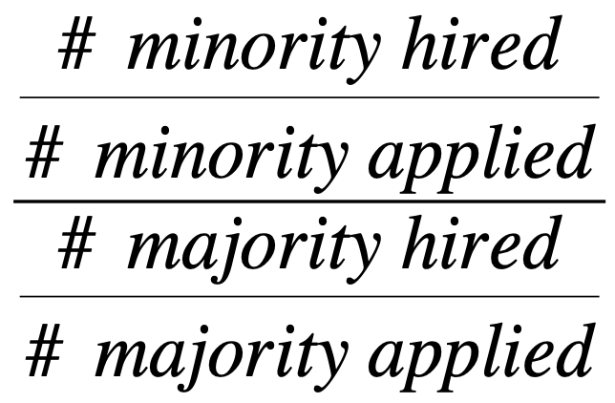
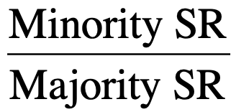
Adverse Impact
Occurs when the method has an adverse effect on members of a protected group compared with majority group
Requirement is applied equally but disproportionately excludes a higher proportion of one group than another
4/5th rule
Passing rate for minority group must be no less than 4/5ths (or 80%) of the passing rate for the majority group

Slide 12
Determining Adverse Impact - Example
40 male applicants, select (hire) 18
Male SR = 18/40 = .45
30 female applicants, select (hire) 12
Female SR = 12/30 = .40
Overall = .40/.45 = .89
The passing rate for the minority group is greater than .80!

Slide 13
Recruitment Practices
53021: Recruitment practices
Districts shall actively recruit from both within and outside the district to attract qualified and equity-minded applicants
Applies to all full-time and part-time vacancies in all job categories (i.e., faculty, classified employees, categorically funded positions, and all executive/administrative/managerial position)
EDC § 87108 - District needs a clearinghouse for advertising district job opportunities and allowing persons to make known their interest in community college employment. Shall include a special emphasis on:
Faculty internship employment opportunities
Reaching students who are qualified for faculty internship programs
How might a district proactively recruit with equity and diversity in mind?

Slide 14
Recruitment Practices 2
53021: Recruitment practices
Recruitment may include:
“Focused outreach and recruitment” of women and minorities (Gov. Code 11139.6(a)(1)
Outreach that “should result” in diversification (Gov. Code 11139.6(d)
Recruitment shall include:
Outreach to economically disadvantaged (Gov. Code 11139.6(a)(3)
How might a district proactively recruit with equity and diversity in mind?

Slide 15
Job Announcement and Qualifications
53022: Job announcement and qualifications
Job announcements shall state clearly:
Job specifications
Knowledge, skills, and abilities necessary to job performance
Possibility of meeting minimum qualifications through equivalency
For all positions, sensitivity to and understanding of IDEAA shall be considered a core system competency and job requirement
How might a district effectively use job announcements to promote IDEAA?

Slide 16
Applicant Pool Review
53023: Applicant pool review
Requires that applications allow for self-identification of gender (including non-binary), ethnicity, ability/disability status.
Do you have local disaggregation of gender, ethnicity, and ability/disability status?
Initial screening for qualifications
Allows districts to extend a search period - if pool diversity does not meet EEO goals and the application has not yet closed.
EEO officer can take appropriate action if the qualified applicant pool does not match the composition of the initial applicant pool if the difference is not job-related.

Slide 17
Screening and Selection Procedures
53024: Screening and selection procedures
In screening and selecting procedures, candidates for faculty and administrative positions must demonstrate “a sensitivity to and understanding of the diverse academic, socioeconomic, cultural, disability, gender identity, sexual orientation, and ethnic backgrounds of community college students”
How can we elicit responses that center IDEAA from applications and interviews?
Shall be based on job criteria
Shall be monitored by the EEO Officer to not have adverse impacts on groups.
May not set aside positions that discriminate or provide preferential treatment prohibited by law.
Where possible committees must have a diverse membership
How do you appoint committees?

Slide 18
Strategies for Achieving Institutional Diversity
53024.1: Strategies for achieving institutional diversity
This section offers 22 strategies that districts may use. Some of these have already been discussed in this presentation.

Slide 19
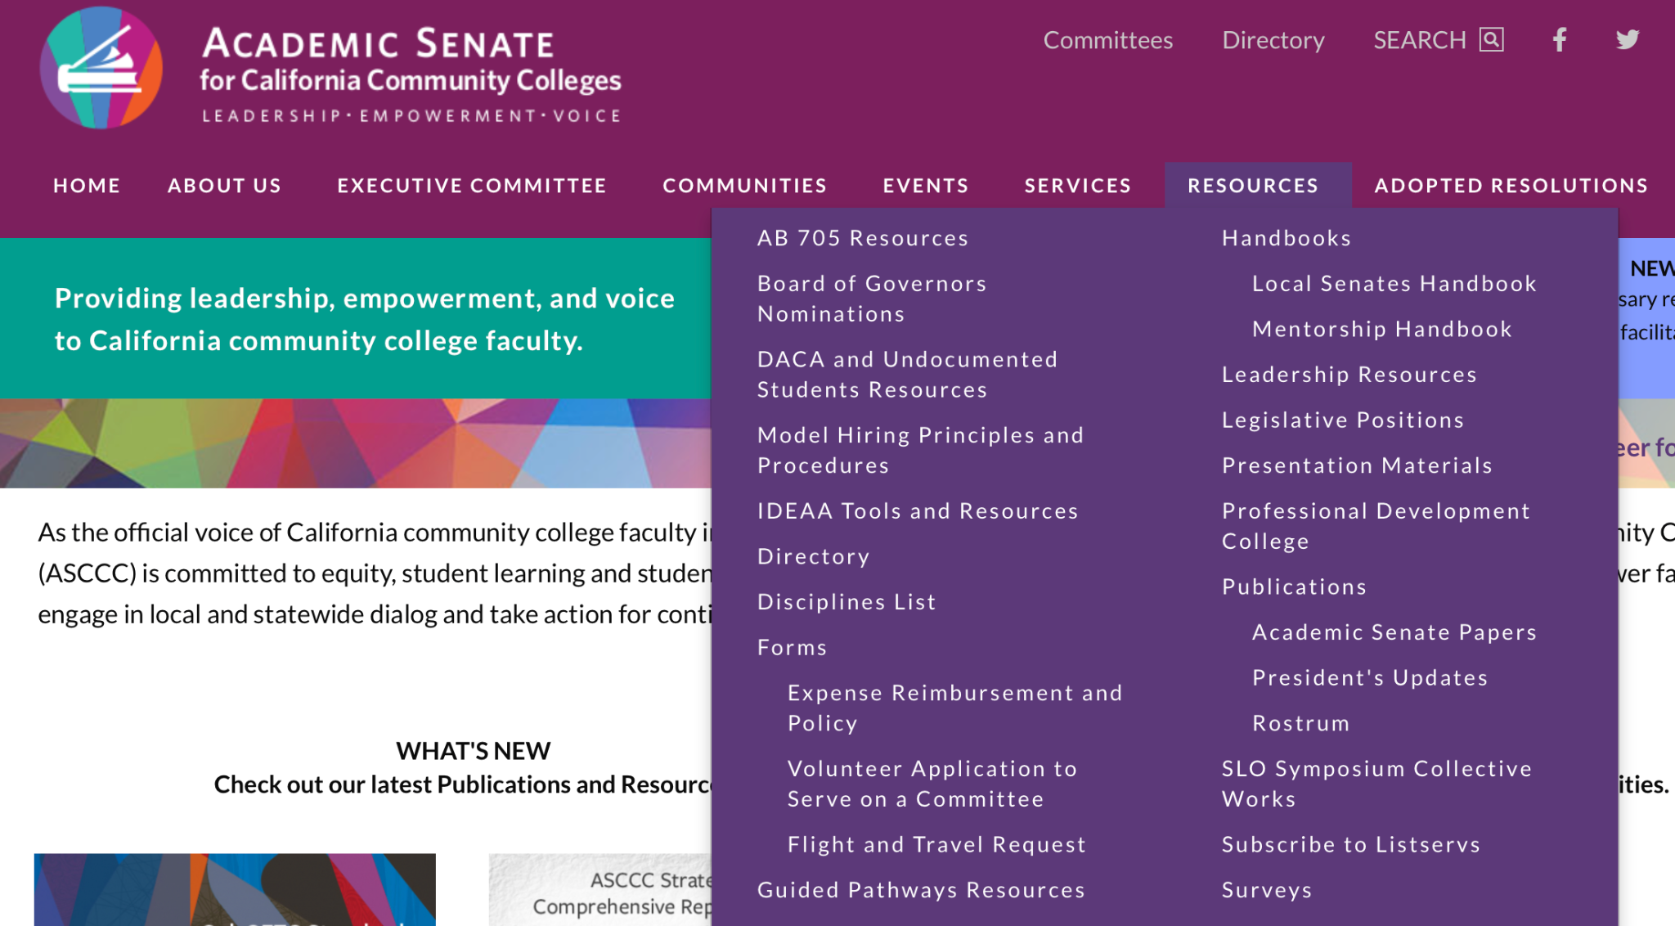
ASCCC & CCCCO Resources
Model Hiring Principles and Procedures (Canvas Shell)
ASCCC Poster Board to the CCCCO EEO Showcase
CCCCO EEO 10 Point Plan for Faculty Diversity Hiring

Slide 20
Thank you
Follow-up: info@asccc.org

