Slide 1
ACCJC Social Justice Policy and Enhancing Racial Equity in our Accreditation Work

Slide 2
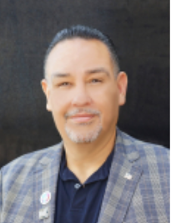
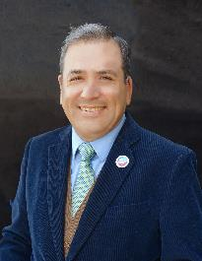
Presenters
Juan Arzola ASCCC At-Large Representative
Political Science – College of the Sequoias
Manuel J. Velez ASCCC Vice President
Chicana and Chicano Studies – San Diego Mesa College
Notes:
Juan & Manuel introduce ourselves

Slide 3
Our Session Today
In June 2021, the Accrediting Commission for Community and Junior Colleges (ACCJC) released its Policy on Social Justice. Historically, institutions of higher learning have operated with firmly established policies and procedures that promote a climate of exclusion, racial inequity and racism towards Black, Indigenous, People of Color (BIPOC). The ACCJC understands that issues around inclusion, diversity, equity and racism are deeply rooted within systemic racists structures and policies that support the very foundation of society. Further, the Commission has determined that people of color have long been disadvantaged by the prejudice, discrimination and implicit biases inherent within higher education that white people have been able to benefit from. Our session today will focus our discussions on the new ACCJC Social Justice Policy and its potential impact on the California Community Colleges accreditation process.

Slide 4
Outline of Topics
Framing our Session
Review 2024 ACCJC Standards Tentative Implementation Timeline
A Walk Through of the ACCJC Website Resources
Social Justice Policy (June 2021)
2024 Standards (June 2023)
Appreciative Inquiry (Ai)
From Equity Talk to Equity Walk
Example 2014 (Standard IV) to 2024 Standards (Standard IV)
Interactive Activity (time pending): Review your local college mission (Standard I)
Q & A

Slide 5
Framing our Session: Racial Equity and Justice in Higher Education Policy
Context-historic and unprecedented cultural shift and shock effected by two pandemics: COVID-19 and the agonizing endurance of white supremacy and state-sanctioned racial violence in the United States.
Prompted us to ask ourselves, "what, CAN, I/we do? Where, DO I/we, have the power to act?”
Our interest for radical social/cultural change aligned/converged.
We turned to one of our more far-reaching social institutions for the possibility of creating positive socio-cultural change

Slide 6
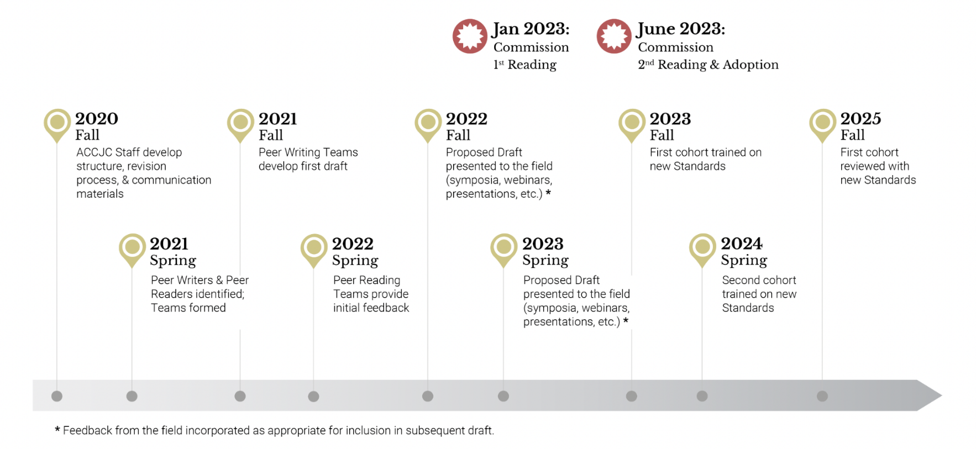
ACCJC Standards Review Tentative Timeline

Slide 7
ACCJC Standards Cohort 1 Pilot (Current Phase)

Slide 8
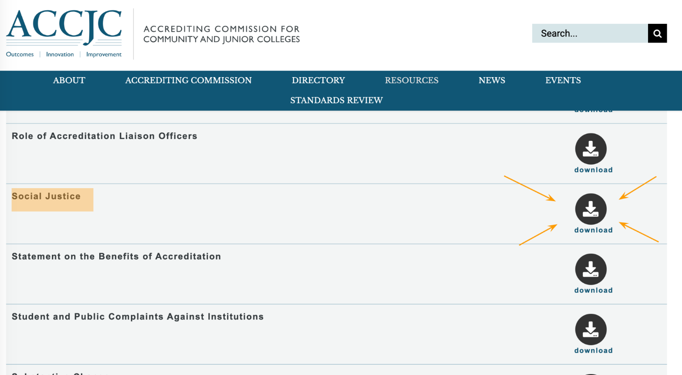
A "Walk Through" of the ACCJC Website: Institutional Policies page scrolled down to Social Justice Policy

Slide 9
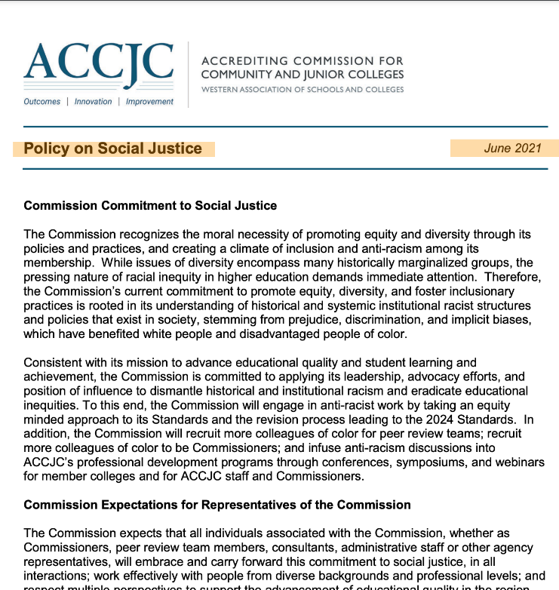
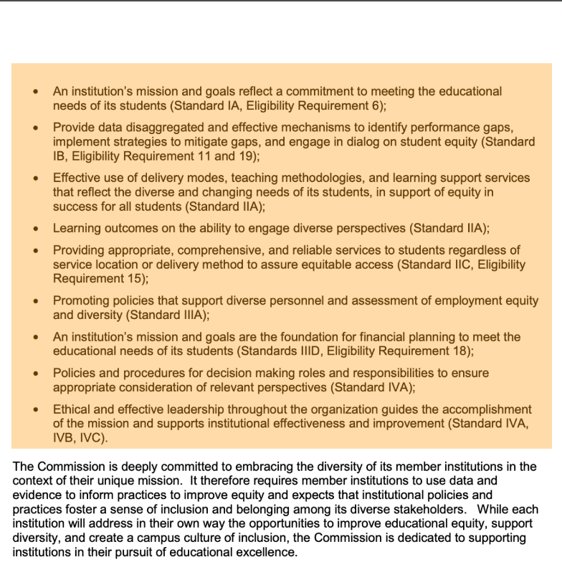
A "Walk Through" of the ACCJC Website: 1st and 2nd page of the Social Justice Policy

Slide 10
ACCJC Policy on Social Justice Adopted June 2021
Overview of the Commission's Policy on Social Justice
Evolution: From diversity to social justice
Intention: Acknowledge & address structural inequities
Alignment: Mission-appropriate interrogation of practices and outcomes
The Commission recognizes the moral necessity of promoting equity and diversity through its policies and practices as well as creating a climate of inclusion and anti-racism among its membership.

Slide 11
ACCJC Social Justice Policy and the 2024 Accreditation Standards
Overview of the Commission's Policy on Social Justice integration into the Accreditation Process
Evolution: From Checklist to Appreciative Inquiry (Ai)
Intention: From Dichotomous (Yes/No) to Data-Driven Introspective Analysis
Alignment: Infuse Equity into College Mission – then appropriately interrogate institutional practices and outcomes within all standards.
The Commission recognizes the moral necessity of promoting equity and diversity through its policies and practices as well as creating a climate of inclusion and anti-racism among its membership.

Slide 12
Social Justice Principles Aligned to 2014 and 2024 Standards & Eligibility Requirements
Social Justice Policy Principles | Aligning Standards
An institution’s mission and goals reflect a commitment to meeting the educational needs of its students | 2014 Standard IA 2024 Standard 1.1-1.5 Eligibility Requirement 6
Provide data disaggregated and effective mechanisms to identify performance gaps, implement strategies to mitigate gaps, and engage in dialog on student equity | 2014 Standard IB 2024 Standard 1.3 Eligibility Requirement 11 and 19
Effective use of delivery modes, teaching methodologies, and learning support services that reflect the diverse and changing needs of its students, in support of equity in success for all students | 2014 Standard IIA 2024 Standard 2.6-2.9
Learning outcomes on the ability to engage diverse perspectives | 2014 Standard IIA 2024 Standard 2.3
Providing appropriate, comprehensive, and reliable services to students regardless of service location or delivery method to assure equitable access | 2014 Standard IIC 2024 Standard 2.6, 2.7 Eligibility Requirement 15
Promoting policies that support diverse personnel and assessment of employment equity and diversity | 2014 Standard IIIA 2024 Standard 3.1-3.3
An institution’s mission and goals are the foundation for financial planning to meet the educational needs of its students | 2014 Standards IIID 2024 Standard 3.4-3.7 Eligibility Requirement 18
Policies and procedures for decision making roles and responsibilities to ensure appropriate consideration of relevant perspectives | 2014 Standard IVA 2024 Standard 4.1-4.3
Ethical and effective leadership throughout the organization guides the accomplishment of the mission and supports institutional effectiveness and improvement | 2014 Standard IVA, IVB, IVC 2024 Standard 4.4-4.6

Slide 13
Conversation Starters at your Institution
IDEAA Toolkit
5 R model
Reflective Questions
Cultural Humility Toolkit
Appreciative Inquiry (Ai)

Slide 14
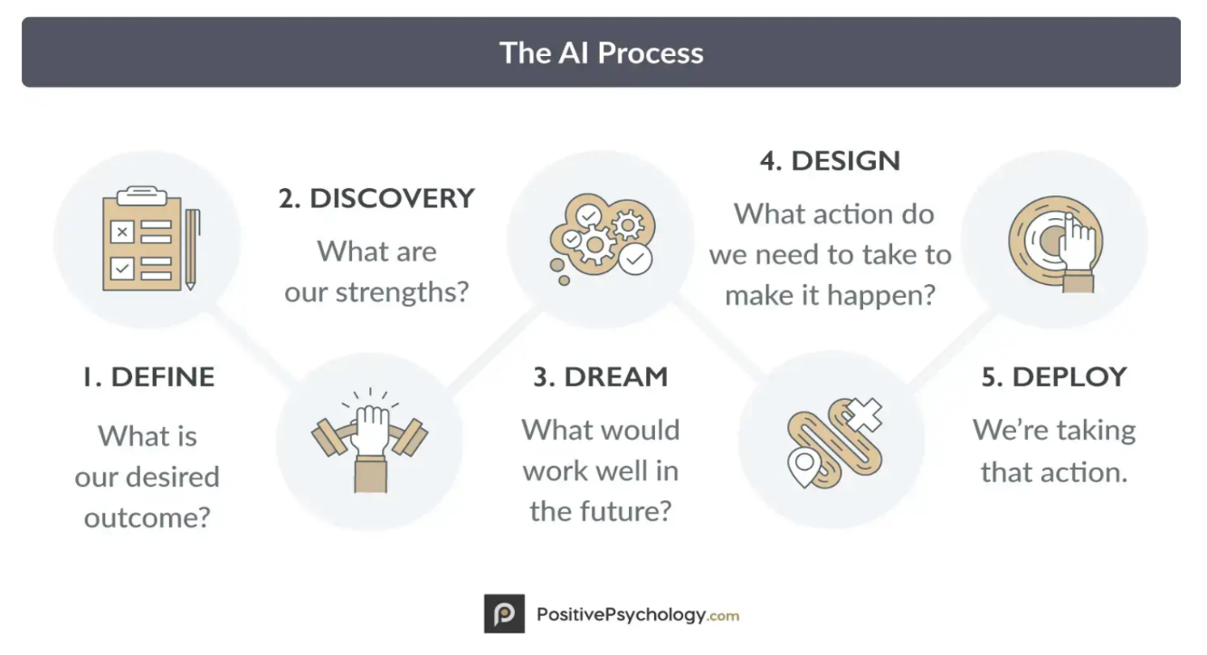
Use Appreciative Inquiry (Ai) To Incorporate IDEAA & Social Justice Into Institutional Practices
Ask Appreciative
Inquiry (Ai)
Questions and Get Input
From All
Stakeholders

Slide 15
Appreciative Inquiry (Ai) questions
When you explore your boldest hopes and aspirations for this review/accreditation process, what is it that you/we ultimately want?
What do we do well in our equity work?
What can we learn from what we do well?
How do we build more on that in other areas?
What are the best aspirations for _____ in 5 years?
What have been the most equity and social justice-minded creative/valued experiences in your time at ____?
What were the conditions that made the experience possible?
If those experiences were to become the norm, how would ____ have to change?
What are our aspirational values?
If you could make three wishes that could potentially improve this community/group/organization to be more socially just, what would they be?
Where do we have SMART (specific, measurable, attainable, realistic, timely) equity goal achievements? How can we build more on that in other areas?
Tips: Praise and appreciation are an investment, not a cost...a ratio of 3-1 positive to critical comments will raise a person's sense of well-being, engagement, innovation, and creative insights.
Adapted from: https://positivepsychology.com/appreciative-inquiry-process/

Slide 16
Where may there be institutional processes, requirements, or practices that sustain systemic inequities and biases?
Are assessments or appeals or review processes potentially culturally biased?
Is there disproportionate participation/use of student services and supports? Is there a need for more targeted welcoming outreach to student populations who use resources at lower levels/rates than others?
Are student conduct reports filed more often on students of certain races/ethnicities?
Are employees of certain ethnicities/races/identities such as LGBTQ+ underrepresented in shared governance and campus committees?
How deeply does the institution go into cultural humility work and addressing and repairing breakdowns around equity/race/identity issues/tensions?
Do constituents feel safe naming/calling out such breakdowns? Are they supported when they do so?
Does the institution invest in professional development and skillful facilitation around difficult conversations around equity at multiple levels of campus culture/structure?

Slide 17
From Equity Talk to Equity Walk
Language matters
Shared language & definitions
Specific, clear, and direct v. ambiguous or coded language
Real and full integration
Interest convergence/alignment
Systemic, structural, and institutional
Examine our education system
Disaggregate data–specificity and detail

Slide 18
What it could look like: A Sample of Mission Statement Revision
Mt. San Jacinto College offers quality, accessible, equitable, and innovative educational programs and services to students aspiring to achieve their academic, career and personal development goals.
We provide students a safe environment in which to pursue basic skills, career and general education pathways. Our programs lead to transfer, associate degrees and certificates, which meet workforce development needs in our diverse communities.
Our commitment to learning and achievement empowers students to enrich our communities and participate meaningfully in today’s complex world.
Active, BOT Approved 2017

Slide 19
From Equity Talk to Equity Walk: Assuming an Ai lens for Accreditation Process
Adopt an Ai lens when reviewing and updating the college mission statement.
Who are we?
What is our purpose?
What are our values?
Who do we serve?
How can we serve?
Fully integrate these elements into the mission statement.

Slide 20
What it could look like: A Sample of Mission Statement Revision
MSJC’s purpose is to celebrate diversity, instill hope, and empower our students to transform their lives and those around them. We provide equity-minded education to combat systemic barriers, promote social mobility, and provide opportunities for educational advancement.
MSJC offers degrees and certifications for career and university preparation, as well as opportunities for lifelong learning and enrichment.
As a Hispanic-Serving Institution, we serve a diverse student population from various identities, cultures, socio-economic backgrounds, life experiences, abilities, and educational needs that represent our community. MSJC is committed to learning and achievement through inclusive and culturally affirming environments that celebrate student voices and create space for self-exploration and growth. We encourage self-advocacy, civic responsibility, and commitment to becoming ambassadors of change in our communities and our world.
2023 Fall Draft Mission Statement (with on-going revisions based on feedback)

Slide 21
Applying an Ai lens to Carefully and Critically Examine College Governance Structures (Standard IV)
Transforming a Hierarchical system into an Equity-Driven System

Slide 22
Student and Faculty Responsibility and Rights to Participate in College Governance
Student 9+1 (Title 5, §51023.7)
Faculty 10+1 (Title 5, §53200)
1) grading policies;
2) codes of student conduct;
3) academic disciplinary policies;
4) curriculum development;
5) courses or programs which should be initiated or discontinued;
6) processes for institutional planning and budget development;
7) standards and policies regarding student preparation and success;
8) student services planning and development;
9) student fees within the authority of the district to adopt; and
+1) any other district and college policy, procedure, or related matter that the district governing board determines will have a significant effect on students.
Curriculum including establishing prerequisites and placing courses within disciplines
Degree and certificate requirements
Grading policies
Educational program development
Standards or policies regarding student preparation and success
District and college governance structures, as related to faculty roles
Faculty roles and involvement in accreditation processes, including self-study and annual reports
Policies for faculty professional development activities
Processes for program review
Processes for institutional planning and budget development
+1) Other academic and professional matters as are mutually agreed upon between the governing board and the academic senate.
-

Slide 23
From Equity Talk to Equity Walk: Assume an Ai lens for Accreditation Process for college governance
Adopt an Ai lens when reviewing and updating the college governing structure.
Does the structure guide the accomplishment of the mission? (SJP #8)
Does the structure support institutional effectiveness and improvement in line with the mission? (SJP #9)
Who is represented? Who is not represented? Who has designated authority?
Does our structure ensure appropriate consideration of relevant perspectives?
How does our structure intentionally integrate student representatives?
Does our governing structure provoke positive climates where students feel safe to speak?
How does our structure intentionally integrate faculty, classified and admin?
Does our governing structure provoke positive climates where ALL constituents feel safe to speak?
Where is the power represented in the structure?
Could the distribution of power be adjusted to balance out decision-making across constituent groups?
What changes could be made to the structure that will effectively perpetuate long-term alleviation of political and social disadvantages within our college community?
How can our structure be improved to further support constituent involvement?
How can our structure be adjusted to bring us more in line with our mission, vision and values?
Fully integrate these elements into the college governing structure.

Slide 24
Forward thinking Framework for 2024 Standards
What did we do?
What was the outcome?
What did we learn?
What will we do differently?
ACCJC (2023, September 9). Introducing the 2024 Standards: Session 1.

Slide 25
Forward thinking Framework for Reflection 2024 Standards
Update BP/APs related to college governance and participation
Explicitly systemize roles and responsibilities of constituent groups in college governance
Update structural design
Integrate principles of Social Justice Policy (2021) into the college governance structure
Redesign or eliminate hierarchical models
Balance power across governing councils
Update college governance handbook
Update Institutional Strategic Plans
Update Senate Constitutions and Bylaws
And more... :-)
What will we do differently?

Slide 26
Q & A
and some Closing Thoughts

Slide 27
References
ASCCC (2023, September 9). Introducing the 2024 Standards: Session 1. Webinar Slide Archive
ASCCC (2023). Student Senate for California Community Colleges. https://www.cccco.edu/About-Us/Chancellors-Office/Divisions/Educational-Services-and-Support/Student-Service/What-we-do/Student-Senate-for-California-Community-Colleges
ASCCC IDEAA Toolkit (2023). Cultural Humility. Retrieved from: https://asccc.org/asccc-inclusion-diversity-equity-anti-racism-and-accessibility-ideaa-tools
ACCJC Accreditation Standards Documents (2023) Repository. Retrieved from: https://accjc.org/eligibility-requirements-standards-policies/#eligibility-requirements
ACCJC Policy on Social Justice
ACCJC Guide to Institutional Self-Evaluation, Improvement and Peer Review
ACCJC Standards Review Tentative Timeline
ACCJC Eligibility Requirements, Accreditation Standards, Institutional Policies, and Operational Policies
McNair, T. B., Bensimon, E. M., & Malcom-Piqueux, L. E. (2020). From equity talk to equity walk: Expanding practitioner knowledge for racial justice in Higher Education. Jossey-Bass, a Wiley Brand.
Lewis, S. (2021, August 19). Reflecting, Healing, & Moving Forward. Zoom keynote for the Diversity, Equity, and Cultural Competence Committee’s (DEqCC’s) Cultural Competency Conference. Google Site.

Slide 28
Other Resources to Support the Work: Conversation Starters at your Institution
IDEAA Toolkit (see next slide)
5 R model (see next slide)
Reflective Questions (see next slide)
Appreciative Inquiry (Ai) (presented on slide 22)

Slide 29
First, Lay a Foundation of Trust-Building and a Campus Culture of Cultural Humility (ASCCC IDEAA Toolkit)
IDEAA Resources: On asccc.org site, go to IDEAA Resources tab
ASCCC Cultural Humility Tool: to help lay a foundation of approaching this work together from a place of cultural humility, a willingness to share vulnerabilities, avoiding “shaming/blaming,” build trust, and collaborate towards shared goal to how best to improve equity outcomes.

Slide 30
As one would build trust, community, and safe space with students, do this with all participants of Program Review, Strategic Planning, & Accreditation Planning Work
Chairs/Facilitators/Leaders' "buy in" and participation and modeling trust-building and cultural humility sets the tone
5R's (adapted from Cultural Humility work in Health care Provider-Patient relationships)
Begin meetings with brief "grounding/centering" practice like reminders of community agreements, breathing exercise, and check ins.
Regular check-ins: "have we addressed all who may be impacted? Are there areas/voices who are not here? Who may need more support/encouragement/invitation to contribute/speak?"
Be mindful to not have the work led just by the loudest &/or most frequent voices or contributors
Reflection: approach every encounter with humility and understanding that there is always something to learn from everyone. What to ask: What did I learn from each person in that encounter?
Respect: treat every person with the utmost respect and strive to preserve dignity at all times. What to ask: Did I treat everyone involved in that encounter respectfully?
Regard: What to ask: Did unconscious biases drive this interaction?
Relevant: What to ask: How was cultural humility relevant in this interaction?
Resiliency: embody the practice of cultural humility to enhance personal resilience and global compassion. What to ask: How was my personal resiliency affected by this interaction?
Adapted from https://www.hospitalmedicine.org/practice-management/staffing/the-5-rs-of-cultural-humility/#:~:text=SHM%20developed%20the%205%20Rs,R%20(Resiliency)%20is%20intrinsic.

