Slide 1
“Data! What is it Good For, Absolutely Something!”

Slide 2
Presenters
Carlos R. Guerrero
ASCCC South Representative
Erik D. Reese
ASCCC Area C Representative

Slide 3
Description
Data currently infuses just about every aspect of our lives, including our colleges and districts. Some items directly in the purview of academic and professional matters make specific requests on data, such as Student Equity and Achievement Plans, asking institutions to look closely at student retention, success, persistence, and completion. Initiatives and legislation, for example AB 928, will have large impacts on our system. Data can be used to help prepare for and anticipate those impacts as well. Join us for a lively discussion about how to leverage data and uplift the faculty voice.

Slide 4
Outline
Overview of the AB 928 (The Example)
Common Vocabulary
Cal-GETC standards
A Tale of 2 Colleges and Courses (The Data)
Impact of AB928 (The Work)
What are some challenges and how can colleges assess these challenges?
Looking Ahead (The Now)

Slide 5
Overview of AB 928
AB 928 (Berman, 2021) - Student Transfer Achievement Reform Act of 2021: Associate Degree for Transfer Intersegmental Implementation Committee.
Major Components
Requires the Intersegmental Committee of Academic Senates (ICAS) to establish a singular lower division general education pathway.
Establishes the Associate Degree for Transfer Intersegmental Implementation Committee.
Requires the CCCs to place students on ADT pathways.
Considerations for up to an additional 6 units for STEM pathways.

Slide 6
Overview of AB 928 (continued)
Requires Intersegmental Committee of Academic Senates (ICAS) to establish a singular lower division general education pathway.
Singular lower division general education pathway agreement by December 31, 2023 and implementation by 2025-2026.
Only lower division GE pathway to determine transfer eligibility to both the CSU and UC systems
GE pathway to include no more units than those required under the current IGETC pattern as of July 31, 2021 (34 semester units)
The Intersegmental Committee of the Academic Senates (ICAS) shall establish the GE pathway by May 31, 2023
IF NOT… administrative bodies of the CCC, CSU, and UC systems shall establish the GE pathway by December 31, 2023.

Slide 7
Overview of AB 928 (continued 2)
The California General Education Transfer Curriculum (Cal-GETC)
Established by the Intersegmental Committee of Academic Senates (ICAS) on May 22, 2023.
Differences in IGETC or CSU GE Breadth (current GE patterns):
Oral communication included (not in IGETC); adjustments to CCC courses required
Arts and Humanities Area limited to two courses
Behavioral and Social Sciences Area limited to two courses
Lifelong Learning and Self-Development not included (not in IGETC but in CSU GE Breadth)
Ethnic Studies included
Information on process

Slide 8
Cal-GETC
Area | Subject | Courses
1 | English Communication English Composition Critical Thinking and Composition Oral Communication | 1 course 1 course 1 course
2 | Mathematical Concepts and Quantitative Reasoning | 1 course
3 | Arts and Humanities Arts Humanities | 1 course 1 course
4 | Social and Behavioral Sciences Two disciplines | 2 courses
5 | Physical and Biological Sciences Physical Science Biological Science Laboratory (for physical or biological science course) | 1 course 1 course (1 unit)
6 | Ethnic Studies | 1 course
11 courses total
Minimum of:
34 semester units
3 semester units per class
4 quarter units per class

Slide 9
Overview of AB 928 (continued 4)
Establishes the Intersegmental Associate Degree for Transfer Implementation Committee.
Primary entity charged with the oversight of the Associate Degree for Transfer (ADT)
Ensure a reduction in the number of excess units accumulated by CCC students before transfer
Eliminate repetition of courses at four-year postsecondary colleges and universities taken by CCC students who successfully transfer
Increase the number of CCC students who transfer
Enhance coordination and communication between four-year postsecondary colleges and universities and the CCCs

Slide 10
Overview of AB 928 (continued 5)
The Intersegmental Associate Degree for Transfer Implementation Committee is currently formulating recommendations in three areas:
GOALS: “Identifying annual goals for increasing transfer rates in California and closing racial equity gaps in transfer outcomes to be adopted by the state.”
STEM: “Proposing a new unit threshold for STEM degree pathways that meet the requirements for admission to the California State University and the University of California.”
REENGAGEMENT: “Reengaging ADT earners who do not transfer or apply for transfer into a four-year postsecondary educational institution.”

Slide 11
Overview of AB 928 (continued 6)
. Requires CCCs to place students on an ADT pathways.
By August 1, 2024
Where ADTs for major pathways exist…shall place students on the ADT pathway if students declare a goal of transfer on their mandatory ed plans
Opt-outs: Students who are UC or Independent bound, or no ADT path exists for major, pursuing associate degree, or a BDP student
Guidance in this area forthcoming, please stay tuned…

Slide 12
Overview of AB 928 (continued 7)
4. Considerations for up to an additional 6 units for STEM pathways.
Work in progress…
The UCTP agreements in Chemistry and Physics are promising:
Students complete some GE after transfer
The Model Curriculum agreed to by CCC/CSU for Engineering is promising
Will additional 6 units for STEM majors be sufficient?
Should it be for the ADT – permitted on front end?
Should it be after transfer, allowing for GE to be completed after transfer – permitted on back end?
ASCCC/Intersegmental Curriculum Workgroup (ICW)/C-ID/Transfer Alignment Project (TAP) - pulling select Faculty Discipline Review Groups together to research and provide recommendations…

Slide 13
Why this matters? Cal-GETC
Currently, students opting to earn an ADT may choose either the IGETC or CSU GE Breadth pathway.
The CSU GE Breadth pathways includes many courses that are not included in the IGETC pathway.
Cal-GETC is very similar to IGETC: oral communication accepted in Cal-GETC but not IGETC.
Questions:
What courses are approved for CSU GE Breadth but are not approved for IGETC?
What are the enrollments in those courses?
How will the change impact students?
What are the numbers and proportions of students that choose IGETC vs CSU GE Breadth?

Slide 14
A Sampling of Courses that meet CSU GE Breadth but NOT IGETC?
Trigonometry
Math for Teachers
Personal Finance
Career Exploration and Life Planning
College Success Strategies
Health Science
Nutrition
Introduction to Kinesiology
Foundation of Fitness and Wellness
Reading for Academic and Lifelong Literacy
Introduction to Career Exploration
Human Reproduction and Sexuality

Slide 15
The Data: The Tale Two Colleges

Slide 16
Large Urban College
Number of courses that meet CSU GE Breadth but not IGETC: 89*
*does not include fitness/PE courses
Total enrollment in all such courses: Fall 2022 - 9294; Spring 2023 - 10083
Course | Fall 2022 Enrollment | Spring 2023 Enrollment
All Fitness/PE* | 3756 | 5549
Studio Art | 377 | 199
Freshman Seminar | 1396 | 180
Introduction to Philosophy | 467 | 455
Spanish I | 228 | 332
College Success | 561 | 602

Slide 17
Small Rural College Example
Impact to Courses in Lifelong Learning and Self Development (from CSU GE Breadth)
Using data from 2022-2023
15 different courses offered
4,012 enrollments
Disciplines offering courses to fulfill this area include Health, Psychology, Business, and Sociology, etc.
Only one program will be impacted because of the number of sections and enrollments currently seen
None of the courses are required for degree or major pathway

Slide 18
Small Rural College Example (Cont.)
What courses are approved for CSU GE Breadth but are not approved for IGETC?
CSU-GE Area and Course | Avg # of sections over last 5 years | Avg. Annual Enrollments over last 5 years | IGETC | Other GE Area? | Required for Major?
Area C1: Arts Art Appreciation | 25 | 887 | Y | N | N
Area C2: Humanities Intro to Philosophy | 4 | 125 | Y | BC-C, A2 | Y
Area D: History of African American | 1 | 24 | N | C2 | ?

Slide 19
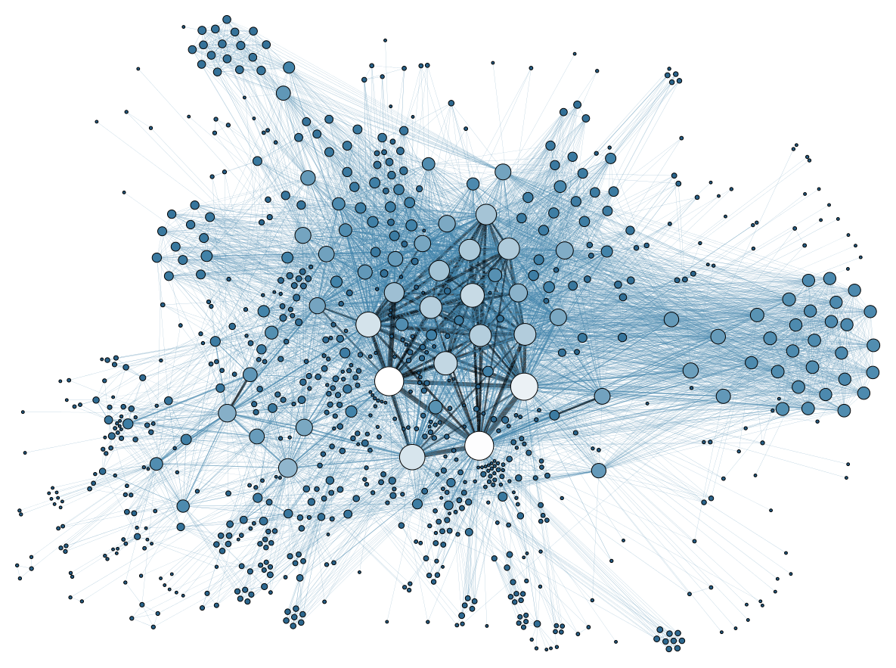
A Tale of Two Courses
Continued Data Usage

Slide 20
AB 928 Public Speaking Requirement
Public Speaking requirement accepted by UC’s after much discussion
CC’s and CSU’s aligned
UC Assembly Approval of Senate Regulation 479 included an English composition prerequisite
Data to the rescue!

Slide 21
Success Data: Public Speaking and English Composition
5 colleges provided similar data
5-year time frame
English Composition before Public Speaking
5−22 percentage point increase in success for Public Speaking
Public Speaking before English Composition
5−17 percentage point increase in success for English Composition

Slide 22
But Wait…There is More!
Three colleges also studied relationship between taking Public Speaking in the first year and earning a degree
Consistently found students that take public speaking in first year are roughly twice as likely to earn a degree
Results consistent for Black, Latinx, and students with GPA above 3.0

Slide 23
Data Informed Result
No English Composition prerequisite requirement for Public Speaking

Slide 24
Impact of AB 928?

Slide 25
AB 928 Implications to ADT pathways
All Transfer Model Curriculum (TMC) will need to be reviewed/updated
TMCs are the framework under which ADTs are created
TMCs are the vehicle under which agreements are made with transfer institutions (CSU, AICCU, HBCU) for determination of “similar” to a baccalaureate major
Changing from CSU GE Breadth/IGETC to Cal-GETC may impact “double-counting”
Reviews beginning fall 2023
ADTs will need to be reviewed/updated
Expecting guidance from CCCCO and ASCCC in late October
Stay tuned…
Examples of Impact on TMCs/ADTs - too many units:
Elementary Teacher Education - Math for Elementary Teachers will not count for Cal-GETC (previously CSU GE Breadth B4 but not IGETC)
Biology, Chemistry, Environmental Science - Uses CSU GE Breadth for STEM or IGETC For STEM to complete some GE after transfer

Slide 26
How will AB928 impact colleges?
Some examples include:
Course offerings/scheduling
Student enrollments
Degree requirements
Workload changes and employee hiring and assignments

Slide 27
Looking Ahead

Slide 28
Key considerations for colleges
What courses meet CSU GE Breadth but not IGETC?
Exploring this information will help faculty and staff anticipate GE changes due to courses that will meet Cal-GETC requirements and those courses that will not
How many courses are we talking about at the college?
This will help workload planning for departments and curriculum committees
What are the enrollments in those courses?
This will help shifting load balances among departments/divisions and such
Who is enrolling in these courses?
This will help in planning outreach needed to students

Slide 29
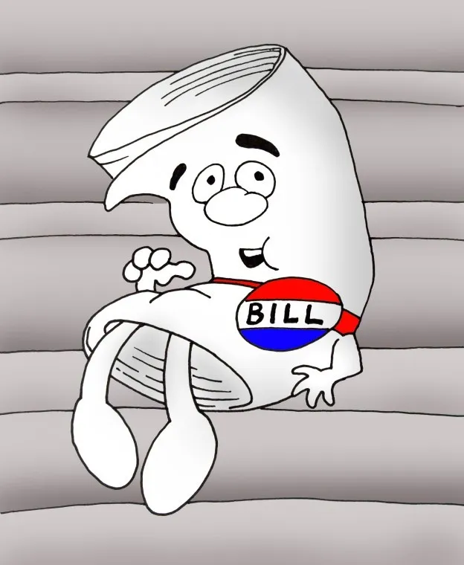
The Tale of Two Bills?

Slide 30
Thank You
Questions?
info@asccc.org

Slide 31
Resources
AB 928 https://www.ab928committee.org AB 1111 https://www.cccco.edu/About-Us/Chancellors-Office/Divisions/Educational-Services-and-Support/common-course-numbering-project Articulation Handbook https://www.csusb.edu/sites/default/files/upload/file/CIAC_Handbook_Spring_2013.pdf CalGETC Webpage https://icas-ca.org/cal-getc-resources/ CalGETC Standards Policies and Procedures https://icas-ca.org/standards-policies-and-procedures-manual/
ICAS - Memos and Letters https://icas-ca.org/our-work/memos/

