Slide 1
Welcome Fall 2023 ASCCC Plenary Faculty Attendees! Thursday, November 16th 3:00 p.m. to 4:00 p.m. Second Breakout Session Managing Change: Leadership and Strategic Thinking Presenters: Anna Nicholas, Ph.D. LaTonya Parker Ed. D. Eric Wada

Slide 2
Objectives and Goals
To better understand strategic leadership
To understand Backbone, Integrity, and Competence-Based Leadership
To engage in dialogue around collective leadership practices
To engage and act on supporting and sustaining leadership (Modeling and Creating Opportunities)
To Understand Leadership Competencies
Converse, Listen and Share

Slide 3
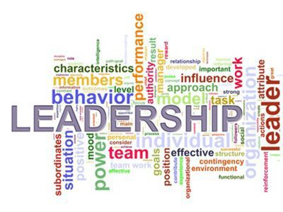
How do you define strategic leadership?

Slide 4
Deion Sanders Quote

Slide 5
For the California Community Colleges… Title 5 §53200
6. District and college governance structures, as related to faculty roles;
7. Faculty roles and involvement in accreditation processes, including self-study and annual reports;
8. Policies for faculty professional development activities;
9. Processes for program review;
10. Processes for institutional planning and budget development; and
11. Other academic and professional matters as are mutually agreed upon between the governing board and the academic senate.
(c) “Academic and professional matters” means the following policy development
and implementation matters:
1. Curriculum, including establishing prerequisites and placing courses within disciplines;
2. Degree and certificate requirements;
3. Grading policies;
4. Educational program development;
5. Standards or policies regarding student preparation and success;

Slide 6
BIC-Based Leadership
BIC - Based Leadership:
Backbone
Integrity
Competence
* Term coined by Lourdes Brent, Professor Emerita from Los Angeles Trade-Technical College, former LATTC Senate President and former LACCD District Academic Senate Secretary

Slide 7
Supporting and Sustaining Leadership (Modeling and Creating Opportunities)

Slide 8
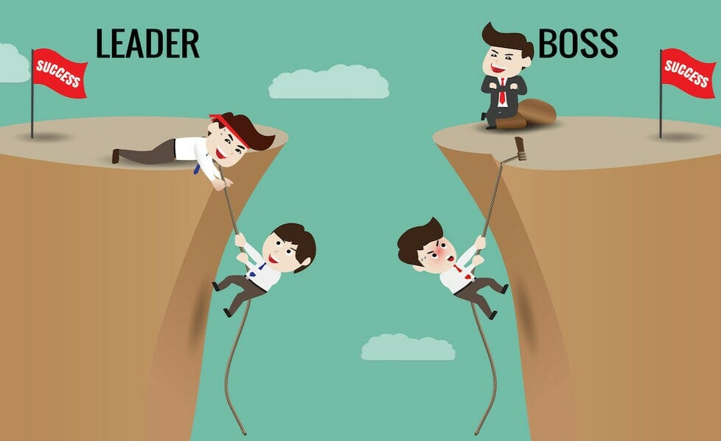
Leadership Competencies
Leadership Competencies

Slide 9
Resources:
ASCCC Faculty Leadership Resource https://www.asccc.org/communities/local-senates/leadership-resources

