Slide 1
Challenges and Opportunities in Career Education

Slide 2
Presenters
Stephanie Curry
ASCCC Area A Representative
stephanie.curry@reedleycollege.edu
Lynn Shaw
Liaison to ASCCC CTE Leadership Committee
shawlynn@gmail.com

Slide 3
Breakout Description
With the Governor’s Executive order N-11-23 calling for a New Master Plan on Career Education, the CCCCO Vision 2030 goal to increase the share of graduates earning a living wage and a new CCCCO California State Update to CTE Plan and Programs, CTE is at the forefront of statewide dialog and planning. Join us at this session to talk about current and future challenges and opportunities for CTE education. Topics will include work experience, GE impacts, working with regional consortia, CTE-related legislation, artificial intelligence (AI)I, competency based education (CBE), and much more.

Slide 4
Career Technical Education Minimum Qualifications
What is it?
Why do CTE faculty candidates need equivalency?
How does this help our students and programs?

Slide 5
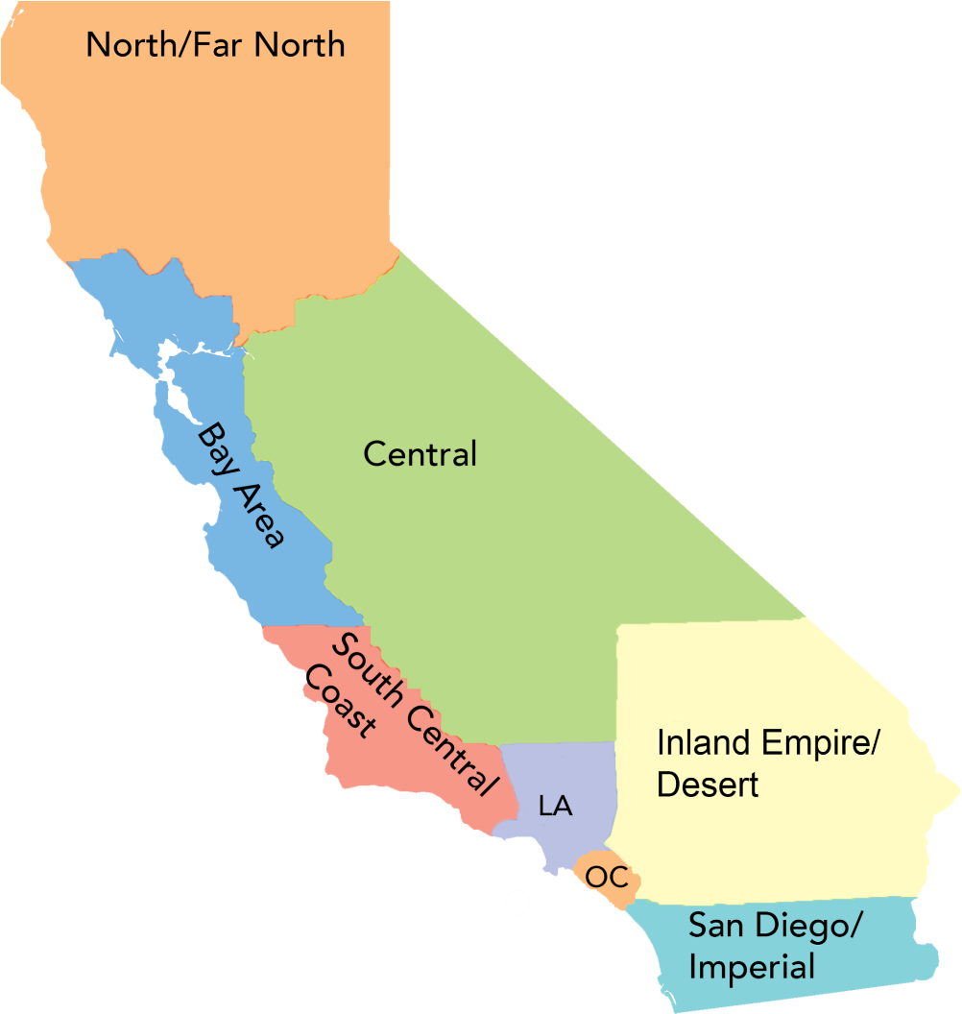
Regional Consortia North Far North Central Valley-Motherload Bay Area South Central Coast Los Angeles Inland Empire/Desert Orange County San Diego/Imperial

Slide 6
California Career Technical Education Funding
Strong Workforce Program - $248M
60% to colleges, 40% to be allocated by vote of each region’s colleges
Requires Regional Workforce Development Plan
K12 Strong Workforce Program - $162M
$162M - awarded by a regional Selection Committee
Awards to be directed by SWP Regional Workforce Development Plan
Regional Collaboration & Coordination Grants - $14.5M
Work with the colleges and key stakeholders in the regional workforce and economic development ecosystem to help drive: collaboration and coordination of career education programs among colleges in each identified region;
Regional Equity and Recovery Partnerships (RERP) - $24M WDB + $9.5M CC
support regional efforts to increase colleges capacity to award credit for prior learning; creating work-based learning opportunities; providing academic and career supports; and providing an on-ramp to credit pathways leading to industry-valued credentials or degrees
K-16 Collaborative $250M
incentivize regional education and workforce collaboration as a way to make a significant impact on the regional economy
California Jobs First (CERF) - $500M
inclusive regional planning processes that produce regional roadmaps for economic; Invest in projects proposed by regional planning tables that align with regional strategies;Align and leverage investments in regions to maximize economic development efforts

Slide 7
Apprenticeship and Work Experience
Apprenticeship is a learn while you earn system, sometimes called the original “degree”
Traditionally apprenticeship is primarily in the building trades, but new occupations are being added
Work Experience is seeing a resurgence

Slide 8
Importance of the CTE Faculty Voice
Most CTE faculty are not yet actively engaged with the local or state Academic Senate
CTE issues are often not on the local senate’s agendas
ASCCC CTE Liaisons

Slide 9
Credit for Prior Learning
Competency Based Education
What are CPL and CBE and how do they help our students?

Slide 10
Artificial Intelligence (AI)
This, I believe is not such a big issue for CTE with regards to using AI for classwork. Many CTE outcomes are demonstrated hands on and that cannot be replaced by AI. It is an issue but not as important as for general education.
But instructors should have discussions of using AI in CTE Programs to illustrate realities of current jobs. Many have AI components or will have AI in the future.

Slide 11
Dual Enrollment
Enrollment Strategy
Intentional Courses (No random acts of Dual Enrollment)
Pathways to College Programs
Career Exploration
Importance of Faculty Role

Slide 12
LET'S HEAR FROM YOU!
What opportunities and challenges are you seeing at your campus?
What are your questions?
How can we help you?

Slide 13
Upcoming CTE Events
Webinar- Demystifying Competency Based Education (CBE) (December 7, 2023)
California Regions at Work Conference- (December 6-8, 2023)
Regional Consortium Events
Central/Motherload Regional Collaborative Event February 2, 2024
Inland Empire Regional Collaborative Event February 9, 2024
San Diego/Imperial Regional Collaborative Event March 8, 2024
North Far North Regional Collaborative Event March 27, 2024
Los Angeles Regional Collaborative Event May 3, 2024
Bay Area Regional Collaborative Event May 10, 2024

Slide 14
Resources
Questions? Email the Academic Senate for California Community Colleges: info@asccc.org
Updated regs: Text of Updated Regulations
CA Internship & Work Experience Association: CIWEA.org
CCCCO Regional Consortiums Regional Consortium Chairs | California Community Colleges Chancellor's Office
Join the CA Community College Curriculum Chairs Listserv: https://groups.io/g/CCCCurriculumChairs/
Volunteer for Statewide Service: https://www.asccc.org/content/new-faculty-application-statewide-service
CTE Minimum Qualifications Toolkit: https://asccc.org/sites/default/files/ADAversion_CTEMinQualsToolkit.pdf
Technical visits, including training your Equivalency Committee: https://www.asccc.org/contact/request-services
CCCCO Vision 2030 https://www.cccco.edu/About-Us/Vision-2030
CCCAOE https://cccaoe.org/
MAP Program (Norco College) https://www.norcocollege.edu/services/enrollment/vrc/Pages/map.aspx

