Slide 1
Leading with Humility: Bringing Cultural Humility into Academic Senate Work Friday November 17, 2023 1:15pm - 2:15pm (online session)

Slide 2
Facilitators
Juan Arzola, ASCCC At-Large Representative
Carlos Reyes Guerrero, ASCCC South Representative
Christopher J. Howerton, ASCCC At-Large Representative

Slide 3
Session Description
Cultural humility is not a destination but a journey. Whether we are leading in our classrooms, leading in our departments, or leading in our college governance, each of us is influential in our collective success. The ASCCC has made cultural humility a priority as we continue to refine our work around IDEAA, and our work with local academic senates who are taking on this important journey. In this session, we will share the cultural humility work in which ASCCC has been engaged, the ASCCC Cultural Humility Toolkit, and, as a community, share experiences, challenges, and opportunities to authentically infuse cultural humility into our work.

Slide 4
A Mindful Moment of Silence
Today we will learn all sorts of important information which will enable us to do better in our anti-racist equity work, and in the world. Let us take a moment to be silent; to think about what is in our hearts and on our minds as we begin this journey together.
You are invited to set an intention for our time together. Please also take this time to remember the original stewards of the land we stand on.
Breathe in… Breathe out… and be still.

Slide 5
Community Agreement for Our Time Together Today
The Four-Fold Way: Walking the Paths of the Warrior, Teacher, Healer, and Visionary By Angeles Arrien
Show up,or choose to be present.
Pay attention to what has heart and meaning.
Tell the truth without blame or judgment.
Don’t be attached to the results; stay open to outcome, not attached to it.

Slide 6
Session Agenda
Define Cultural Humility and 4 Principles
Cultural Competence vs Cultural Humility
Dialogue vs. Discussion
Leading with Empathy and Listening
Understanding impact of Power and Privilege
Institutional Consistency
ASCCC Cultural Humility Toolkit and planned update

Slide 7
Cultural Humility
“…not a discreet endpoint, but a commitment and active engagement in a lifelong process that individuals enter into on an ongoing basis with patients, communities, colleagues, and with themselves.”
(Leland Brown, 1994)

Slide 8
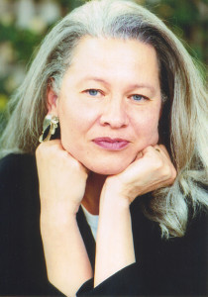
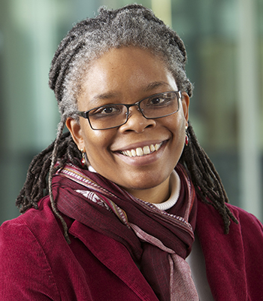
Pioneers in this Work
Dr. Melanie Tervalon - Bio
Dr. Jann Murray-García – Bio
VIDEO/Documentary: Cultural Humility: People, Principles and Practices - Vivian Chavez

Slide 9
Cultural Humility Principles
Principle 1: A lifelong commitment to lifelong learning, self-reflection, and compassionate self-critique. (Intra)
Principle 2: An investment in interconnectedness and interdependence. Developing mutually-beneficial partnerships with communities on behalf of individuals and defined populations; partnering with those you serve. (Inter)
Principle 3: Identifying and redressing power imbalances in relational dynamics. Disrupting systems of oppression and harm. (Cultural)
Principle 4: Advocating for and maintaining institutional consistency with principles 1-3. (Systems/Institutions)
Adapted from Tervalon M, Murray-Garcia J: “Cultural humility versus cultural competence: a critical distinction in defining physician training outcomes in multicultural education, “Journal of Health Care for the Poor and Underserved 1998; 9(2):117-124.

Slide 10
Cultural Competence Vs. Cultural Humility
Cultural Competence
Assumes an end-point or ability to arrive at competence
Outward facing; learning about the “other”
Doesn’t intentionally address power and privilege
Does not address institutional responsibility; Responsibility placed on practitioner
Congruent set of beliefs, practices, assumptions, and protocols upheld in cross-cultural settings.
Cultural Humility
No end-point; ongoing learning
Inward-facing; Self-reflection and compassionate self-critique
Intentionally addresses P&P
Requires Institutional Analysis, Consistency, and Transformation
Trauma Informed and Harm Reducing
Responsibility is shared among individuals and the system; the system leads by example
Congruent set of beliefs and guiding principles in ALL settings.

Slide 11
Dialogue vs. Discussion
Dialogue
To learn
To hear and understand different perspectives
To offer, reflect and inquire
To explore collective thinking and meaning
To allow for common ground
To discover/create shared visions
To seek coherence between thought and action
Discussion
To fix
To advocate a single perspective
To present a position as "right“
To sell, persuade, enlist
To succumb to one strong opinion
To prove one's own vision
To decide to act first

Slide 12
Dialogue is…
Open-hearted and empathetic (feeling with)
Perspective-based vs. prejudice-based
Open-minded, curious and learning focused
Non-threatening environment to evaluate personal assumptions and stereotypes
Not focused on being politically correct rather it is focused on understanding diversity, equity, and authentic inclusion on a deeper, more meaningful level.

Slide 13
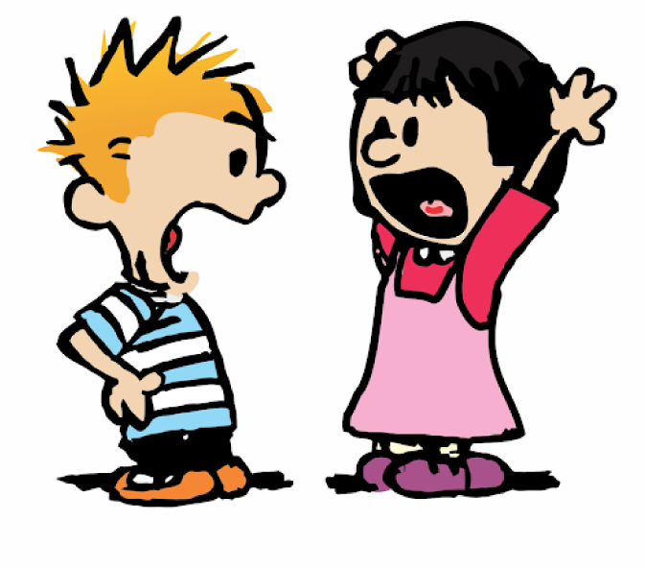
Dialogue is NOT..
Closed-hearted and sympathetic (feeling for)
Discussion (a word that shares its root meaning with “percussion” and “concussion” both of which involve breaking things up)
Argumentative or debate orientated
Forms of communication aimed toward a goal, to form consensus, to solve a problem, or to have one’s opinion prevail
Adapted from Intro. to Dialogue Groups, LLNL, 10/1/97

Slide 14
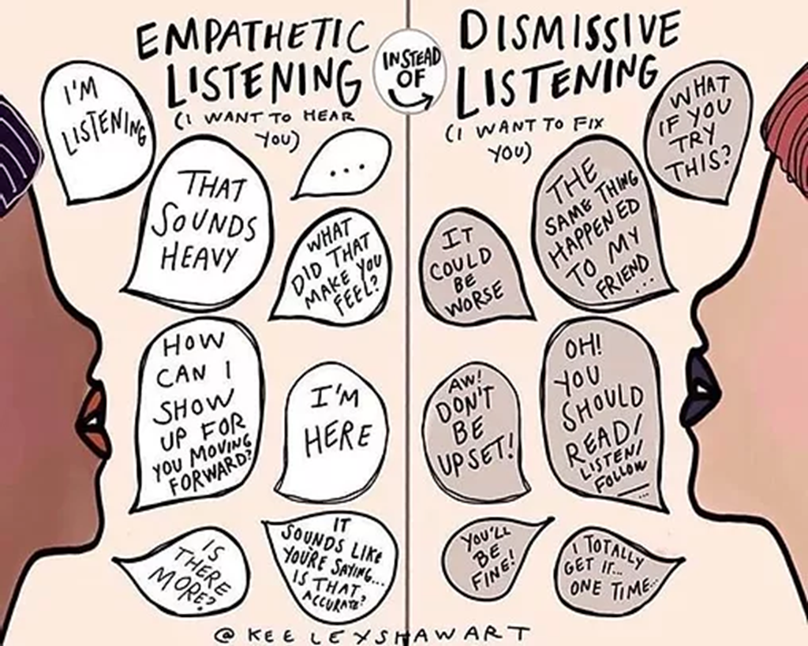
Leading with Empathy
Empathy is not the same as sympathy
Empathy – involves feeling what someone else feels
Sympathy – understanding someone else’s emotions but from your own perspective
Video: Empathy by Brene Brown

Slide 15
Leading with Curious Listening
The skill of curious listening takes time and it takes active energy. Practice by being intentional about the following DOs & DON’Ts:
DO:
ignore your internal noise and thoughts
listen to the other person’s words and their impact on you
sense how the other person is feeling (… Tap into empathy)
DON’T:
formulate a response in your mind
think about advice, opinions, or solutions
silently judge or criticize the person or what they are saying
feel the need to memorize anything they say
Source: https://masterpieceleader.com/tag/humble-inquiry/

Slide 16
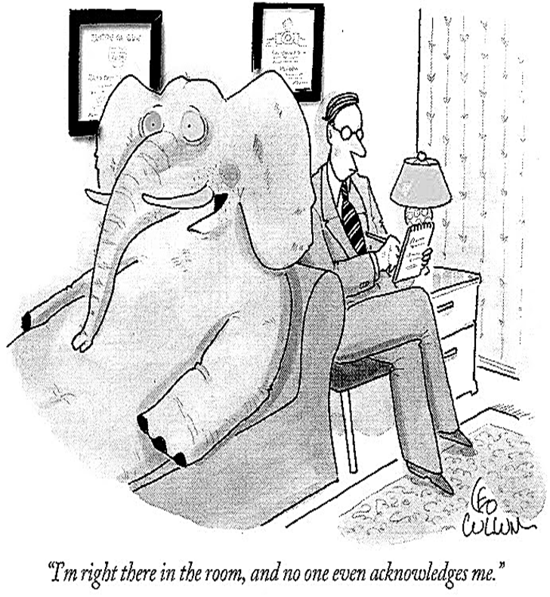
Power & Privilege
Power is the ability to influence and make decisions that impact others.
Privilege is advantages and benefits that individuals receive because of social groups they are perceived to be a part of. Privilege is often a result of systematic targeting and/or marginalization of another social group.
Source: https://students.dartmouth.edu/opal/education/introduction-power-privilege-and-social-justice

Slide 17
Institutional Consistency
Cultural Humility requires institutions are also self-reflective, honor the wisdom and partnerships of those we serve, and challenge systems of oppression, power and privilege to ensure everyone is treated with equity, justice, and fairness.

Slide 18
Why Institutional Consistency?
Institutions are fairly stable social arrangements and practices through which collective actions are taken. Examples of institutions in the U.S. include the legal, educational, health care, social service, government, media and criminal justice systems.
Institutional Oppression occurs when established laws, customs, and practices systematically reflect and produce inequities based on one’s membership in targeted social identity groups. If oppressive consequences accrue to institutional laws, customs, or practices, the institution is oppressive whether or not the individuals maintaining those practices have oppressive intentions.
Adapted from “Institutional Oppression,” Tools for Diversity

Slide 19
Take a Breath

Slide 20
ASCCC Cultural Humility Toolkit

Slide 21
Cultural Humility Journey Map

Slide 22
Cultural Humility as an Equity Lens

Slide 23
Reflections & Final Thoughts
Thank you for spending this time with us today and enjoy the rest of our fall plenary!
Questions?
info@asccc.org

