Slide 1
Welcome to Fall 2023 Plenary Session

Slide 2
Agenda
Call to Order
Land Acknowledgement
Action
Adoption of the Procedures
Adoption of the Spring 2023 Plenary Session Minutes
Foundation Report
State of the Academic Senate for California Community Colleges

Slide 3
Land Acknowledgement
We begin today by acknowledging that we are holding our gathering on the land of the Acjachemen (Juaneño) Nations who have lived and continue to live here. We recognize the Acjachemen (Juaneño) Nations and their spiritual connection to the ocean and the land as the first stewards and the traditional caretakers of this area we now call Costa Mesa. As we begin, we thank them for their strength, perseverance, and resistance.
We also wish to acknowledge the other Indigenous Peoples who now call Costa Mesa their home, for their shared struggle to maintain their cultures, languages, worldview, and identities in this diverse city.

Slide 4
Actions
Adoption of Minutes
from Spring 2023
Plenary Session
Minutes can be found under the Resources tab of the Fall 2023 Plenary Session webpage
Adoption of the
Procedures for
Fall 2023
Plenary Session
Procedures can be found on the Fall 2023 Resolutions Page, linked in the Resources tab of the Fall 2023 Plenary Session webpage
Also, please review the 2023 ASCCC Audit Report available on the Plenary Session Event page at the ASCCC website. We are proud to report there are no findings or comments.

Slide 5
Celebrating 15 years of Supporting Faculty Professional Growth & Participation in
ASCCC Events
ASCCC Fall 23 Plenary Report
November 14
Westin South Coast Plaza

Slide 6
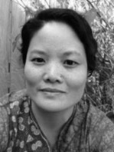
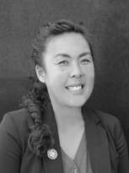
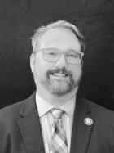
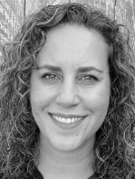
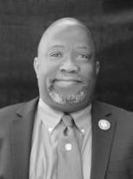
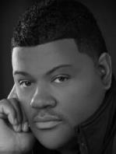
2023-2024 Board of Directors
 | President: Karen Chow De Anza College chowkaren@deanza.edu |  | Executive Director: Krystinne Mica Academic Senate for California Community Colleges krystinne@asccc.org
 | Secretary: Christopher Howerton Woodland College chowerto@yccd.edu |  | Treasurer: Mitra Sapienza City College of San Francisco msapienz@ccsf.edu
 | Director: Robert L. Stewart Jr. Los Angeles Southwest College stewarrl@lasc.edu |  | Director: Robert Chambers San Diego City College rjchambers.arts@gmail.com

Slide 7
Celebrating our 15th Year of Supporting ASCCC & Faculty!

Slide 8
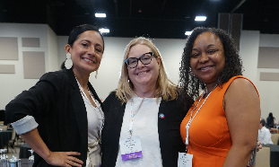
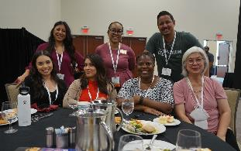
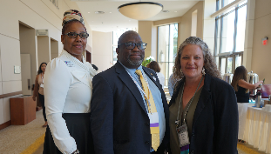
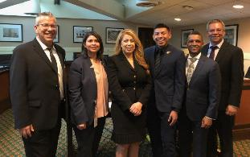
Mission and Purpose
Mission
The mission of the Academic Senate Foundation for California Community Colleges (ASFCCC) is to enhance the excellence of the California community colleges by sustained support for professional development of our diverse faculty in the furtherance of effective teaching and learning practices.
Purpose
The specific purposes of this corporation are to benefit, support, and enhance the excellence of California community colleges through fundraising efforts towards professional learning for faculty and to promote innovative activities and strategies to advance teaching and learning.
Notes:
This Fall the foundation decided to look over its Mission and Purpose statement and revise it in order to more accurately reflect the work that we do:
Original Purpose: The specific purposes of this corporation are to benefit, support, and enhance the excellence of California community colleges; to support, design and implement professional development for California community college faculty; to research, develop and communicate effective practices to promote effective teaching and learning in the California community colleges; and to promote a variety of activities and strategies to advance teaching and learning.

Slide 9
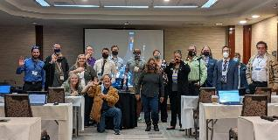
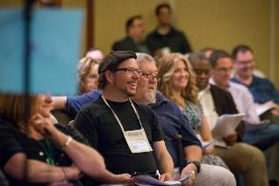
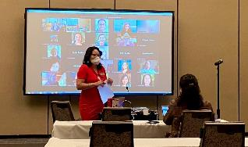
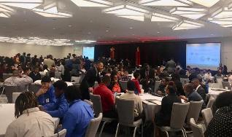
Supporting Professional Development
ASCCC Plenary/Institute/A2MEND Scholarships & Sponsorships
Throughout the year, Academic Senate Foundation offers in-person and virtual attendee scholarships to faculty, and we ensure awardees from each ASCCC Area for plenaries, institutes, and A2MEND.
Last year we offered a total of 37 scholarships to full and part-time faculty & sponsored the LGBTQ+ Summit
Innovation Scholarships
Innovation Scholarships provide faculty with funding to attend ASCCC events as well as external events and conferences to expand their understanding of best practices and apply them to their local college and share those results with the field at large. Special consideration will be given to grants that promote and enhance Diversity, Equity, Inclusion, and Anti-racism.
Faculty can apply for a grant of up to $1,500 to participate in professional development (workshops, classes, webinars, institutes and conferences).
Last year we awarded 2 Innovation Scholarships for a total of $3.000.

Slide 10
Faculty Game Night!
Let’s celebrate the 15th year anniversary of the Foundation for ASCCC!
Games, Appetizers, and Nonalcoholic drinks!
TONIGHT, Thursday, 5:30 p.m. to 6:30 p.m in Viejo/Laguna Room, 1st floor
Win prizes, including a FREE registration to an upcoming ASCCC event!
Suggested donation of $15 for the 15th anniversary
Be a monthly sustainer at $10+1 OR ANY amount

Slide 11
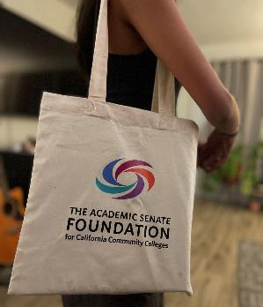
Get Your ASFCCC Gear and
Support a Great Cause!
Make sure to stop by our ASFCCC table during the Fall Plenary to get your hands on some merchandise featuring our new logo!
Donate to the foundation and get tickets for a chance to spin our Prize Wheel and win some merchandise!
T-shirts, water bottles, notepads and other merchandise featuring our new logo will also be available for a small donation.
What an excellent way to support your colleagues and look cool in the process!

Slide 12
Financial Statement (July ‘22- June ‘23)
Revenues
Sponsorships $23,500.00
Donations Revenue $23,795.88
Other Revenue $184.90
Total Revenue $47,480.78
Expenditures
Scholarships $21,437.36
LGBTQ+ Summit and $4,013.34
Other Sponsorships
Other Expenses $20,908.65
Total Expenditures $46,359.15
Notes:
Total number of dollars spent on scholarships and sponsorships = $17,373.76
Other Expenses = Professional Fees, Dues/Subscriptions, and office supplies
Important to consider that our fiscal year ends in June, so these numbers will certainly change by then. Also, important to remember that our biggest fundraiser is the Area competitions so our Donations Revenue should see an increase after Spring Plenary as long as the Area competition is robust!

Slide 13
Testimonials from Faculty Scholarship Recipients
“I went to the Society of Integrative and Comparative Biology conference in January 2023. I presented a talk on High Impact Practices at this conference and chaired the session on high impact practices in undergraduate education. I learned different ways to better engage students in science courses and the importance of involving freshman and sophomore students in small research projects to increase their understanding of science.”
--Kelly Kissane, Lassen College Biology Faculty, Innovation Scholarship Recipient
“In April 2023, I traveled to the future with over 1300 Black California Community College leaders, educators, counselors, and students to the African American Male Education Network and Development (A2MEND) Summit…I’d never been in a predominantly Black space for an extended period of time until A2MEND. I felt it before I was conscious of what I was witnessing: Black folks—young, old, leaders, students, writers, poets, administrators, faculty—creating and taking up space; allowing themselves to expand as big and authentic as they were meant to be and should always have been. The breath was a collective sigh of relief and a collective breath of fresh air where the relaxation into authentic self was possible…and palpable. For the first time in my academic journey, I was breathing too.”
-- Winnie Tam Hung, Consumnes River College Ethnic Studies Faculty Chair

Slide 14
Thank you!
On behalf of the AS Foundation Board of Directors, thank you for your generous support and contributions!
Visit us at asfccc.com for more information on our scholarships and how you can support our work!

Slide 15
State of the Academic Senate for California Community Colleges

Slide 16
Leadership can be stressful
"Man Stressed At Work Illustration" by Ciphr Connect is licensed under CC BY 2.0.
Image by Gerd Altmann from Pixabay

Slide 17
You are part of a community. We are stronger together.
Images by Gerd Altmann from Pixabay

Slide 18
Academic Senate Vision and Mission
Vision
Faculty leading change, serving students, and advancing inclusion, diversity, equity, anti-racism, and accessibility
Mission
As the official voice of California community college faculty in academic and professional matters, the Academic Senate for California Community Colleges (ASCCC) is committed to advancing inclusion, diversity, equity, anti-racism, accessibility, student learning, and student success. The ASCCC acts to:
Empower faculty to engage in local and statewide dialog and take action for continued improvement of teaching, learning, and faculty participation in governance
Lead and advocate proactively for the development of policies, processes, and practices
Include diverse faculty, perspectives, and experiences that represent our student populations
Develop faculty as local and statewide leaders through personal and professional development
Engage faculty and system partners through collegial consultation

Slide 19
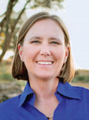
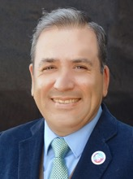
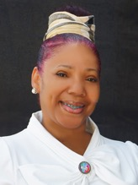
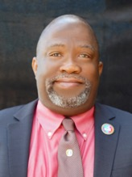
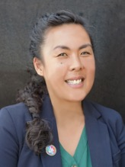
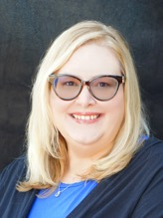
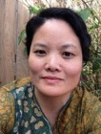
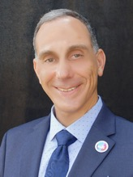
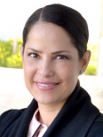
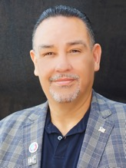
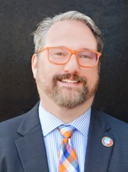
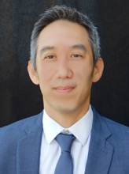
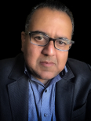
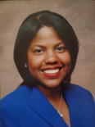
Executive Committee Members 2023-2024
President
Cheryl Aschenbach
Vice President
Manuel Vélez
Secretary
LaTonya Parker
Treasurer
Robert L. Stewart, Jr.
Executive Director
Krystinne Mica
Area A Rep
Stephanie Curry
Area B Rep
Karen Chow
Area C Rep
Erik Reese
Area D Rep
María-José
Zeledón-Pérez
At-large Rep
Juan Arzola
At-Large Representative
Christopher Howerton
North Rep
Mitra Sapienza
North Rep
Eric Wada
South Rep
Carlos Guerrero
South Rep
Kimberley H. Stiemke

Slide 20
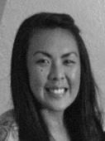
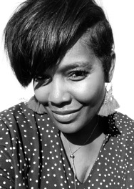
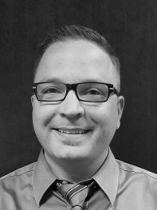
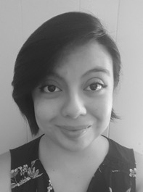
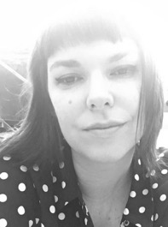
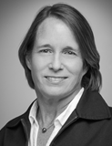
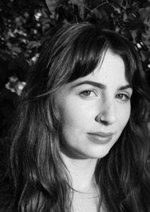
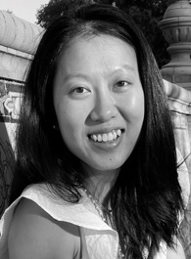
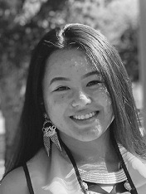
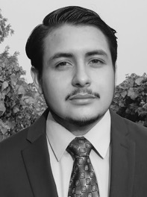
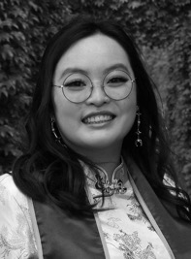
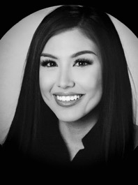
ASCCC Office Team
Executive Director
Krystinne Mica
Director of Administration
Tonya Davis
Director of Finance
Alice Hammer
Administrative Assistant
Kyoko Hatano
C-ID Program Manager
Miguel Rother
Program Manager
Selena Silva
Program Coordinator
Megan Trader
Visual Designer
Katie Nash
Communications Coordinator
Emily Nicol
Research Associate
Gina Lam
Events Planner
Kayla Vue
Accounting Clerk
Brando Jimenez
Administrative Assistant
Amy Liao
Executive Assistant
Patricia Carrillo

Slide 21
Thank you
Image by Pete Linforth from Pixabay

Slide 22
Fall 2023 Plenary Session
Plenary Session is a venue for
Submitting, debating, and voting on resolutions around statewide academic and professional matters;
Educating local senate leaders on statewide academic and professional matters by providing professional development opportunities;
Sharing information about ASCCC and its work;
Networking with other faculty and colleague leaders from across the state

Slide 23
Academic and Professional Matters Title 5 §53200(c) The “10+1”
Curriculum including establishing prerequisites and placing courses within disciplines
Degree and certificate requirements
Grading policies
Educational program development
Standards or policies regarding student preparation and success
District and college governance structures, as related to faculty roles
Faculty roles and involvement in accreditation processes, including self-study and annual reports
Policies for faculty professional development activities
Processes for program review
Processes for institutional planning and budget development
+1 Other academic and professional matters as mutually agreed upon between the governing board and the academic senate

Slide 24
ASCCC Strategic Directions
Strategic Plan Comprehensive Report 2018-2023
2023-2024 Strategic Work Plan
Embracing Organizational Change
Engaging Proactively in Partnerships and Advocacy to Advance Faculty Voice and Student Success
Advancing Faculty Engagement in Data Literacy
Developing Innovative Activities to Empower Faculty and Uplift Underrepresented Voices

Slide 25
Responding to Resolutions: ASCCC Efforts
Sp23 1.03 Flexible Area Meetings *New format F23
Sp23 01.01 Add a PT Rep to Exec Committee
Sp23 07.01 Destigmatize Academic Probation Language and Processes *Webinar Dec. 8
Sp23 13.02 Adopt Enrollment Management Paper (from F18 17.01). *published paper
Sp23 13.03 Adopt Effective and Equitable Online Education: A Faculty Perspective Paper (from Sp22 13.02) *published paper
Sp23 13.05 Considering the Merits and Faults of Artificial Intelligence in the Community College Classroom *effort underway

Slide 26
Responding to Resolutions: ASCCC and System Efforts
Sp23 07.06 Revisit Baccalaureate Degree Upper Division General Education and Minimum Qualification Requirements *5C
F22 07.01 Comprehensive Title 5 Revision to Align Associate Degree General Education with the AB 928-required General Education Pathway AND Sp23 06.05 Support Revised Title 5 Associate Degree Requirements *new regulations effective 11/16/23
Sp23 10.01 Disciplines List-Ethnic Studies *Updated MQ Handbook
Sp23 12.01 Assert the Value of Work Done by the Online Network of Online Education (@ONE) and Support Local Reliance on Training Resources. *See @ONE website

Slide 27
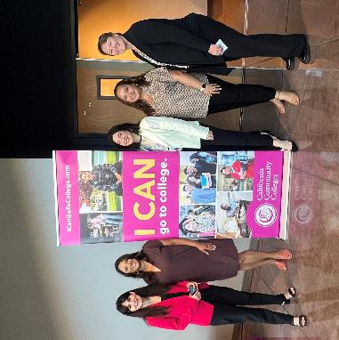
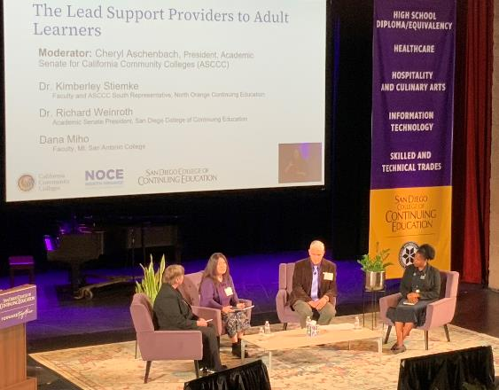
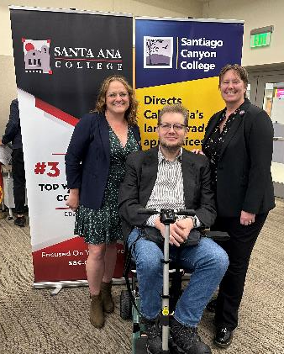
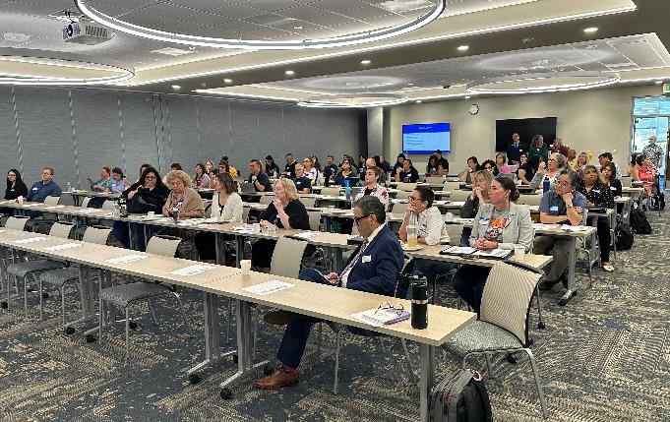
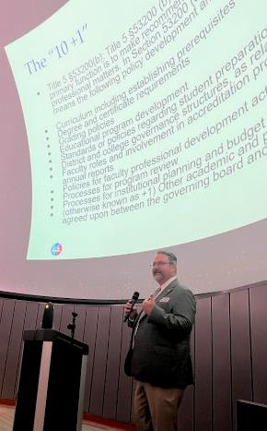
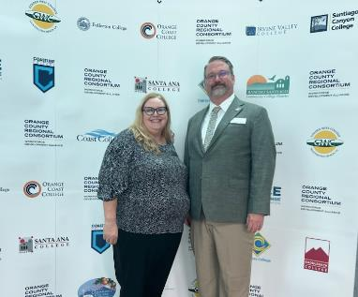
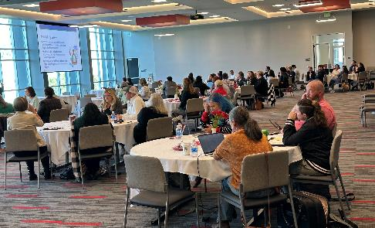
ASCCC on the Road
CTE Regionals in collaboration with Regional Consortia
Curriculum Regionals
Vision 2030 DEIA Summit
Vision 2030 Faculty Panels
Dual Enrollment
Career Education
College Visits
Sept. Exec Mtg

Slide 28
Leadership and Representation
Ongoing ASCCC Co-Chair:
CCC Curriculum Committee (5C)
Distance Education & Education Technology Advisory Committee (DEETAC)
Technology & Telecommunications Advisory Committee (TTAC)
Intersegmental Curriculum Council
California Virtual Campus (CVC) Advisory Committee
Short-term Task Force Co-Chair:
AB 1111 Common Course Numbering Task Force
AB 928 Implementation Committee
AB 89 Task Force
Burden-Free Instructional Materials Task Force
Universal Design for Learning Task Force

Slide 29
Vision 2030
Dual Enrollment
Rising Scholars
Mapping Articulated Pathways (Credit for Prior Learning)
Career Education
Guided Pathways
Baccalaureate Programs
Generative Artificial Intelligence
Join us for an overview of Vision 2030 and a conversation with Chancellor Christian Friday @ 3:50PM

Slide 30
Build Connections
ASCCC Webpage…resources, resources, and more resources!
Official Listservs – subscribe here
Unofficial Listservs:
Curriculum: CCCCurriculumChairs+subscribe@groups.io
Senate Presidents: cccsenates+subscribe@googlegroups.com
ASCCC Caucuses
Small or Rural Colleges
LGBTQIA+
Asian Pacific Islander
Latinx
Womxn’s
Black
Articulation and Transfer
ASCCC Liaisons

Slide 31
Upcoming Webinars and Events
Webinars
November 27 2:00PM-3:00PM AB 928 Committee Report Update
November 28 2:00PM-3:00PM AB 1111 Common Course Numbering Report Update
December 7 12:00PM-1:30PM Demystifying CBE
December 8 10:00AM-11:30AM Destigmatizing Academic Probation
January 29 10:00AM-11:30AM IDEAA-focused Professional Development for Faculty
Events
February 2 CTE Regional: Central Mother Lode
February 9 CTE Regional: Inland Empire

Slide 32
We Can Do This!
Center students – our why!
Learn, access resources, share with others
Build community and collaborate
Communication
Stay focused on the 10 + 1 and academic senate purview
Practice self care

Slide 33
Thank you! Questions! info@asccc.org

