Slide 1
Welcome Slide
2023 ASCCC Fall Plenary General Session
Presented By:
Dr. Darla Cooper, The RP Group Executive Director
Dr. LaTonya Parker,
Counselor/Professor, Moreno Valley College and ASCCC Secretary

Slide 2
AGENDA
Brief overview of the African American Transfer Tipping Point Study
Deep dive into how Moorpark is re-imagining supporting academically struggling students
How Academic Senate is making changes at the system level

Slide 3
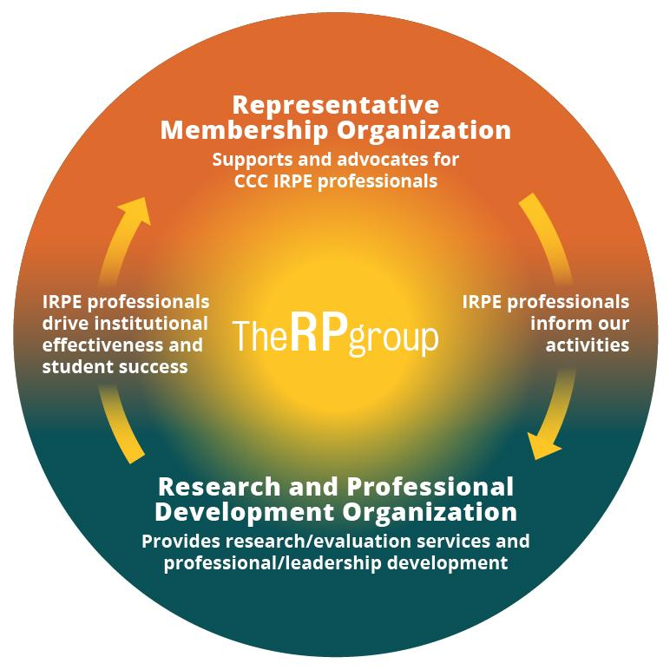
About The RP Group
Mission: As the representative organization for Institutional Research, Planning, and Effectiveness (IRPE) professionals in the California Community Colleges (CCC) system, The RP Group strengthens the ability of CCC to discover and undertake high-quality research, planning, and assessments that improve evidence-based decision-making, institutional effectiveness, and success for all students.
Services: Research, evaluation, planning, professional development, and technical assistance—designed and conducted by CCC practitioners
Organization: 501(c)3 with roots as membership organization

Slide 4
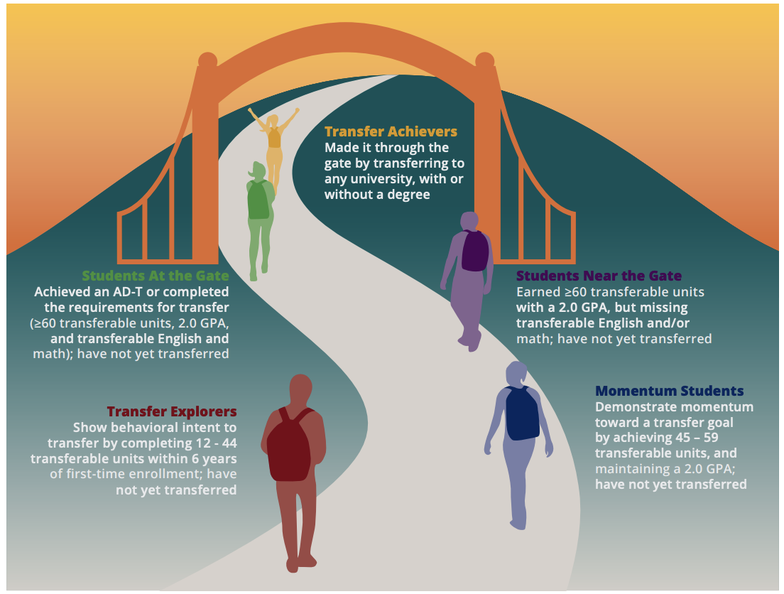
Through the Gate
Mapped California’s transfer landscape, identifying a continuum of milestones for the student transfer journey and quantifying how many students were “near” or “at” the transfer gate

Slide 5
Through the Gate
While African American/Black students are less likely to make it “near the transfer gate,” among those who do reach this milestone, they are significantly more likely to transfer than their peers.
When compared to White students, African American/Black students are 2.04 times more likely to transfer than remain near the gate.

Slide 6
The African American Transfer Tipping Point
Study made possible with generous funding from:

Slide 7
GUIDING QUESTIONS
What factors (both academic and non-academic) contribute to students' likelihood of reaching the tipping point?
Which programs and practices are associated with greater persistence to and through the tipping point, and ultimately, the transfer gate?

Slide 8
METHODS
Phase 1: Exploring student course-taking patterns
Phase 2: Interviews and focus groups with college practitioners and transfer-motivated students at colleges having higher success with transfer among African American students
Phase 3: A survey of African American/Black students across the CCC

Slide 9
Phases 1 and 2:
Factors Influencing Whether or Not an African American/Black Student Makes It Near The Transfer Gate

Slide 10
POPULATION
Six first-time cohorts enrolled at a CCC between 2011 and 2016
Tracked for six years
Completed at least 12 transferable units with passing grades and had not yet enrolled in a university
69,242 African American/Black students and 778,977 non-African American/Black students

Slide 11
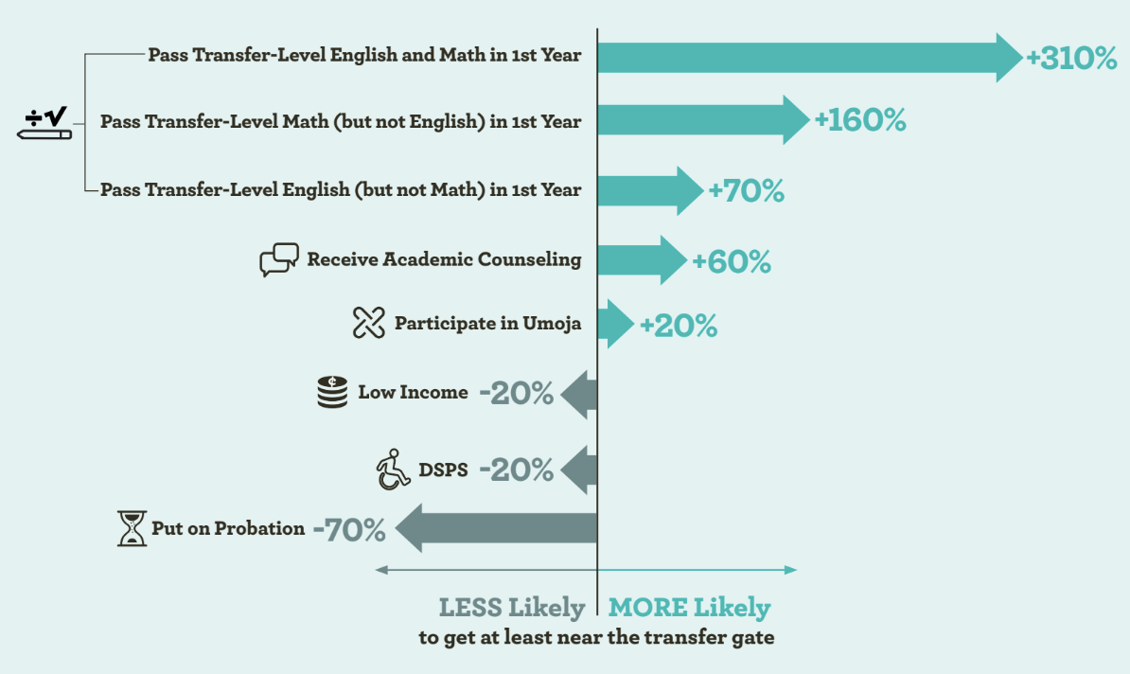
Phase 1 Results

Slide 12
Phase 1 Results 2
….vs 110% for non-African American/ Black Students
41% of African American/Black students are put on probation vs 29% of non-African American/Black students
...

Slide 13
Phase 2 Results
Interviews and Focus Groups Revealed…..
Passing Math and English: Faculty help students build their confidence as students, increase their mastery of key subjects and support their success.
Academic Counseling: Students avoided general and Transfer Center counseling, as they did not feel heard, seen, valued, or respected and did not see themselves reflected.
Umoja: Mandatory, dedicated, and proactive counseling offered by Umoja allows the time and space for counselors who reflect students’ backgrounds to build relationships with them.
Academic Probation: The word probation is triggering. Receiving a notice of probation can be devastating. Probation negatively impacts financial aid eligibility.

Slide 14
Phase 3:
Leveraging Statewide Survey
Findings to Dive Deeper into Results

Slide 15
Phase 3 Survey Sample
Of the 7,148 respondents…
75% were currently enrolled at a CCC (n=5,348)
13% had transferred to a university (n=936)
13% had exited without transferring (n=864)
57% had planned to at some point

Slide 16
Phase 3 Survey Sample 2
121 CCCs*
64% Female
48% Ages 18-25
47% Financial Aid Recipients
44% First Generation
22% with Physical or Cognitive Disabilities
14% LGBTQ
11% Student Athlete
10% with Mental Health Condition
7% Military
7% Former Foster Youth
4% Justice Involved
*includes five non-credit colleges
Participation in Groups
28% EOPS
18% Umoja
13% DSPS
10% Promise Program
10% Honors Programs
9% Black Scholars
8% MESA
8% Dual Enrollment
6% Aspire
4% Puente

Slide 17
Phase 3 Constructs
Explored
Six Success Factor Definitions
Directed: students have a goal and know how to achieve it
Focused: students stay on track – keeping their eyes on the prize
Nurtured: students feel somebody wants and helps them to succeed
Engaged: students actively participate in class and extracurricular activities
Connected: students feel like they are a part of the college community
Valued: students’ skills, talents, abilities, and experiences are recognized; they have opportunities to contribute on campus, and feel their contributions are appreciated.

Slide 18
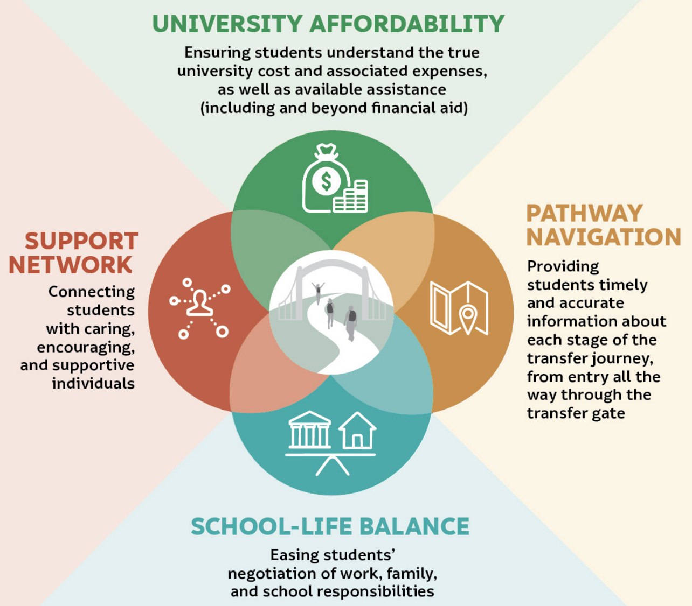
Phase 3 Constructs
Explored 2

Slide 19
Phase 3 Constructs
Explored 3
Microaggressions
Ascription of Intelligence: Assigning a degree of intelligence to a person of color based on race
Assumption of Criminality: Assuming a person of color is dangerous, criminal, or deviant based on race
Second-Class Citizening: When a White person is given preferential treatment over a person of color
Pathologizing Culture: The notion that the values and communication styles of the dominant/White culture are ideal

Slide 20
Phase 3:
Four Core Student Experiences
Passing Transfer-Level Math and English
Academic Counseling
Umoja
Academic Probation

Slide 21
Passing Transfer-Level Math and English

Slide 22
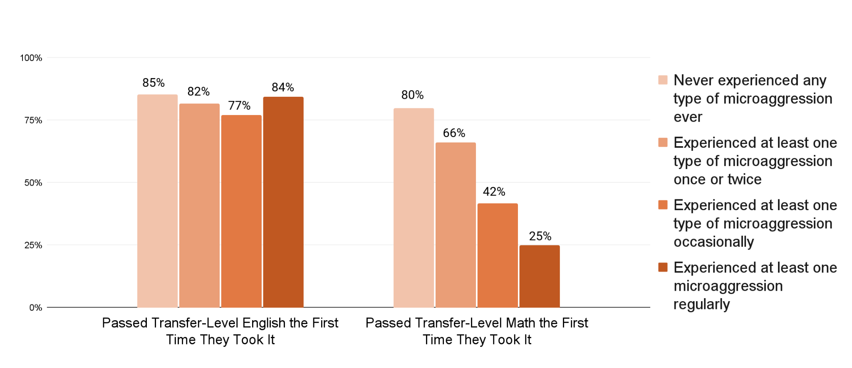
Transfer-Level Course Passing
African American/Black Students who did not pass math on the first try were much more likely to report having experienced microaggressions during their time at their college. No association was found when it came to passing transfer-level English.

Slide 23
Student Voice on Impact of Microaggressions
There was one time (and I don't remember it happening again), but …this semester, it was my [redacted] professor... [For this class], the lights are usually off, but she'll have us raise our hands for stuff and answer questions, and she'll make jokes or not (they're not really jokes because they're not funny) about how she won't call on darker complexion students because she can't see [us].

Slide 24
Let’s Discuss
Microaggressions are negatively associated with passing transfer-level math in a timely manner.
What about this finding do you find surprising?
How might we support faculty to help students succeed in the face of experiencing microaggressions?

Slide 25
Academic Counseling

Slide 26
Academic Counseling 2
Two-thirds of African American/Black survey respondents said they would prefer to see an African American/Black counselor, but only half saw an African American/Black counselor.
42% of students who successfully transferred met with a African American/Black counselor compared to 33% among students who left without transferring.

Slide 27
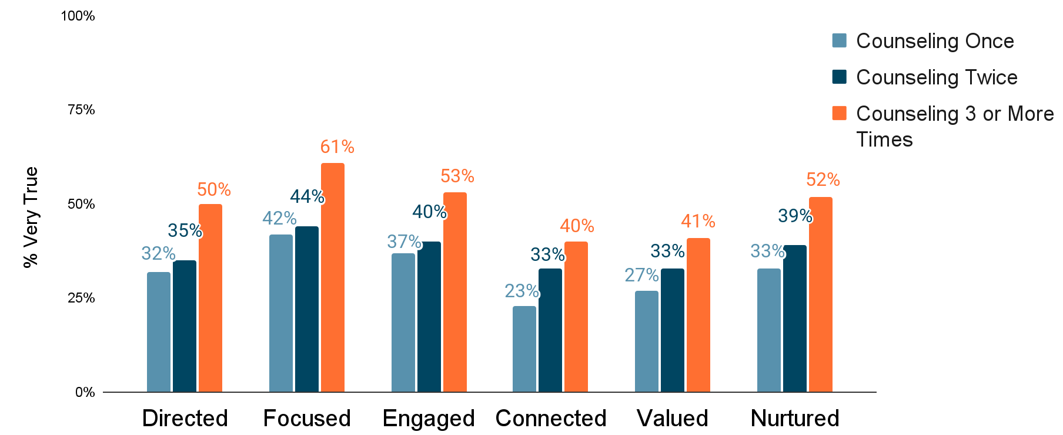
Academic Counseling 3
The more frequently African American/Black students received academic counseling, the more likely they were to identify with each of the six student success factors, notably the degree to which they were focused.

Slide 28
Let’s Discuss 2
African American/Black students say they would like to be able to see African American/Black counselors.
Aside from hiring more American/Black counselors, what else can colleges can do to ensure African American/Black students have as positive, as worthwhile an experience as possible, regardless of the race/ethnicity of the counselor?

Slide 29
Umoja

Slide 30
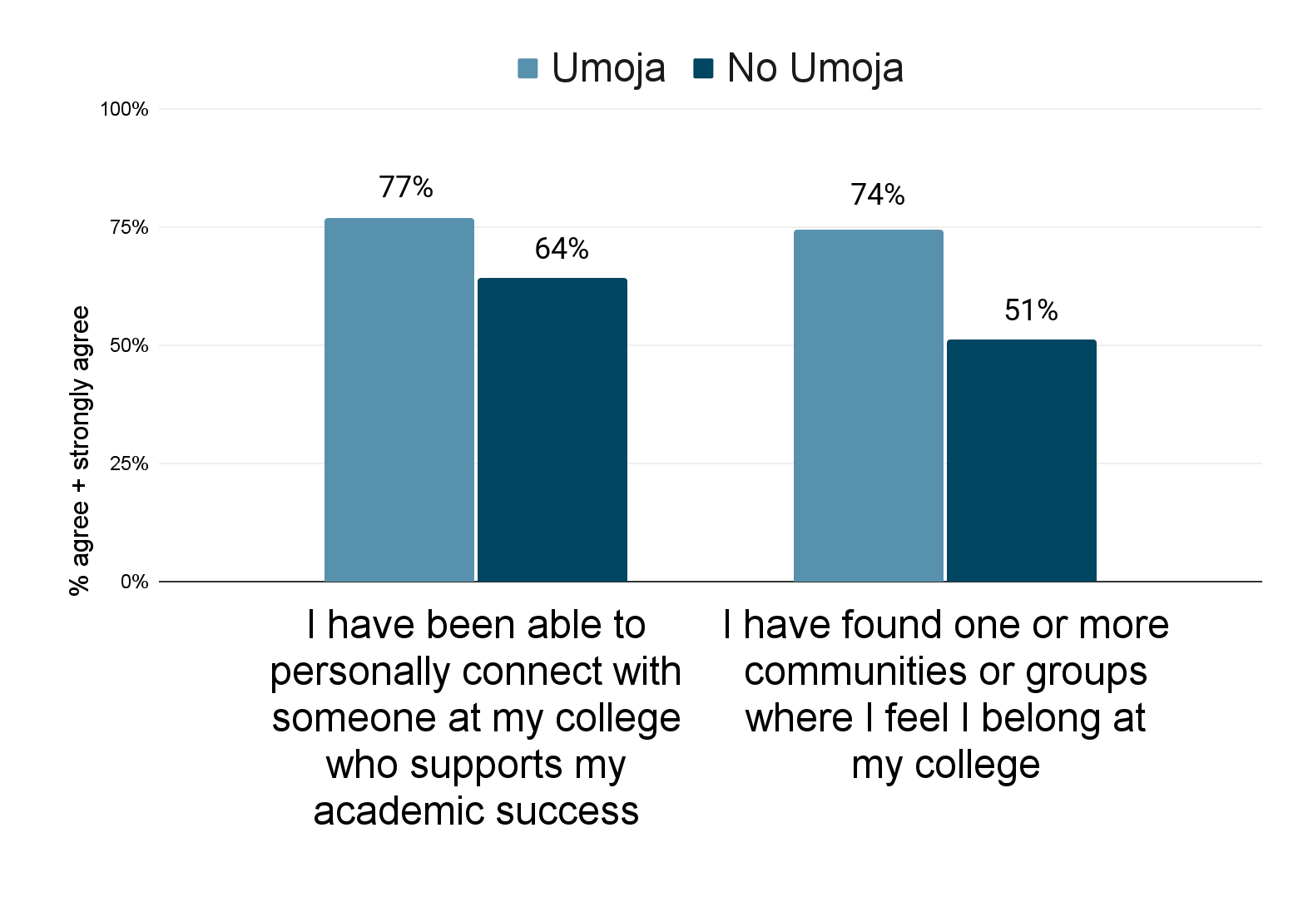
Umoja
44% of Umoja participants received academic counseling at least 3 times vs. 31% among non-Umoja participants.
79% of Umoja participants had seen an African American/Black counselor vs. 45% of non-Umoja participants.
Umoja participants are more likely to find a community where they belong and to personally connect with someone at their college who supports their academic success.
Students who participated in Umoja were more likely to identify with each of the six student success factors than those who did not participate in Umoja.

Slide 31
Let’s Discuss 3
Umoja participants are more likely to find community, experience belonging, and personally connect with someone at the college who supports their academic success.
What practices can counselors, teachers, and others use to ‘Umoja-fy’ their practice? How can other student support programs help students feel the way Umoja students feel?

Slide 32
Academic Probation

Slide 33
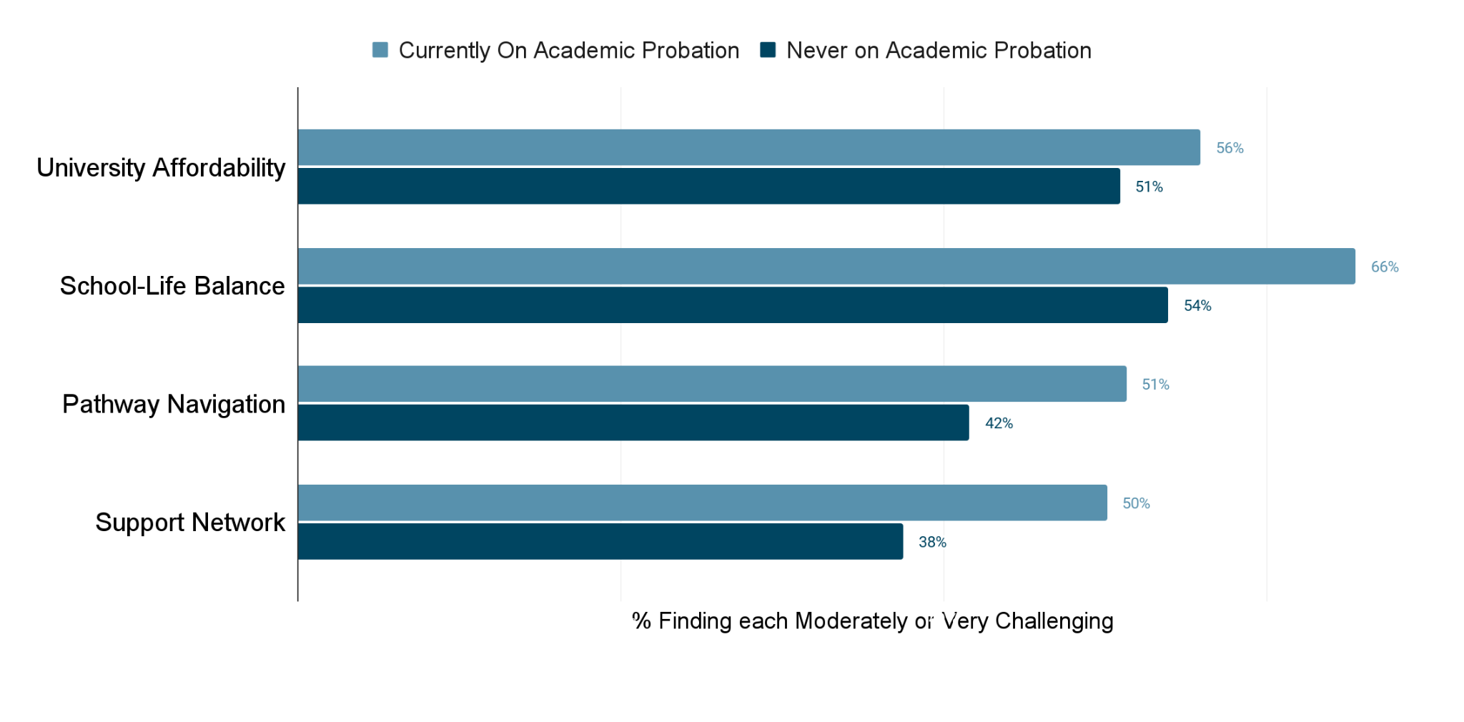
Students who were currently on probation were much more likely than students never on probation to report the challenges with University Affordability, School-Life Balance, Pathway Navigation, and finding a Support Network.
Academic Probation

Slide 34
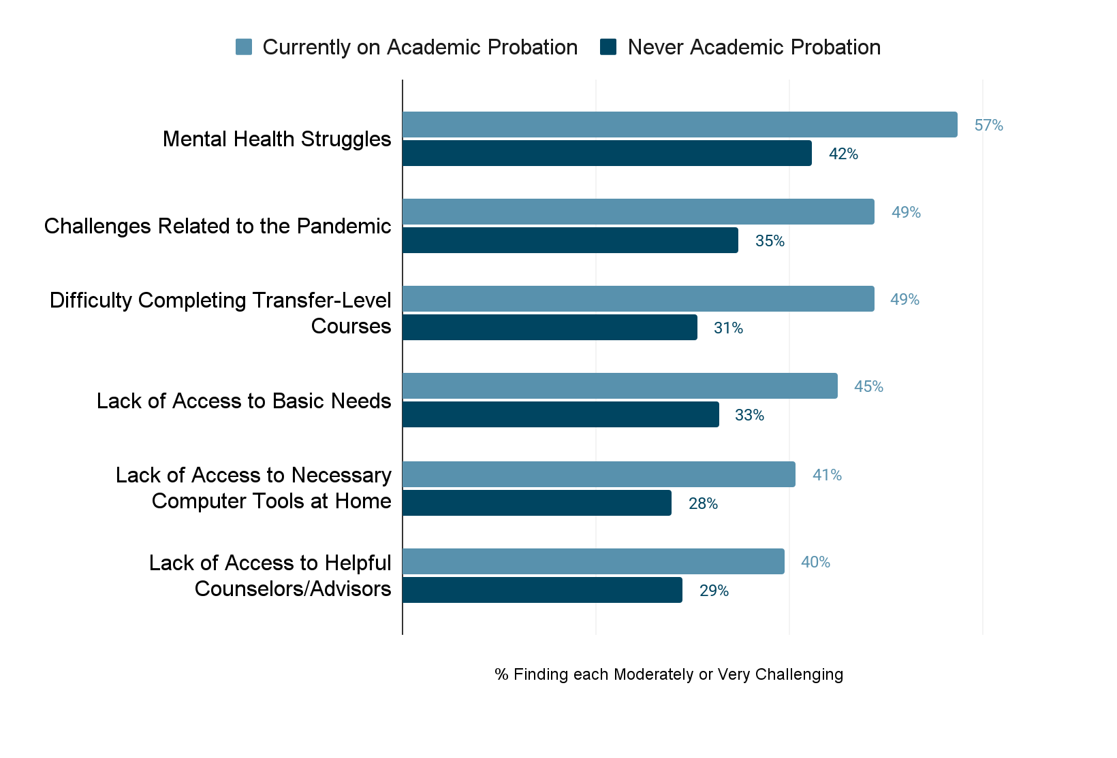
Students who were currently on probation were much more likely than students never on probation to report various challenges in their daily lives.
Academic Probation

Slide 35
From Research to Action
Resolution Number 07.01 - Spring 2023
Whereas, Current California Code of Regulations Title 5 §55031 Standards for Probation [1] requires colleges to place students on academic or progress probation if they fall below grade point average or successful course completion standards;
Whereas, The term “probation” is a deficit-minded principle that is associated with criminal activity, and this term and current practices are perpetuating trauma for students who identify as Black, Indigenous, or People of Color as well as justice-impacted students; [2]
Whereas, Studies such as the Research and Planning Group's The African American Transfer Tipping Point: Identifying the Factors that Impact Transfer Among African American/Black Community College Students (2022) show that being put on academic probation “presents a significant barrier to making it near the transfer gate for students of all races/ethnicities” [3]; and
Resolved, That the Academic Senate for California Community Colleges work with the California Community Colleges Chancellor’s Office to overhaul the Title 5 language on probation, including a name change and updating the language and processes to be asset-minded, not punitive; and Resolved, That the Academic Senate for California Community Colleges support local academic senates with professional development and resources to encourage reviewing local policies and practices with an aim of mitigating local processes that may negatively impact students who are on academic or progress probation while Title 5 changes are in progress.

Slide 36
Let’s Discuss 4
Students on academic probation were much more likely than students never on probation to report a wide range of challenges in their daily lives.
How does this finding resonate with you in respect to students on academic probation you’ve counseled?
What suggestions do you have for colleges trying to support students on academic probation, before, during, and after?

Slide 37
Let’s Discuss!

Slide 38
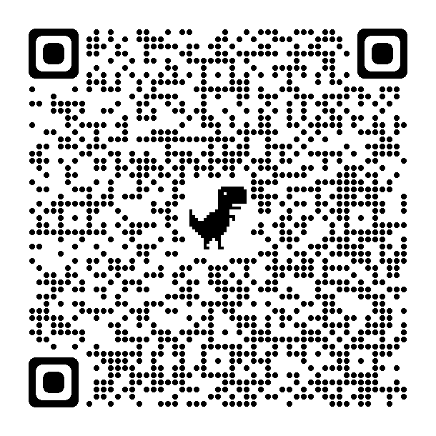
New
Report!

Slide 39
Webinar information

Slide 40
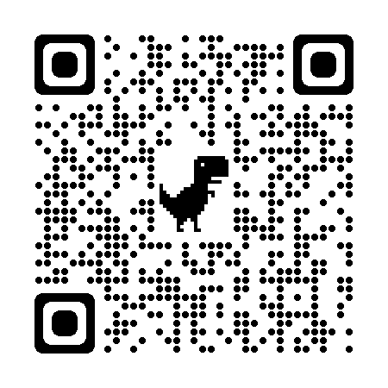
THANK YOU!
Project Leads
Darla Cooper, EdD
Katie Brohawn, PhD
Project Team
Alyssa Nguyen, MA
Rogéair D. Purnell, PhD
Ashley Redix, PhD
Daisy Segovia, PhD
Kelley Karandjeff, EdM
Analytic Advisor
Terrence Willett, MS
Click on the QR Code to access the project webpage. Click on Resources tab to access briefs.

