Slide 1
Understanding Legislative and Budget Processes
Gwen Earle, Associate Professor, Business - College of the Desert
Angela Medina Rhodes, Academic Senate President, Rio Hondo College
Austin Webster, ASCCC Legislative Advocate
Manuel Vélez, ASCCC Vice President

Slide 2
Description and Overview
Description
As the legislature increasingly passes laws impacting academic and professional matters, it is imperative that faculty stay informed on the budget and legislative processes and increase local and statewide advocacy efforts. Presenters will review the budget and legislative processes and discuss ways faculty, especially local academic senate leaders, can engage in advocacy.
Overview
California Legislative Process
California Budget Process
Staying Informed
Engaging in Advocacy

Slide 3
Legislative Basics
Two ways legislators enact actions for us:
Bills generated by legislators in senate and assembly
Budget, including Budget Act and Trailer Bills
Legislators work in 2-year cycles
2023 = 1st year of 2023-2024 legislative cycle
2024 = bills held in 2023 + new bills introduced
It’s important to have some understanding of legislative process
Bill development process
Legislative calendar
Bill movement within each house

Slide 4
More Legislative Basics
Creation:
Bill sponsor’s idea is put into draft language by the Legislative Council and is introduced into the house or origin by the legislative author
Sponsor = Individual, advocacy group, or organization will a bill idea
Author = Elected representative in CA Senate or Assembly
How Many Bills Are Possible in a Two-Year Session?
Assembly members = 50 bills max/2-yr session (Assembly Rule 49)
Senate members = 40 bills max/2-yr session (Senate Rule 22.5)
5,600 bills possible in 2-yr session (4,000 + 1,600)

Slide 5
Bills, Bills, and More Bills
Annually, 1,900-2,500 bills are introduced in the California Senate and Assembly.
Approx. 10% are related to higher education
2021
2,379 Bills introduced, including 203 pertinent to CCCs
836 Bills made it to Governor’s desk.
91 new CCC-related bills
2022
2,353 Bills introduced, including 240 pertinent to Higher Ed.
1,166 Bills made it to Governor’s desk; 997 signed into law
99 new CCC-related bills
2023
2,632 Bills introduced – highest in over a decade (California Globe article Feb. 18, 2023)
187 pertinent to Higher Ed. (81 CCCs Tier 1 Tracking) as of Chancellor’s Office Report at May 18 Consultation Council)

Slide 6
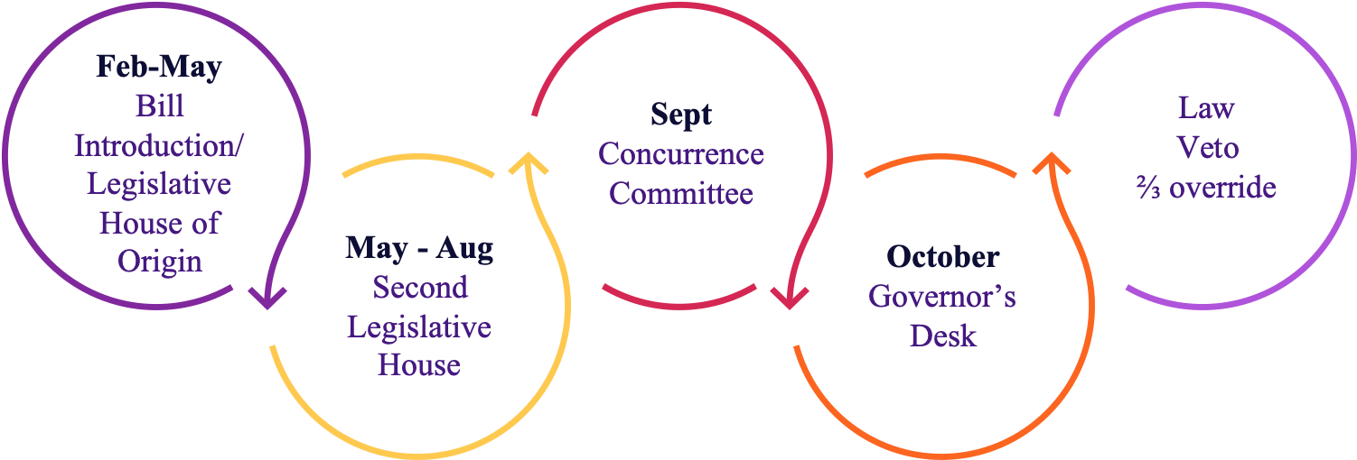
Legislative Calendar

Slide 7
Bill Movement Within Each House
Policy Committee(s)
Appropriation Committee
(fiscal impact)
Floor Vote
Move to 2nd House or Return to House of Origin
Introduced in House of Origin
(AB or SB)

Slide 8
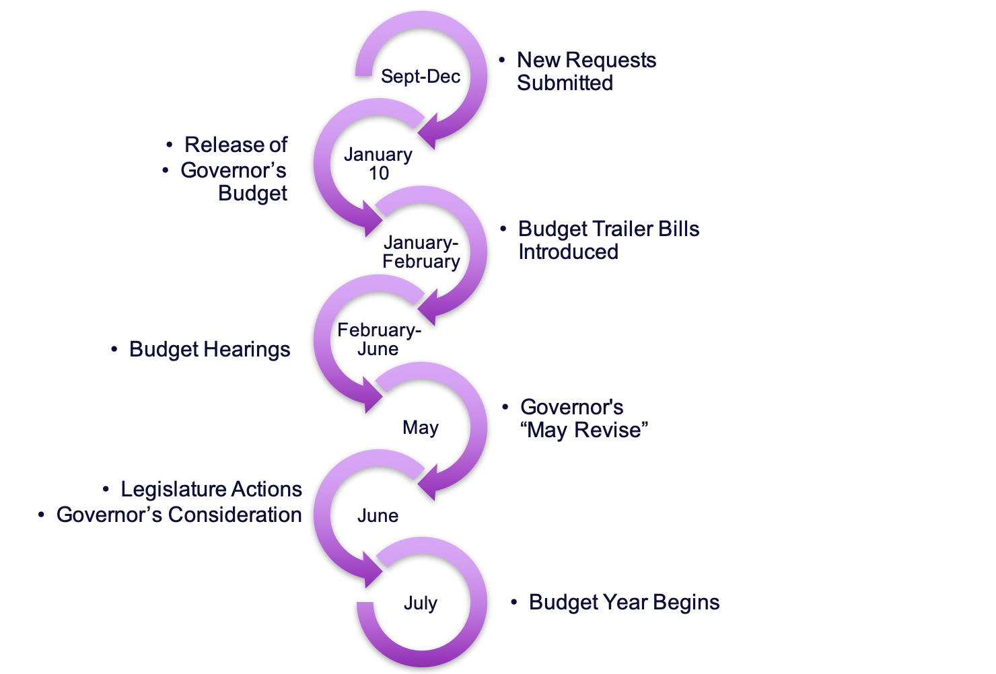
Legislative Budget Process

Slide 9
2023-2024 Legislative Highlights -
Signed Into Law
AB 789 (Berman) - Satisfactory Academic Progress & Financial Aid
AB 1291 (McCarty) - UC ADT Pilot Program
SB 444 (Newman) - MESA Programs
SB 467 (Portantino) - Apprenticeship and Workforce Training Programs
CCCCO Quick Reference Guide

Slide 10
2023-2024 Legislative Highlights –
ASCCC Priority Bills
AB 811 (Fong) - Repeatability
AB 817 (Pacheco) - Open Meetings: Teleconferencing
AB 1142 (Fong) - Coordinating Commission for Postsecondary Ed
AB 680 (Rubio) - Nonresident Tuition Exemptions
ASCCC Legislative Updates

Slide 11
2023-2024 Legislative Highlights –
Budget Act & Fiscal Outlook
Statewide $32.5 Billion Budget Deficit
CCC Funding Stable Despite Budget Shortfall
8.22% COLA SCFF & Categorical Programs
LAO Fiscal Forecast Delayed Due to Late Tax Filing Deadline
California Higher Education Budget Summary
California Community Colleges Budget Analysis

Slide 12
Staying Informed:
Follow ASCCC and System Partners
ASCCC Legislative Updates
FACCC Legislative Positions
CFT Legislative Updates
CCA Legislation and Political Action
CCCCO Tracked Legislation
CCLC Legislative Actions

Slide 13
California Legislative Information Website
Bill Information
Today’s Schedule
Bill Information
CA Law
Publications
Other Resources
My Subscriptions
My Favorites
Bill Text
Votes
History
Analyses
Law As Amended
Compare Versions
Status
Comments to Author
Track Bill
Add to Favorites
leginfo.legislature.ca.gov

Slide 14
Advocate! Find and Connect with Legislators
Find your California Representatives
Senate
California State Senate Webpage
Senate Roster
Assembly
California Assembly Webpage
Assembly Roster

Slide 15
Follow Committees; Submit Letters
Assembly
Assembly Committee on Higher Education
Assembly Budget and Subcommittee 2 on Education Finance
Streaming info for Assembly Floor Sessions and Committee Hearings
Senate
Senate Committee on Education
Senate Budget and Fiscal Review and Subcommittee 1 on Education
Streaming Info for Senate Floor Sessions and Committee Hearings
Submit position letters
Submit as an individual or organizational representative
Advocacy Quick Reference Guide
California Legislature Position Letter Portal

Slide 16
Advocacy Through Relationship Building
Build a connection to local legislators
  Attend local events
  Schedule meetings
  Provide input (informal & formal) on bills
  Invite representatives and staff to campus
Connect with others: faculty, staff, administration, board members
  Ask about their positions, concerns
  Consider potential impacts, both intended & unintended
  Consider collaborations and shared statements

Slide 17
Resources for Advocacy
CA State Senate Publication: The Legislative Process: A Citizen’s Guide to Participation
ASCCC/FACCC Advocacy & Legislative Training Webinar: Sp22 Recording | Powerpoint
ASCCC Rostrum Article (Feb. 2019): Why Legislative Advocacy Matters
ASCCC Rostrum Article (Nov. 2013): Advocacy at the Local Level: What Your Senate Can Do to Stay Informed and Active

Slide 18
Questions?
Thank you!
info@asccc.org

