Slide 1
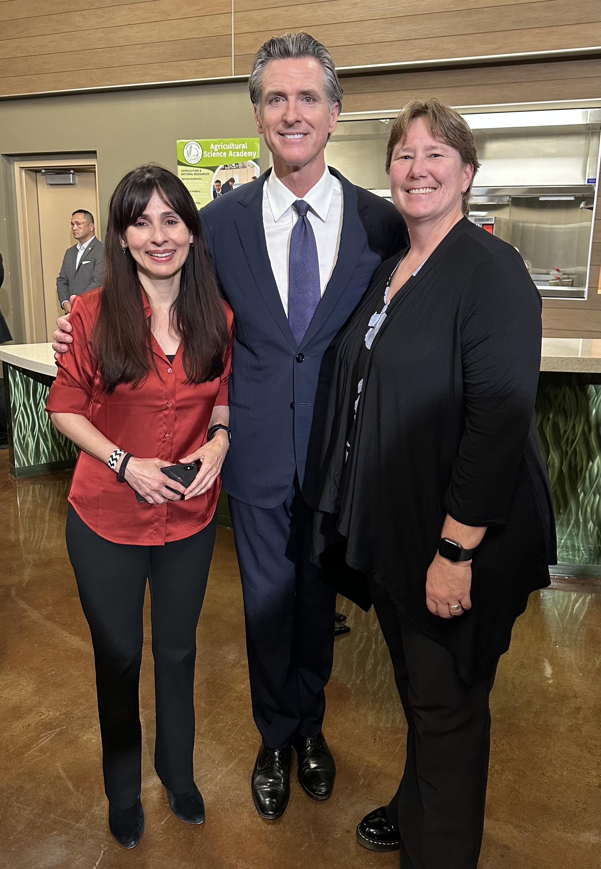
Vision 2030 at ASCCC
Our time is now!
California Community Colleges taking care of
our students, our communities, and our planet
November 17, 2023

Slide 2
Vision 2030 - Goals
Equity in Success
Equity in Access
Equity in Support

Slide 3
Vision 2030 - Pathways to Reach Future Learners
Veterans
Students who are justice-involved or justice-impacted
Working adults, our future learners
Bringing college to students
Foster youth
Dual enrollment
Notes:
Vision 2030 spotlights certain categories of students and future learners who continue to need focused attention responsive to legislation that was enacted where the implementation is not yet at scale or where new state and federal investments have been made in light of the pandemic’s impact on increasing income inequality and poverty.

Slide 4
Vision 2030 - Strategic Directions
Equitable Pathways
to Baccalaureate Attainment
Equitable Workforce
and Economic Development
Generative AI and the Future of Teaching and Learning
California Community Colleges are committed to the governor’s ambitious higher education goal of 70% postsecondary degree and certificate attainment among working-aged Californians by 2030.
Vision 2030 furthers the sector approach to workforce development through High Road Training Partnerships with a focus on hands-on training for career readiness.
The priority sectors are health care, climate, STEM and technology, education and early education.
Generative AI provides new opportunities and challenges for education.
Use of tools such as ChatGPT has become a part of students’ studying, research and more.
Future workforce implications with the expansion of AI

