Slide 1
Coffee Networking: Meet and Greet Thursday November 16, 2023 8:15am - 9:00am

Slide 2
Facilitators
Christopher J. Howerton, ASCCC At-Large Representative
Kathy Osburn, Antelope Valley College, ASCCC Relations with Local Senate Committee
María-José Zeledón-Pérez, ASCCC Area D Representative
Notes:
Each of us will introduce ourselves, our various roles, and what was your first plenary like, and what do you enjoy most about plenary experiences.

Slide 3
Session Description
Come share space and build community with us! Join members from the Relations with Local Senates Committee for an opportunity to meet other plenary session attendees, to discuss the upcoming plenary general and breakout sessions, and answer any logistics questions you might have. Bring your coffee, breakfast, and questions!

Slide 4
Session Agenda
Welcome and group introductions
Open questions and discussion

Slide 5
Welcome and Introductions
Name
College, discipline, and roles your serve on your campus
ASCCC Area?
Is this your first ASCCC Plenary?
What do you hope to get out of this event?

Slide 6
Questions and Discussion
What questions do you have about ASCCC or our Plenary Events?
Any emerging topics?

Slide 7
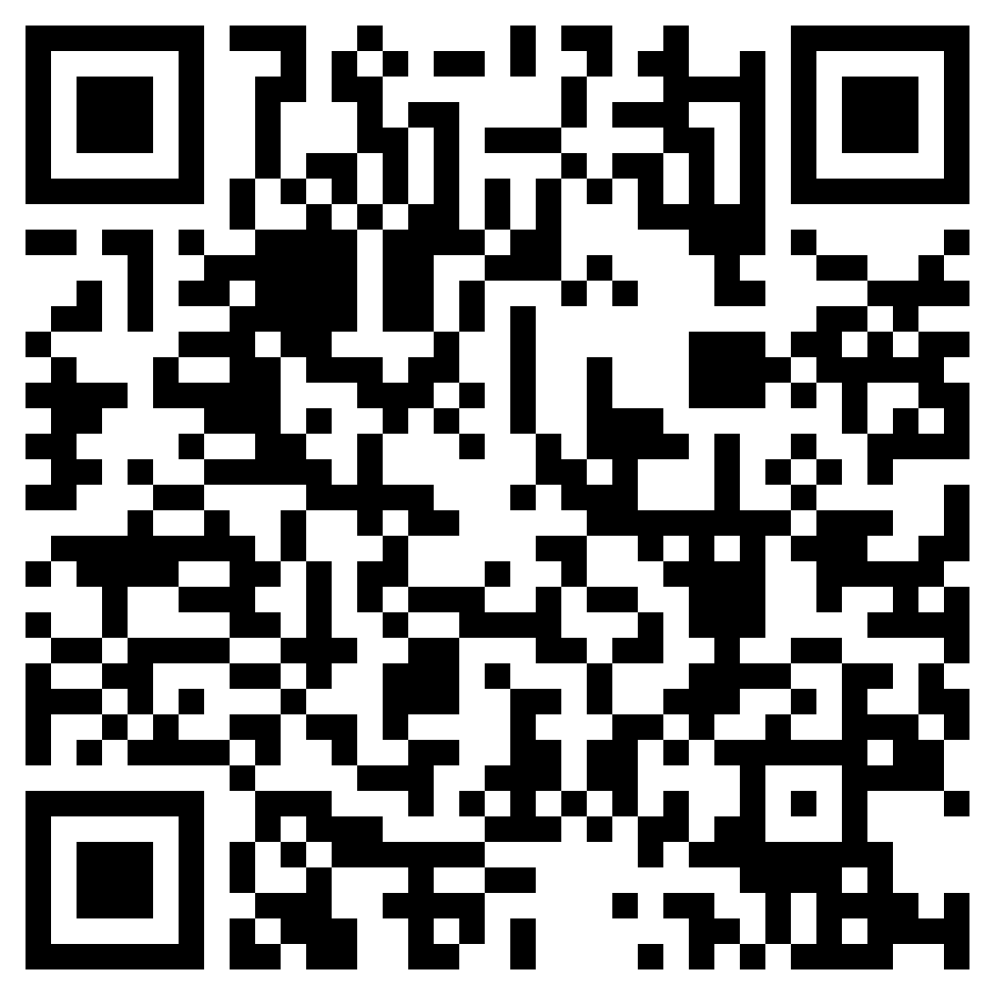
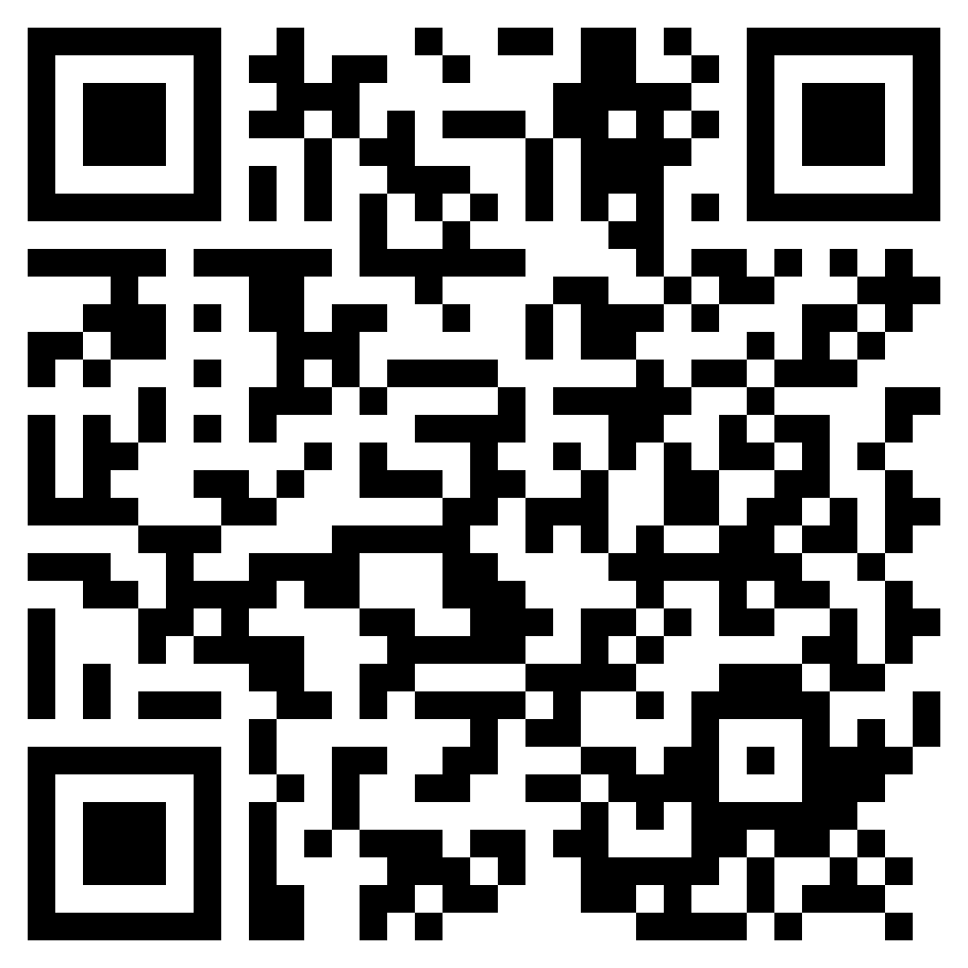
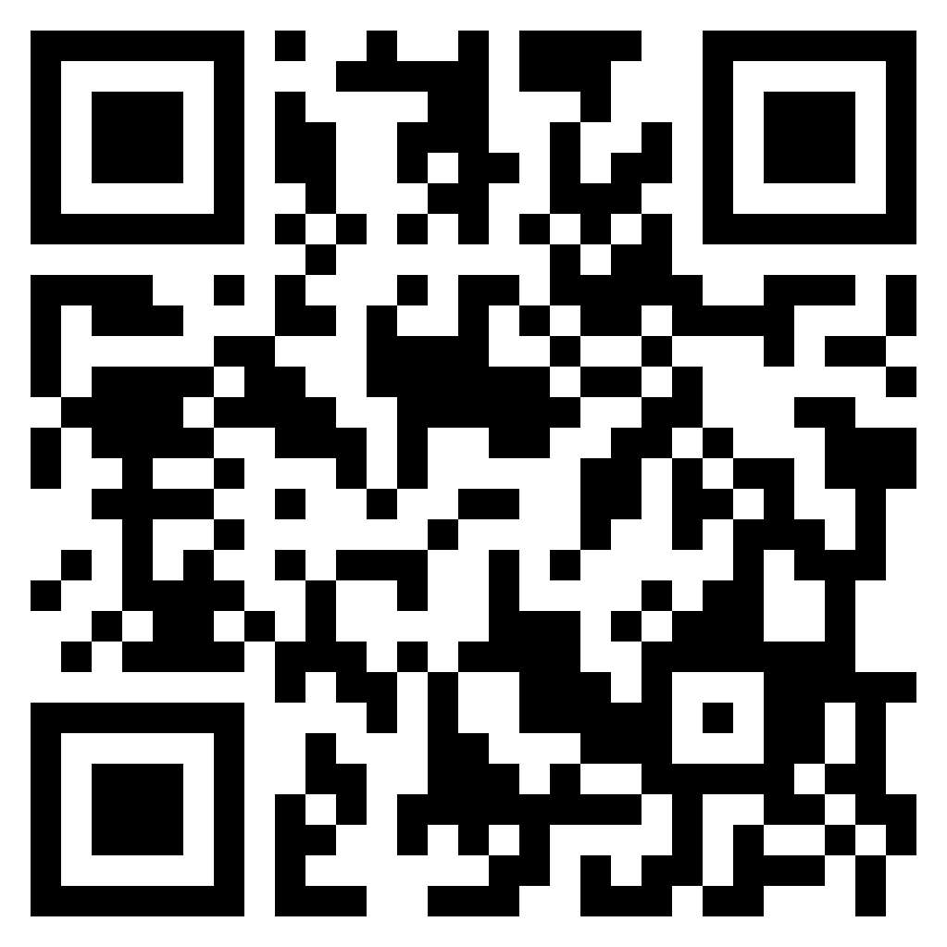
Resources
2023 New Delegate Information Packet
ASCCC Member Senate Area Map and List
2023 Fall Plenary Session Program

