Slide 1
Local Curriculum Processes - Closing the Loop on Curriculum Changes Shireen Awad, Curriculum Specialist, Chaffey College Dr. Angela Burk-Herrick, Curriculum Chair, Chaffey College Michelle Grimes-Hillman, Dean of Academic Affairs, Long Beach City Dr. Jennifer Zellet, Vice President of Instruction, Modesto Junior College 2020 Curriculum Institute

Slide 2
Before We Start…
WELCOME!
Please complete the “Who’s in the room?” poll in the Pathable platform.
Please use the chat room feature in the Pathable platform to ask questions that come up during the presentation at any time.
Notes:
Michelle

Slide 3
Description
In recent years, the California Community Colleges Chancellor’s Office has taken steps to streamline the curriculum review process for most curriculum proposals. Colleges should continue to examine local curriculum review processes to ensure that they are responsive to emerging student needs and recent legislative mandates. Additionally, as new curriculum is developed or deleted and existing curriculum is revised, there are downstream effects on a number of campus offices and, most importantly, on our students. This breakout explores the requirements for curriculum review and discusses effective practices for ensuring that curricular changes are broadcast to those who need to know.
Notes:
MICHELLE

Slide 4
Outline
CCCCO Streamlining
Streamlining Local Curriculum Processes
Streamlining workflow after Local Curriculum Approval
Reviewing COR through an Equity Lens
Curriculum Committee Training
Responding to Emergent Situations
Recommendations
Notes:
MICHELLE

Slide 5
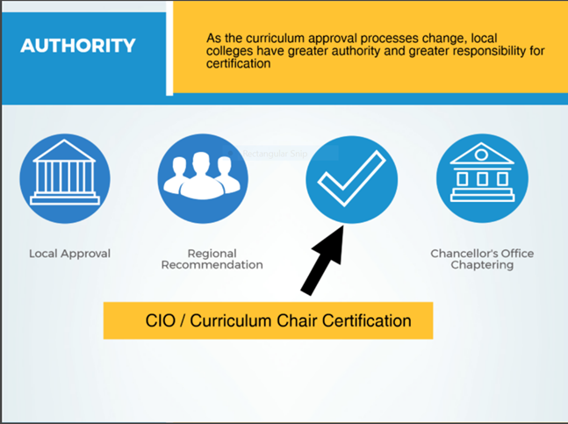
CCCCO Streamlining: 2016-2020
All credit courses (including cooperative work experience).
Noncredit course mods.
Modifications to all existing credit programs except for ADTs.
Note that changing program goal will require a new program submission.
New credit degrees and certificates with a program goal of local (not ADTs or CTE).
CO required a board policy on credit hour and COOP-ED plan on file.
Submissions still required for CO called “chaptering” for the above proposals.
Notes:
SHIREEN

Slide 6
Streamlining Local Curriculum Processes
In accordance with title 5, California Community Colleges have some autonomy over curriculum processes.
Processes include: local approval, local curriculum review, and local timelines and deadlines for submission.
All colleges must have a Curriculum Committee, but ad-hoc committees from the Curriculum Committee are up to the college (e.g., General Education Committee, Prerequisite Workgroup, and Technical Review Committee).
Notes:
SHIREEN

Slide 7
Streamlining Local Curriculum Processes
As the Chancellor’s Office continues to streamline curriculum processes, it is highly recommended that colleges review their local processes for streamlining benefits as well.
How many steps are in your local approval process (i.e., the workflow from origination to Governing Board approval)? (Chat Box)
Streamlining = reduction, rearrangement, and/or addition of steps to local processes.
Annual Curriculum Training to ensure compliance with the annual certification.
Notes:
SHIREEN

Slide 8
Curriculum Streamlining Throughout the Years (Example: Chaffey College)
Faculty Senate, Board Approval (final authority) after Curriculum Committee Review. This concludes local approval
COCI submission
Notes:
SHIREEN

Slide 9
What Happens Next?
The local curriculum process plants the seed for curriculum to grow and flourish inside the classroom as well as in other departments.
What departments are affected by Curriculum?
Admissions and Records
Degree Auditors
Counseling and Matriculation
Assessment
Articulation
Financial Aid
Distance Education Office
Guided Pathways Team
High School Partnerships
Marketing
More?
Notes:
Angela

Slide 10
Streamlining workflow AFTER Local Curriculum Approval
Process Overview (Example: Chaffey College)
Initial Brainstorm to sort “FYI” areas from “Action” areas
Follow-ups with “Action” areas (as needed)
Finalize Workflow
Notes:
Angela

Slide 11
Initial Brainstorm Results
Notes:
Angela

Slide 12
Initial Brainstorm Results cont’d
Notes:
Angela

Slide 13
Follow-Ups with Action Areas
Build out workflow to ID what they need/when
What will they be doing? For programs, courses (which courses?)
Is there other information they need from us? Does it involve work from other areas?
Establish area curriculum related workflow
Take time to understand how curriculum impacts other departments through individual meetings/conversations
Take new information and revise workflow charts
Notes:
Angela and Shireen
Discuss meeting with FA, A/R, Marketing
What does LIVE really mean?
For example: our email to everyone that about courses and programs being approved.
Curriculum Office is the first step but not the last.
Upon approval, how are departments notified of effective dates?
Just because a course/program is effective, does it mean it should be offered?
Depending on when a course is approved, it can take almost 1.5 years to get IGETC approval.
Student catalog rights
Important for Guided Pathways and Program Maps

Slide 14
Example: Action from Workflow Conversations
Notes:
Shireen

Slide 15
Final Workflow from Curriculum to Other Departments
Notes:
Shireen and Angela
Curriculum Office Role Boundaries/ Roles
Pass the Baton/Revisit as things change
Note: Initial charts should have everything laid out
Transition to Michelle

Slide 16
Reviewing COR Components through an Equity Lens
Curriculum Committee (T5 §55002 - 55002.5 elements of Credit COR)
Course Number and Title
Unit Value and Contact Hours – including “homework” hours
Requisites
Catalog Description
Objectives
Content
Methods of Instruction
Methods of Evaluation
Sample Assignments – Required Reading and Writing Assignments
Notes:
Michelle and Jennifer

Slide 17
Opportunities for Equity in Curriculum Review
Special procedures required for:
Limitations on Enrollment (prerequisites, corequisites, advisories, and conditions on enrollment)
Distance education
Access issues
Accessible software
Subcommittees may make recommendations to the full committee
Equity Audits
Notes:
Jennifer

Slide 18
Curriculum Committee Composition and Training
Equity and Committee Composition
Who sits on the Curriculum Committee?
Who sits on Tech Review?
What is the impact of committee composition on curriculum decisions?
Equity and Curriculum Committee Training
Annual Curriculum Committee Retreats
Curriculum Meetings
ASCCC Support
Notes:
Jennifer

Slide 19
Responding to Emergent Situations
Case Study: Modesto Junior College
Contingency Planning and DE Addenda
COVID-19 required us all to make contingency plans
Emergency Addenda for Spring, Summer, and Fall
Local Contingency Plans by December 2020
Faculty Concerns
Faculty desire contingency plans
Existing processes provided for permanent DE approval
Not all courses are intented for ongoing assignment to DE modality
Conditional use DE modality not able to be encoded on existing form
Notes:
Jennifer

Slide 20
Late Spring Pivot
Modification of Distance Education Addendum Form
ECO “Emergency Conditions Only”
Definition approved by Curriculum Committee and also Academic Senate
Plan
Summer meetings to approve DE Addenda Only in the meetings
Expanded meeting participation and made all decisions provisional until first full Curriculum Committee Meeting Fall 2020 (transparency)
Fulfill contingency planning for December Deadline
Notes:
Jennifer

Slide 21
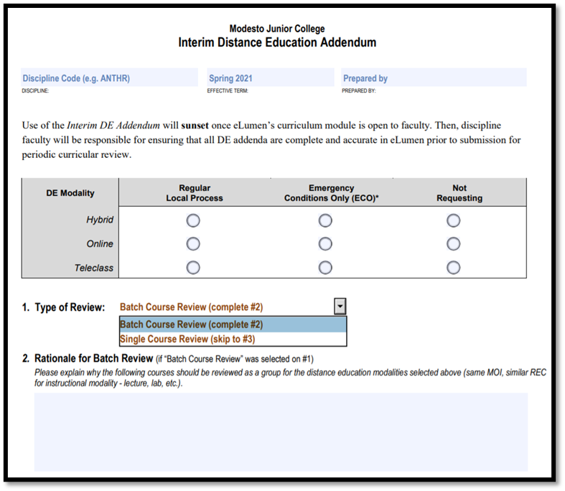
Summer Pivot
Evolution of the “Batch”
Sequential and “Like” Courses
Simplify work for Faculty
Same Form, different Drop Down
All while transitioning Curriculum Management Systems https://www.mjc.edu/governance/curriculum/
Notes:
Jennifer

Slide 22
Recommendations
Prepare timelines and calendars for your campus community regarding curriculum deadlines.
Monthly curriculum submissions to the local Board and COCI.
Create a workflow of curriculum impacts. Who do you pass the baton to?
Review curriculum with an equity lens.
Review ASCCC Website
Utilize ASCCC Representatives for help
Technical Visit (Request from Senate President)
Notes:
Shireen

Slide 23
Any Questions?
Thank you for attending this session!
Angela Burk-Herrick
angela.burkherrick@chaffey.edu
Jennifer Zellet
zelletj@mjc.edu
Michelle Grimes-Hillman
mhillman@lbcc.edu
Shireen Awad
sharon.awad@chaffey.edu

