Slide 1
Noncredit Progress Indicators, Data Collection, and Metrics
Dana Miho, Mt. San Antonio College
Shannon Rider, Mt. San Antonio College
Sachiko Oates, Santa Barbara City College
ASCCC Career and Noncredit Education Institute
April 25, 2019

Slide 2
Background
The method for measuring progress in noncredit
The interplay of proof of progress and funding
The role of CB21 coding
The need for progress indicators in noncredit

Slide 3
Rationale
Establish clear communication between institution MIS reporting and noncredit programs - provide the Chancellor’s Office and other stakeholders with clearer evidence of student success
Demonstrate, through statistics, that noncredit students progress
Report an accurate picture of noncredit student progress statewide
Validate the enhanced funding for noncredit Career Development and College Preparation (CDCP) courses

Slide 4
Noncredit Progress Indicators
Grades A through F - Currently being used in some noncredit programs (HS diploma programs and some CTE programs)
Pass (P): Satisfactory completion of course
No Pass (NP): Less than satisfactory completion of course
Satisfactory Progress (SP): Satisfactory progress towards completion of course - Specifically designed for the open-entry/open-exit instructional delivery system
Note:
Assigning progress indicators as “grades” - currently optional
BOG approval for SP into Title 5 § 55023 as a grade value for noncredit programs
Collected and submitted to MIS by institutions at their will

Slide 5
Classroom Assessment: Measuring Learning Gains
Test data demonstrating learning gains (quizzes, midterms, finals, etc.)
Course-level SLOs
CASAS, TABE, and other standardized assessments showing progress and learning gains
English Literacy and Civics (EL Civics) assessments
Faculty’s evaluation of a student’s participation and demonstrated classroom performance (attendance, class projects, presentations, writing samples, etc.)
Portfolio approach

Slide 6
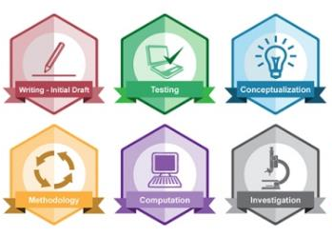
New ways to measure and recognize skills attainment
ePortfolios
Credit for Prior Learning
Digital badges
Micro credentials

Slide 7
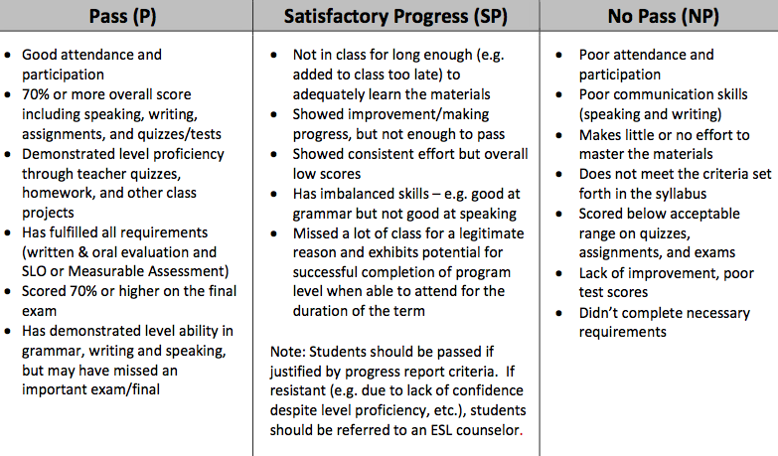
Maintaining Grading Consistency:
Program-wide Guidelines
English as a Second Language
English as a Second Language

Slide 8
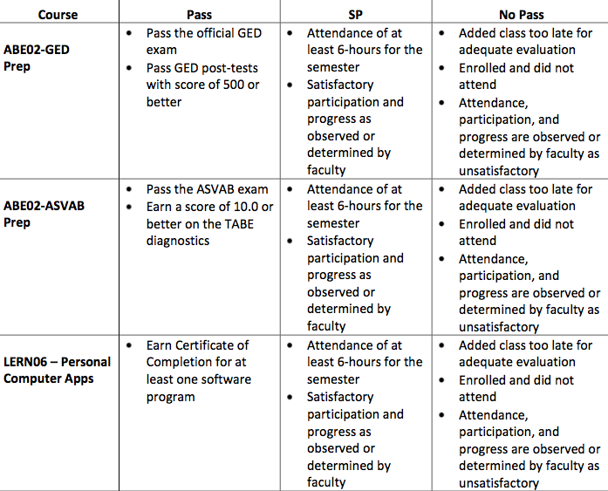
Adult Basic Education

Slide 9
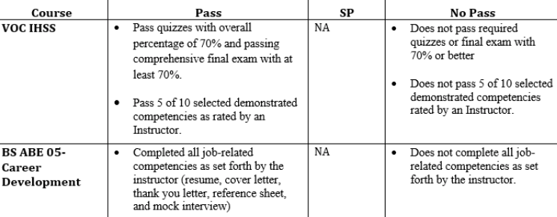
In-home Support Services/IHSS (Short term Vocational)

Slide 10
Implementation & Faculty Involvement
Educate faculty about the purpose and rationale of implementing progress indicators - faculty buy-in
Develop program-wide guidelines for assigning progress indicators - need to be a faculty driven process
Continued dialogue - review grading guidelines for effectiveness - department meetings, advisory group, in-services, etc.
Inform faculty about data and close the loop (use results to refine instruction)

Slide 11
Incorporating Progress indicators: Local Sis, Outcomes, and Metrics
Entry in SIS
Faculty enter progress indicators
End of each term
Local Data Queries
IR Staff/Other Staff
By term, year, longitudinal
Chancellor’s Office MIS
Reporting progress indicators to MIS
Statewide Noncredit Metrics

Slide 12
Incorporating Progress indicators: Local Sis, Outcomes, and Metrics
Entry in SIS
Student Outcomes:
learning, pass rates, course rigor
Local Data Queries
Student Journeys:
transition to credit, certificates
Compliance:
accreditation, grants, program review, assessment

Slide 13
Student Outcomes SCE Progress Indicators by Program
 | Progress |  |  |  |  |  | No Progress
 | Pass |  | Satisfactory Progress |  | Total Progress |  | No Pass |  | Dropped OR No Grade |  | Total No Progress
 | N | % | N | % | N | % | N | % | N | % | N | %
ABE | 1185 | 34 | 2299 | 66 | 3484 | 100 | 2 | 0 | 0 | 0 | 2 | 0
AHSD | 283 | 29 | 650 | 66 | 933 | 95 | 47 | 5 | 1 | 0 | 48 | 5
HSE | 93 | 19 | 406 | 81 | 499 | 100 | 0 | 0 | 0 | 0 | 0 | 0
HSR | 560 | 63 | 232 | 26 | 792 | 89 | 79 | 9 | 15 | 2 | 94 | 11
AWD | 28 | 2 | 1108 | 74 | 1136 | 75 | 304 | 20 | 66 | 4 | 370 | 25
EOA | 2738 | 16 | 13337 | 78 | 16075 | 94 | 164 | 1 | 918 | 5 | 1082 | 6
ESL | 6886 | 50 | 3208 | 23 | 10094 | 74 | 1143 | 8 | 2418 | 18 | 3561 | 26
VESL | 511 | 52 | 78 | 8 | 589 | 60 | 110 | 11 | 281 | 29 | 391 | 40
Health Careers | 298 | 79 | 1 | 0 | 299 | 80 | 20 | 5 | 57 | 15 | 77 | 20
STV | 336 | 82 | 0 | 0 | 336 | 82 | 28 | 7 | 46 | 11 | 74 | 18
STV Mirrored | 425 | 69 | 0 | 0 | 425 | 69 | 107 | 17 | 86 | 14 | 193 | 31
Voc Re-Entry | 1407 | 25 | 3576 | 64 | 4983 | 89 | 257 | 5 | 363 | 6 | 620 | 11
Total Records | 13343 | 33 | 21319 | 53 | 34662 | 85 | 2004 | 5 | 3888 | 10 | 5892 | 15
Notes:
In addition to assessment testing

Slide 14
Longitudinal Comparisons
 | 2015-16 |  |  | 2016-17 |  |  | 2017-18
 | Enrolled | Progress |  | Enrolled | Progress |  | Enrolled | Progress
 | N | N | % | N | N | % | N | N | %
ESL | 5390 | 4567 | 85 | 6089 | 5126 | 84 | 6852 | 6020 | 88
VESL | 314 | 209 | 66 | 251 | 182 | 73 | 556 | 441 | 80
STV | 109 | 82 | 75 | 148 | 132 | 89 | 312 | 269 | 86
Notes:
Could also break down by Levels, by semesters, etc.

Slide 15
VESL Transitions to Credit
Term | Cohort | Completed VESL 1 | V1 to credit | V2 to credit | V1 to CTE credit | V1 to CTE NC | VESL 2 to CTE credit | V2 to CTE NC | Total Transfers
Fall 2017 to Spring 2018 | AM | 26 | 19% | 12% | 0% | 15% | 0% | 4% | 50%
 | PM | 21 | 10% | 10% | 10% | 0% | 0% | 0% | 29%
 | Total | 47 | 15% | 11% | 4% | 9% | 0% | 2% | 40%
Term | Cohort | Completed VESL 1 | V1 to credit | V2 to credit | V1 to CTE credit | V1 to CTE NC | VESL 2 to CTE credit | V2 to CTE NC | Total Transfers
Spring 2018 to Fall 2018 | AM C1 | 21 | 24% | 5% | 0% | 19% | 0% | 0% | 48%
 | AM C2 | 27 | 33% | 7% | 0% | 7% | 0% | 0% | 48%
 | PM | 24 | 17% | 8% | 0% | 4% | 0% | 8% | 38%
 | Total | 72 | 25% | 7% | 0% | 10% | 0% | 3% | 44%

Slide 16
Student achievement data

Slide 17
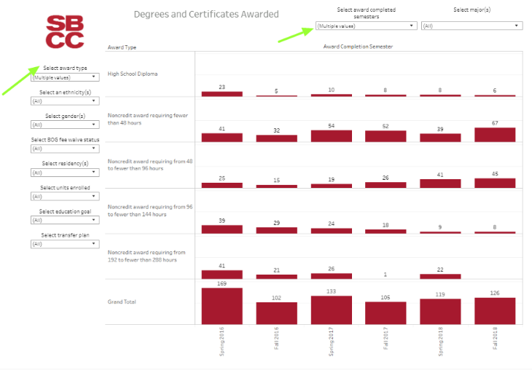
Noncredit Certificate completion

Slide 18
Mapping Progress indicators to MIS
Entry in SIS
Local Data Queries
Chancellor’s Office MIS
Map SIS Fields to MIS Data Elements
Upload to Chancellor’s Office

Slide 19
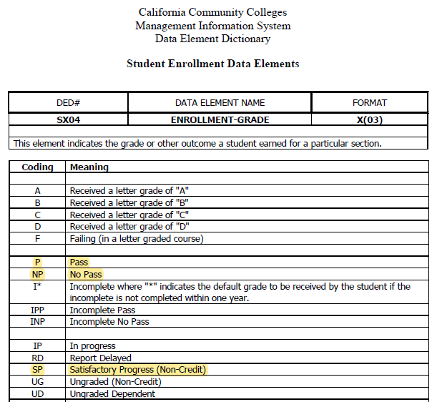
Progress Indicators to MIS to Metrics
Student Success Metrics
Strong Workforce
Adult Ed/ESL Pipeline
Short-Term Career Ed Pipeline
Notes:
statewide data system supported by the California Community Colleges Chancellor's Office and hosted by Cal-PASS Plus, provides data to California community colleges on progress, employment, and earnings outcomes for both CTE and non CTE pathways

Slide 20
challenges
Different Data Systems
Institutional Research
Complete reliance on part-time faculty

Slide 21
bibliography
https://www.newworldofwork.org/wp-content/uploads/2018/06/21st-Century-Skills-Badging_Article.pdf
https://foundationccc.org/What-We-Do/Workforce-Development/Workforce-Services/21st-Century-Skills-Badging
https://www.asccc.org/content/prior-learning-experience-credit-faculty-question
Davidson, D. (2016) Prior Learning Experience for Credit: A Faculty Question
http://caeconomy.org/reporting/entry/program-awarding-credit-for-experience-helps-fast-forward-college-for-worki
Ono, N. (2017). Program awarding credit for experience helps fast forward college for working Californians, CALIFORNIA ECONOMIC SUMMIT
https://www.asccc.org/papers/awarding-credit-where-credit-due-effective-practices-implementation-credit-exam
Valenzuela, I., MacIntyre, D. J., Klein-Collins, B., and Clerx, J. (2016). Prior Learning Assessment and Competency-Based Education: AN OVERVIEW OF PROGRAMS, POLICIES AND PRACTICES,
https://www.asccc.org/resolutions/ensuring-integrity-credit-exam-processes ACADEMIC SENATE FOR CALIFORNIA COMMUNITY COLLEGES, 2008 Fall Resolution Number: 09.05

Slide 22
Contact Information
Dana Miho
Professor, English as a Second Language
Mt. San Antonio College
dmiho@mtsac.edu
Shannon Rider
Strong Workforce Project Manager
Mt. San Antonio College
srider@mtsac.edu
Sachiko Oates
ESL Faculty Liaison
Santa Barbara City College
sooates@pipeline.sbcc.edu

