Slide 1
Noncredit Basics
ASCCC 2020 VIRTUAL CURRICULUM INSTITUTE
July 8, 2020

Slide 2
Presenter Introductions
Sam Foster, Ph.D.
South Representative, ASCCC
Chantée Guiney
Specialist, Educational Services and Support
California Community Colleges Chancellor’s Office
Neil Kelly
Specialist, Workforce and Economic Development
California Community Colleges Chancellor’s Office

Slide 3
Learning Outcomes
In this session you will gain an understanding of…
Considerations for your college to incorporate noncredit courses and programs into curriculum offerings
The basics of noncredit curriculum, including an introduction to terms like Career Development and College Preparation (CDCP) noncredit the ten instructional categories,
The possibilities for integrating noncredit into instructional programs
Adult Education
Faculty perspectives on noncredit
and much more!

Slide 4
Presentation Overview
Icebreaker Activity
The Equity Imperative
Background
Noncredit Curriculum
Interactive Activity
Faculty Perspectives
Noncredit Adult Education Programs
Resources
Q & A

Slide 5
Vision for Success
Core Commitments
Increase credential obtainment by 20%
Increase transfer by 35% to UC and CSU
Decrease unit obtainment for a degree
Increase employment for CTE students
Reduce and erase equity gaps
Reduce regional gaps
Focus on students’ goals
Design and decide with the student in mind
Pair high expectations and high support
Evidence-based decisions
Own student performance
Enable innovation and action
Cross-system partnership
Notes:
Completion- Most students who enter a community college never complete a degree or certificate or transfer to a 4-year university
Time to Degree-CCC students who do reach a defined educational goal such as a degree or transfer take a long time to do so, often accumulating many excess course credits along the way
Achievement gaps persist across the CCCs and high-need regions of the state are not served equitably

Slide 6
Call to Action for Equity
Systemwide review of police and first responder training and curriculum.
Campus leaders host open dialogue and address campus climate.
Campuses audit classroom climate and create an action plan to create inclusive classrooms and anti-racism curriculum.
District Boards review and update your Equity plans with urgency.
Shorten the time for the full implementation of the DEI Integration Plan
Engage in the Vision Resource Center “Community Colleges for Change.”

Slide 7
BREAKING THE ICE!
Please answer each “pre-presentation” poll question
Notes:
How would you rate your knowledge of noncredit…
Ratings
1-2: Very limited or no information about noncredit
3-4: Little experience with noncredit
5: Expert

Slide 8
Noncredit Curriculum
Chantée Guiney, Chancellor’s Office

Slide 9
Noncredit Curriculum Overview
Background
Noncredit Courses
Noncredit Programs
Resources

Slide 10
Background

Slide 11
What is Noncredit? short history and guiding philosophy
Noncredit instruction evolved from the first adult school in California in 1865
For students with diverse backgrounds, noncredit education is an important contributor to “open access” within the CCC system
Offers students access to a variety of low and no-cost courses
Noncredit courses often serve as a first point of entry for those who are underserved, as well as a transition point to prepare students for credit instruction and the workforce
Courses focus on skill attainment, not grades or units
Flexible course scheduling and open entry/exit options for students who are working and managing college simultaneously
While not all colleges offer a variety of noncredit courses, most do offer noncredit supervised tutoring
Suggested noncredit resources include the Program and Course Approval Handbook (PCAH) and publications by the Academic Senate for California Community Colleges (ASCCC)

Slide 12
What is Noncredit? guiding philosophy
Flexible
Open Entry/Open Exit
Equity Centered
Open Access
Low and no-cost courses
Competency Focused
Prepares students for credit instruction and workforce opportunities
Focus is on skill attainment, not grades or units
First point of entry for underserved students
Flexible course scheduling

Slide 13
Noncredit Flexibility
College
Workplace
Communities
Access
Open Entry/
Open Exit
Pass/No Pass
Satisfactory Progress
Notes:
CG
The components that contribute to the dynamic flexibility of noncredit

Slide 14
Noncredit Courses

Slide 15
Noncredit Instructional Categories Eligible for Apportionment
[EC § 84757; Title 5 § 58160] | [CDCP: EC § 84760.5; Title 5 § 55151]
Noncredit Course Categories
ESL
Immigrant Education
Elementary and Secondary Basic Skills
Health and Safety
Substantial Disabilities
Parenting
Home Economics
Older Adults
Short-term Vocational
Workforce Preparation
STREAMLINED APPROVAL!
Noncredit courses are approved by districts and “chaptered” by CCCCO via the CO Curriculum Inventory (COCI)
Note: A noncredit instructional category that is outlined/circled in red denotes an instructional category in which eligible noncredit courses may be sequenced to lead to a Career Development and College Preparation (CDCP) (“enhanced funding”) certificate program, pursuant to
Ed Code § 84760.5.
Refer to PCAH for specific curriculum submission requirements applicable to each category
Notes:
Noncredit course categories that are eligible for State apportionment, per EDC section 84757 (9 categories defined in EDC; 10th category (workforce preparation) defined in Title 5 section 55151)
Underlined categories are CDCP enhanced funding (EDC 84760.5(b); Title 5 section 55151 – CDCP)

Slide 16
Noncredit Course Outline of Record (COR)
All courses are required to have an official course outline of record
Current CORs must be maintained in the official college files (paper or electronic database) and made available to each instructor.
COR must meet standards in title 5, § 55002 (c) and contain components described in subsectiNoncrediton (2):
“[(2)] Course Outline of Record. The course is described in a course outline of record that shall be maintained in the official college files and made available to each instructor. The course outline of record shall specify the number of contact hours normally required for a student to complete the course, the catalog description, the objectives, contents in terms of a specific body of knowledge, instructional methodology, examples of assignments and/or activities, and methods of evaluation.”
The COR of noncredit distance education courses must specify the expected hours of outside-of-class student work: “[o]utside-of-class work expected as noted in the course outline of record…” (CCR Title 5, § 58003.1 (f)(2))
Notes:
COCI COURSE RECORD SECTION IS “COURSE DETAILS” AND THE FIELDS INCLUDE: TRANSFER STATUS; COURSE BASIC SKILLS STATUS (CB08); STUDENT ACCOUNTABILITY MODEL (SAM) PRIORITY CODE (CB09); COURSE COOPERATIVE WORK EXPERIENCE STATUS (CB10); COURSE CLASSIFICATIONSTATUS (CB11); EDUCATIONAL ASSISTANCE CLASS INSTRICTION – APPROVED SPECIAL CLASS (CB13); COURSE PRIOR TO TRANSFER LEVEL (CB21); NONCREDIT CATEGORY (CB22); FUNDING AGENCY CATEGORY (CB23); COURSE PROGRAM STATUS (CB24); COURSE GENERAL EDUCATION STATUS (CB25); SUPPORT COURSE STATUS (CB26).
COCI COURSE LINK: https://coci2.ccctechcenter.org/admin/courses/detail/386452

Slide 17
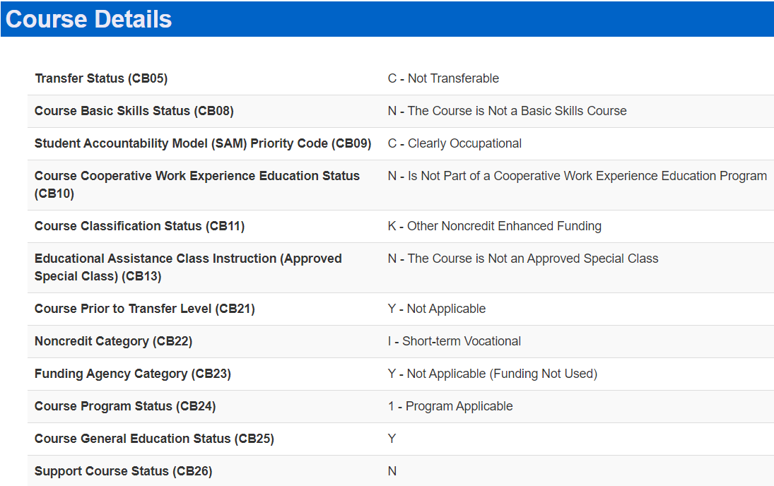
CDCP validation field
Refer to MIS Data Element Dictionary for specific noncredit data integrity and relationships
Notes:
COCI COURSE RECORD SECTION IS “COURSE DETAILS” AND THE FIELDS INCLUDE: TRANSFER STATUS; COURSE BASIC SKILLS STATUS (CB08); STUDENT ACCOUNTABILITY MODEL (SAM) PRIORITY CODE (CB09); COURSE COOPERATIVE WORK EXPERIENCE STATUS (CB10); COURSE CLASSIFICATIONSTATUS (CB11); EDUCATIONAL ASSISTANCE CLASS INSTRICTION – APPROVED SPECIAL CLASS (CB13); COURSE PRIOR TO TRANSFER LEVEL (CB21); NONCREDIT CATEGORY (CB22); FUNDING AGENCY CATEGORY (CB23); COURSE PROGRAM STATUS (CB24); COURSE GENERAL EDUCATION STATUS (CB25); SUPPORT COURSE STATUS (CB26).
COCI COURSE LINK: https://coci2.ccctechcenter.org/admin/courses/detail/386452

Slide 18
Noncredit Programs
Notes:
CG

Slide 19
Noncredit Programs
NONCREDIT PROGRAMS
Certificate of Competency
Certificate of Completion
Adult High School Diploma
(AHSD)
Noncredit Pre-apprenticeship
STREAMLINED APPROVAL!
Noncredit programs are approved by districts and “chaptered” by CCCCO via the CO Curriculum Inventory (COCI). Streamlined approval does not include CDCP programs in the instructional domain of “short-term vocational with high employment potential”; CCCCO review and approval is required
Note:
Programs circled in red are CDCP (Career Development and College Preparation).
CO “approval” is currently required for CDCP programs in the instructional domain of short-term vocational with high employment potential. The short-term vocational CDCP program is in the certificate of completion group
[References: EC 84760.5; Title 5, 55151]
The underlined programs are eligible for CDCP enhanced funding, EDC 84760.5 (b)
Notes:
- Noncredit Programs, Title 5 section 55155
- Underlined programs are CDCP (EDC 84760.5; Title 5 section 55151)
- AHSD, see Title 5 section 55154

Slide 20
Career Development and College Preparation (CDCP) Programs
Edu Code 84760.5 (b) -
Limits CDCP eligibility to courses in the following instructional domains:
Workforce Preparation
* Short-term Vocational
With High Employment Potential
Elementary and Secondary Basic Skills
English as a second language (ESL) and
vocational English as a second language
*CCCCO approval is required
Certificate of Completion
Title 5,
§ 55151(h)
Career Development
Certificate of Competency
Title 5,
§ 55151(i)
College Preparation
Notes:
Education Code section 84760.5 provides the fundamental framework for defining CDCP noncredit courses and classes that are eligible for enhanced funding.
Only courses subject to subdivision (b) of 84760.5 are eligible for enhanced funding, which limits eligibility to the following:
- Classes and courses in elementary and secondary basic skills;
- Classes and courses for students eligible for educational services in workforce preparation classes in the basic skills of speaking, listening, reading, writing, mathematics, decision-making and problem-solving skills that are necessary to participate in job-specific technical training;
- Short-term vocational programs with high employment potential, as determined by the California Community Colleges chancellor in consultation with the Employment Development Department utilizing job demand data provided by that department; and
- Classes and courses in English as a second language and vocational English as a second language.

Slide 21
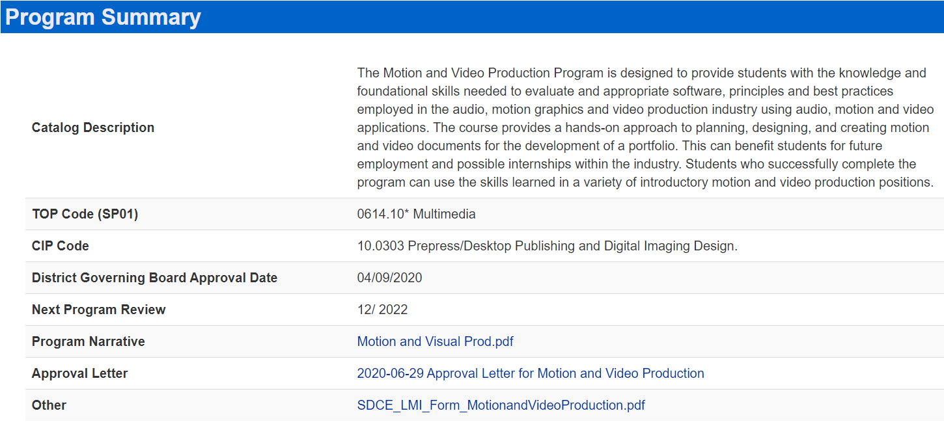
CO Curriculum Inventory - Noncredit Certificate Program Detail Screen
CTE must describe jobs program can lead to
Must coincide with record fields and Narrative
*
CTE Vocational TOP Code
4-item Narrative per the PCAH
Notes:
COCI PROGRAM RECORD SECTION IS THE “PROPOSAL SUMMARY” AND THE FIELDS INCLUDE: CATALOG DESCRIPTION; TOP CODE; CIP CODE; DISTRICT GOV. BOARD APPV’L DATE; NEXT PROGRAM REVIEW; PROGRAM NARRATIVE; APPROVAL LETTER; and a field titled, “OTHER” that serves as a space for colleges to attach supporting documentation; as you can see in the certificate example that is shown here, the supporting documentation attached to the record is the “LMI” (Labor Market Information); in accordance with ED 84760.5 (CDCP statute) the CCCCO must verify that CDCP certificate proposal submissions in the “Short-term Vocational with High Employment Potential” instructional domain includes evidence of high employability (the LMI, preferably from State of CA Employment Development Dept. (“EDD”); the LMI analysis should be per the colleges’ local county or region.
COCI PROGRAM LINK: https://coci2.ccctechcenter.org/admin/programs/detail/49691

Slide 22
Noncredit Course and Program Approvals in 2020
STOP: Needs CO Approval before chaptering:
All CDCP certificate programs in the domain of short-term vocational (includes new and modified and includes new and modified apprenticeship)
GO: Does NOT need CO approval before chaptering:
CDCP certificates in the domains of ESL, Workforce Preparation, and Elementary & Secondary Basic Skills (new and modified)
AHSD - Adult High School Diploma Programs (new and modified)
All noncredit courses (new and modified)

Slide 23
Resources for Curriculum Specialists
CCCCO Educational Services Division - Curriculum & Instruction Unit
https://www.cccco.edu/About-Us/Chancellors-Office/Divisions/Educational-Services-and-Support/What-we-do/Curriculum-and-Instruction-Unit
Program and Course Approval Handbook (PCAH), 7th Ed
https://www.cccco.edu/-/media/CCCCO-Website/Reports/CCCCO_Report_Program_Course_Approval-web-102819.pdf?la=en&hash=06918DD585E9F8C0805334FEA3EB1E6872C22F16
TOP-CIP Crosswalk (June 2020)
https://www.cccco.edu/-/media/TOPCIP2020June.xlsx?la=en&hash=8A4217DB70CFD069AFD2F4876E173E8EC65C482F
California Education Code
https://www.cccco.edu/About-Us/Chancellors-Office/Divisions/General-Counsel/Programs
CCR Title 5 (Ch. 6 – Curriculum, Ch. 7 – Special Programs, Ch. 9 – Fiscal Support)
https://www.cccco.edu/About-Us/Chancellors-Office/Divisions/General-Counsel/Programs
The Course Outline of Record: A Curriculum Reference Guide (ASCCC)
http://www.asccc.org/node/175016
CO MIS: Data Mart | CO MIS Data Element Dictionary (CB Data Elements)
http://extranet.cccco.edu/Divisions/TechResearchInfoSys/MIS.aspx
Chancellor’s Office Curriculum Inventory (COCI)
https://coci2.ccctechcenter.org/admin/courses/review/374561

Slide 24
Curriculum Team by Region
Name and Email | Region
Patti Blank pblank@cccco.edu | Macro Region A (Northern Inland, Northern Coastal, Lake Tahoe)
David Garcia dgarcia@cccco.edu | Macro Region A (Greater Sacramento) Macro Region E (San Diego/Imperial)
Chantee Guiney cguiney@cccco.edu | Macro Region B (North Bay, Mid-Peninsula, Silicon Valley, Santa Cruz/Monterey)
Zitlali Torres ztorres@cccco.edu | Region B (East Bay)
Kevin Lovelace klovelace@cccco.edu | Region C (Central Valley)
Kevin Olson kolson@cccco.edu | Region D (South Central Coast) Region F (Inland Empire/Desert)
Njeri Griffin ngriffin@cccco.edu | Region G (Los Angeles/Orange County)
Please check CCCCO curriculum webpage for periodic updates

Slide 25
We are here to support you
Noncredit – Chantee Guiney (cguiney@cccco.edu); Neil Kelly (nkelly@cccco.edu)
ADT – Kevin Olson (kolson@cccco.edu); Njeri Griffin (ngriffin@cccco.edu)
Financial Aid – Gina Browne (gbrowne@cccco.edu)
Apportionment - Wrenna Finche (wfinche@cccco.edu)
Articulation – Bob Quinn (bquinn@cccco.edu); Devin Rodriguez (drodriguez@cccco.edu)
Competency Based Education – Chantee Guiney (cguiney@cccco.edu)
Credit for Prior Learning – Chantee Guiney (cguiney@cccco.edu)

Slide 26
Final Activity
Please answer each “post-presentation” poll question
Notes:
Final activity How would you rate your knowledge of noncredit…
Ratings
1-2: Very limited or no information about noncredit
3-4: Little experience with noncredit
5: Expert

Slide 27
Faculty Perspective
Sam Foster, ASCCC

Slide 28
Considerations - Noncredit Courses
While there are no registration fees for noncredit courses, other fees may be charged
Materials fees may be charged
Must meet the same standards of documentation as materials fees for credit courses
Many colleges try to limit or eliminate materials fees using grant and categorical funding (SEA, CAEP, SWF, etc)
Noncredit courses may require textbooks, but many colleges consider no- and low-cost alternatives
Classroom sets
OER
Lending library
Grant funding
Notes:
(CA/CG)

Slide 29
Minimum Qualifications
Title 5 § 53412 lists the minimum qualifications (MQs) to teach noncredit. Although some MQs are the same as for credit instruction (i.e., §53410), some areas have different MQs including: Basic skills mathematics and English, English as a Second Language, heath and safety, citizenship, home economics and older adults
The Minimum Qualifications Handbook (also called the Disciplines List) details the requirements
Notes:
SAM

Slide 30
Faculty Considerations
Noncredit faculty face unique challenges
Many noncredit classes are taught in an open-entry/open exit environment, with students entering the class at different points without the benefit of developing earlier foundational skills
Varying gaps in the academic knowledge of adult students creates a wide spectrum of abilities present in most noncredit classes
Pedagogy becomes increasingly important
Instructors need to scaffold lessons for different groups in the same classroom
Different teaching strategies are needed to enable students to succeed, particularly given that many of the students have failed traditional basic skills classes in mathematics and English or are English language learners
Talents/qualities of an effective noncredit instructor (understanding of noncredit student)
Notes:
(CA)

Slide 31
Partnerships Between Credit and Noncredit
Noncredit Support Courses. These courses are designed together with credit faculty to support students who are currently enrolled or are preparing to enroll in credit courses.
Some options include
Corequisite support courses
Modularized support courses
Intensive review courses
Mirrored courses

Slide 32
Corequisite Noncredit Course
Common Features
Students enroll in the class for free
Students can be required to enroll
Students don’t accumulate excess units
Courses could be scheduled as open entry/open exit or regularly scheduled times
Student can reenroll in the support course until they pass the transfer course

Slide 33
Modularized Support
Colleges can create modularized courses (particularly using noncredit) that would allow the student to get help with a specific issue at any point during the semester (depending on how the college schedules them).
A student could access as many or as few modules as they need during the term.

Slide 34
Intensive Review
Colleges can create intensive review courses that could be offered during the summer session (or winter intersession) for students to catch up before entering the transfer level.
As a noncredit course, it can be easily scheduled to begin at any time during the term (open entry/open exit).
These courses are typically optional, but they could be a way for students to refresh their skills and build confidence before the semester.

Slide 35
Mirrored Credit and Noncredit Courses
Colleges can have equivalent versions of credit and noncredit courses (usually seen in ESL or short term vocational).
These courses are scheduled at the same time, with a credit instructor. Usually 3-5 noncredit seats are reserved.
These types of courses can be helpful for students that are transitioning from noncredit to credit.

Slide 36
From Noncredit to Credit: Providing a Guided Pathway for Students
For noncredit students seeking to transition into credit programs transition specialists can provide an important safety net. Some crucial areas of support include:
Career and academic counseling
Financial aid services
Academic support including tutoring
Supportive Services such as CalWORKs, CAEP, EOPS and DSPS

Slide 37
Working Together to Support Students
Partnerships between credit and noncredit faculty can be an effective way to help students meet their educational goals
Courses that build bridges between credit and noncredit can be a way to introduce noncredit offerings to faculty that typically teach credit courses

Slide 38
Neil Kelly

Slide 39
Noncredit / Adult Education Fund Sources
Noncredit funding mechanism – apportionment, CDCP, and non-enhanced.
California Adult Education Program – regional apportionment, needs based
WIOA II – grant funds based on payment points
Others: Contractual Services, CalWORKs, Perkins, & Strong Workforce

Slide 40
Noncredit / Adult Education Fund Sources – Recent Survey 18-19 fund sources
A recent survey of community college noncredit programs:
60% of their funding came from noncredit funding mechanism – apportionment, CDCP, and non-enhanced.
25% of their funding came from the California Adult Education Program.
7% of their funding came from the WIOA II grant.
Remaining 8% was combination of in-kind, CalWORKs, Contracts, Perkins, & SWP.

Slide 41
Noncredit / Adult Education Fund Sources
Noncredit funding mechanism – ten program areas.
California Adult Education Program – seven program areas (doesn’t include older adults, home economics, and health & safety).
WIOA II – three program areas – ESL, & Basic skills (adult basic & adult secondary education)

Slide 42
Non Credit Student Data Reporting

Slide 43
LaunchBoard www.calpassplus.org/Launchboard/Adult-Education-Pipeline.aspx
Notes:
Major dashboards -

Slide 44
What is the LaunchBoard?
Statewide suite of dashboards supported by the Community College Chancellor's Office and hosted by Cal-PASS Plus, provides data on progress, employment, and earnings outcomes for community college pathways, adult education, and K14 career pathways.
This information is intended to facilitate local, regional, and statewide conversations about how to foster economic mobility.
Notes:
Suite of dashboards; kind of data (actionable

Slide 45
Fast Facts
Practitioner Driven – Designed to improve educational practice
Display Types – Student Journeys or Education Reform Key Metrics
Uses Public Data Sets – Leverages CC, AE, K12, EDD other data
Matches Data to Track Transition – AE/CC; K12/CC; CC/LMI
Compares institutions, regions, state level data
Disaggregated by ethnicity, age, gender, program

Slide 46
LaunchBoard Tools Relevant for Noncredit Programs
Student Success Metrics
Build 2.6 March 2020
Any student with enrollment record (value in SX)
Organized around student journeys – Adult Ed/ESL; Short Term CTE, Degree Transfer, Undecided, All
College Pipeline
Build 3.0 April 2020
Includes noncredit filter to only look at NC programs
Includes noncredit students with 12+ Instr hours (SX05)
Adult Education Pipeline
Build 3.0 Feb 2020
Matches unitary student records from TE/COMIS
Reports progress & outcomes for students with 12+ Instr hours in TE or MIS
Notes:
Major dashboards -

Slide 47
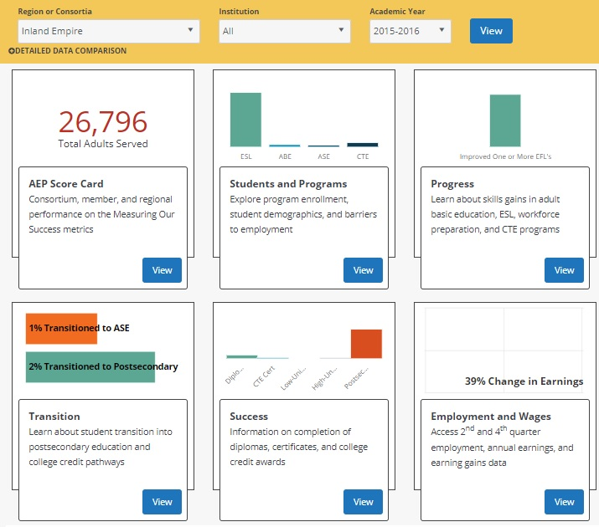
Adult Education Pipeline

Slide 48
Visualize by region, institution, year
Six high level live metrics on (tiles) organized by student momentum points
CAEP Score Card with Measuring our Success reporting metrics
Summary infographic in each page focused on a key data point or question
Detailed data charts and tables with:
Additional AE Key Metrics
Multiple disaggregations
Time trends
Comparison view in Detailed Data View

Slide 49
Two Systems – Three Data Scenarios
What are the Data Systems Used for CAEP Reporting?
Adult Education
Community
Colleges
CC Noncredit
Programs
Data reported through regular MIS reporting by the colleges
Data reporting through CASAS TOPSpro Enterprise
New MIS Elements align data collected through TOPSpro and MIS for accurate display of data for both systems in the LaunchBoard AE Pipeline.
Notes:
We’re closely aligned in some places and there are some places that the concepts do not translate. LB is going to be used as the source to document methodology for funding.

Slide 50
CAEP Reporting Requirements or Colleges(19/20)
What are the CAEP Reporting Requirements?
MIS Data Collection: College Districts required to collect and enter all required CAEP adult learner student, enrollment, and other data into MIS
Data Uploads: Data uploads occur as part of the colleges regular data upload to COMIS. There is no separate reporting process for college noncredit data.
WIOA Title II Reporting: Colleges receiving WIOA Title II funds must report quarterly through TOPSpro Enterprise as required by CDE
TE Reporting for Non-WIOA II Colleges: Colleges may ALSO use TOPSpro to report students who do not have a record in MIS
Primary Data Source: For every student with an MIS record, MIS is the PRIMARY VALIDATED source for student, course, enrollment, and outcome data

Slide 51
Vision for Success and Noncredit

Slide 52
Vision for Success
Core Commitments
Increase credential obtainment by 20%
Increase transfer by 35% to UC and CSU
Decrease unit obtainment for a degree
Increase employment for CTE students
Reduce and erase equity gaps
Reduce regional gaps
Focus on students’ goals
Design and decide with the student in mind
Pair high expectations and high support
Evidence-based decisions
Own student performance
Enable innovation and action
Cross-system partnership
Notes:
Completion- Most students who enter a community college never complete a degree or certificate or transfer to a 4-year university
Time to Degree-CCC students who do reach a defined educational goal such as a degree or transfer take a long time to do so, often accumulating many excess course credits along the way
Achievement gaps persist across the CCCs and high-need regions of the state are not served equitably

Slide 53
Noncredit and the Vision for Success / SCFF
Chancellor’s Office Priorities: Student Centered Formula Funding (SCFF)
Student Centered Formula Funding – Tracking noncredit student data in the LaunchBoard, Student Success Metrics, and the Adult Education Pipeline.
Field Workshops & Webinars on student data, data platforms & dashboards, and how it connects to SCFF.

Slide 54
Noncredit and the Vision for Success / Guided Pathways
Chancellor’s Office Priorities: Guided Pathways
Addresses the equity gaps by strengthening the awareness and knowledge of how noncredit and equity are a major issue within the reform agenda and initiatives.
Partner with Guided Pathway Coordinators on building pathways to noncredit and K12 adult education.
Use the Guided Pathway Coordinators to develop noncredit best practices.

Slide 55
Noncredit and the Vision for Success / AB705
Chancellor’s Office Priorities: AB705
Offer CB21 Revision workshops to noncredit practitioners with the focus on improving the transition of adult education & noncredit students into credit coursework (AB705).
Utilize the LaunchBoard Adult Education Pipeline data on AB705 and Guided Pathways to identify continuous improvement and model practices.

Slide 56
Noncredit and the Vision for Success / Financial Aid
Chancellor’s Office Priorities: Financial Aid / Non-Resident Fees
Promote awareness of federal Ability to Benefit (ATB) for students without a high school diploma who could qualify for federal aid.
Promote SB554, SB68, and AB540 to support waiving nonresident fees for noncredit students.

Slide 57
Noncredit Supports
Academic Senate CCC
http://asccc.org
CCC Chancellor’s Office
http://cccco.edu
Vision Resource Center https://visionresourcecenter.cccco.edu/
California Adult Education Program website https://caladulted.org/
Association of Community and Continuing Education (ACCE) http://www.acceonline.org/
California Council of Adult Educators (CCAE) https://www.ccaestate.org/
LaunchBoard https://www.calpassplus.org/LaunchBoard/Home.aspx

Slide 58
Presenter Contact Information
Sam Foster
SFoster@fullcoll.edu
Chantée Guiney
cguiney@cccco.edu
Neil Kelly
nkelly@cccco.edu

Slide 59
Thank you!

