Slide 1
Area A Meeting – June 19, 2020

Slide 2
Today’s Agenda
Introductions
Area Meeting Review
Resolutions
Resources

Slide 3
Area A Introductions
Please add the following to the Chat:
Your name
Your college
Your leadership role at your college
Add any questions, comments, or ideas you have throughout today’s session in the Chat area.

Slide 4
AREA A – 29 Colleges
American River College
Bakersfield College
Butte College
Cerro Coso College
Clovis Community College
Columbia College
Cosumnes River College
Feather River College
Folsom Lake College
Fresno City College
Lake Tahoe Community College
Lassen College
Madera Community College
Merced College
Modesto Junior College
Porterville College
College of the Redwoods
Reedley College
Sacramento City College
San Joaquin Delta College
College of the Sequoias
Shasta College
Sierra College
College of the Siskiyous
Taft College
West Hills College Coalinga
West Hills College Lemoore
Woodland Community College
Yuba College
Notes:
Area A runs from the Oregon border through the Central Valley to Bakersfield

Slide 5
AREA B – 29 Colleges
College of Alameda
Berkeley City College
Cabrillo College
Canada College
City College of San Francisco
Chabot College
Contra Costa College
De Anza College
Diablo Valley College
Evergreen Valley College
Foothill College
Gavilan College
Hartnell College
Laney College
Las Positas College
Los Medanos College
College of Marin
Mendocino College
Merritt College
Mission College
Monterey Peninsula College
Napa Valley College
Ohlone College
San Jose City College
College of San Mateo
Santa Rosa Junior College
Skyline College
Solano College
West Valley College
Notes:
Area B encompasses the Greater Bay Area, from Mendocino to Monterey

Slide 6
AREA C – 26 Colleges
Allan Hancock College
Antelope Valley College
College of the Canyons
Cerritos College
Citrus College
Compton College
Cuesta College
East Los Angeles College
El Camino College
Glendale College
Los Angeles City College
Los Angeles Harbor College
Los Angeles Mission College
Los Angeles Pierce College
Los Angeles Southwest College
Los Angeles Trade Technical College
Los Angeles Valley College
Moorpark College
Mt. San Antonio College
Oxnard College
Pasadena City College
Rio Hondo College
Santa Barbara City College
Santa Monica College
Ventura College
West Los Angeles College
Notes:
Los Angeles and the Central Coast

Slide 7
AREA D – 33 Colleges
Barstow College
Chaffey College
Coastline College
Copper Mountain College
Crafton Hills College
Cuyamaca College
Cypress College
College of the Desert
Fullerton College
Golden West College
Grossmont College
Imperial Valley College
Irvine Valley College
Long Beach City College
MiraCosta College
Moreno Valley College
Mt. San Jacinto College
Norco College
North Orange Continuing Education
Orange Coast College
Palo Verde College
Palomar College
Riverside City College
Saddleback College
San Bernardino Valley College
San Diego City College
San Diego Continuing Education
San Diego Mesa College
San Diego Miramar College
Santa Ana College
Santiago Canyon College
Southwestern College
Victor Valley College
Notes:
Area D is Orange County, San Diego, the Inland Empire, and across the Arizona border

Slide 8
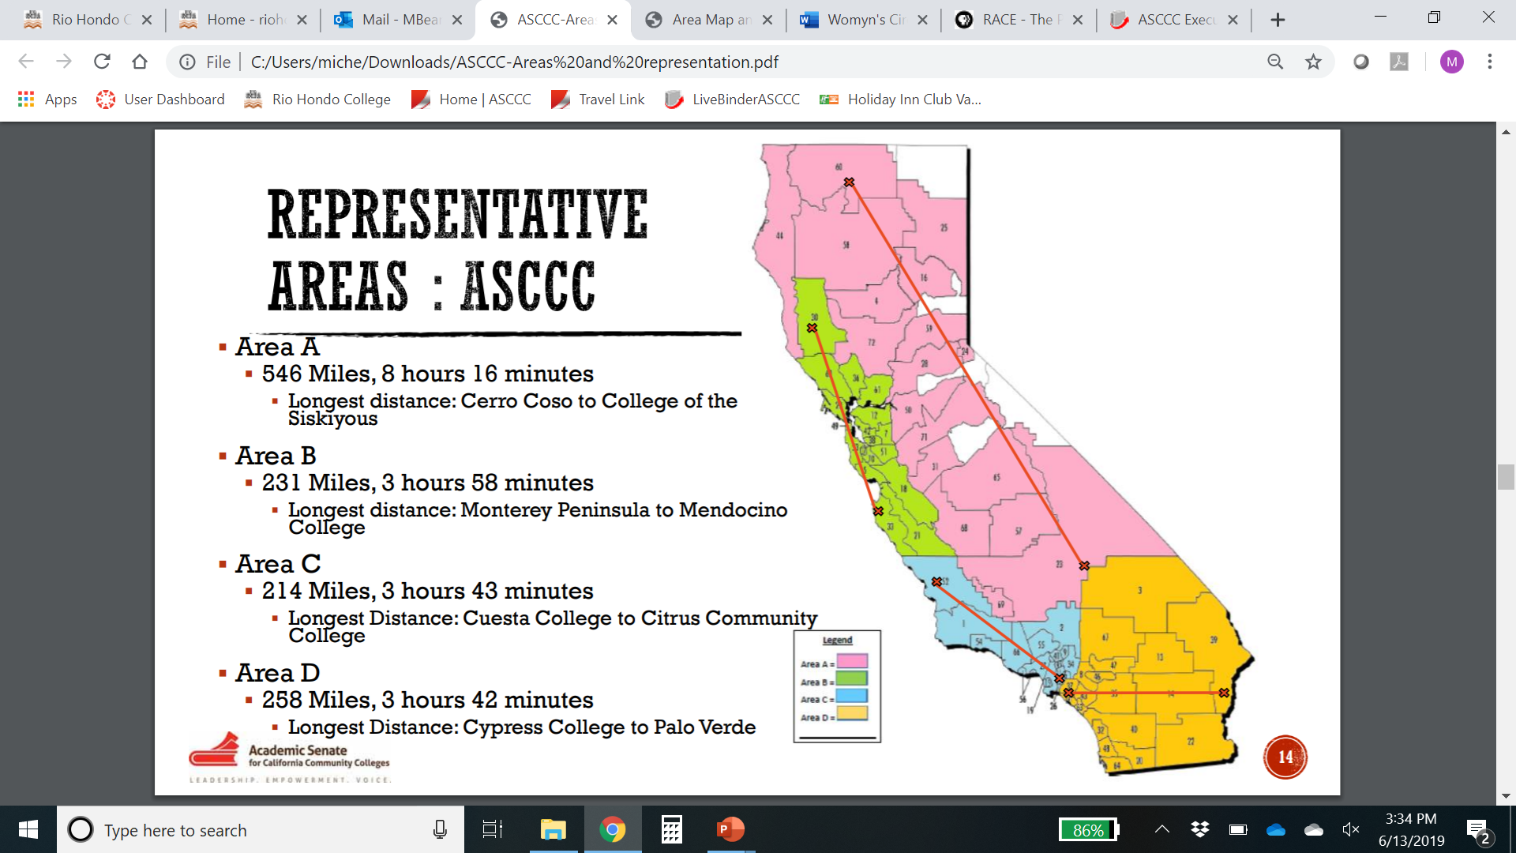
Area Colleges

Slide 9
AREA A – 29 Colleges
American River College
Bakersfield College
Butte College
Cerro Coso College
Clovis Community College
Columbia College
Cosumnes River College
Feather River College
Folsom Lake College
Fresno City College
Lake Tahoe Community College
Lassen College
Madera Community College
Merced College
Modesto Junior College
Porterville College
College of the Redwoods
Reedley College
Sacramento City College
San Joaquin Delta College
College of the Sequoias
Shasta College
Sierra College
College of the Siskiyous
Taft College
West Hills College Coalinga
West Hills College Lemoore
Woodland Community College
Yuba College
Notes:
Area A runs from the Oregon border through the Central Valley to Bakersfield

Slide 10
What does the Area Rep do?
Provide information about Academic Senate activities and resources
Provide communication to the field
Listservs
Help senate presidents/delegates prepare for Plenary
Facilitate Area Meetings
Before and at Plenary
Notes:
Regional meetings
Exec Meetings at colleges
Senate presidents – Hayward readers

Slide 11
What’s an Area Meeting?
President/Vice President Report
Pre-Session Resolutions Review
Newly Proposed Resolutions
Area Concerns
Special Program/Host Highlight
Community Building
Notes:
Pre-session resolutions—Time to send in amendments!

Slide 12
Why Resolutions?
Resolution development is the primary and formal mechanism for setting policy of the Academic Senate.
Resolutions identify and record the will of the academic senates of the California community colleges. The Academic Senate relies on formal resolutions to set direction for the organization as a whole.
Members of the Academic Senate Executive Committee and its standing and ad hoc committees implement adopted resolutions to respond to issues, to conduct its work, and to take action.

Slide 13
What’s the Resolution Process?
Pre-Session Resolutions
ASCCC Executive and Committees
Area Meetings
New Resolutions
Delegates and local senate representatives at Plenary
Amendments
Review and discuss in Area Meetings and Plenary
Amendment Sheets—four delegate signatures
Watch for DEADLINES and Mandatory Meetings!
Notes:
Review Resolutions packet—explain this comes from Exec and committees
At actual Plenary—will include resolutions from Area meetings
New Resolutions—from delegates at Plenary:
If authors are in room—ask for background and rationale of new resolutions
Review New Resolutions—any amendments?
At Plenary—Amendments Deadline 12:30 p.m. Friday
Search website for other resolutions
Max 4 Whereas or Resolved
Spell out acronyms
Create a clear title

Slide 14
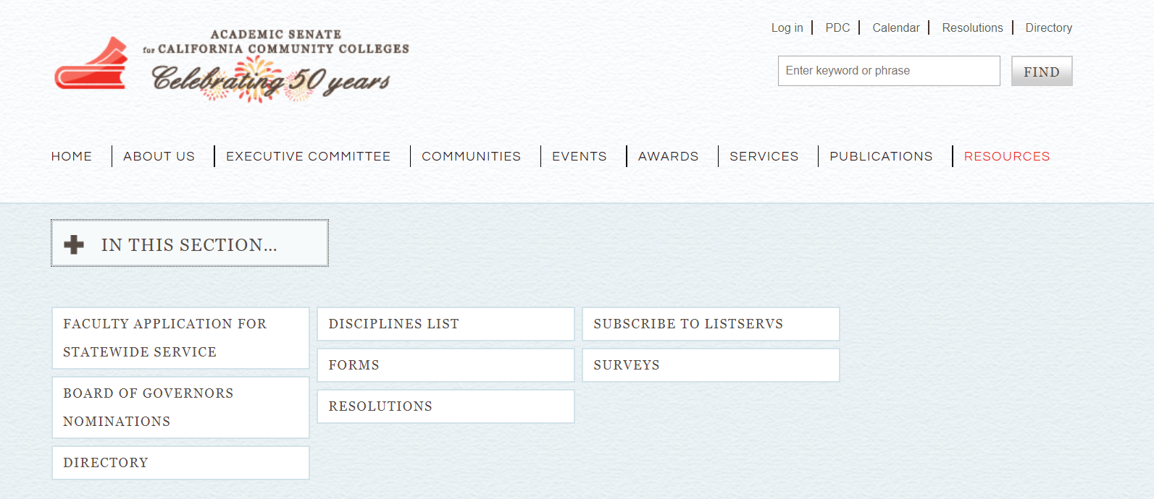
What about Resources?
Bookmark ASCCC.org
Volunteer for Committees
Download the Handbook
Consider a Technical Visit
Sign-up for Listservs
Notes:
Communities under the RESOURCES tab
Handbook under the COMMUNITIES tab
Technical Visits under SERVICES tab
Listservs under RESOURCES

Slide 15
Thank You
Contact Information—email me anytime!
Julie Oliver oliverj@crc.losrios.edu

