Slide 1
Area B Meeting
Dr. Karen Chow
Area B Representative

Slide 2
Session Learning Outcomes
Build “local” relationships
Summarize Area B Meetings
Outline resolutions process
Locate resources

Slide 3
Introductions– In person: Turn to your neighbor and share; if online/virtual, post in Chat
Name
College
Discipline
Role/Title/Position
Emerging/Post-Pandemic lessons

Slide 4
Pair Share
A favorite childhood memory
Somebody who inspires you
Triumphs
Challenges
Leadership goal for the upcoming year
In person: Turn to your neighbor and share; if online/virtual, post in Chat

Slide 5
ASCCC Areas
Four geographic areas called A, B, C, and D (map reference)
Area A
  29 colleges; 1 district senate
Area B
  29 colleges; 5 district senates
Area C
  26 colleges; 1 district senate
Area D
  33 colleges; 2 district senates

Slide 6
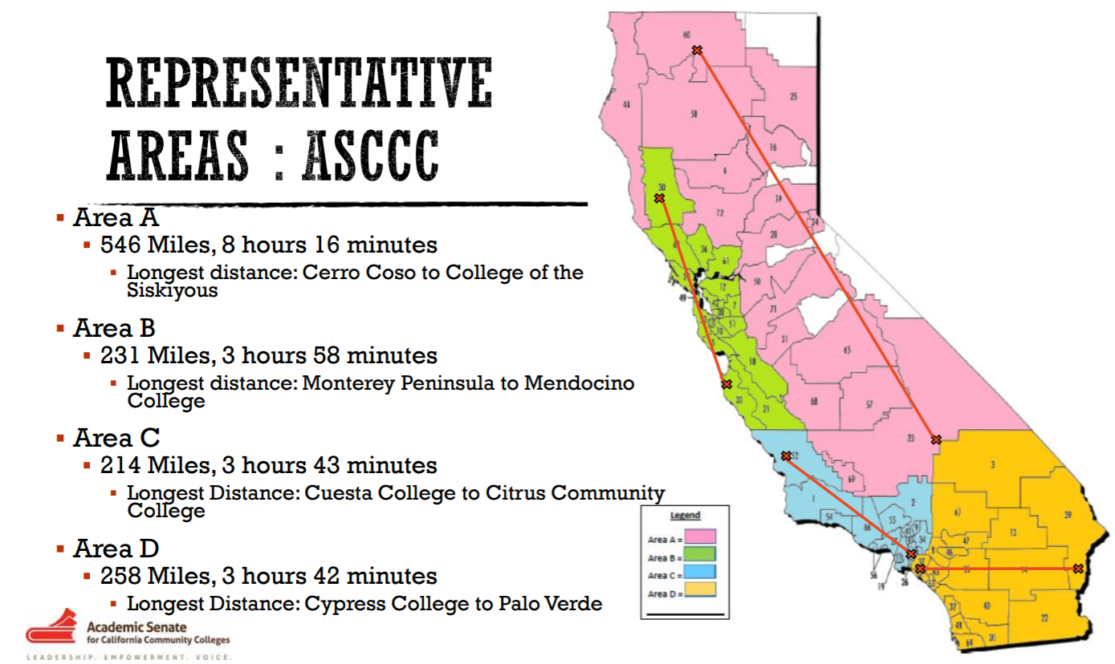
Representative Areas

Slide 7
Area B Colleges & Districts
College of Alameda
Berkeley City College
Cabrillo College
Cañada College
Chabot College
Contra Costa College
Contra Costa CC District
De Anza College
Diablo Valley College
Evergreen Valley College
Foothill College
Foothill - De Anza CC District
Gavilan College
Hartnell College
Laney College
Las Positas College
Los Medanos College
College of Marin
Mendocino College
Merritt College
Mission College
Monterey Peninsula College
Napa Valley College
Ohlone College
Peralta CC District
City College of San Francisco
San Jose City College
College of San Mateo
San Mateo CC District
Santa Rosa Junior College
Skyline College
Solano College
West Valley College
West Valley – Mission CC District

Slide 8
Area Rep Duties
Provide information about ASCCC activities and resources
Provide communication to the field
  Listservs—sign up at https://asccc.org/sign-our-newsletters
Aid and support senate presidents & delegates prepare for Plenary
Facilitate Area Meetings
  Before and at Plenary
What do Area Reps Do?

Slide 9
What is usually in an Area Meeting?
President/Vice President report
Sometimes other reports/guests (FACCC, CCCCO)
Pre-session resolutions review
Newly proposed resolutions
Update on Disciplines List Proposals & Hearings
Area triumphs and concerns
Special program/host highlights (yay for in-person!)
Community building
Notes:
Fall Meeting: hosted by Santa Rosa JC
Spring Meeting hosted by CCSF?

Slide 10
What is a Resolution?
Formal process for ASCCC policy development
Record the will of the body (California academic senates)
Directs the work of the ASCCC
Implemented by members of the ASCCC Executive Committee and its committees
Notes:
Communities under the RESOURCES tab
Handbook under the COMMUNITIES tab
Technical Visits under SERVICES tab
Listservs under RESOURCES

Slide 11
Resolutions Process
Pre-Plenary Resolutions
  ASCCC executive and committees
  Area meetings
New Resolutions
  Registered faculty attendee at Plenary (with 4 delegate signatures)
Amendments
  Review and discuss at area meetings and Plenary
  At Plenary amendments require 4 delegate signatures
Mindful of deadlines and mandatory meetings for authors of resolutions and/or amendments
Notes:
Review Resolutions packet—explain this comes from Exec and committees
At actual Plenary—will include resolutions from Area meetings
New Resolutions—from delegates at Plenary:
If authors are in room—ask for background and rationale of new resolutions
Review New Resolutions—any amendments?

Slide 12
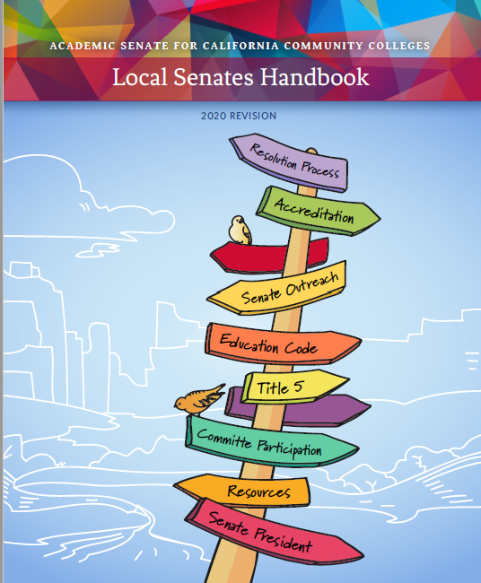
Resources
ASCCC website
Local Senates Handbook
Each other!
info@asccc.org

Slide 13
For Fun: What does “B” stand for in Area B?
Word Cloud live generator: Go to www.menti.com and enter in Code number that Karen gives us

Slide 14
Reminders!
Breathe
You can do it! You got this!
One need not have all the answers
  Let me get back to you
Let me confer with the officers and get back to you
Let me research this and get back to you
Deflect!
Do not have to know the solution to start the conversation (”We have this issue…can we start a conversation about this?”)
Styles differ wildly
Start building your AS leadership huddle HERE! Exchange contact information!
info@asccc.org
Thank you for participating today!

