Slide 1
Area C Meeting
Erik Reese—ASCCC Area C Representative

Slide 2
Session Learning Outcomes
Build “local” relationships
Summarize Area C Meetings
Outline resolutions process
Locate resources
Review mock resolutions

Slide 3
Introductions
Name
College
Discipline
Role/Title/Position
Favorite summer food or tradition

Slide 4
Pair Share
Favorite childhood memory
Somebody who inspires you
Triumphs
Challenges
Leadership goal for the upcoming year
Favorite part of working from home
Best advice you received at work

Slide 5
ASCCC Areas
Four geographic areas called A, B, C, and D (map reference)
Area A
29 colleges; 1 district senate
Area B
29 colleges; 5 district senates
Area C
26 colleges; 1 district senate
Area D
33 colleges; 2 district senates

Slide 6
Representative Areas
Notes:
Area A runs from the Oregon border through the Central Valley to Bakersfield
Area B encompasses the Greater Bay Area, from Mendocino to Monterey
Area C: Los Angeles and the Central Coast
Area D is Orange County, San Diego, the Inland Empire, and across the Arizona border

Slide 7
Area C—Member Senates
Allan Hancock College
Antelope Valley College
College of the Canyons
Cerritos College
Citrus College
Compton College
Cuesta College
East Los Angeles College
El Camino College
Glendale College
Los Angeles City College
Los Angeles CC District
Los Angeles Harbor College
Los Angeles Mission College
Los Angeles Pierce College
Los Angles Southwest College
Los Angeles Trade-Technical College
Los Angeles Valley College
Moorpark College

Slide 8
Area C—Member Senates (Cont.)
Mt. San Antonio College
Oxnard College
Pasadena City College
Rio Hondo College
Santa Barbara City College
Santa Monica College
Ventura College
West Los Angeles College

Slide 9
Area Rep Duties
Provide information about ASCCC activities and resources
Provide communication to the field
Listservs
Aid and support senate presidents & delegates prepare for Plenary
Facilitate Area Meetings
Before and during Plenary Sessions and Faculty Leadership Institute

Slide 10
Area Meetings
President/Vice President report
Pre-Plenary resolutions review
Newly proposed resolutions
Area triumphs and concerns
Special program/host highlights
Community building
Also, at Plenary Session and Faculty Leadership Institute

Slide 11
Resolutions
Formal process for ASCCC policy development
Record the will of the body (California academic senates)
Directs the work of the ASCCC
Implemented by members of the ASCCC Executive Committee and its committees

Slide 12
Resolutions Process
Pre-Plenary Resolutions
ASCCC executive and committees
Area meetings
New Resolutions
Registered faculty attendee at Plenary (with 4 delegate seconders)
Amendments
Review and discuss at area meetings and Plenary
At Plenary amendments require 4 delegate seconders
Mindful of due dates/times and mandatory meetings for authors of resolutions and/or amendments

Slide 13
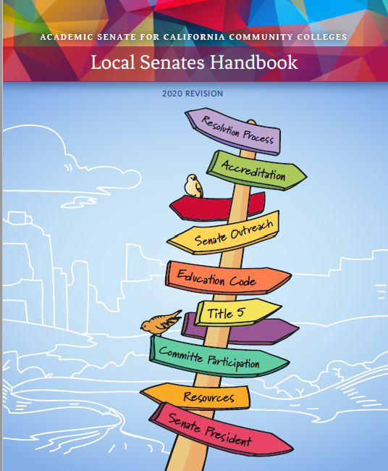
Resources
ASCCC website
Local Senates Handbook
Each other!
info@asccc.org

Slide 14
Reminders
Breathe
You can do it! You got this!
One need not have all the answers
Let me get back to you
Do not have to know the solution to start the conversation
Styles differ wildly
info@asccc.org
Notes:
Deflect!
Let me confer with the officers and get back to you
Let me research this and get back to you

Slide 15
Mock Resolutions Review
Have your packets ready
Will read the title and resolved statements
Discussion around clarifying questions and possible amendments

Slide 16
For what does “C” in Area C stand?
Provide words starting with “C”
Notes:
Word cloud!
Google doc?...just collect?

