Slide 1
AREA D MEETING
María-José Zeledón-Pérez, Ed. D.
ASCCC Area D Representative

Slide 2
AGENDA
Introductions
The Four Areas
Area Meeting Review
Resolutions
Resources

Slide 3
ASCCC Area D Representative Dr. María-José Zeledón-Pérez
The elected Area D Representative serves as both a member of the executive board of the Academic Senate for California Community Colleges and serves 62,000 faculty and 2.4 million students in all academic and professional matters.
The Area D Representative leads a dynamic team of educators located in southern California and include community college districts in Imperial, Los Angeles Orange, Riverside, San Bernardino and San Diego counties.
It includes the largest number of college and district academic senates from among the Academic Senate for California Community College’s four geographic regions:
The colleges in Area D range from large urban (Long Beach City College, San Diego City College) to small and very rural (Barstow, Copper Mountain, Palo Verde College).
Area D includes some of the oldest colleges in the California community college system: Fullerton College was the third to open in the state, tied with Bakersfield opening in 1913, and San Diego opened the following year.

Slide 4
The Four Areas
This four-area grouping is the formal basis for local senate representation to the Executive Committee of the Academic Senate for California Community Colleges.
The Area Representatives are responsible for coordinating two area meetings each year. At these meetings, held each fall and spring prior to the upcoming plenary session, local senate delegates meet at a college in their area or via zoom.
The groups discuss matters of concern to their areas as well as review proposed resolutions to be voted on during session.
Area A: Stephanie Curry
Area B: Karen Chow
Area C: Erik Reese
Area D: María-José Zeledón-Pérez

Slide 5
More about what the Area Rep does
Provide information about Academic Senate activities and resources
Provide communication to the field
Listservs
Help senate presidents/delegates prepare for Plenary
Facilitate Area Meetings before and at Plenary
Consult with or visit local senates.
Requests for such visits should be forwarded through the Academic Senate Office at info@asccc.org.
You can access a list of all colleges by Area here: Area Map and College Listing

Slide 6
ASCCC
The Executive Committee is comprised of 14 representatives elected by the delegates each year in Spring and the Executive Director (ex officio member).
As noted in the bylaws, this group adopts procedures, implements policies adopted at the plenary sessions, transacts business, and performs other functions that are not inconsistent with the intent, purposes, and provisions of the Bylaws and Senate Rules.
The Executive Committee meets every month except July.

Slide 7
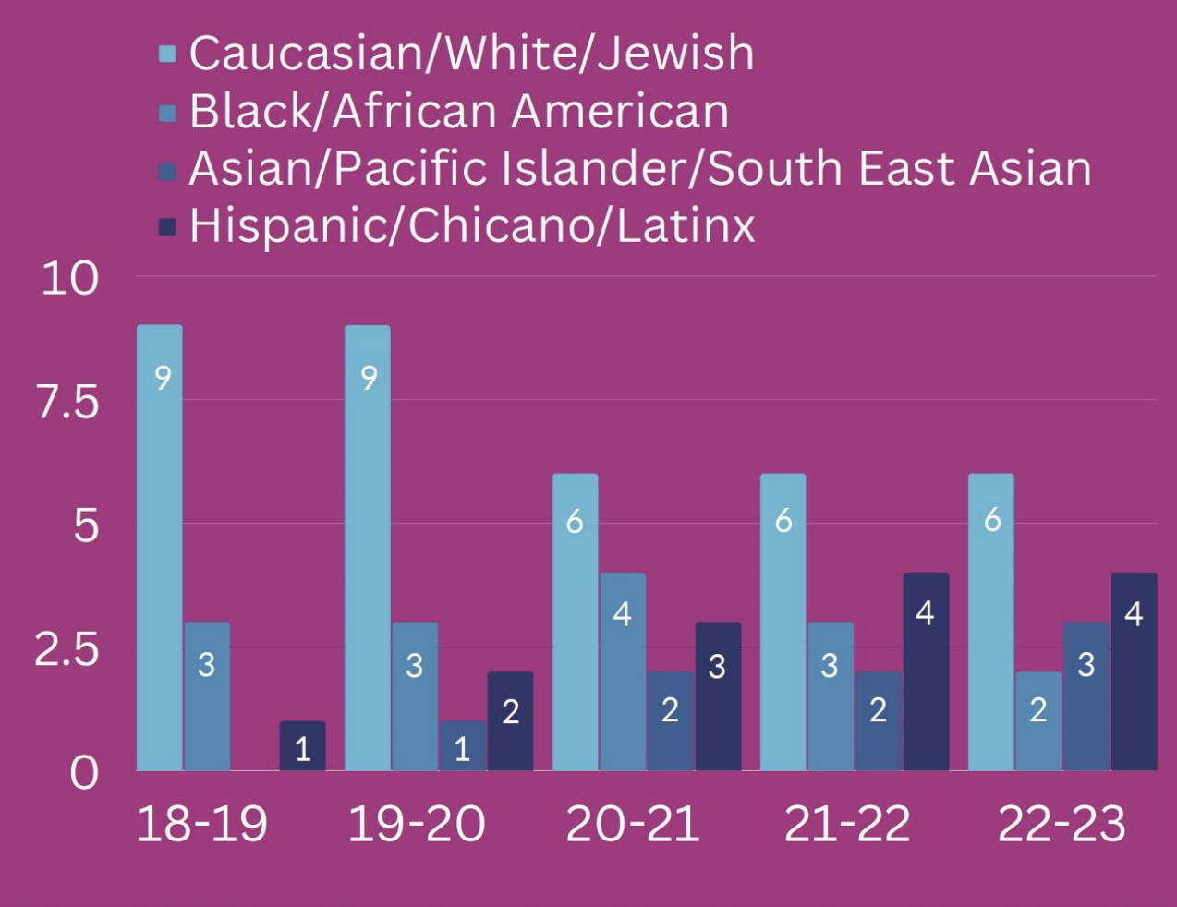
What we do as the ASCCC team
The Area D Representative and the ASCCC Executive Board work to empower faculty to engage in local and statewide dialog and take action for continued improvement of teaching, learning, and faculty participation in governance.
Representation Matters
The representation of the governing body of an organization is critically important, as diverse representation provides more voices, critical to make collective change. The ASCCC remains committed to advancing inclusion, diversity, equity, antiracism, and accessibility.

Slide 8
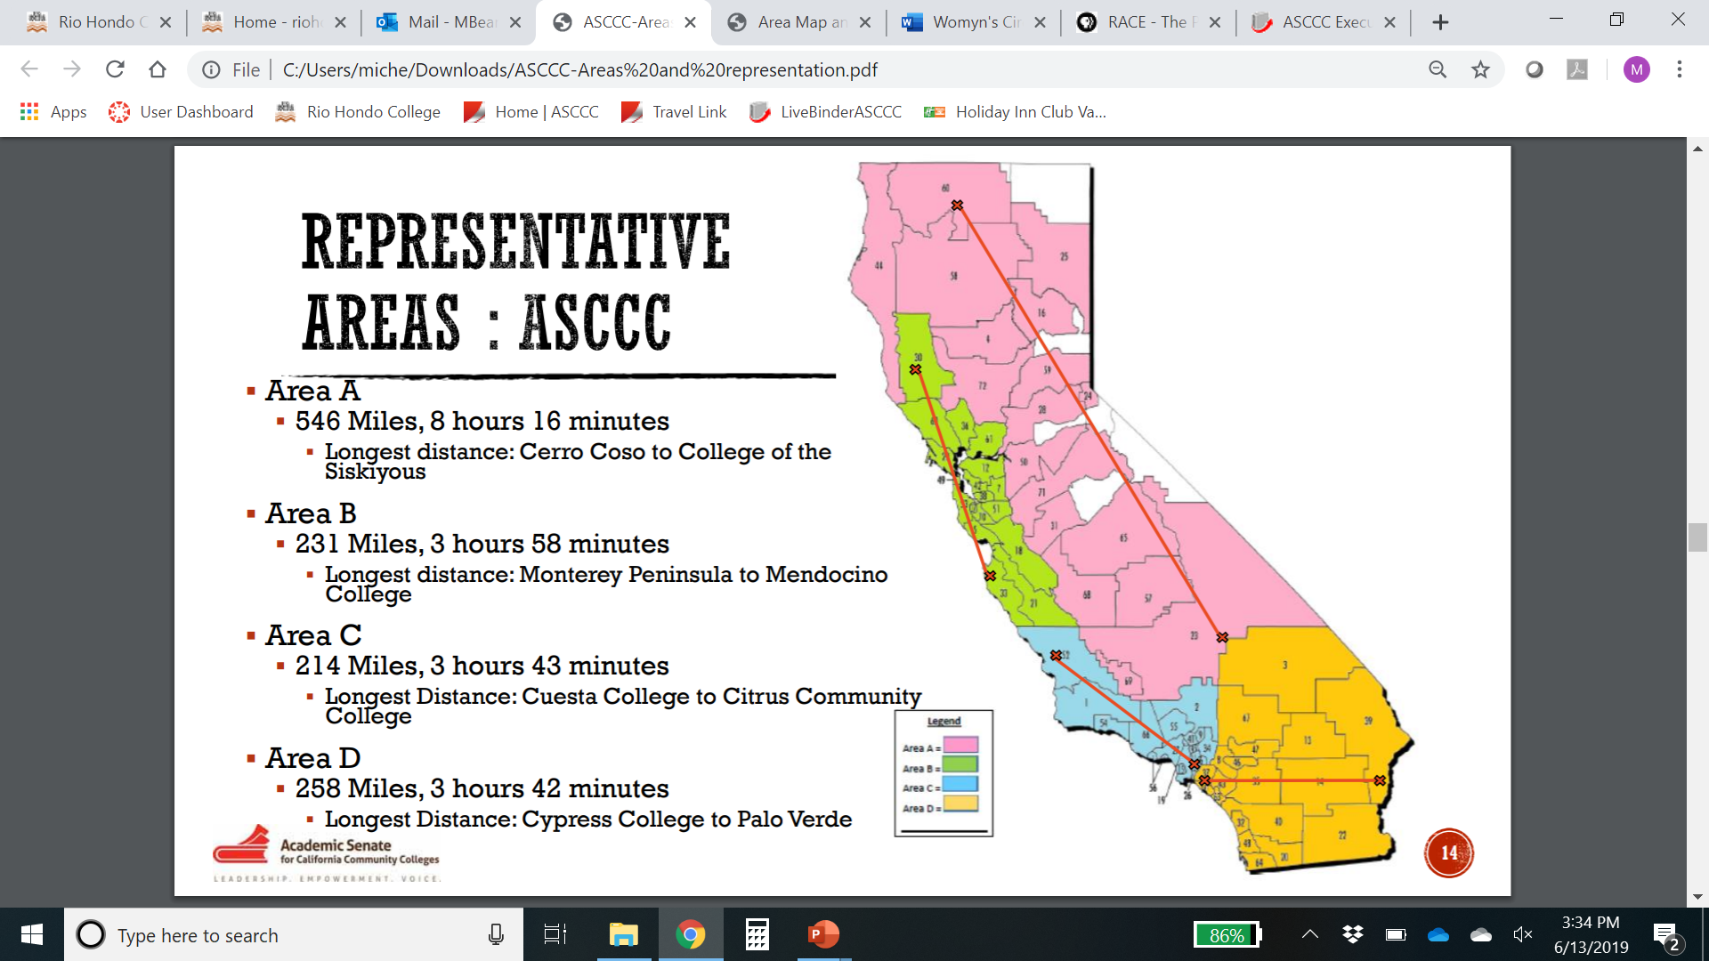
Area Colleges

Slide 9
AREA D – 33 Colleges
Barstow College
Chaffey College
Coastline College
Copper Mountain College
Crafton Hills College
Cuyamaca College
Cypress College
College of the Desert
Fullerton College
Golden West College
Grossmont College
Imperial Valley College
Irvine Valley College
Long Beach City College
MiraCosta College
Moreno Valley College
Mt. San Jacinto College
Norco College
North Orange Continuing Education
Orange Coast College
Palo Verde College
Palomar College
Riverside City College
Saddleback College
San Bernardino Valley College
San Diego City College
San Diego Continuing Education
San Diego Mesa College
San Diego Miramar College
Santa Ana College
Santiago Canyon College
Southwestern College
Victor Valley College

Slide 10
AREA A – 29 Colleges
American River College
Bakersfield College
Butte College
Cerro Coso College
Clovis Community College
Columbia College
Cosumnes River College
Feather River College
Folsom Lake College
Fresno City College
Lake Tahoe Community College
Lassen College
Madera Community College
Merced College
Modesto Junior College
Porterville College
College of the Redwoods
Reedley College
Sacramento City College
San Joaquin Delta College
College of the Sequoias
Shasta College
Sierra College
College of the Siskiyous
Taft College
West Hills College Coalinga
West Hills College Lemoore
Woodland Community College
Yuba College

Slide 11
AREA B – 29 Colleges
College of Alameda
Berkeley City College
Cabrillo College
Canada College
City College of San Francisco
Chabot College
Contra Costa College
De Anza College
Diablo Valley College
Evergreen Valley College
Foothill College
Gavilan College
Hartnell College
Laney College
Las Positas College
Los Medanos College
College of Marin
Mendocino College
Merritt College
Mission College
Monterey Peninsula College
Napa Valley College
Ohlone College
San Jose City College
College of San Mateo
Santa Rosa Junior College
Skyline College
Solano College
West Valley College

Slide 12
AREA C – 26 Colleges
Allan Hancock College
Antelope Valley College
College of the Canyons
Cerritos College
Citrus College
Compton College
Cuesta College
East Los Angeles College
El Camino College
Glendale College
Los Angeles City College
Los Angeles Harbor College
Los Angeles Mission College
Los Angeles Pierce College
Los Angeles Southwest College
Los Angeles Trade Technical College
Los Angeles Valley College
Moorpark College
Mt. San Antonio College
Oxnard College
Pasadena City College
Rio Hondo College
Santa Barbara City College
Santa Monica College
Ventura College
West Los Angeles College

Slide 13
What do we do in an Area Meeting?
President/Vice President Report
Pre-Session Resolutions Review
Newly Proposed Resolutions
Area Concerns
Special Program/Host Highlight
Community Building
Notes:
Pre-session resolutions—Time to send in amendments!

Slide 14
Why Resolutions?
Resolution development is the primary and formal mechanism for setting policy of the Academic Senate.
Resolutions identify and record the will of the academic senates of the California community colleges. The Academic Senate relies on formal resolutions to set direction for the organization as a whole.
Members of the Academic Senate Executive Committee and its standing and ad hoc committees implement adopted resolutions to respond to issues, to conduct its work, and to take action.

Slide 15
What’s the Resolution Process?
Pre-Session Resolutions
ASCCC Executive and Committees
Area Meetings
New Resolutions
Delegates and local senate representatives at Plenary
Amendments
Review and discuss in Area Meetings and Plenary
Amendment Sheets—four delegate signatures
Watch for DEADLINES and Mandatory Meetings!
Notes:
Review Resolutions packet—explain this comes from Exec and committees
At actual Plenary—will include resolutions from Area meetings
New Resolutions—from delegates at Plenary:
If authors are in room—ask for background and rationale of new resolutions
Review New Resolutions—any amendments?
At Plenary—Amendments Deadline 12:30 p.m. Friday
Search website for other resolutions
Max 4 Whereas or Resolved
Spell out acronyms
Create a clear title

Slide 16
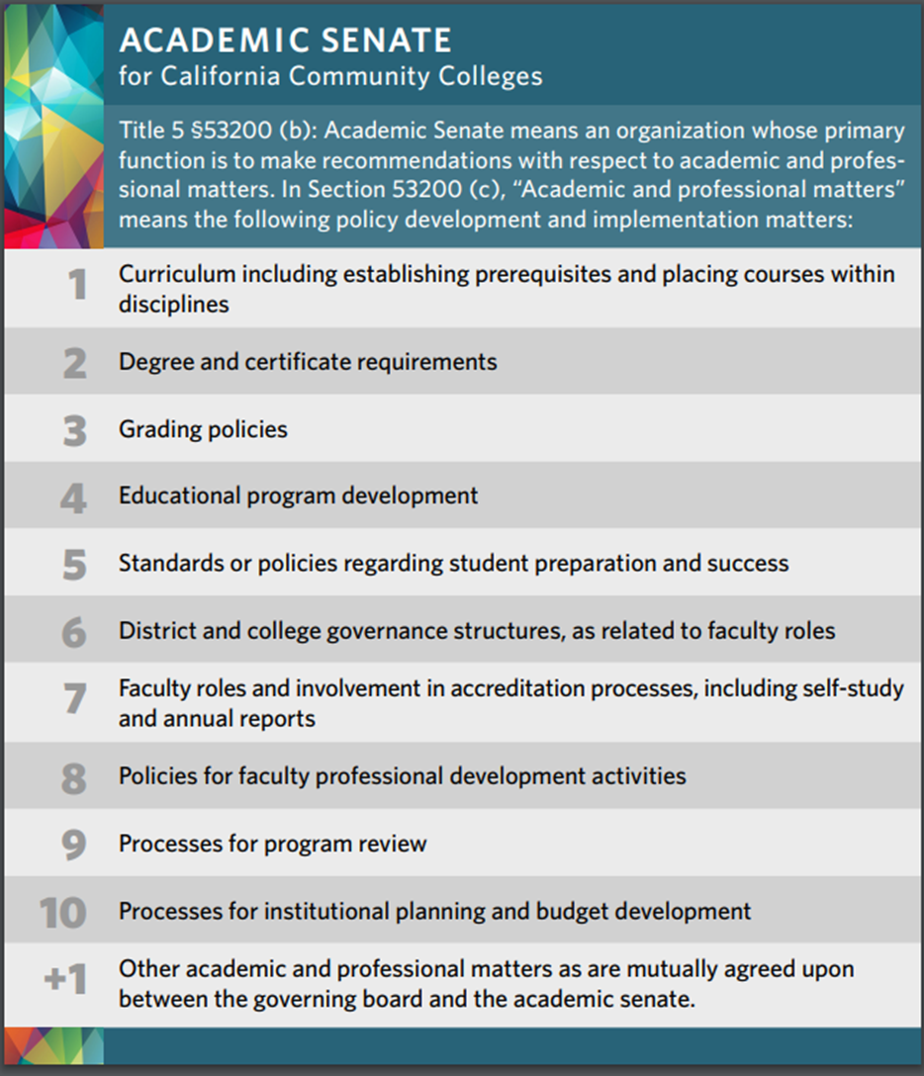
ASCCC Leadership and Resolutions Resources
Leadership Resources
Senate Delegate Roles and Responsibilities
Resolutions Handbook
Resolution Writing And General Advice
Resolutions
ASCCC 10+1 Flyer

Slide 17
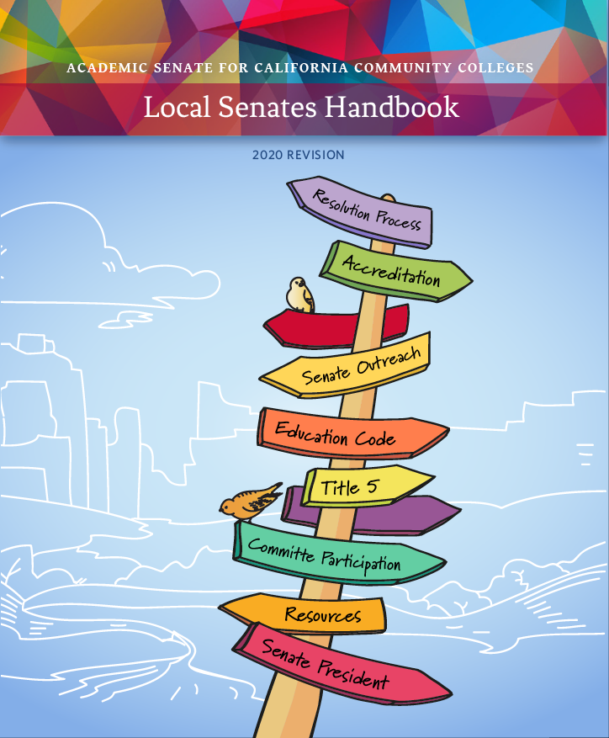
ASCCC General Resources
Bookmark ASCCC.org
ASCCC website
Volunteer Application to Serve on a Committee
ASCCC Local Senates Handbook
Consider a Local Senatel Visit
Sign-up for ASCCC Listservs
ASCCC Bylaws
Notes:
Communities under the RESOURCES tab
Handbook under the COMMUNITIES tab
Technical Visits under SERVICES tab
Listservs under RESOURCES

Slide 18
Thank You! Gracias!
Contact Information
María-José Zeledón-Pérez, Ed.D.
ASCCC Area D Representative
mzeledon@sdccd.edu
Email me anytime!

