Slide 1
From an Empty Cup You Cannot Pour: Self-Care Check-up Wednesday, June 16, 2021 at 3:45pm--5:00 pm Michelle Velasquez Bean, ASCCC Treasurer Karen Chow, ASCCC Area B Representative
Notes:
Present in moment!
Native American Sleep🌙Music: canyon flute & nocturnal canyon sounds, meditation https://www.youtube.com/watch?v=CwNzOddvbY0
Start with music!
3 min

Slide 2
Session Description
Really? The buzzword “self-care” again? How many times have you wanted to scream at hearing that--because you are just that tired? because it is all too much? because you really do need something to help reduce the stress and anxiety of carrying the load of leadership. We hear you! The struggle is real! If you’re ready to get real and try a few things to take a load off and center on your needs as the amazing leader you are, then join us for this interactive session to explore, share, and engage in a self-care inventory and promising positive practices to achieve work-life balance.

Slide 3
Today, we will . . .
Frame the Need for Self-care
Create a Fears List in Google
Do a Self-care Check-up
Share Self-care Ideas
Review Leadership and Balance
Commit to a Self-care Plan
Notes:
1 min (Michelle)

Slide 4
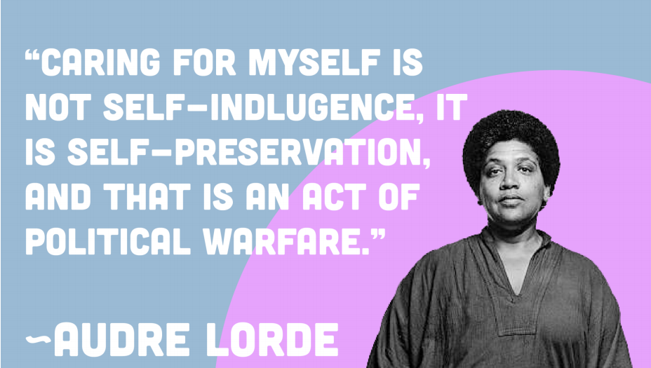
Notes:
4 min (karen)

Slide 5
Caring is self-preservation, especially for BIPOC
Self-care Day Author:
Recognize that our energy is a finite resource!
“BIPOC (Black, Indigenous, people of color); those living with disability; transgender, Two Spirit or non-binary people; and the elderly and the young as we have so much more in our cups – or on our plates – because of the bodies in which we move through the world”
Self-care has become a commercialized concept defined by a capitalist market
“Me time” becomes individual responsibility instead of acknowledging the need for collective survival and support against oppression
“Shifting responsibility for well-being onto already vulnerable people is a strategy of divide and conquer. It serves to neutralize social outrage by separating and silencing critical voices.
Notes:
Source: https://globeandfeminist.com/2020/07/24/self-care-day/
“We’ve come to recognize that our energy is a finite resource. It’s common for us to hear that we need to take care of ourselves, that we can’t fill anyone’s cup from an empty pitcher. But the pitcher/cup metaphor is still a relational one, based on the idea that women primarily exist in service of others. We are viewed as vessels of energy to be emptied and refilled time and time again so that others may live and thrive. This is especially true for BIPOC (Black, Indigenous, people of colour); those living with disability; transgender, Two Spirit or non-binary people; and the elderly and the young as we have so much more in our cups – or on our plates – because of the bodies in which we move through the world.
Stripping away its radical political roots has commercialized self-care. It’s now marketed as a personal responsibility, underscored by concepts of productivity, self-worth, and deservingness as defined by a capitalist market. The core concept – that rest is an essential part of resisting against oppression and fighting for social change – gets lost. This neutralization of self-care as a tool of political warfare is not an accident.
When self-care is framed as little more than “me time”, collective survival becomes an individual responsibility. And that’s a problem. It makes it much harder for people who experience multiple systems of oppression to care for themselves without community support. Framing self-care as a simplistic replacement for integrated systems of social care, takes governments and organizations off the hook for a greater responsibility for the wellness and healthy functioning of communities. Shifting responsibility for well-being onto already vulnerable people is a strategy of divide and conquer. It serves to neutralize social outrage by separating and silencing critical voices.”

Slide 6
Fears List: Use the Google doc
It’s not selfish. It’s necessary!
https://docs.google.com/document/d/1GINh9XUMF5pLiU5U3C1T2aiEmT_Jv5X6ZrDE7HdvDQk/edit?usp=sharing
Notes:
5 min (michelle)
Recap--3 min (michelle and karen)

Slide 7
Self-care is a collective act!
Normalize strategizing, supporting, and collectivizing self-care for self and community
It IS appropriate to have some time on your agenda
take time/space to ground oneself
take 5-10 minutes to connect with others
Bring it into the space as a leader
Import it into the work
Notes:
3 min (karen)
It IS appropriate to have some time on your agenda (taking time/space to ground oneself, 5-10 minutes to connect with others)--we have a slide on this later

Slide 8
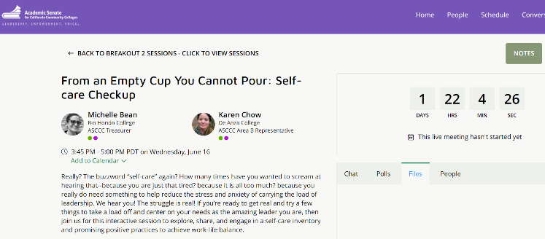
Self-care Check-up
Print and take this little inventory:
https://positivepsychology.com/wp-content/uploads/Self-Care-Checkup.pdf
Notes:
3 min (directions)
2 min (take-away)

Slide 9
Self-care Ideas
What does self care mean to you?
Fill in--use Pathable CHAT
I do my best to care for myself and to me that means by . . . (activities that bring you joy)
Notes:
3 min (michelle)

Slide 10
Some Promising Practices
Make self care routine for yourself and your group/class
put your oxygen mask in first—what serves you to pour into others
you feel your best when you grow gain and give yourself flexibility to be and do what you need
Establish mindfulness routines to stay grounded
use micro practice—touch something to bring core values to mind
use micro practice—look at a picture that brings a beautiful moment back to mind
breathe--feel where is feels good and go there
Notes:
Positive affirmations--Positive phrases or statements used to challenge negative or unhelpful thoughts. These are positive phrases which you repeat to yourself which describe how you want to be.
7 min (michelle and karen)

Slide 11
Some Promising Practices (cont’d)
Self-awareness
acknowledge feelings
notice when too much is on your plate
know that you cannot make everyone happy
Set boundaries
avoid the “save the world” thought
have a shut off time
Be with family and do altruistic activities —be with whom/what fuels you
Give your body the space it needs
take breaks
5-minute yoga
hydrate and eat
Self talk
positive affirmations
give yourself grace!
Delegate and assign to others
Notes:
Positive affirmations--Positive phrases or statements used to challenge negative or unhelpful thoughts. These are positive phrases which you repeat to yourself which describe how you want to be.
7 min (michelle and karen)

Slide 12
Managing the Demands as President and Academic Leader
Be kind to yourself
Have clarity on roles (officers and senators)
Delegate and encourage collective leadership
Cultivate and turn to your huddle for support (who are not necessarily just your colleagues)
Work to develop effective campus relationships amongst all constituency groups and students, but ultimately you can’t make everyone happy and that’s an impossible burden that you shouldn’t take on!
Notes:
Effective relationships--doesn’t giving all of you all of the time!
3 min (Karen)

Slide 13
Phrases for Balance and Strength
I am sorry, I respectfully disagree.
Now is not a good/appropriate time for me. Perhaps, we can discuss this at another time.
I hear you and want to listen to your concerns. This is not the appropriate time. Please email me so we can schedule something.
Although, an emergency for you, I remain assured that you respect the “participatory governance process”. As a result, I cannot authorize the presented documents, without having a conversation with the academic senate.
I appreciate your leadership and position. However, I would like to share an additional perspective.
May I share with you my professional observations?
Although you are the (insert title), my expanded statements are shared with you so under your leadership the mission and values of the college may be fulfilled.
Notes:
Phrases to help you navigate and respond to stressful and tense moments--you will need these to stay balanced.
3 min (Karen and Michelle)

Slide 14
Benefits of Prioritizing Self-Care
Greater insight into your own personal behavior.
Personal commitment to stay healthy and thrive to keep going (even during challenges)
Deadlines are critical. However, walking away and resting, may offer you refreshed ideas and strategies.
Learning to say No!
Notes:
3 min (Karen)

Slide 15
Collective Self Care and Your Senate Meeting Agenda
Pouring into others
Fill your love cup--prioritize your self-care
Open the meeting with a mindfulness activity
Encourage the use of the “call-in” when problem solving and decision making
Close the meeting with a moment of celebration and appreciation
End the meeting with a purposeful statements from different cultures to uplift humanity and inclusiveness
“To teach is to love!”
Notes:
3 min--Michelle

Slide 16
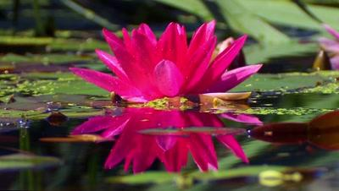
Today’s Takeaways
Feel free to RAISE HAND to share
Notes:
Take Q&A and Aha Moments!
15 min

Slide 17
Self-care Plan—COMMIT TO YOURSELF for this coming year!

Slide 19
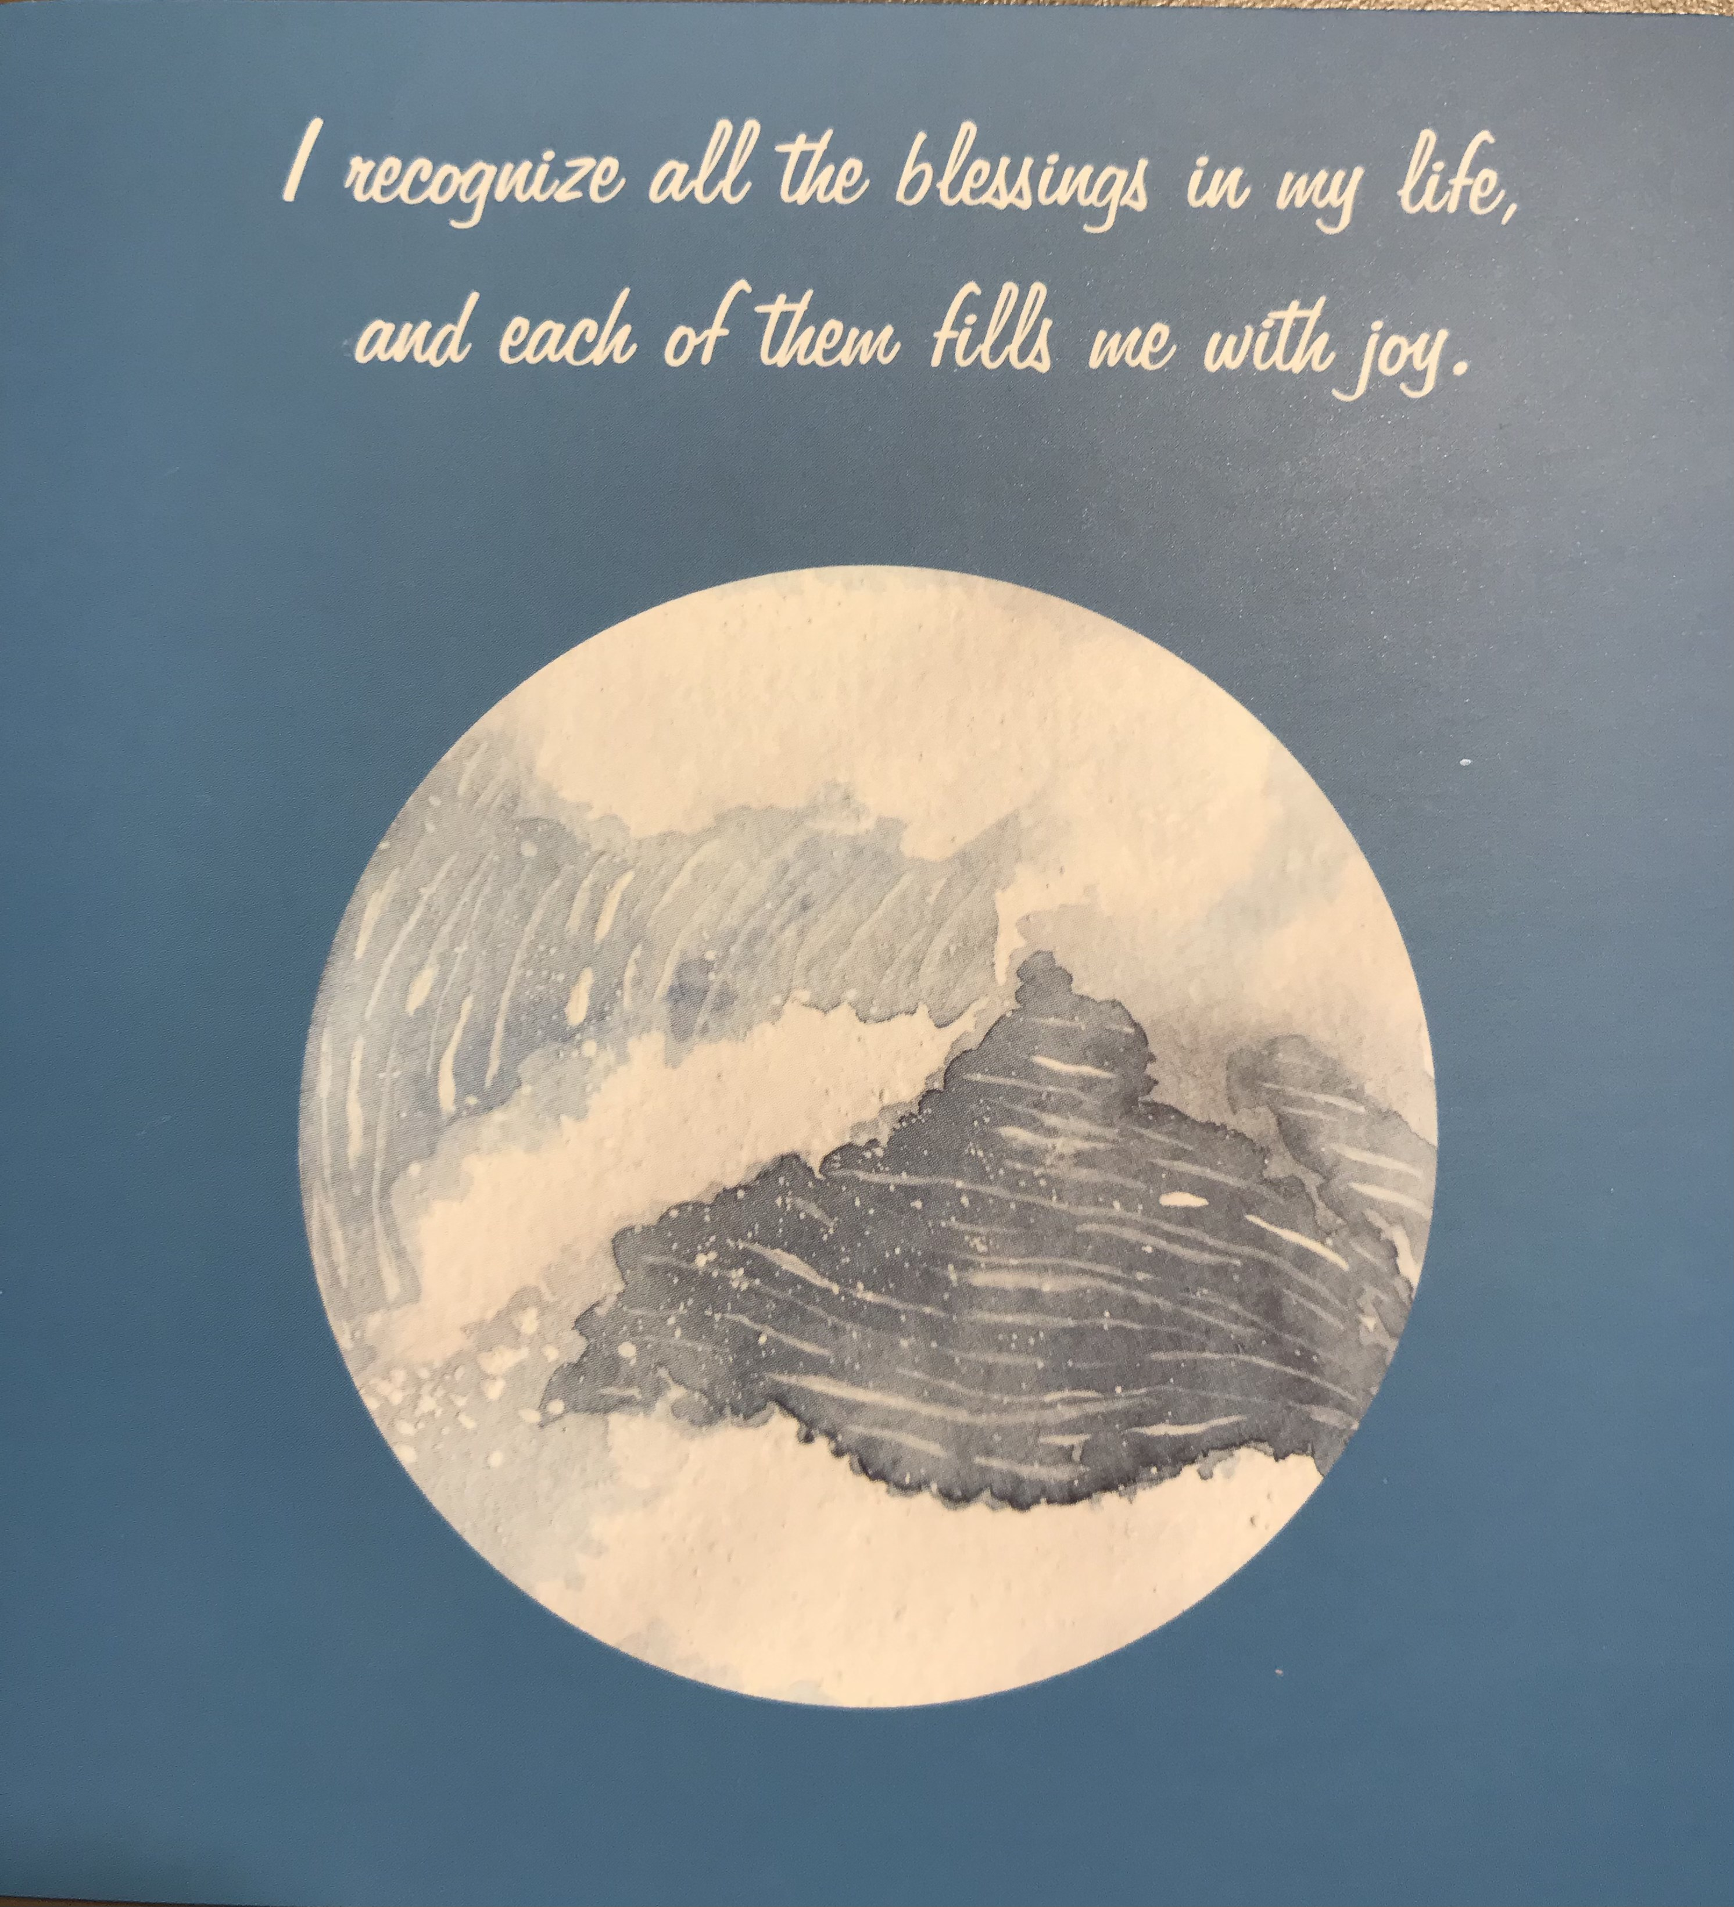

Slide 20
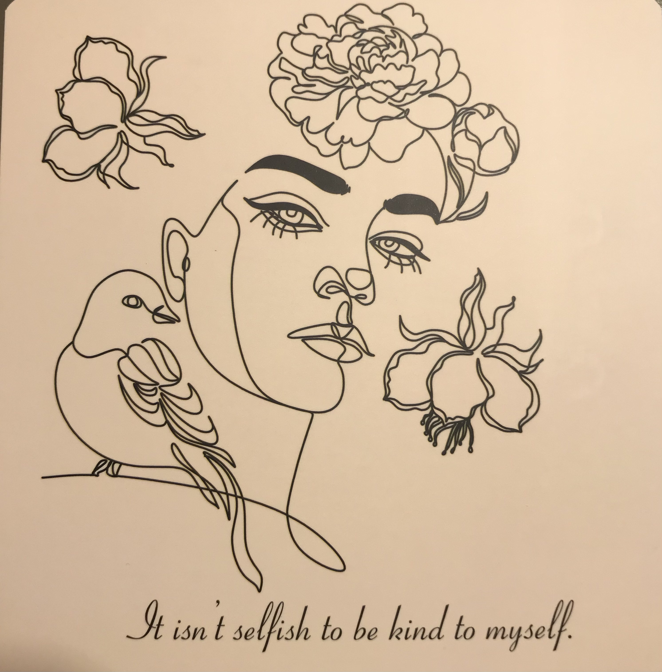

Slide 21
Some Other Resources
ASCCC Resources, under Self-Care/Social Justice:
https://www.asccc.org/covid-19-faculty-resources
Chow and Bean--FLI powerpoint from 2020:
https://www.asccc.org/content/creating-and-leveraging-collegiality-leadership-effectiveness
Dr. Erin Charlens. The Black Woman Superpower and Socially Concious Self-care:
https://indd.adobe.com/view/861210a6-c4e2-4715-b335-7fd34a456cb3

Slide 22
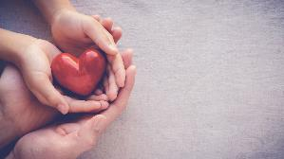
Thank you and be well!
For any support at anytime, contact
info@asccc.org
Michelle Bean--mbean@riohondo.edu
Karen Chow--chow.karen@fhda.edu

