Slide 1
Welcome Ginni May, ASCCC President Clemaus Tervalon, SSCCC President-elect
Notes:
Ginni

Slide 2
Land Acknowledgement
We acknowledge that this important work is taking place throughout the unceded territory of California, home to nearly 200 tribal nations. We acknowledge and honor the original inhabitants of our various regions. A land acknowledgment is a critical step towards working with native communities to secure meaningful partnership and inclusion in the stewardship and protection of their cultural resources and homelands.
We begin today by acknowledging that we are holding our gathering on the land of the Nisenan Nations who have lived and continue to live here. We recognize the Nisenan Nations and their spiritual connection to the ocean and the land as the first stewards and the traditional caretakers of this area we now call Sacramento. As we begin we thank them for their strength, perseverance and resistance.
We also wish to acknowledge the other Indigenous Peoples who now call Sacramento their home, for their shared struggle to maintain their cultures, languages, worldview and identities in our diverse City
Notes:
Ginni

Slide 3
Faculty Leadership Institute 2022
Hybrid Event
First in-person opportunity at FLI since June 2019
Connected with those attending virtually
Wednesday afternoon and Thursday morning
ASCCC and SSCCC in partnership
Thursday afternoon thru Friday evening
Nuts and bolts of academic senate leadership
Grounded in the tenets and principles of Inclusion, Diversity, Equity, Anti-racism, and Accessibility (IDEAA)
Reception with Faculty Empowerment Leadership Academy (FELA) Recognition Ceremony
Saturday morning
Mock Resolutions Session
Notes:
Ginni
Welcome Clemaus

Slide 4
Welcome from SSCCC President-elect
Words of Welcome
Introduction of Executive Board and Staff
Introduction of Student Leaders
Notes:
Clemaus

Slide 5
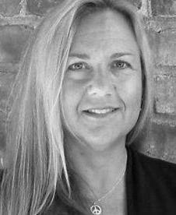
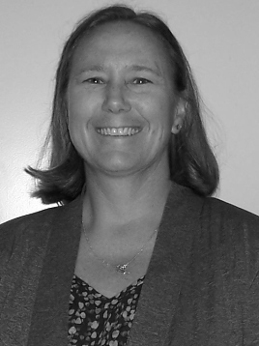
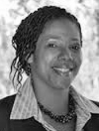
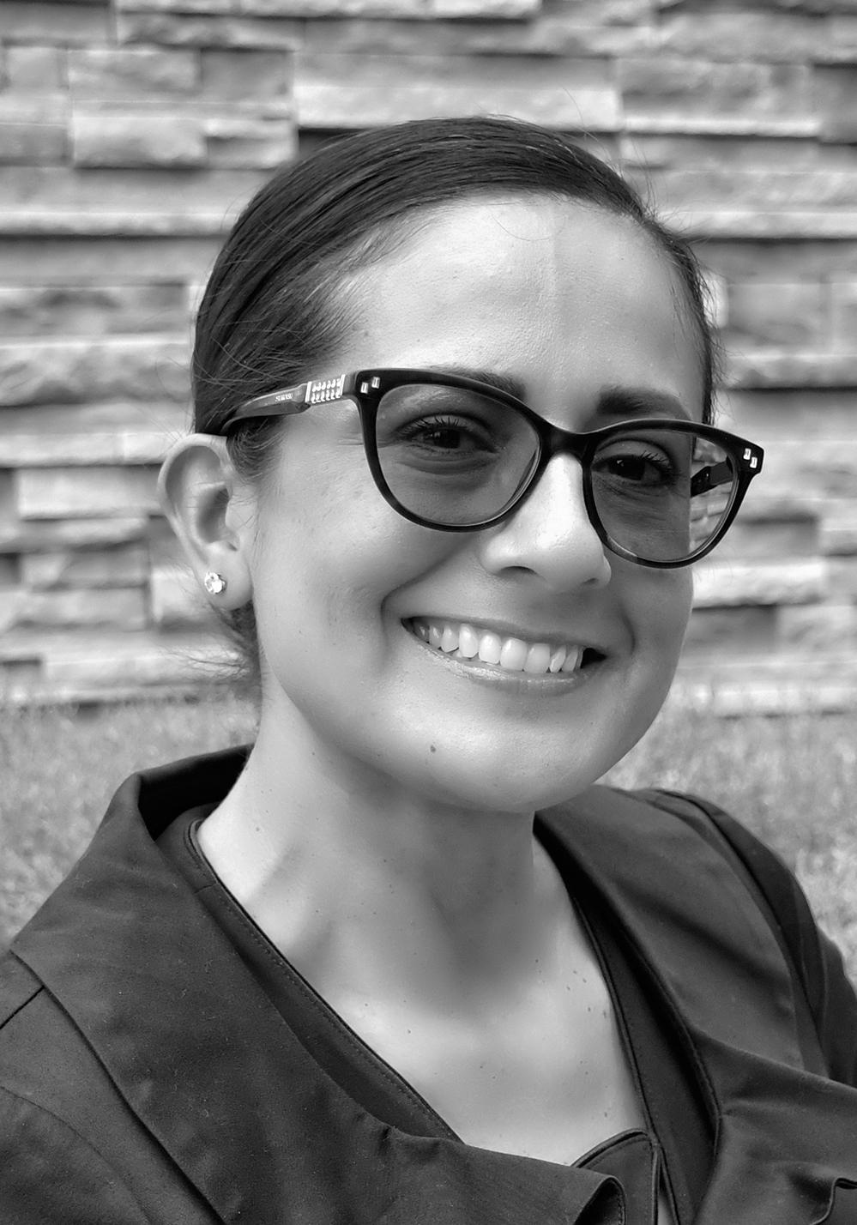
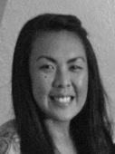
ASCCC 2022-23 Executive Committee
Officers
Virginia May
President
Cheryl Aschenbach
Vice President
LaTonya Parker
Secretary
Michelle Bean
Treasurer
Krystinne Mica
Executive Director
Notes:
Ginni

Slide 6
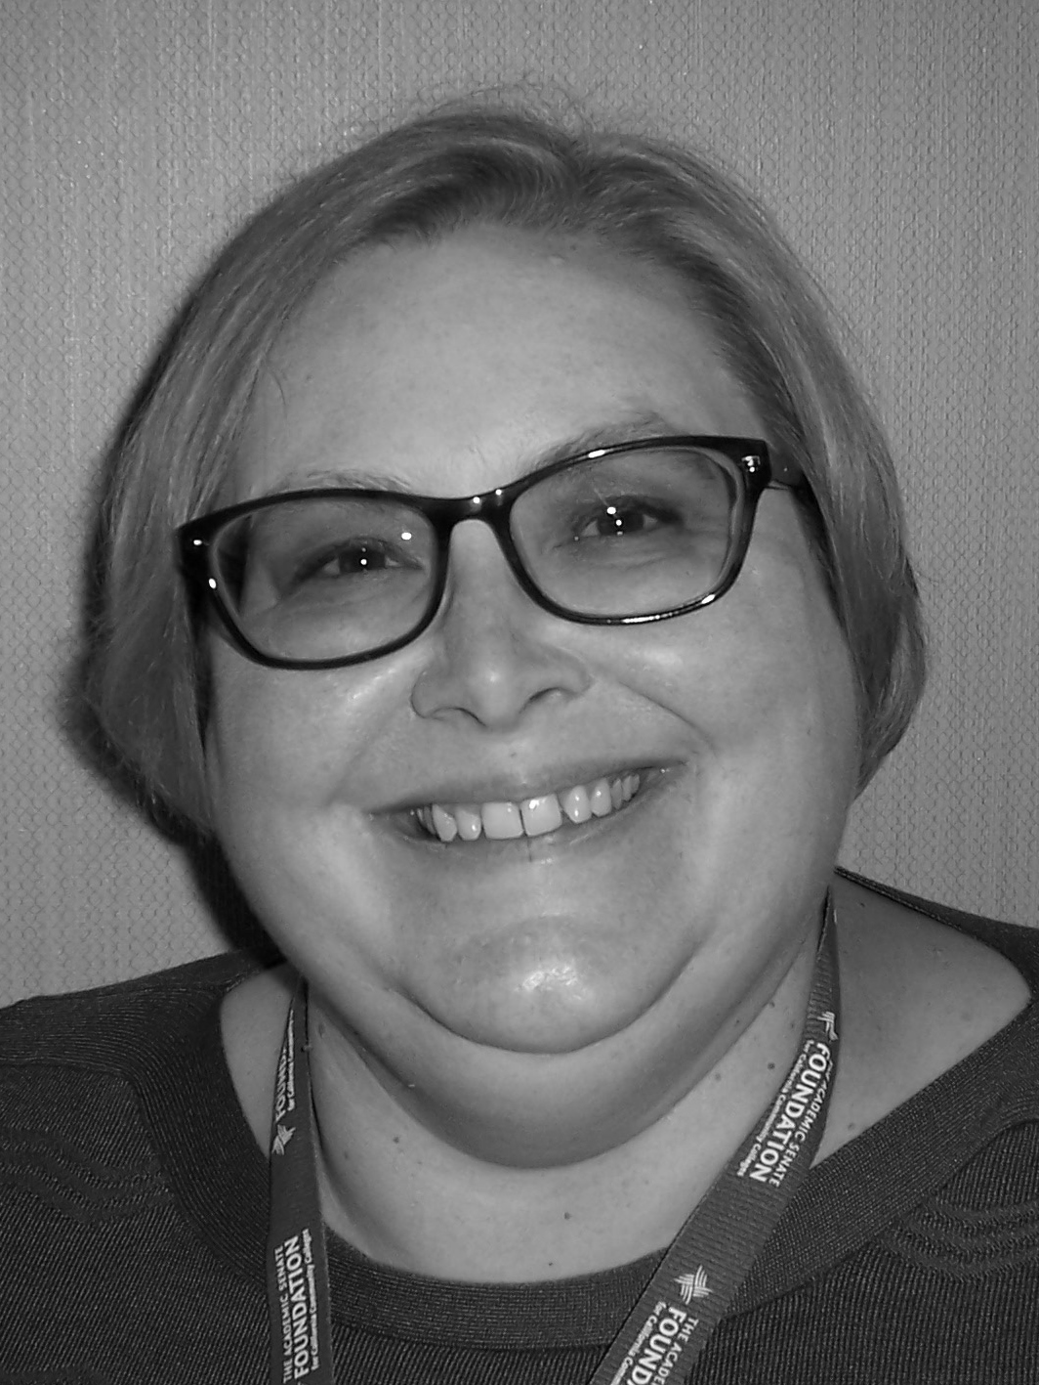
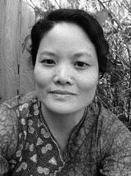
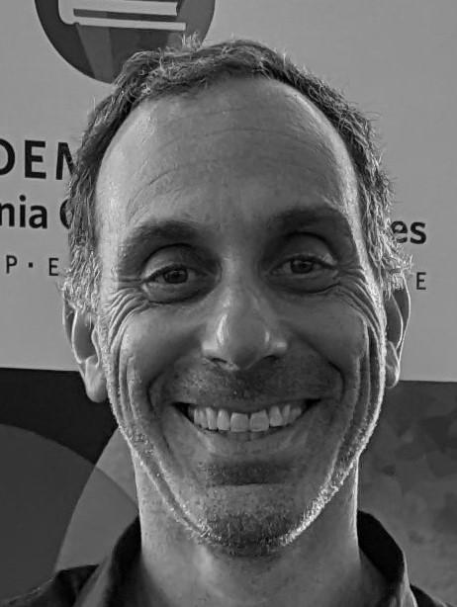
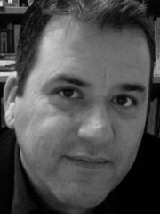
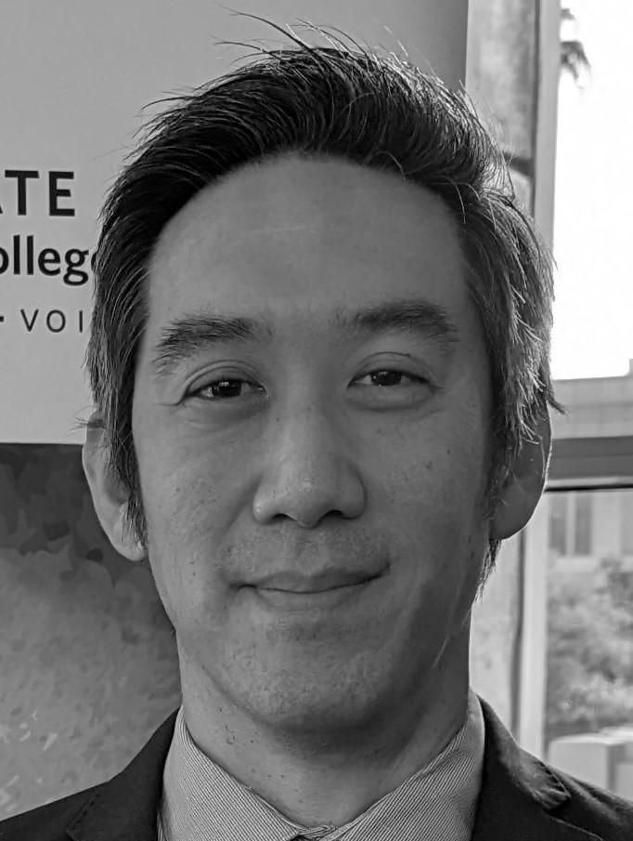
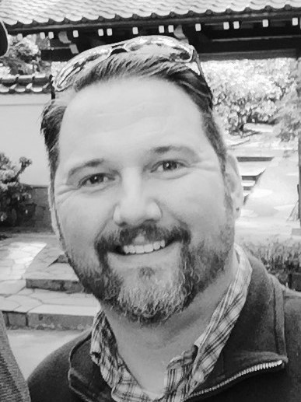
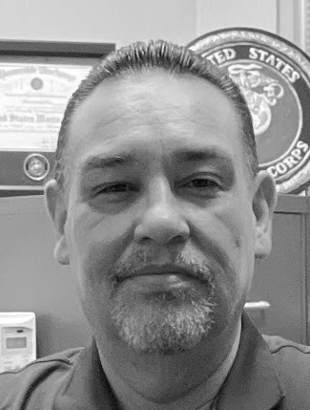
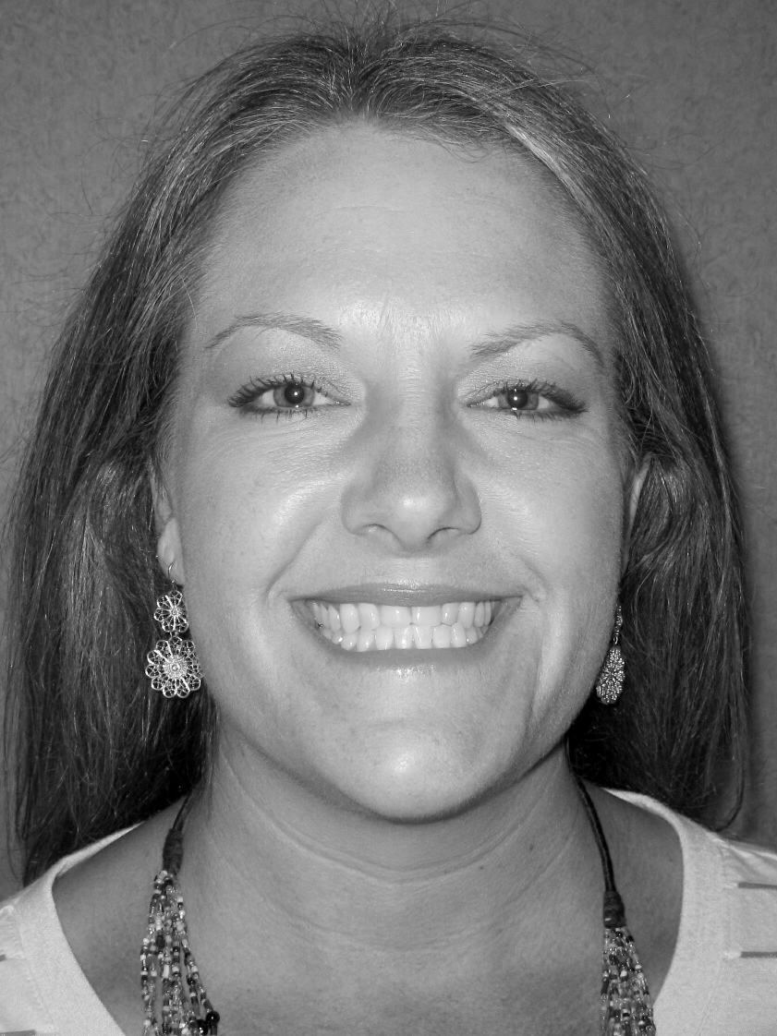
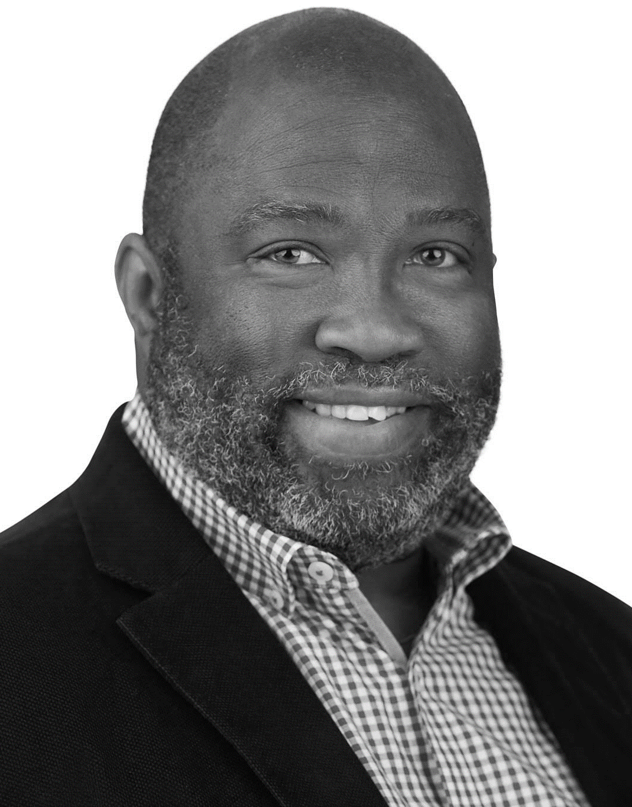
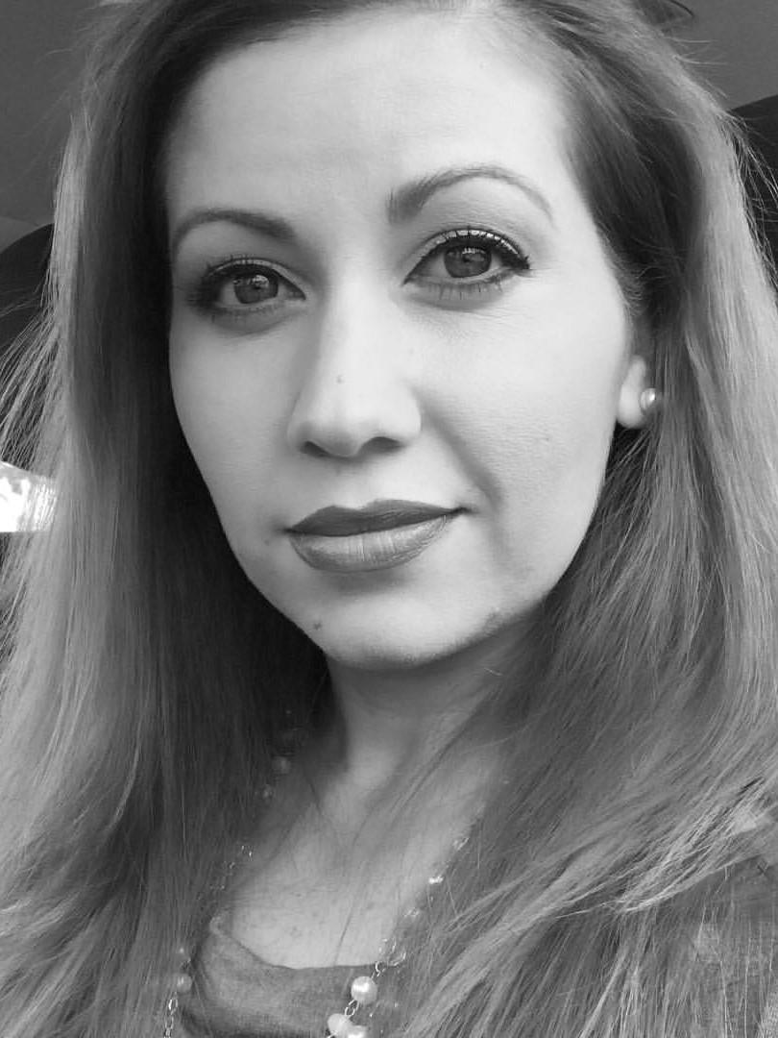
ASCCC 2022-23 Executive Committee
Representatives
Stephanie Curry
Area A Representative
Karen Chow
Area B Representative
Erik Reese
Area C Representative
Manuel Vélez
Area D Representative
Eric Wada
North Representative
Christopher Howerton
North
Representative
Juan Arzola
At-large Representative
Carrie Roberson
At-large Representative
Robert L. Stewart Jr.
South
Representative
Amber Gillis
South
Representative
Notes:
Ginni

Slide 7
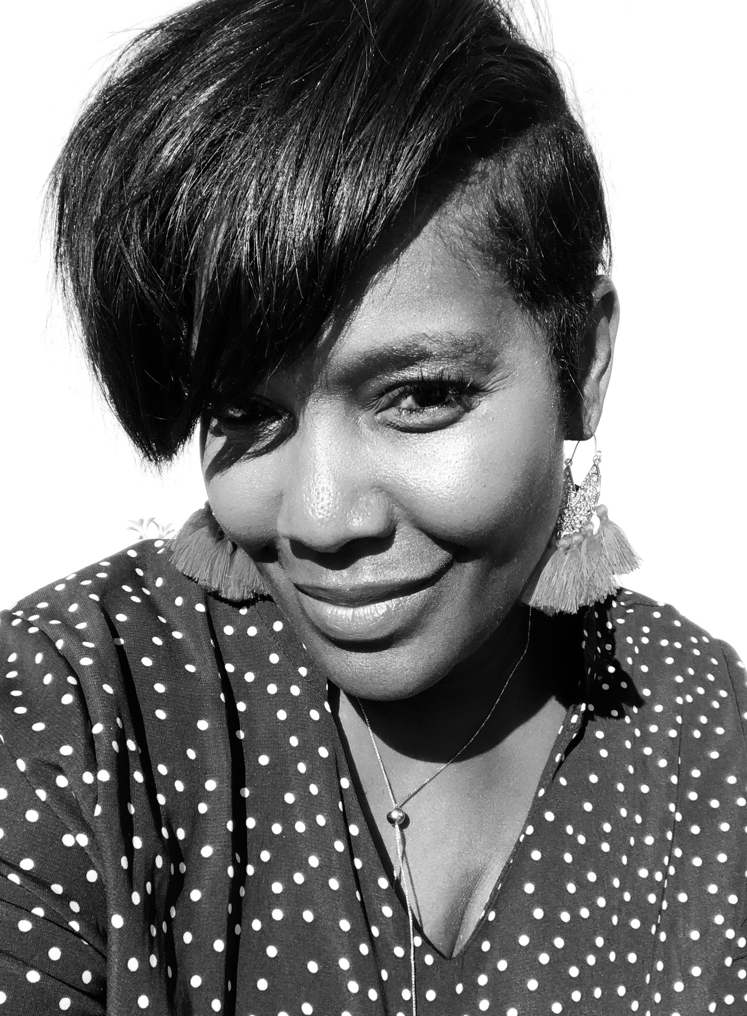
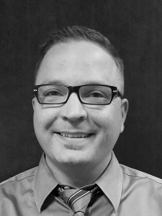
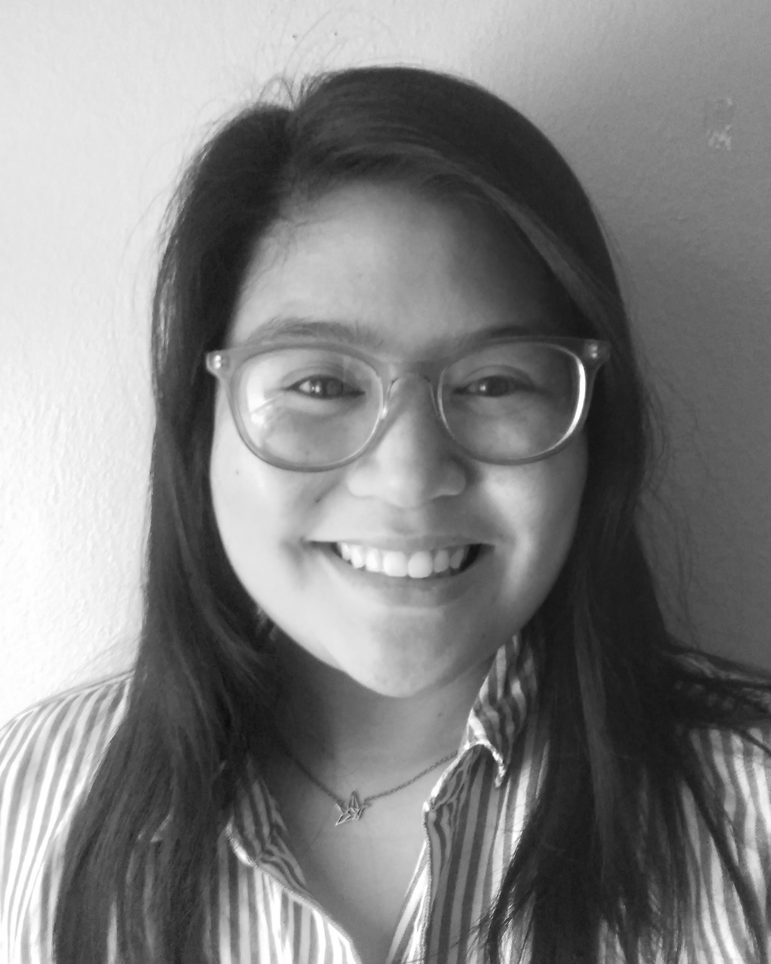
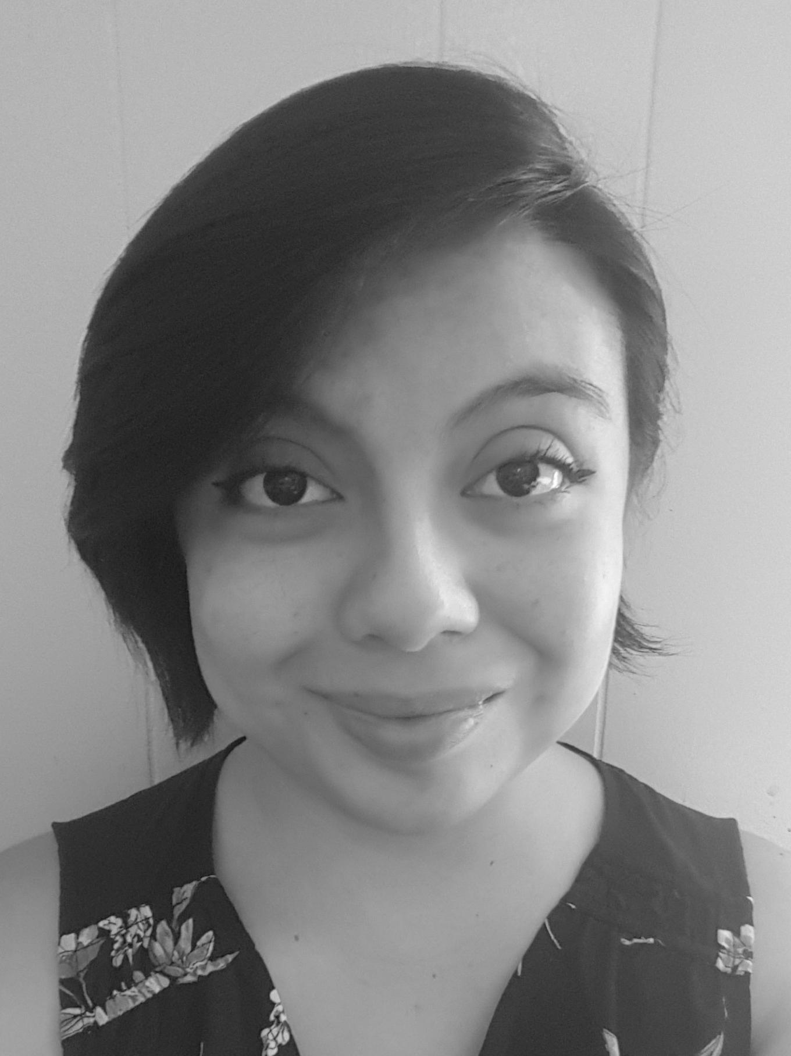
ASCCC Staff
Krystinne Mica
Executive Director
Tonya Davis
Director of Administration
Alice Hammar
Director of Finance
Miguel Rother
C-ID Program Manager
Melissa Marquez
Executive Assistant
Selena Silva
Program Manager
Notes:
Ginni

Slide 8
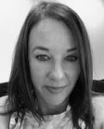
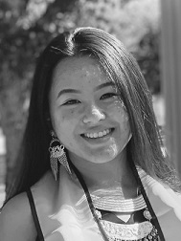
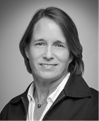
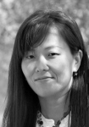
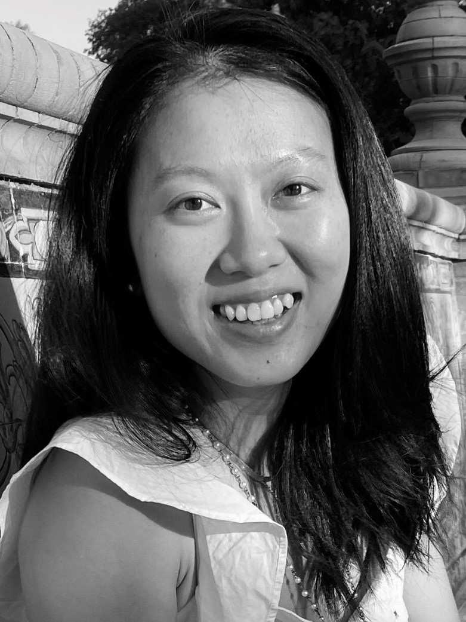
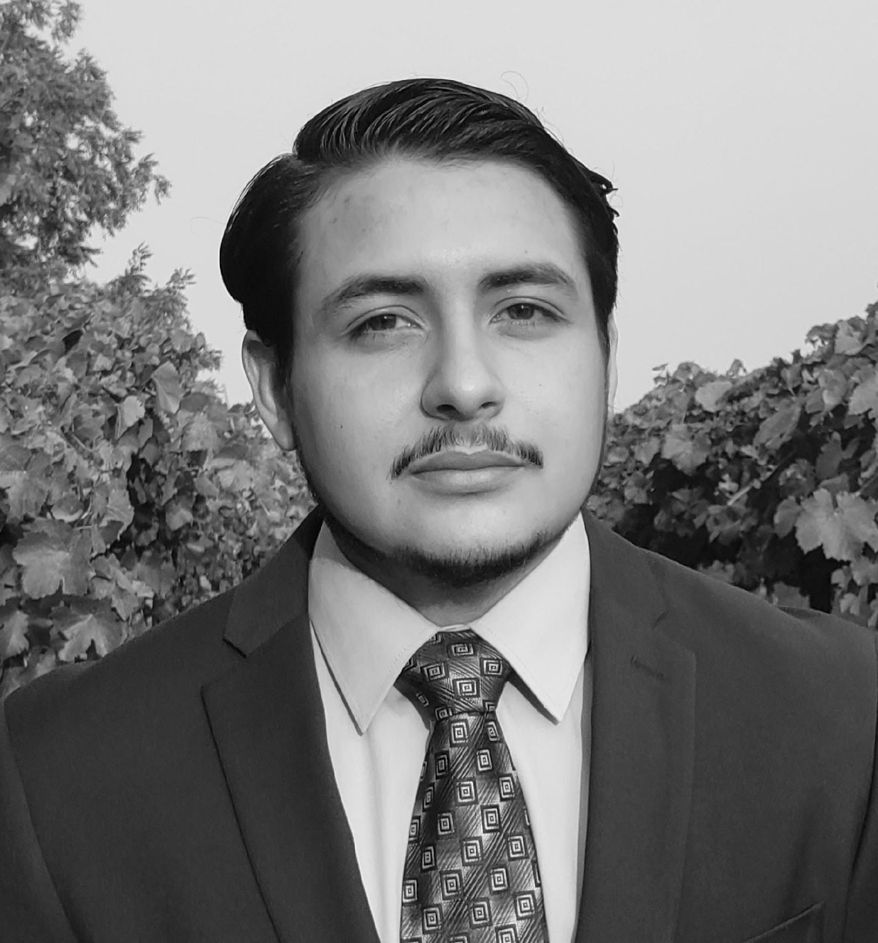
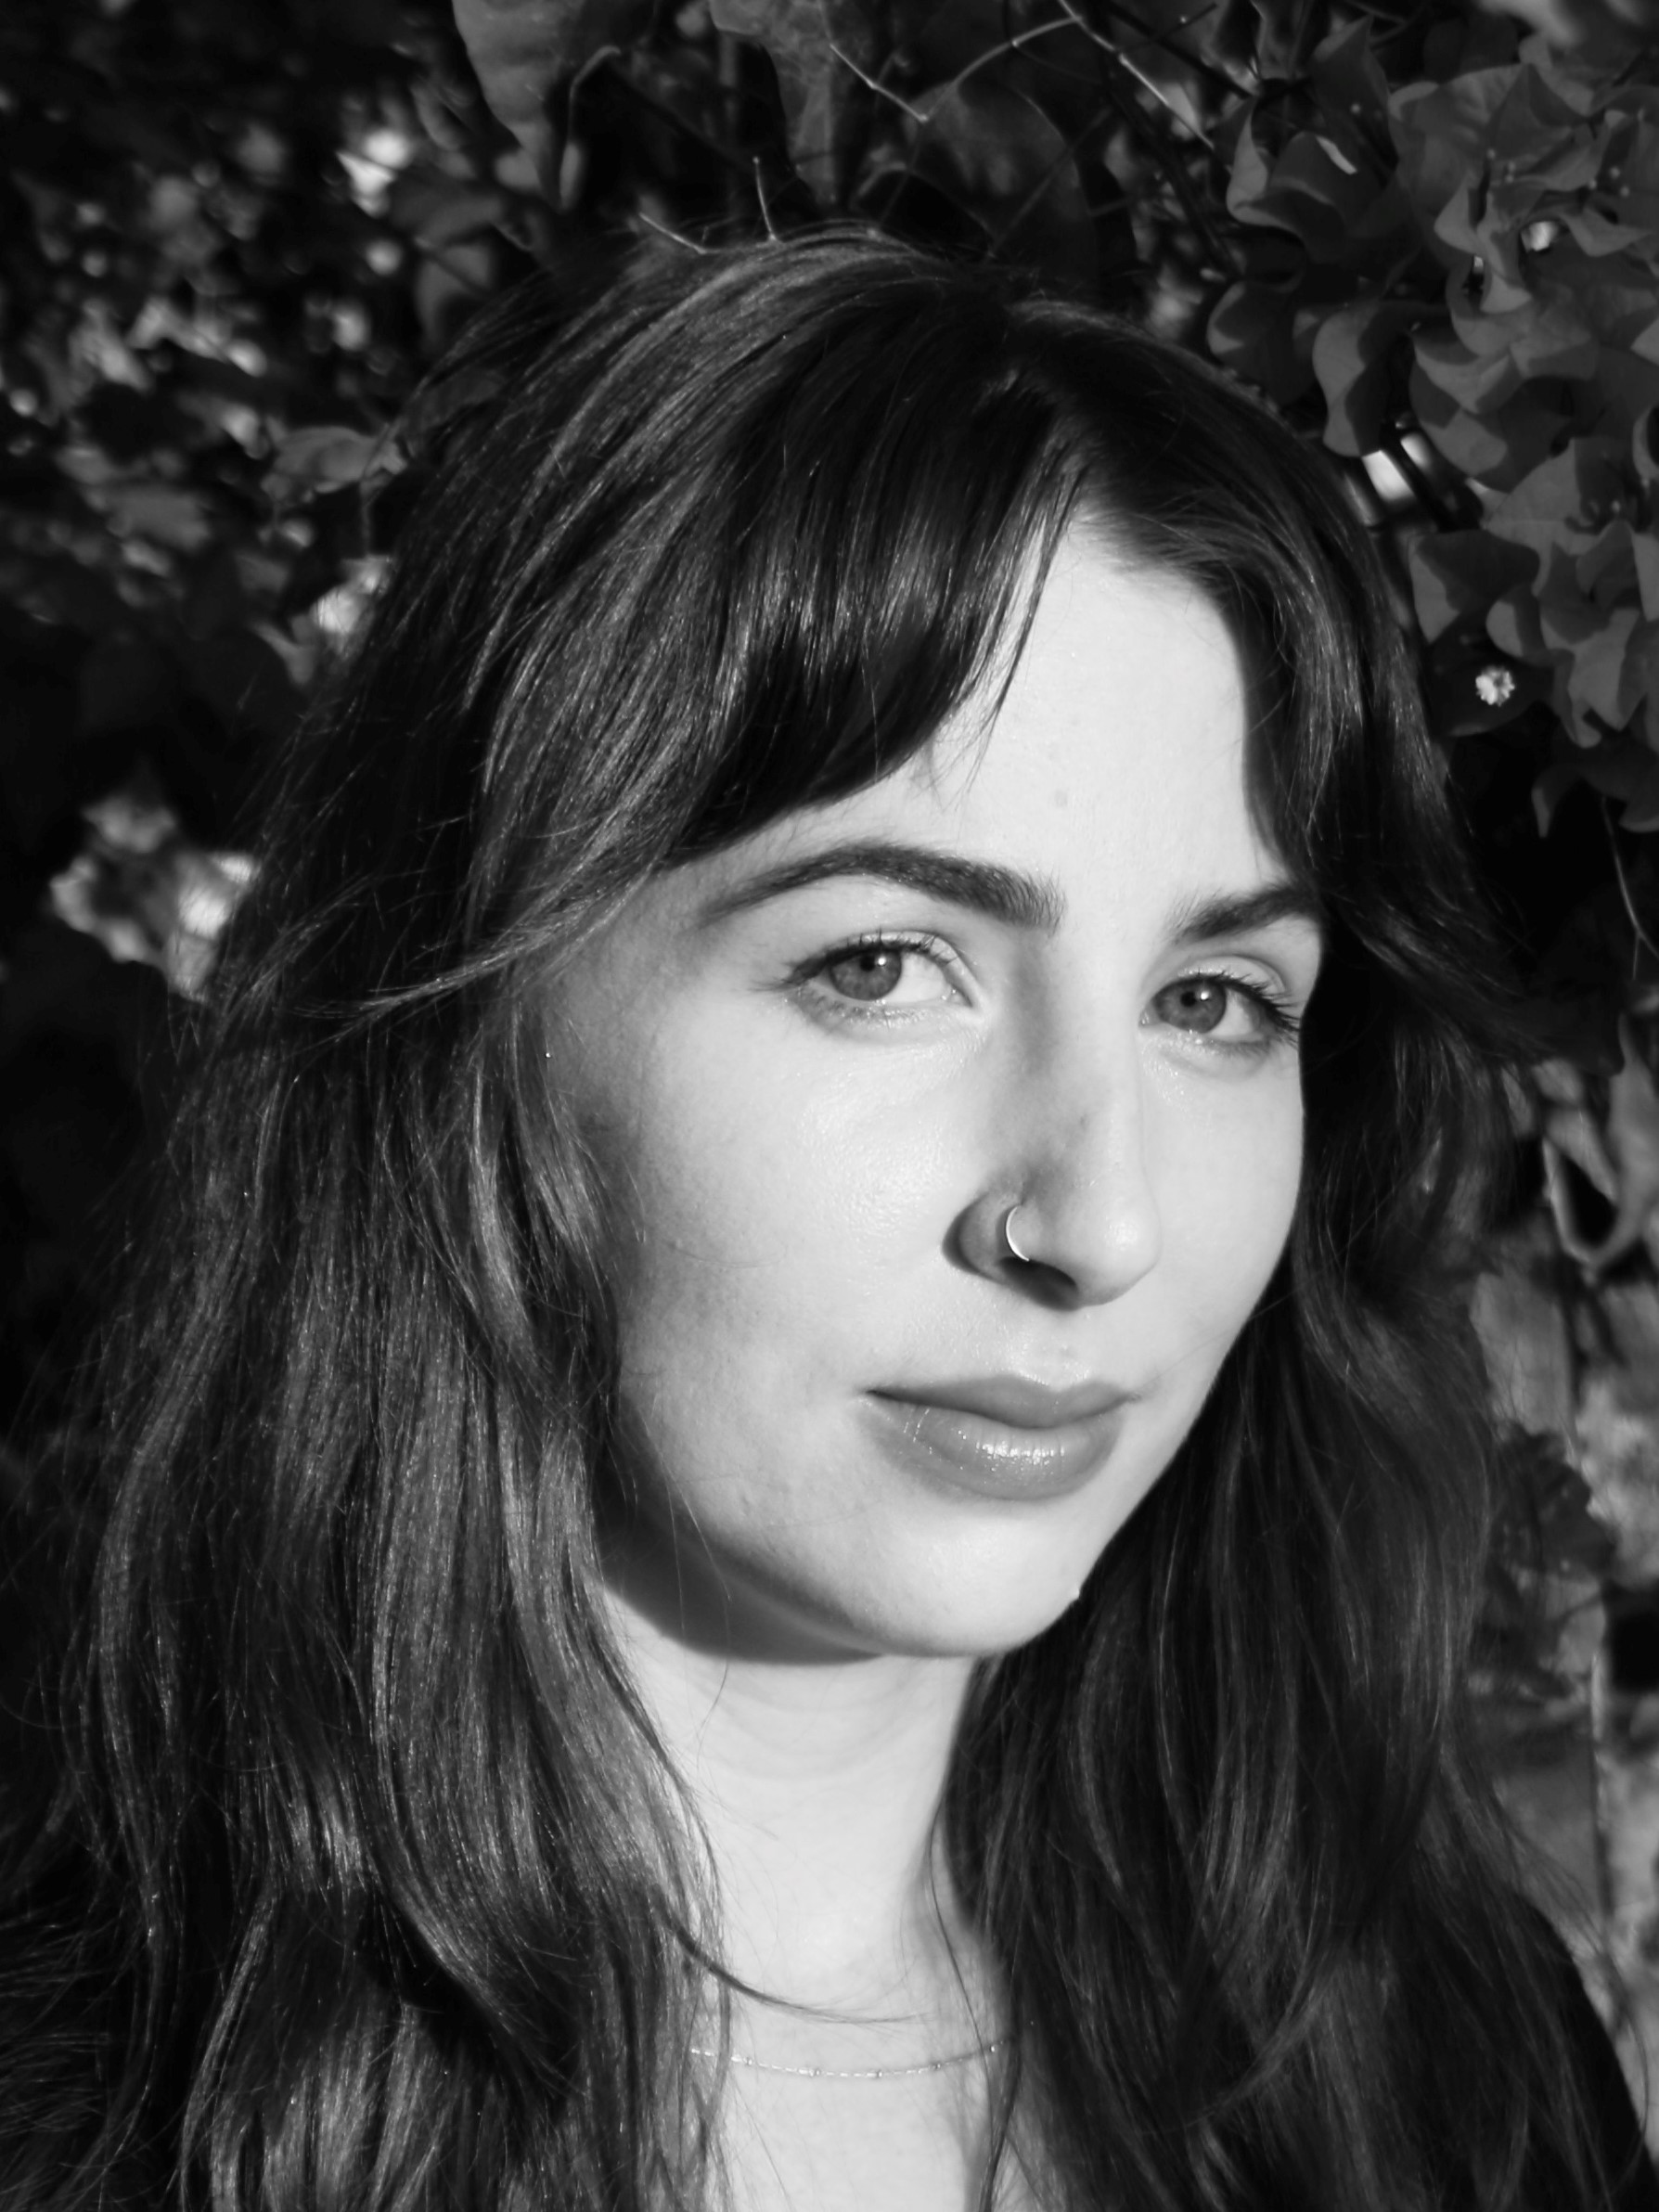
ASCCC Staff
Megan Trader
Program Coordinator
Edie Martinelli
Events Manager
Kayla Vue
Events Assistant
Katie Nash
Visual Designer
Kyoko Hatano
Administrative Assistant
Gina Lam
Research Associate
Brando Jimenez
Accounting Clerk
Emily Nicol
Administrative Assistant
Notes:
Ginni

Slide 9
Thank You!
Enjoy the
Faculty Leadership Institute!
Notes:
Ginni to Introduce Cheryl, Angelica, and LaTonya

