Slide 1
Managing Conflict… and BEYOND!
Silvester Henderson, ASCCC At Large Representative
Ginni May, ASCCC Treasurer
Carrie Roberson, ASCCC North Representative
Faculty Leadership Institute 2019
Sheraton Grand Sacramento

Slide 2
Here we are…
Many individuals at colleges are experiencing “initiative fatigue,” finding their patience, tolerance, and the ability to work collaboratively wearing thin. In turn, this affects various institutional and governance components of the college or district and has the potential to create workplace conflict. This breakout will reiterate the importance of developing interpersonal skills and consider conflict resolution approaches that can positively enhance our work. Bring your everyday wisdom and join us to address critical steps toward managing conflict and engaging in inclusionary practices that support a peaceful and productive work environment.
Notes:
At this point have a conversation. Can either go through our power point or we can have a discussion about how to have critical conversations with fellow faculty and administration

Slide 3
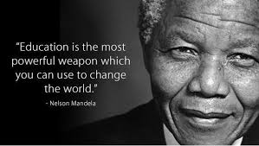
Notes:
CHANGE THE WORLD?! Pressure is on!
Dynamic system of higher education: accessible and most valuable!

Slide 4
TODAY
“Initiative fatigue”- who, what, when, where, why?
Conflict? CONFLICT!
Interpersonal skills- constructive or destructive?
RE: Solutions!

Slide 5
“Initiative fatigue” REALITIES!
WHO: we are a system
WHAT: system driven by legislation and law
WHEN: now…and forever?
WHERE: CCCCO, local college, department/program, other?
WHY: students!
HOW: 114 ways of doing,
114 ways of being

Slide 6
Conflict? → CONFLICT!
Conflict is inevitable!
WHY?
~~~~~
Assumptions, perceptions, and values
Status quo (institutional practices/norms)
Ownership/ Fear of Loss
Communication (social/cultural)
Knowledge, experience, expertise
What else?
Notes:
To each their own…
What else? Professional satisfaction, timing, & MORE!

Slide 7
CONFLICT Considerations…
What is the culture around conflict?
Avoidance
Accommodation
Competition
Compromise
Collaboration
Notes:
AVOIDANCE: strategy seeks to put off conflict indefinitely. By delaying or ignoring the conflict, the avoider hopes the problem resolves itself without a confrontation.
ACCOMODATION: strategy essentially entails giving the opposing side what it wants. The use of accommodation often occurs when one of the parties wishes to keep the peace or perceives the issue as minor.
COMPETITION: strategy to operate as a zero-sum game, in which one side wins and other loses.
COMPROMISE: Compromise: strategy typically calls for both sides of a conflict to give up elements of their position in order to establish an acceptable, if not agreeable, solution.
COLLABORATION: strategy integrates ideas set out by multiple people. The object is to find a creative solution acceptable to everyone. Collaboration, though useful, calls for a significant time commitment not appropriate to all conflicts.
NOT GOOD OR BAD! Situation considerations and… (next slide)

Slide 8
CONFLICT Dynamics…
Power and/or authority implications
Institutional practices and differences
Context
Situation
Information and facts- er, factual information!
Interpersonal Skills!
Notes:
Go round and round with dynamics at play… hard to figure out just what dynamic most influences the constructive or destrctuve components of conflict management.

Slide 9
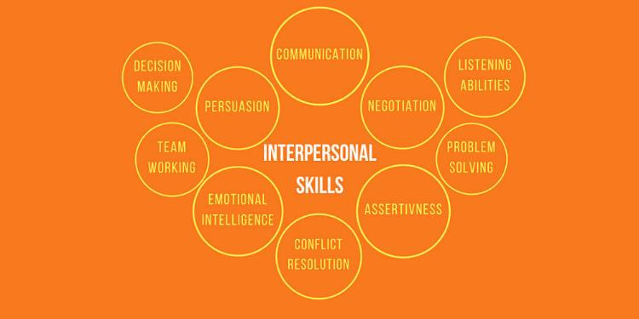
Interpersonal SKILLS!
Who said “attitude is everything?!”
Notes:
Focus on SKILLS- must be developed, practiced
A spectrum, not always demonstrated OR surprise yourself!
PARTICIPATORY ACTIVITY:
Have participants ID leadership skills that support conflict resolution (characteristics and behaviors within each of the SKILL areas)

Slide 10
RE:SOLUTIONS!
One size fits all solutions
Dismissal of others’ ideas, thoughts, perceptions
Ignoring unfavorable variables
Accusations/ assumptions
BEWARE…

Slide 11
RE:SOLUTIONS!
EFFECTIVE STRATEGIES for MANAGING CONFLICT
Understand realities
Identify the “why”
Consider the conflict culture
Recognize conflict dynamics
Enhance intra/ interpersonal skills
Notes:
EVERYDAY WISDOM? Self-awareness
Process for RE:Solutions at the ASCCC
Democracy is messy!
See Resolutions workshops for more info!
*One way you can support conflict management on your campus?
*I commitment to support yourself in conflict management

Slide 12
Communication Styles “Heart of the Problem”
Socialization practices & problem solving
Barriers to collaboration
Challenges surrounding institutional transformation

Slide 13
Let’s give it a try…
SCENARIO #1:
Two disciplines do not agree about who owns a particular class
SCENARIO #2:
Philosophical and practical disagreement about when a core course within a program is scheduled
Notes:
Participatory Activity
There is more than one size fits all!

Slide 14
THANK YOU- and GOOD LUCK!
Silvester Henderson
shenderson@losmedanos.edu
Ginni May
mayv@scc.losrios.edu
Carrie Roberson
RobersonCa@butte.edu

