Slide 1
Wednesday, June 16th 11:00-12:15pm Embedding DEI into Hiring Processes and Supporting Faculty Diversification Michelle Velasquez Bean, ASCCC Treasurer LaTonya L. Parker Ed. D., ASCCC Area D Representative

Slide 2
Session Description
While hiring practices may vary in terms of specifics in the 73 community college districts in California, basic principles and tenets of faculty hiring are consistent across the state. In recent years, a focus on diversifying the faculty who are hired at community colleges has increased in intensity, and both the Academic Senate for California Community Colleges and the California Community Colleges Chancellor’s Office have responded in a range of ways. This session will engage attendees in the hiring of new faculty and staff, and the use of an equity lens in hiring practices and procedures. As a team of leaders, we will share strategies on what kinds of practices and processes can be used to ensure that hiring committees are engaged in the work of equity, diversity, and inclusion. During this interactive, session we will examine some of the best practices from the Chancellor’s Office EEO Hiring Guide, as well as provide a framework for practitioners to bring back to their campuses and districts for systematic approaches to diversity, equity and inclusion.

Slide 3
ASCCC Sandbox – Your Chat Connecting Space…
Chat here!

Slide 4
Agenda
Equal Employment Officers (EEO) & Diversity Advisory Committee Integration Plan
Strategies
Challenges
Student Participation in all Hiring Committees
Why it Matters?
ASCCC Model Hiring Practices Canvas Module

Slide 5
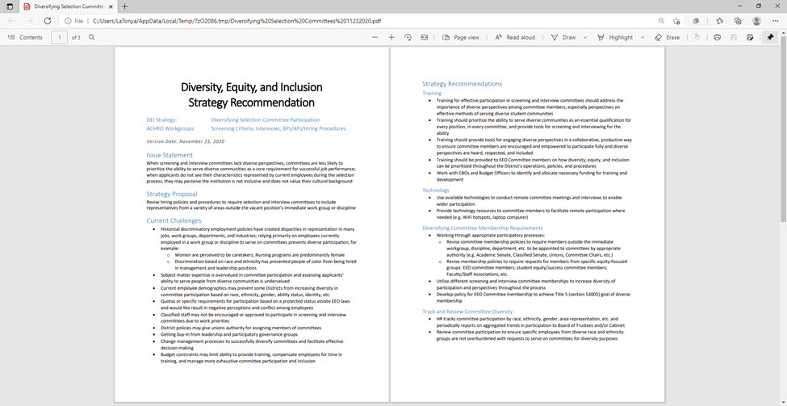
Equal Employment Officers (EEO) & Diversity Advisory Committee
Integration Plan Highlights

Slide 6
Hiring & Outreach
Implement innovative hiring and outreach practices focused on diversity
Recruitment
Develop culturally responsive faculty and staff (classified and administrators) recruitment strategies
Committee Makeup
Diversify hiring or screening committees with members of diverse educational background, gender, and ethnicity
Evaluations
Establish a diversity component in faculty evaluations
Diversity, Equity and Inclusion (DEI) Integration Plan

Slide 7
Organizing the work
Conducting Diversity Recruitment and Outreach
Writing Equity-minded Position Descriptions
Writing Equity-focused Vacancy Announcements and Application Requirements
Developing Equity-focused Screening Criteria
Writing and Conducting Equity-minded Interviews
Writing Equity-focused BPs and APs, including faculty hiring procedures
Writing and Bargaining Equity-minded Performance and Tenure Evaluations
Writing Exit Interviews Addressing Workplace Culture
Creating Diversity Retention Strategies
Collecting, Analyzing, and Reporting EEO Data
Notes:
Modeling diverse participation:
Antelope Valley College
Chabot-Las Positas CCD
Coast CCD
College of the Canyons
College of the Desert
Contra Costa CCD
Gavilan College
Kern CCD
Los Angeles CCD
Monterey Peninsula College
Mt. San Jacinto Community College
North Orange CCD
Riverside CCD
San Diego CCD
Santa Monica College
Shasta College
State Center CCD
Yosemite CCD/CCC Registry

Slide 8
Strategies Association of Chief Human Resource Officers (ACHRO), Equal Employment Officers(EEO) & ASCCC
Strategy Recommendations
Completed fall 2020:
Diversifying Selection Committee Participation
Student Participation in Selection Committees
Strategy Recommendations Drafted fall 2020:
DEI-focused Exit Interviews
DEI-focused Employment Marketing Videos
Prioritizing DEI in Interview Questions
Key Collaborations:
California Community College Trustee (CCCT) Board Workgroups
ASCCC Model Hiring Practices Canvas Module
CIO workgroup partners

Slide 9
Strategies Challenges
• Historical discriminatory employment policies have created disparities in representation in many jobs, work groups, departments, and industries; relying primarily on employees currently employed in a work group or discipline to serve on committees prevents diverse participation
• Subject matter expertise is overvalued in committee participation and assessing applicants’ ability to serve people from diverse communities is undervalued
Notes:
for example:
o Women are perceived to be caretakers, Nursing programs are predominantly female
o Discrimination based on race and ethnicity has prevented people of color from being hired in management and leadership positions

Slide 10
Challenges Continued…
• Current employee demographics may prevent some Districts from increasing diversity in committee participation based on race, ethnicity, gender, ability status, identity, etc.
• Quotas or specific requirements for participation based on a protected status violate EEO laws and would like result in negative perceptions and conflict among employees
• Classified staff may not be encouraged or approved to participate in screening and interview committees due to work priorities

Slide 11
Challenges Continued
• District policies may give unions/collective bargaining units authority for assigning members of committees
• Getting buy-in from leadership and participatory governance groups
• Change management processes to successfully diversify committees and facilitate effective decision-making
• Budget constraints may limit ability to provide training, compensate employees for time in training, and manage more exhaustive committee participation and inclusion

Slide 12
Recommendation: Add Student Participation in ALL Hiring Committees
Strategy Proposal:
Increasing input from students in processes and criteria used for screening and interviewing applicants will provide more diverse perspectives on which candidates are considered qualified and increase the importance of serving diverse communities successfully as minimum and preferred qualifications.
Notes:
Current Challenges
• Students typically cannot be available to serve as formal voting members of screening and
interview committees due to scheduling conflicts (class schedules, work schedules, etc.)
• Financial constraints may prevent students from being able to participate without pay
• Districts are concerned with confidentiality in the hiring process and including multiple students
makes it more likely for breaches to occur
• Districts are concerned about ensuring EEO compliance and managing student participation while
complying with internal EEO-related policies and complying with state and federal regulations
• Districts are concerned students may not be adequately trained or possess skills necessary to
participate in committees effectively
• Concerns about student(s) participating in a selection committee enrolling in a course taught by a
newly hired faculty
• Getting buy-in from leadership and participatory governance groups
• Change management processes to successfully integrate students into committees and facilitate
effective decision-making
Informal Student Participation in Committees
• Revise policies to require informal student participation in all committees
• Prior to application screening, invite students to committee meeting to provide their perspective
on effective performance in the position
o What skills and abilities do great professors have?
o What does great service from Financial Aid staff look like?
o What skills and abilities to you want to see in a Counselor?
• Invite students to committee meetings to discuss criteria used to screen applications and select
applicants for interviews
• Invite students to committee meetings to provide recommendations on questions to be used in
interviews and input on evaluating responses to questions
• Invite students to review application materials and provide input to committees
• Invite students to observe interviews and provide input to committees
• Invite students to observe teaching/work demonstrations and provide input to committees
• Diversify student participation by requesting student representatives from a variety of campus
organizations
Student Participation in Final Interviews
• CEOs invite students to participate in final interviews
• Participation may be to observe only and then provide input during deliberations; or,
• Participation may include asking prepared questions or engaging in open discussion with
candidates

Slide 13
Recommendation: Add DEI Discussion to Every Agenda
Dr. Regina Stanback-Stroud at ASCCC Spring Plenary:
“Move at the pace of the needs of the oppressed, not the comfort of the privileged!”
Don’t give up!
Ask WHY at every meeting and in every space—use your privilege and position.
Examine the WHY—ask:
Whom does this harm?
Whom does this benefit?
Notes:
Stanback Stroud: “I’m not going to behave myself so that people can like me.” Get into good trouble!

Slide 14
Why It Matters?
Findings in a 2019 study published in the journal Race Ethnicity and Education stressed “the need for diverse faculty to enhance student success, ultimately improving grades and retention. Given the benefits to students, a focus on the hiring and retention of faculty of color may be key in addressing academic disparities.”
Notes:
“Faculty diversity has benefits for all students; however, increasing faculty diversity may be particularly helpful in reducing academic disparities for students of color,”
https://www.tandfonline.com/doi/abs/10.1080/13613324.2019.1679759?journalCode=cree20

Slide 15
How to Start Antiracist Work: Faculty Hiring Practices for Diversification
Dr. Abdimalik Buul, Summer 2020 Rostrum:
“Race-conscious inquiry and talking about race is uncomfortable for many because we have been socialized to avoid meaningful discussions about race, but we must persist through the discomfort. Emotions run deep and high when conversations about race emerge, but those conversations are valuable and important. Brave spaces, where the work around institutional change takes place, are needed. The challenge is, however, in answering if we are ready to invest and to investigate the patterns rooted in a dominant culture that preserves the status quo. The death of George Floyd is a glaring example of the ambivalence that ensues when we do not intervene and have necessary dialogue. If we are serious about addressing the equity gap that persists across California community colleges, we must also acknowledge the problematic equity gap that exist in our faculty hiring practices and the suffocating knees on the necks of our Black faculty resulting in the deleterious impact on our student success.”
Notes:
Buul, Abdimalik. https://asccc.org/content/how-start-antiracist-work-faculty-hiring-practices-diversification

Slide 16
Faculty Hiring and Diversity: An Ongoing Collaborative Effort Dolores Davison, ASCCC President Mayra Cruz, ASCCC 2020-2021 Treasurer
“One of the most crucial of these assigned tasks is in the area of diversification of faculty hiring. The examination of faculty hiring requires the review of the structural, human, and cultural factors that are part of the hiring process. To this end, the ASCCC developed a series of modules around all areas of the hiring process, including not only hiring itself, but recruitment and retention as well.” February 2021 Rostrum
Notes:
https://www.asccc.org/content/faculty-hiring-and-diversity-ongoing-collaborative-effort

Slide 17
Practical Steps for Anti-Racist Hiring Practices (Dr. Buul)
Cluster Hiring
Intentional Recruitment
Post Hiring Autopsy
Mentorship
Notes:
1. Cluster Hiring--Anti-racist institutions practice cluster hiring, where they hire multiple faculty of color at once, so feelings of isolation are not so prevalent (Guenter-Schlesinger and Ojikutu, 2016). San Diego State—model of Cluster Hires: https://sacd.sdsu.edu/diversity-initiatives/aa-cluster-hires.
2. Intentional Recruitment--Diversifying pipelines by advertising positions in diverse magazines or posting advertisements with diverse organizations, as well as diversifying adjunct/part-time faculty pools.
3. Post Hiring Autopsy--Equity-minded institutions follow up on a holistic model by conducting a post-hiring report on the number of candidates who applied, those who were invited to an interview, and those who were forwarded as finalists.
4. Mentorship-- Mentorship is critical for the professional development of any college faculty; however, due to scarcity of faculty of color, it is more salient to their success to support them with intentional mentorship, which can come from white faculty as well, as research confirms that it is a common myth that only faculty of color can effectively mentor faculty of color (Brown, Davis, and McClendon, 1999).

Slide 18
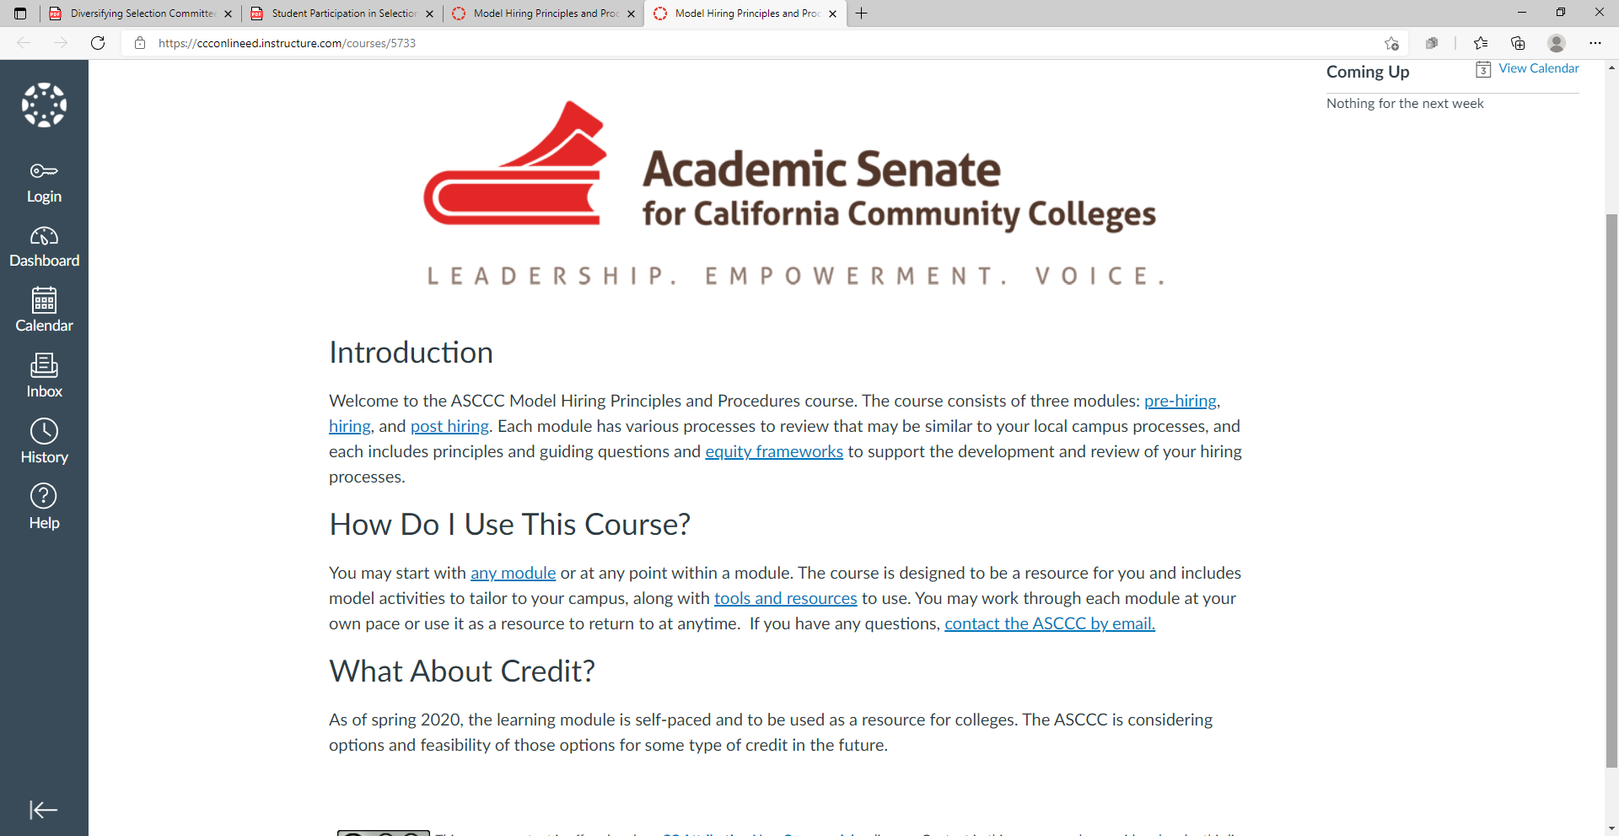
ASCCC Model Hiring Practices Canvas Module
Those modules, detailing model hiring practices and procedures, can be found at https://ccconlineed.instructure.com/courses/5733

Slide 19
Shared Best Practices/Q & A

