Slide 1
Beyond Buzzwords
Creating a Culture of Accountability Around Diversity, Equity, and Inclusion

Slide 2
Introduction
Over the last decade we’ve seen an increase in focus on concepts such as diversity and equity across the nation. This positive development is evident in the support DEI efforts have gained from local, regional, and statewide groups, including the ASCCC. At the community college level this has translated into efforts to encourage diversity and equity through professional learning, curriculum redesign, and other efforts that are finally moving DEI goals past superficial conversations and towards concrete efforts that effectively work to address structural racism and the difference in student success levels that it creates. In this session we’ll explore the various ways that our colleges are working to sincerely and successfully infuse diversity, equity, and inclusion into their college culture and discuss ideas for implementing effective DEI strategies at your college.
Cheryl Aschenbach, ASCCC Secretary
Manuel Vélez, ASCCC South Representative
Notes:
Cheryl

Slide 3
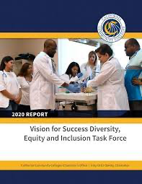
DEI Efforts at CCCs
In 2019 the Vision for Success Diversity, Equity and Inclusion Task Force was established at the request of the Board of Governors. This group had two main goals:
Consider adding a diversity-related goal and/or commitment to the Vision for Success; and
Design, draft and implement a set of statewide structural changes, including policies, practices and tools that the system can utilize to rapidly improve recruitment, retention and support of diverse faculty, staff, and administrators.
Notes:
Manuel

Slide 4
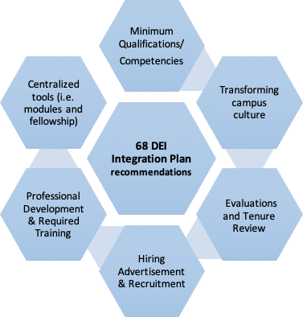
DEI Efforts at CCCs
Transforming Culture
DEI Implementation Plan
https://www.cccco.edu/-/media/CCCCO-Website/Files/Communications/vision-for-success/5-dei-integration-plan.pdf?la=en&hash=2402789D82435E8C3E70D3E9E3A8F30F5AB13F1D
Notes:
DEI implementation approved by BOG Sept 2019

Slide 5
DEI Efforts at CCCs
In June of 2020, Chancellor Oakley called on the CCC system to “take action against structural racism”, identifying 5 areas around which mobilization could take place. Among them were areas related to DEI:
Audit classroom and create inclusive classrooms with anti-racism curriculum
District-wide reviews of equity plans
Focus on early implementation of the CCC Diversity, Equity, and Inclusion Integration Plan

Slide 6
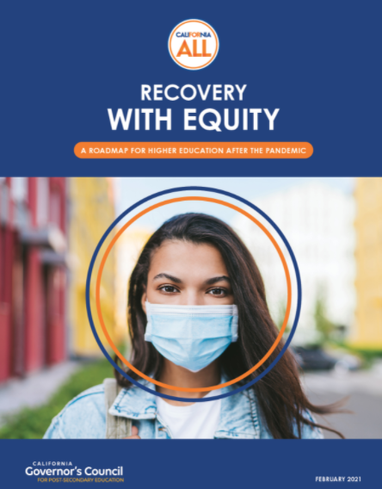
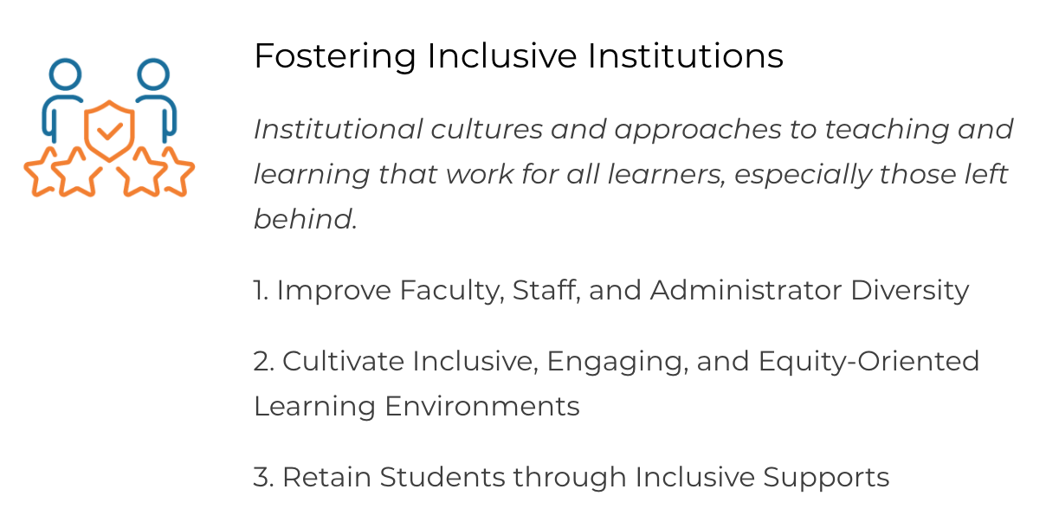
Governor’s Recovery with Equity Report
https://www.capostsecondaryforall.org/wp-content/uploads/2021/03/Recovery-with-Equity_2021Mar25-12pm.pdf
Notes:
4 Broad recommendation areas:
Fostering inclusive institutions
Streamlining pathways to degrees
Facilitating student transitions
Simplifying Supports for Student Stability
Elements of Fostering Inclusive Institutions:
1.Enact legislation mandating that each segment upskill all board members, staff, faculty, and administrators with training and professional development in implicit bias, cultural competency/fluency, and effective teaching techniques for diverse learners, targeting 2022 for completion of first-round professional development.
2.Re-envision curricula across disciplines to be anti-racist and equity-centered and foster a sense of belonging among students…For example, students’ course evaluations could include a question pertaining to whether the course content aligned with principles of diversity, equity, and inclusion.
3. Implement culturally competent teaching and learning practices, which include routinely assessing instruction from a diversity, equity, and inclusion perspective.
4. Incorporate equity-centered practices into teaching and learning, grading, annual evaluations, and faculty review/tenure processes.

Slide 7
Small Group Discussion Prompt #1
The DEI Implementation Plan and Chancellor’s “Call to Action” motivated many local colleges and districts to implement their own efforts to address structural racism and to promote diversity, equity, and inclusion. Take some time to discuss with your group how your college and district reacted to this call. You many consider some of the following points to help you in your discussion:
What level of support did the “call to action” have at your college or district? Was there any opposition and if so, what was this opposition based on?
In what ways did your Academic Senate respond to the Chancellor’s call?
What DEI efforts were already on their way at your college/district prior to the Chancellor’s call? What DEI efforts were specifically motivated by the the call?
Notes:
Cheryl

Slide 8
Long Beach City College
Cultural Curriculum Audit
The Cultural Curriculum Audit is a three day intensive workshop for faculty. The goal of the audit is to redesign a course (individually or as part of a team) with a focus on increasing equity and student success. The audit includes presentations on a variety of topics as well as time to collaborate with discipline partners and small groups of faculty across disciplines. Because of the three-day time commitment this is a stipended workshop that generally occurs outside of the semester during the summer and winter intersessions. The following topics are covered in the workshop:
Understanding Success and Equity Data Principles of Student Equity Thinking About Identity Implicit Bias Redesigning the Syllabus Creating a Welcoming Canvas Home Page | Modifying a COR Redesigning Course Content Creating an Inclusive and Empowering Zoom Classroom 101 Active Learning Strategies Making Assignments More Transparent Grading Through an Equity Lens
Notes:
To date, how many instructors have completed the program? Does participation/interest grow each year?
​We have had approximately 230 LBCC faculty participate in the Cultural Curriculum Audit over the past 2 years (that number is about 270 when we include participants from other colleges). Yes! The cohort sizes have grown each year. In Summer 2019, when we were still on campus, there were about 30 participants. By Summer 2020, with the online audit, we reached 65 participants.
What are the most visible or positive outcomes of the program to date?
​The most visible outcomes of the program include a clear application of equity-minded skills and practices. At the end of the audit, each participant spends time completing and submitting final deliverables. This includes a revised and equity-minded syllabus, culturally relevant lesson plan, transparent assignments, and a slideshow presentation highlighting these changes. The before and after of these items is often quite remarkable. In addition, we have seen a strong trend of audit participants/leaders moving into campus leadership positions. Currently, the following positions are held by former audit participants: Student Equity Coordinator, FPD Coordinator, Online Education Faculty Coordinator, OER Coordinator, Academic Senate President, Cultural Curriculum Audit Coordinator.
Are participants compensated for participating and if not, how are participants recruited?
Yes.​ Participants who complete the audit, including all program deliverables noted above, receive a $1,000 stipend. This was originally funded through Guided Pathways, and has since been covered by CARES Act funds with the focus being online instruction.
How much, if at all, has the program evolved or changed since its inception?
​Wendy will be writing you on this point, as she has been a key leader since the beginning. In addition, here is our recent article through @ONE that briefly sums up the evolution of the audit: https://onlinenetworkofeducators.org/2021/03/19/conducting-an-online-course-cultural-curriculum-audit-steps-toward-student-equity-and-success/
I’m thrilled to announce that our College has been generously gifted $30 million from author and philanthropist MacKenzie Scott. This money has been given in recognition of the work we’ve already accomplished to further our equity efforts and become a more race conscious college

Slide 9
San Diego Mesa College:
13 Point Strategic Action Plan
for Racial & Social Justice
The 13 Point Strategic Action Plan for Racial & Social Justice is a comprehensive vision for campus-wide efforts based on community organizational plans. The action plan calls for a college-wide commitments to DEI, Community Involvement, Accountability and Transparency, and Restorative Justice through 13 “actions”:
Develop a proactive hiring plan Provide campus DEI training Provide evidence of DEI training for employee evaluation and advancement Evaluate and improve DEI in classrooms Evaluate and improve DEI in departments Evaluate and improve DEI in schools Evaluate and improve DEI in administration | Provide sense of belonging via services, activities, spaces Provide sense of belonging via Ethnic Studies curricula and programs Provide sense of belonging via campus climate Expand DEI positions and influence Conduct annual DEI evaluations DEI data analysis report and integration
Notes:
In terms a a general description of "The San Diego Mesa College 13 Point Strategic Action Plan for Accountability in Diversity, Equity and Inclusion," I would summarize it as follows: The 13 Point Strategic Action Plan for Accountability in Diversity, Equity and Inclusion is a comprehensive approach to assessing the extent of Mesa College's support for diversity, equity and inclusion initiatives on our campus. The 13 Point Plan not only assesses, but organizes a structure for the review, planning and integration of evaluative data. The purpose of the plan is to hold all campus and District constituencies accountable for seeing that our programs, policies, procedures, governance structures and spaces, are socially just, culturally affirming, anti-racist and equitable. The plan will necessitate ongoing review, input, implementation and participation from students, faculty, professional staff and administrators. The goal of the plan is to encourage more transparency, better communication, and an expansion of the reach of diversity, equity and inclusion to all aspects of our campus, including classrooms, schools, programs, persons, services and governance structures. The 13 Point Plan has been synchronized with the San Diego Community College District's policies supporting diversity, equity and inclusion, the Mesa College 2030 Master Plan, and the goals set forth by the Mesa College Success, Equity and Transformation Committee and the Mesa College Committee for Diversity Action, Inclusion & Equity.
Regarding the goal, see the above summary.
Regarding the response to the plan, there have been several recommendations from campus constituents for amending or appending the Plan. These suggestions were excellent, greatly appreciated and incorporated into the Plan. Although there are many divergent ideas on how each of the tenets of the Plan should be operationalized, the overall Plan itself has been met with universal approval, including from the AFT and the District's Campus Diversity Advisory Council. On campus, the 13 Point Plan was approved by the Academic Senate, the Classified Professional Senate, the Associated Students and the President's Cabinet. Further, President Luster has set a meeting on June 17, 2021 at 4 pm (Let me know if you want to attend, and I'll have Sara Beth send you a Zoom link) to further discuss the implementation of the plan, resources and timeline.

Slide 10
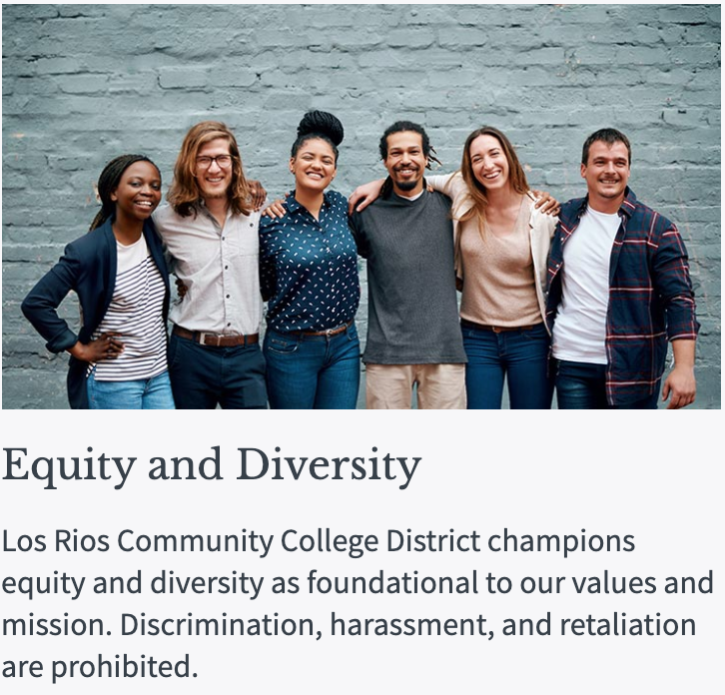
Los Rios Community College District:
Incorporating DEI
into Faculty Evaluations
March 2021 Learning Session with DEI Implementation Task Force
Incorporating a DEI self-reflection question into faculty evaluation process
Takeaways from LRCCD:
A commitment to DEI must be institutionalized, including integration into the strategic planning process
Support structures and resources are critical
Partnerships between academic senates and unions are integral
Including and empowering people to lead courageously is important
Facilitating trust through code-switching and interest-based negotiations is key
Notes:
Cheryl
•A district must institutionalize a commitment to DEI.
•Integrating a district commitment into the strategic planning process is critical.
•Districts must build in support like a manual for hiring policies, professional development, faculty academies, etc.
•Academic Senate and the bargaining units must develop a partnership.
•This work is about bringing people in and empowering people to lead courageously.
•Code switching is key and interest-based negotiations facilitate building trust.

Slide 11
Los Angeles Community College District
Project Match
Project Match is a program to prepare and recruit a diverse community college faculty who are sensitive to the needs of the students and community it serves. The goals of the program are to:
improve the diversity of the faculty pool in the District
mentor participants to serve as role models reflecting that diversity within the District
better reflect the diversity of the communities within the largest community college district in the nation
Notes:
ManuelProject MATCHMentors Act To Change Historyis a project at the Los Angeles Community College District. Project MATCH was launched in 1991 to increase and diversify the faculty applicant pool in the Los Angeles Community College District. MATCH recruits and 2 prepares individuals from historically underrepresented groups for careers as community college instructors. MATCH primarily targets candidates with master's degrees who have not yet taught at the community college level
The program embodies LACCD’s equity framework dedicated to the principles of equity, justice and community. LACCD and its colleges are actively working together to build our antiracist organizational capacity and resilience and move forward towards a more socially and racially-just academic community.
Each year hundreds of applicants are interviewed. Those who are chosen attend The Summer Institute, held during the months of July and August, designed to give mentees the fundamental theories and skills necessary to thrive in their community college mentorship. Summer Institute classes are scheduled twice per week on Thursday and on Saturday. Thursday class is from 6:00 pm to 10:00 p.m. and the Saturday class is from 8:30am to 3:00pm. Mentees are given a stipend of $800 and work along with their mentor during the fall semester (3 hours per week for 15 weeks)
The 2013 Dr. John W. Rice Diversity Awards hosted by the Foundation for California Community Colleges

Slide 12
Small Group Discussion #2
As we learned during this session, the DEI Implementation Plan and Chancellor Oakley’s Call to Action certainly helped to promote and increase DEI efforts at community college’s across the state with some promising results. In this discussion take some time to dialogue over the effectiveness of some of these programs or any efforts that you’re aware of at your college or region. The following questions are provided to help with your discussion:
Of the programs presented, which would work best at your college? If your college is currently offering a similar program, tell us about it.
In what ways, if at all, do these efforts move us past “buzzwords”?
What can the ASCCC do to promote and support DEI efforts? The Chancellor’s Office? The Board of Governors?
Notes:
Manuel

Slide 13
Cheryl Aschenbach
ASCCC Executive Committee Secretary
caschenbach@lassencollege.edu
Manuel J. Vélez
ASCCC Executive Committee South Representative
mvelez@sdccd.edu

