Slide 1
Budgets as Value Statements: Breaking It Down and Bringing in the Discussion
General Session: Thursday, June 17 at 1:30 -2:45 p.m.
Follow- up Breakout Session: Thursday, June 17 at 3:15 p.m.

Slide 2
General Session Description
While it is a harried and crazy time right now, it is also an important time to discuss useful and innovative ways to use federal and state money to support the work we are doing for student success, diversity, inclusion, equity, and antiracism. What is being proposed and what is changing in the budget? How are we going to address the harm done and the impacts on our students and our system as a result of the pandemic? How do we redesign and reimagine the way we address the acute needs of students and reflect the values of California community colleges? During this session, the presenters will provide an overview of state and federal budgeting processes and give suggestions on how faculty leaders might get involved and feel more empowered to ask questions in order to make sound decisions that drive the DEI work on our college campuses.

Slide 3
Today’s Presenters
Michelle Velasquez Bean, ASCCC Treasurer
Mario Rodriguez, Los Rios Community College District, Vice Chancellor of Finance and Administration
Notes:
3

Slide 4
Topics
Overview of student centered funding formula
Impact on how local budget allocations
Overview of state budget process
Overview of current budget proposals
Federal stimulus focused on mitigating impact on students
Involvement in budget discussions—the faculty role
Notes:
Today. . .
Mario will review all the nuances of budgets and budget processes
I will end with faculty role and what and why its necessary

Slide 5
Use Pathable Chat
Notes:
Use Pathable for Chat for Q&A
Closed caption
PPT in Pathable

Slide 6
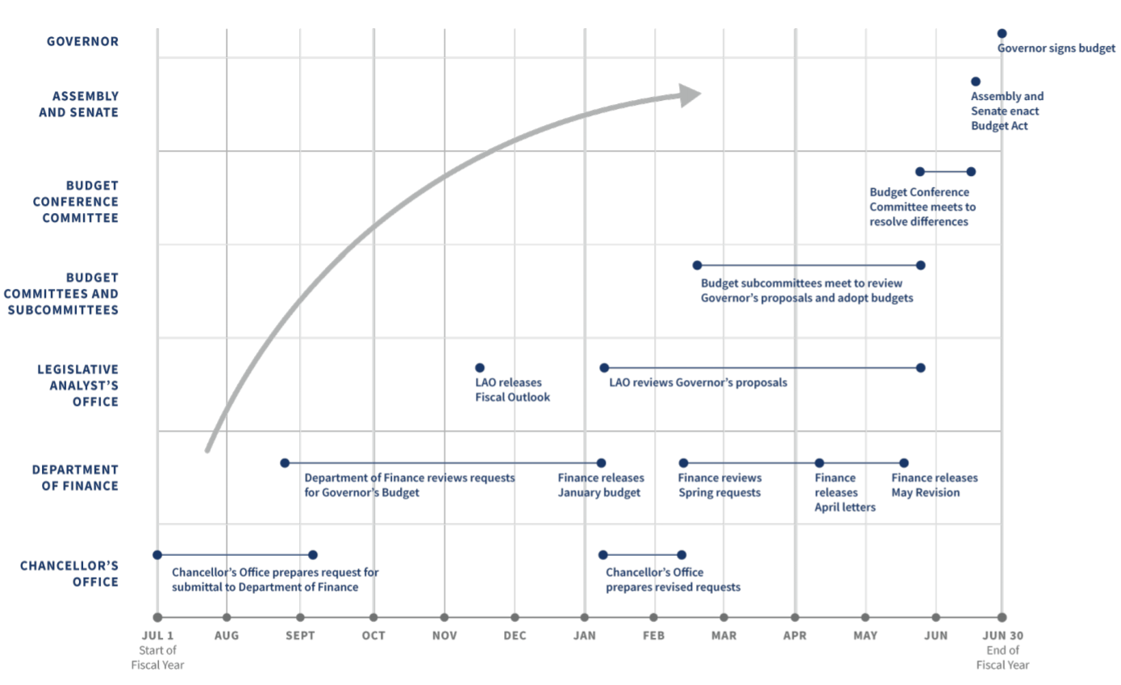
Budget Process
6

Slide 7
2021-22 Budget Proposal and Impact
Turn around in state economic and revenues
State Assembly and Senate have reached an agreement on the California Budget
Large COLAs, Student Aid, Technology, and Faculty
Mostly one-time, but substative ongoing adjustments
7
Notes:
Deferrals vs cut to base apportionment- Those deferrals will be a challenge for districts but seem better than a permanent reduction to apportionment rates.
Note for Mario: Outcome of the conference committee between the legislature and the administration to be conclude by June 15.
7

Slide 8
Student Centered Funding Formula
Replaced “Program-Based Funding Model” or Senate Bill 361
70% based on students served and funding for your site
Base Allocation
20% based on the number of financially needy and Assembly Bill 540 students served
Supplemental Allocation
10% based on outcomes of students
Success Allocation
8

Slide 9
SCFF Calculation - Site
9

Slide 10
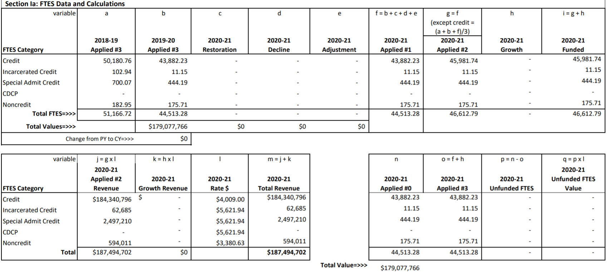
SCFF Calculation - FTES
10

Slide 11
SCFF Calculation - Supplemental
11

Slide 12
SCFF Calculation – Success (All)
12

Slide 13
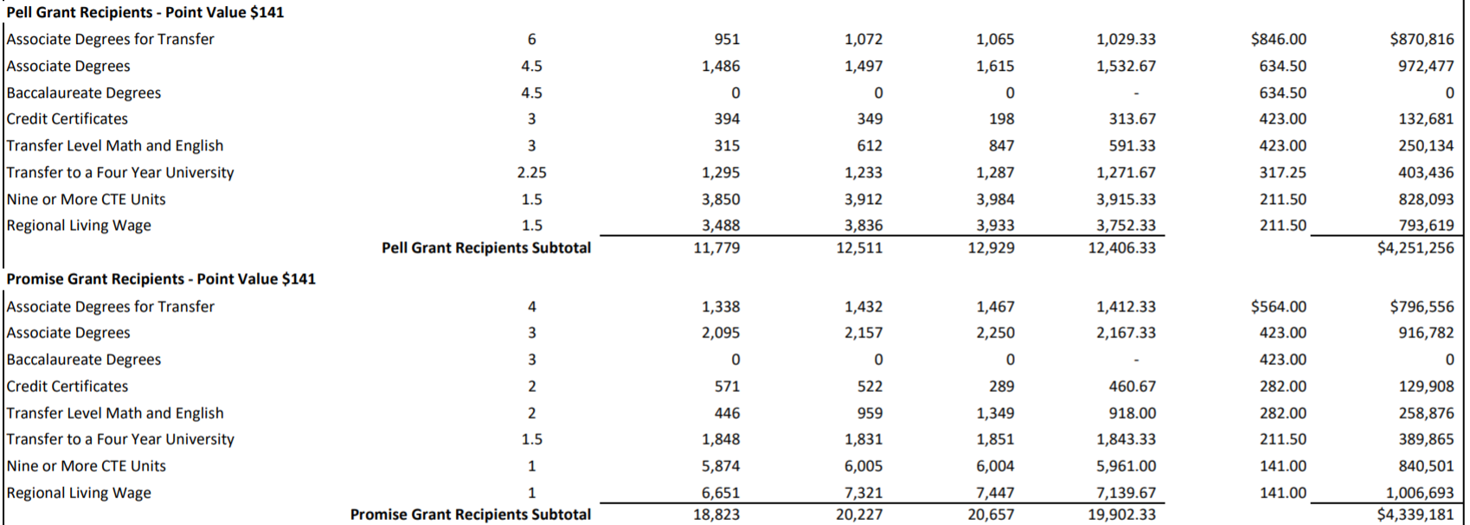
SCFF Calculation – Success (Pell and Promise)
13

Slide 14
Important Terminology
Stability: “Guaranteed” funding for 1 year. By end of the subsequent year, college must achieve original Full Time Equivalent Students(FTES) goal or lose funding.
Restoration: Entitled to restore base funded FTES during three years following year of initial decrease.
Hold Harmless: The amount of funding recived in 2017-18, grown by the Cost of Living Adjustment (COLA) until 2023-24. (Note: 2021-22 budget will likely extend until 2024-25)
14

Slide 15
Perspective on SCFF
Relative benefits of the change
Allows conversations to occur in areas that would have seemed like just cost increases
Considers more than just “time in seat” when making decisions
Directs resources to areas of the state that have higher need
Aligns resources with educational goals
Questions to ponder
Are we aligning our allocations to the SCFF?
Are we focusing on the incentives it is providing us?
15

Slide 16
Faculty Obligation Number (FON)
Title 5 §§ 51025 and 53311
AB1725 (passed in 1988) established a goal to reach 75% of instructional hours to be taught by full-time faculty
Includes all tenured and tenure track positions (instructional and non-instructional)
Does not matter the funding source (unrestricted general fund, restricted funds, etc.)
Compliance based on each CCDs FON in 1988-1989
Increased proportionally with funded credit FTES
Compliance FON is the lower of Advance FON or P2 FON
16

Slide 17
50% Law
Education Code § 84362
Only the Unrestricted General Fund
Numerator
Full-time and part-time instructors salaries and benefits; Instructional aides salaries and benefits
Denominator
Non-instructional salaries and benefits; Supplies and materials; Other operating expenses
Exclusions
Instructional staff-retirees’ benefits and retirement incentives; Student health services above amount collected; Student transportation; Non-instructional staff-retirees’ benefits and retirement incentives; Rents and leases; Lottery expenditures; Capital expenditures
17

Slide 18
Federal Stimulus
The Coronavirus Aid, Relief, and Economic Security Act (HEERF I)
March 2020
The Coronavirus Response and Relief Supplemental Appropriations Act (HEERF II)
December 2021
American Rescue Plan Act (HEERF III)
March 2021
Roughly half of funding for students in emergency grants
Rest of funding used to defray costs associated with the pandemic
18

Slide 19
State Stimulus
2020-21 Budget Act
June 2020
Relief for AB 540 students through the California Dreamer Service Incentive Grant
2021-22 Budget Act
March 2021 “early action”
Emergency financial assistance to low-income students
Continued focus on dealing with the pandemic in 2021-22 Budget
19

Slide 20
Perspective on Stimulus
Three buckets of funding:
Meet the moment for our students
Direct aid to students, digital gaps, equity gaps, supports, etc.
Defray expenses caused by the sudden change
Lost revenue, auxiliary funds, allow college to adjust to shock, etc.
Return stronger for our new normal
Invest in our people, technology, health, safety, etc.
Try to find the silver lining in this dark time
Keep a focus on the ongoing costs associated with the proposed changes
20

Slide 21
Local Budgets as Value Statements
Aligning budget priorities with the college mission and goals
Affirming institutional equity goals
Ensuring that educational integrity and campus needs for serving a diverse student body are understood
21
Notes:
21

Slide 22
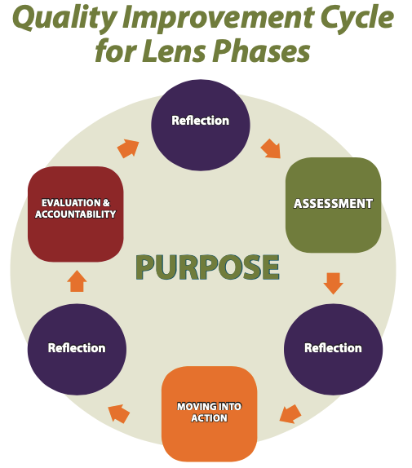
Our Why?
Applying an equity and empowerment lens
Action toward the SSCCC Antiracism Plan
22
Notes:
Retrieved from https://multco.us/diversity-equity/equity-and-empowerment-lens
The equity and empowerment lens (with a racial justice focus) improves planning, decision-making, and resource allocation leading to more racially equitable policies and programs. At its core, it is a set of principles, reflective questions, and processes that focuses at the individual, institutional, and systemic levels by:
deconstructing what is not working around racial equity;
reconstructing and supporting what is working;
shifting the way we make decisions and think about this work; and
healing and transforming our structures, our environments, and ourselves.
SSCCC: Action Plan: https://studentsenateccc.org/news-events/newsroom/newsroom.html/article/2020/09/06/ssccc-anti-racism-a-student-plan-of-action
22

Slide 23
23
Notes:
Align—with vision, mission, values, goals and commitments statewide and locally!
How is the academic senate transforming and working toward these efforts?
23

Slide 24
2020 Call for Action: What we have been asked to do
What resources have been allocated for the prioritizing of . . .
Culturally responsive curriulum and practices
Curriculum committee engagement and review of processes (e.g., audits)
Leading courageous and brave conversations
Antiracism/no hate education and being proBlack
Faculty evaluation and equitable hiring processes
Representation in governance and all committees (including student voices at every table)
Student Equity and Achievement plan and Equal Employment Opportunity plan
Notes:
2020 Call to Action from CCCCO
2020 Call to Action from ASCCC
Leading courageous and brave conversation--acknowledge, without assigning blame, that the structure of the college houses the biases and prejudices of its founding time
Equity minded hiring practices—use the Canvas modules to frame the questions: https://ccconlineed.instructure.com/courses/5733

Slide 25
Questions to ask in decision making:
1. Who are the racial/ethnic and student groups affected? What is the potential impact of the resource allocation and strategic investment to these student groups?
2. Does the decision being made ignore or worsen existing disparities or produce other unintended consequences? What is the impact on eliminating the opportunity gap?
3. How does the investment or resource allocation advance opportunities for students not historically served well?
4. What are the barriers to more equitable outcomes? (e.g., mandated, financial, programmatic, managerial or institutional)
25
Notes:
25

Slide 26
Questions (cont’d)
5. How have you intentionally involved stakeholders who are also members of the communities affected by the strategic investment or resource allocation? How do you validate your assessment in (1), (2) and (3)?
6. How will you modify or enhance your strategies to ensure each learner and communities’ individual and cultural needs are met?
7. How are you collecting data on race, ethnicity, and other key data that addresses the "why"?
8. What is the commitment to professional learning for equity? What resources are you allocating for training in culturally responsive instruction and services?
26
Notes:
Stephen Kudour: “If it’s about the students, without the students, then it’s not for the students.”

Slide 27
Recap: Budgets Reflect Values
A budget reflects the priorities of the institution.
Priorities are set based on the Educational Master Plan or Strategic Plan and broad goals established by the local board of trustees.
Collegial consultation is the process for the effective participation of faculty.
These priorities must be aligned to the Vision for Success Goals.
27
Notes:
This is the recap of the why:
Continuous of improvement—requires the ask, the action, the assessment (aligned?), the reflection (values?), the action, assmt, reflection, etc. CYCLICAL
Next is Mario—for the budget process details at state level

Slide 28
Empowering Faculty: Your Role as Leaders
Education Code Section 70902 (b)7 requires boards to ensure the right of faculty to participate effectively in district and college governance
Title 5 §53203 requires that “the governing board or its designees will consult collegially with the academic senate when adopting policies and procedures on academic and professional matters.”
Academic and professional matters are defined in Title 5 §53200 and specifically provide for faculty roles in processes for institutional planning and budget development
28
Notes:
Michelle—assert your role as faculty AB 1725 (10+1)
Read policies—every district may be different on what is mutual agreed and what is relied primarily upon (on specifics of 10+1)

Slide 29
Use the 10 +1 Regularly to Frame Your Questions
Notes:
Learning how to use the 10+1 regularly: What part of the 10+1 are you referring/using?
Graphic: https://www.asccc.org/10_1

Slide 30
Faculty Role in Budget Processes
College and district budget committees: Assure that faculty appointments to all governance committees, including committees that deal with planning and budget, are made by the academic senate in a manner that ensures an equitable representation of faculty.
Evaluate all processes for program review, prioritization of needs, and budgeting and widely distribute the results of program review and prioritization processes.
Engage in the assessment of budget processes, applying an equity lens.
30
Notes:
Budget paper:
30

Slide 31
Local Senate President’s Role in Checks and Balances
Local Academic Senate President signature on statewide grants and initiatives:
Guided Pathways
Student Equity and Achievement (SEA) Program
Others
Curriculum Implications
New degrees and certificates must meet needs of students and the community
Guided Pathways and AB 705 implementation should be supported
31
Notes:
Others—Perkins, HSI grants, basic needs, and other grants and special funding
Last point-Discuss how faculty leaders must be empowered to better understand the current budget climate to ensure budgetary decisions are made to best serve students, faculty leaders should understand how the budget works at the state and at the local level
Student Centered Funding Formula—Performance-based Funding
Guided Pathways and AB 705 Implementation:
Monitor student success and persistence
Watch enrollment trends—AB 1805

Slide 32
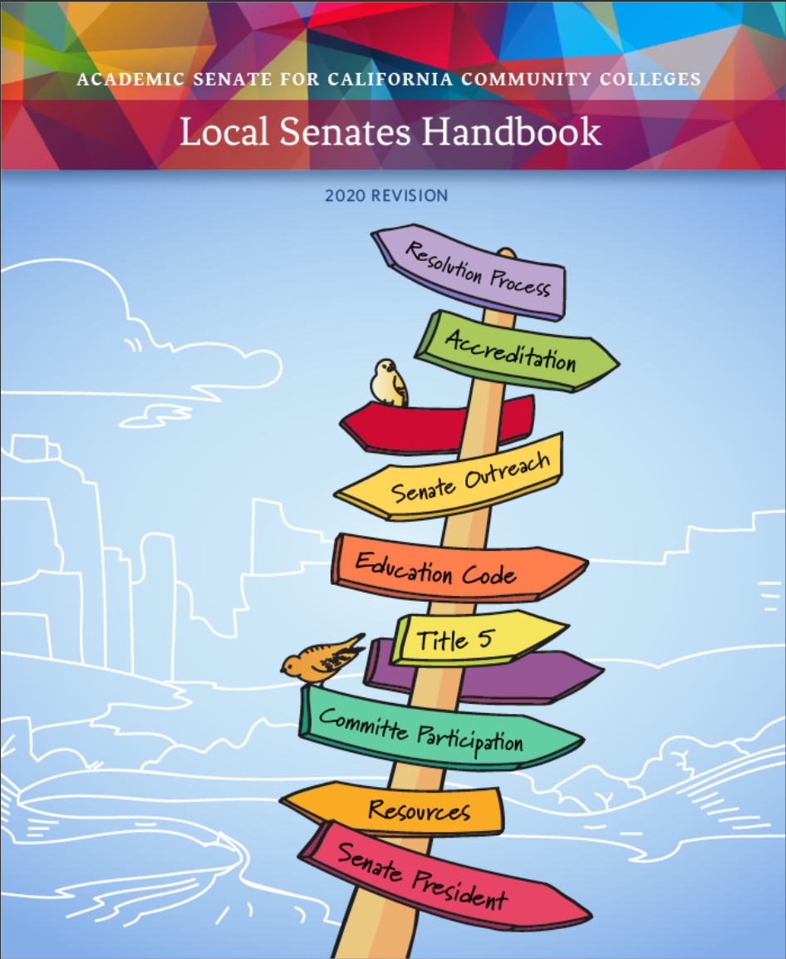
From Local Senates Handbook
Secure Resources to Ensure Senate Success
Work with the local administration to identify the types of budget resources, such as reassigned time or travel, available to the senate.
Work with the administration to put in writing any budget agreements to fund the senate. Informal agreements have a habit of disappearing with rapidly shifting administration members.
Justify to the college administration why inadequate resources may harm students, accreditation, campus climate, and effective participatory governance in order to convince the college to increase resources.
Notes:
Local Senates Handbook: Part 3 (Duites of Local Senate President) page 32: https://indd.adobe.com/view/7f4e2df0-a2c8-42cd-8a88-bb92cfc68ed3
There may be other budget items that senates are responsible for such as clerical staff, equipment and supplies – not all colleges have this.
Reassigned time, travel funds, professional development funds, supplies, funds to host events, and such.
And documenting agreements is crucial!
Remember the WHY—when asking for resources!
32

Slide 33
Q&A
Notes:
Michelle Chat monitor

Slide 34
For more information contact:
info@asccc.org
34

Slide 35
Resources
ASCCC Budget Processes and the Faculty Role https://asccc.org/sites/default/files/BudgetProcess_FacultyRole.pdf
ASCCC Local Senates Handbook (2020)
https://asccc.org/sites/default/files/ASCCC_Local-Senates-Handbook_2020_Apub.pdf
CCCCO Student Centered Funding Formula
https://www.cccco.edu/About-Us/Chancellors-Office/Divisions/College-Finance-and-Facilities-Planning/Student-Centered-Funding-Formula
SSCCC Antiracism Student Plan of Action
https://studentsenateccc.org/news-events/newsroom/newsroom.html/article/2020/09/06/ssccc-anti-racism-a-student-plan-of-action
35

