Slide 1
One Community: Collaborating to Support Equitable Teaching and Learning

Slide 2
Presenters
Marty Alvarado Executive Vice Chancellor, CCCCO
Cheryl Aschenbach ASCCC Secretary, Lassen College
Dr. Karen Chow ASCCC Area B Representative, DeAnza College
Dr. Lataria Hall CCCCSSO President, Fresno City College
Dr. Jennifer Vega La Serna CCCCIO President, College of Sequoias

Slide 3
Ice Breaker
In the chat, provide
Name
College
What do you hope to take from this session?
Notes:
Karen
Cheryl - drop prompt into chat

Slide 4
Agenda
Setting the context
Getting Real: Breaking Down Silos and Working Together
Final thoughts and next steps
Notes:
Cheryl

Slide 5
Objectives
Set the context for the urgency, necessity, and opportunity of this work
Introduce key concepts and frameworks for supporting equitable classrooms and student support services
Engage in activities and share ideas and resources that can support this work
Notes:
Cheryl

Slide 6
Setting the Context
Marty Alvarado - CCCCO
Key system reforms that call for a focus on supporting equitable classroom & student supports
Cheryl Aschenbach - ASCCC
The importance of partnering to ensure equitable learning
Jennifer Vega La Serna - CCCCIOs
CIO role in partnering with faculty to advance equitable student learning
Lataria Hall - CCCCSSOs
CSSO role in partnering with faculty to advance equitable student learning
Karen Chow - DeAnza College
Local senate president role in partnering to advance equitable student learning
Notes:
Cheryl (Overview)
Goal: To provide a frame of reference for why focus on the classroom and student support spaces, why now, and introduce a framework that can be used during this session
Marty provides context related to key system reforms that call for renewed focus on supporting equitable classrooms & a framework for the session activity (5 min)
Cheryl provides context for why this is important for faculty & why partnership is important (5 min)
For ASCCC FLI: Add CIO (Jennifer), CSSO (Lataria), and Local Senate (Karen) perspectives

Slide 7
Guided Pathways
2021-22 Priorities
Strengthen our focus on equity & dismantling structural racism
Focus on data and the GP Key Performance Indicators (KPIs)
Connect reforms, initiatives, and structures to the Guided Pathways framework & priorities
Support & Strengthen Teaching and Learning
Notes:
Marty

Slide 8
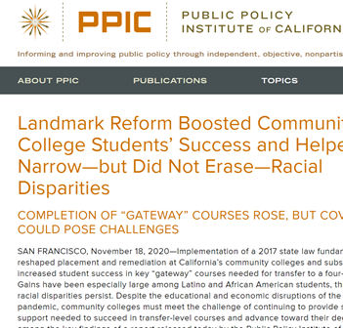
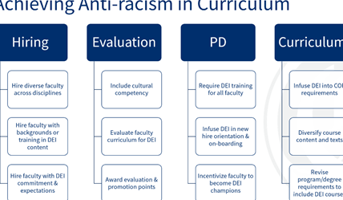
Bringing It All Together -
Teaching & Learning
Notes:
Marty

Slide 9
Ensuring Learning with Equity Strategy
LEARNING ENVIRONMENT
LEARNING
TEAMS
ACTIVE LEARNING
LEARNING MATERIALS & CURRICULUM
LEARNING
OUTCOMES
DATA
Notes:
Marty
© Copyright PresentationGO.com – The free PowerPoint template library

Slide 10
Teaching & Learning Ecosystem
Faculty & Staff
Evaluations
Professional Development
Accountability & Accreditation
Culturally Responsive Curriculum & Teaching Practices
Student Outcomes/Student Experiences
Notes:
Marty

Slide 11
Creating the Change
Encourage diversity-focused criteria in employee evaluations and tenure review
Increased Transparency
Explicit Accountability
Reduced micro/macro aggressions
Increased feedback and support
Safer learning environments
Improved retention & persistence
DEI-Related Evaluation Criteria
Faculty & Staff Behavior
Student Outcomes
Notes:
Marty

Slide 12
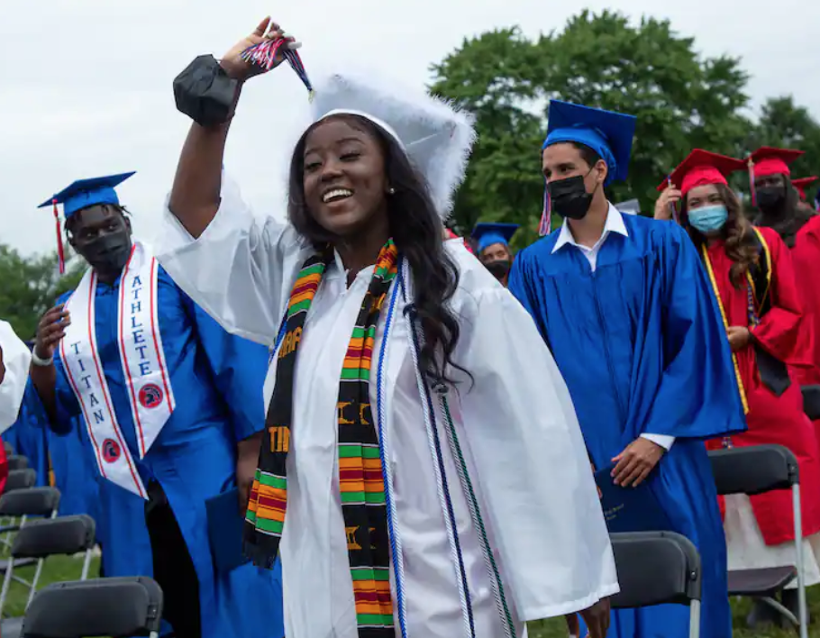
Notes:
Cheryl - context: Why partnering to ensure equitable learning is important
Take-aways from CIO Conference presentation

Slide 13
Comments from CIOs at
2021 CIO Conference
Concerns about reaching faculty
Questions about providing supports and resources faculty need
Challenge of transactional nature of many faculty interactions
Sense of urgency around moving the needle for students
Challenge of helping faculty see impacts of inequitable practices on students
Recognition that advancing equitable teaching and learning is a responsibility of everyone
Notes:
Cheryl - takeaways/summary of comments from CIO Conference

Slide 14
Partnering with Instructional Leadership, including CIOs and Deans, to Advance Equitable Student Learning
Notes:
Context: CIO role in partnering with faculty to advance equitable student learning
Jennifer continue setting context – authentic assessment example
Syllabi PE department example
Curriculum - partnerships with Sarah

Slide 15
Partnering with CSSOs to Advance Equitable Student Learning
Notes:
Lataria

Slide 16
Notes:
Lataria
Journey ~partnership
Every person is at a different point in their equity journey
Part of the journey is being authentically and consistently equity-minded ~ with each other (staff) & students
Part of this work entails figuring out where people are on their equity journey. Some, for example, still feel that being equity minded is providing all students the same amount of services. While this is true, we should provide quality services to all students, some students require more services than others. We have to be race-conscious and we have to understand that RACE does matter.
Not a one and done

Slide 17
•As institutions move toward more equitable outcomes there is a need to recognize that racial equity may demand the unequal treatment of students and redistribution of resources, equity-minded practitioners must be willing to invest more resources, time, and effort on Latinx students relative to other student groups (Felix & Ramirez).
•Equity-mindedness is not about remediating racially-minoritized students who are perceived as deficient, but about respecting their aspirations and struggles and changing existing policies, practices, and structures that are found to underserve them.
Notes:
Lataria
We (educators) must be able to recognize the differences in race, gender, class, ethnicity, sexual orientation, and other social identities among their students, but most importantly adjust their approach to teaching those students accordingly
Classrooms are works in progress in which we inevitably bring…our different social identities and social locations into the learning process
To achieve equity, we must address the ways in which those identities and locations are part of how we learn and who we are as we learn, and build on those perspectives as a way to understand each other and make learning relevant
CSSO role in partnering with faculty to advance equitable student learning
Pathway Teams Example
Student Plans
Micro-aggressions
Syllabi -

Slide 18
Collaborating with Administration as a Local Senate Leader to Advance Equitable Teaching and Learning
Notes:
Karen
Meet with CSSOs in addition to CIOs and college presidentsContext: Context: Local senate president role in partnering to advance equitable student learning

Slide 19
Getting Real: What Does This Mean in Practice?
Guiding questions
How do we encourage faculty colleagues to identify and improve teaching practices that are not student-centered or equitable?
What is scary or challenging about collaborating with CIOs and CSSOs to promote equitable learning practices?
What do you need CIOs and CSSOs to know or do? What should they expect of faculty?
Go to Google doc (link in chat)
Select at least one question
Take a few moments to reflect and capture a few initial thoughts
Together, we’ll discuss thoughts shared
Notes:
Cheryl introduce ; Cheryl & Karen facilitate follow-up
Google doc: https://docs.google.com/document/d/1Ub9R8ea_LMQunWoJVFc7he1EOfjpasO8glLd174QqFM/edit?usp=sharing
How do we encourage faculty to move from high stakes testing to authentic assessment?
How do you encourage departments to begin a cultural curriculum audit that includes syllabi, textbook, resources (including textbook selections), and content review?
What keeps you up at night relative to ensuring equitable teaching and learning?
How do we encourage faculty colleagues to identify and improve teaching practices that are not student-centered or equitable?
What policies, practices, or supports can CIOs and CSSOs put into place to address promote equitable teaching practices?
What is scary or challenging about collaborating with CIOs and CSSOs to promote equitable learning practices?
What do you need CIOs and CSSOs to know or do? What should they expect of faculty?

Slide 20
Final Thoughts & Next Steps
We’re in this together
We want you to feel empowered to have conversations with your faculty colleagues, your CIOs, and your CSSOs
CIOs and CSSOs will be encouraging faculty to have conversations with you
Chancellor’s Office will support via resources, webinars, and continued work with us to ensure learning
Notes:
Cheryl w/ all revisiting benefits of working together

Slide 21
Resources
ASCCC
Local senate visits to facilitate dialog and share effective practices
Tools for dialog: principles, guiding questions, equity framework, and sample dialog processes (see Pre-Hiring Module in Model Hiring Process resource)
Center for Urban Education
Syllabus Review Guide
Publications
Equity Tools
Teaching and Learning Webinar Series – TBD
Bensimon, E.M., McNair,T., Piqueux (2020) From Equity Talk to Equity Walk
Notes:
Idea- Teaching and learning series – includes hybrid flex, etc. – provide a schedule of dates (ASCCC, CCCDO, CIO and CSSO) – tie to DEI work

