Slide 1
Resolutions: a fun follow-up
June 16-18, 2021

Slide 2
Presenters
Amber Gillis, ASCCC South Representative and 2021-2022 Resolutions Chair
Stephanie Curry, ASCCC Area A Representative

Slide 3
Breakout Description
Whereas, At local and statewide levels, academic senates rely on clear, actionable resolutions to set their direction and take positions; and
Whereas, The ASCCC resolutions process allows for all California community college faculty to participate in making policy recommendations that guide and impact our system
Resolved, That attendees come to this session to learn how to develop statewide resolutions that are more likely to be approved; and
Resolved, The presentation will touch base about differing local resolutions processes, delve deep into the Resolutions Handbook, and tune up participants’ resolutions for the Mock Plenary Session.

Slide 4
Session Outcomes
Consider and discuss how local resolutions processes vary
Brainstorm ways to foster greater faculty engagement in resolutions processes
Use Resolutions Page on ASCCC Website to check already adopted resolutions
Review specific passages of Resolutions Handbook
Develop/Fine-tune Resolutions for Saturday’s Mock Plenary

Slide 5
By 6:00pm Tonight
Email your mock resolution to resolutions@asccc.org
Secure the signature of four conference attendees as seconders on the resolution form and submit to any member of the Executive Committee IF you want your Mock Resolution to be debated in Mock Plenary

Slide 6
Introductions
In the Pathable Chat
list your name,
college, and
resolution topic idea.

Slide 7
The ASCCC Local Senates Handbook Recommends . . .
“The Academic Senate for California Community Colleges conducts its business using the resolutions process (see the ASCCC Resolutions Handbook) and recommends that local senates do likewise; many senates, however, reserve resolutions only for the most urgent of their statements and recommendations.” (ASCCC Local Senates Handbook)
How are the processes different?

Slide 8
Mock Resolution from Last Session
Does it have at least one Whereas statement, and at least on Resolved statement?
Four is the limit.
Let’s check it against some of the guidelines in the Resolutions Handbook.
Feel free to edit as we go!

Slide 9
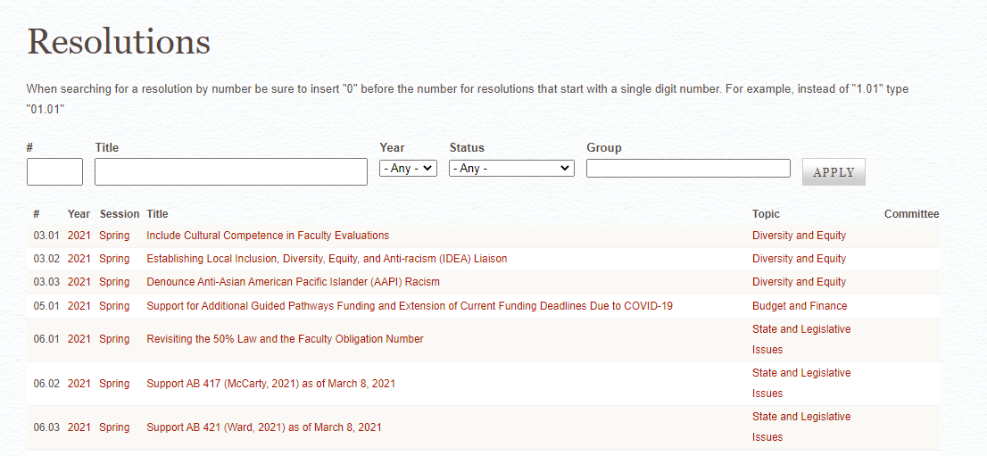
From ASCCC Resolutions Handbook:
“Homework: The Academic Senate has hundreds of resolutions, and they are accessible for review on its website, asccc.org. It is possible that a resolution already exists for the position you wish to take. Please review the existing resolutions first so that duplication can be avoided.”
“It is strongly advised not to introduce resolutions to reaffirm existing positions because of the confusion that may ensure if such resolutions fail.”

Slide 10
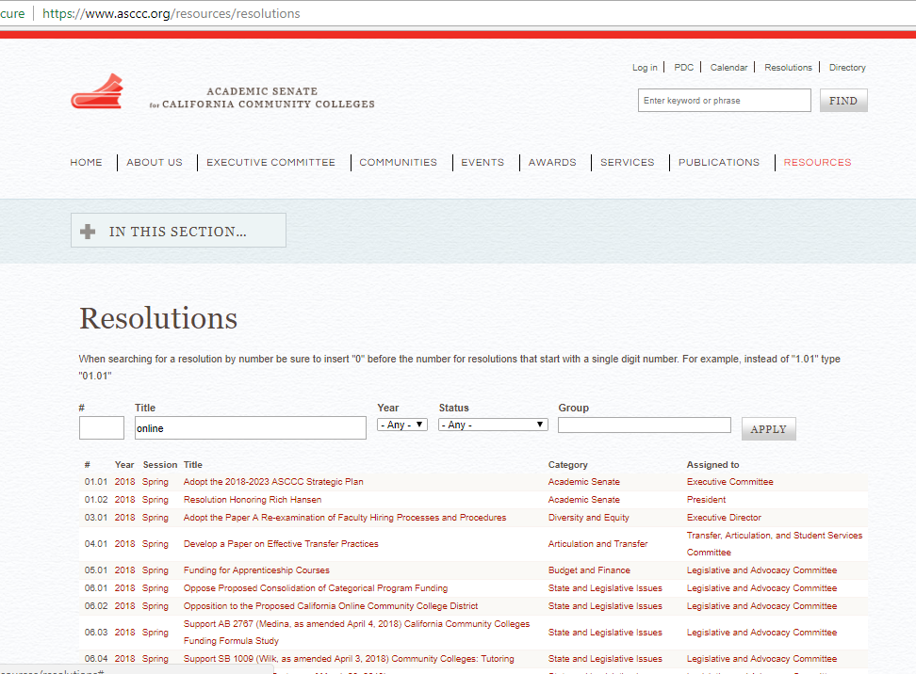

Slide 11
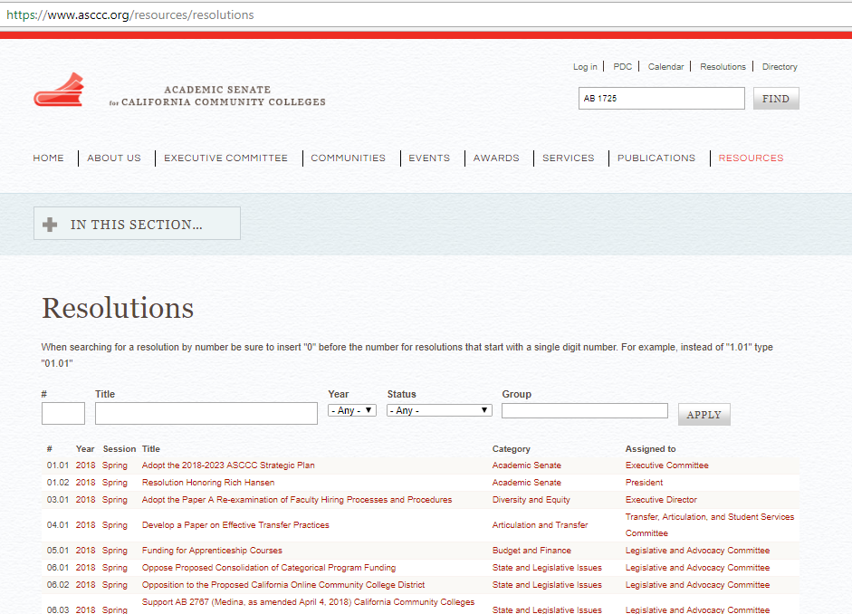

Slide 12
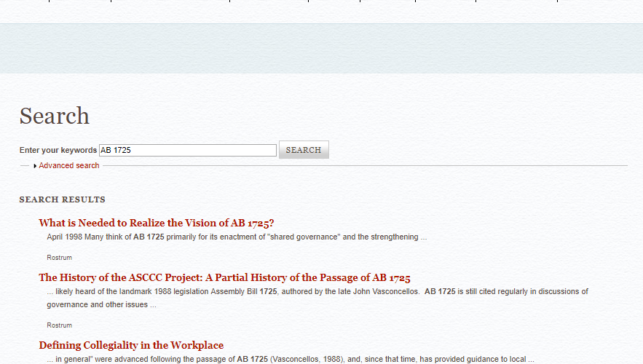

Slide 13
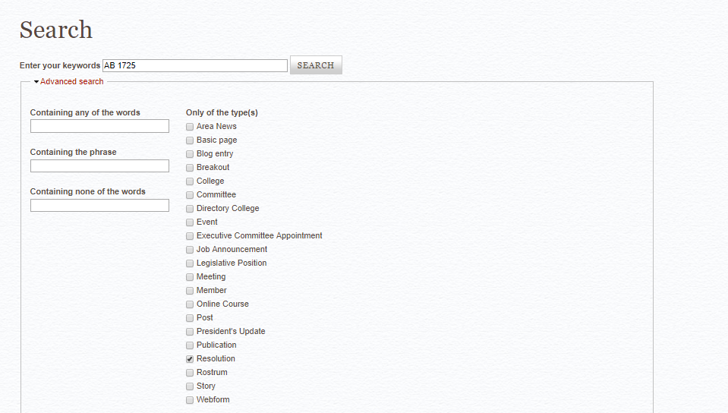

Slide 14
ASCCC Resolutions Do Not/Should Not . . .
Typically reaffirm existing positions (because of the conflict that can ensue if they fail)
Recommend action outside the 10 + 1
Deal with strictly local concerns
Contain more than four Whereas or Resolved statements
Use inflammatory tone or contain personal insults or language that may be perceived as such

Slide 15
ASCCC Resolutions Do/Should
be direct & clear
contain factual Whereas statements
include references
write out full names of groups/organizations in first use
avoid lumping (one reason per Whereas)
only direct the academic senate to act (we can request to or recommend of other entities)
include title
be actionable:
“work with [other body] to ensure” vs. “ensure”
“oppose” vs. “prevent”

Slide 16
First Whereas
“Consider using the first ‘whereas’ as an introduction, outlining the situation in general or providing background and indicating the people or groups involved before justifying your resolutions in the other ‘whereas’ statements.”

Slide 17
Citing Legislation
Cite last name of author and year passed or date of most recent proposed legislation or regulations included in legislation.
For example, AB 1725 (Vasconcellos, 1988), AB 705 (Irwin, 2017), AB 130 (Low, as of June 3, 2019)
Include hyperlink in footnote¹
¹https://www.asccc.org/papers/resolution-handbook

Slide 18
Full Names of Organizations /Acronyms
Write out the names of groups or organizations in your first reference to the within your resolution. The name may be followed by a parenthetical abbreviation, which may then be used for future references. It is unnecessary to note an acronym if the group or organization is not referenced again in the resolution.
Ex: California Community Colleges Chancellor’s Office (instead of “Chancellor’s Office”)

Slide 19
Actionable Language
Urge
Research
Develop (a position, materials, a paper, etc.)
Distribute
Oppose
Publish
Survey
Encourage
Conclude
Adopt
Request
Express
Form
Collect
Communicate
Recognize

Slide 20
Advice on Wording
Recommend: Directed to a body with specific authority over issue in question? Within ASCCC purview to recommend?
Ensure: Does ASCCC have power to fulfill this goal? If not, consider “work with.”
Assert or Affirm: Has the ASCCC already researched and developed position on issue? No? Consider using “explore” so the field can discuss and build a foundation for the issue at hand.
Work with: Often followed by another direction to accomplish something .

Slide 21
The Resolved Statements
Must begin with “Resolved, That the Academic Senate for California Community Colleges . . .”
Each must be able to stand alone
Must be actionable
Must be supported by the Whereas statements

Slide 22
Clearly Listed Contact
If you submit a resolution during session, list your full name, followed by your college, as the contact.
Ex: Contact: Geoffrey Dyer, Taft College
Pre-session resolutions from committees are identified as such.
Only include area if resolution was forwarded at pre-session area meeting.

Slide 23
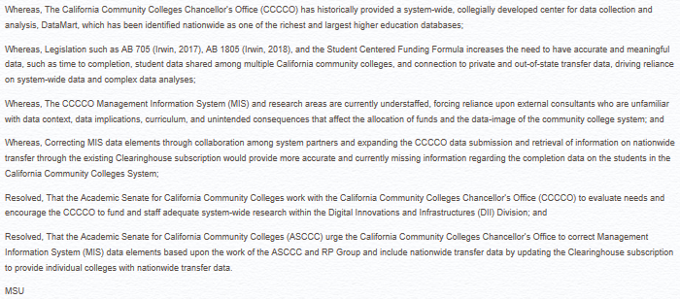
Sample Resolution
What do you notice about this resolution?

Slide 24
Activity
Small breakout groups work on short resolution for the mock plenary

Slide 25
By 6:00pm Tonight
Email your mock resolution to resolutions@asccc.org
Secure the signature of four other conference attendees as seconders on the resolution form and submit to any member of the Executive Committee IF you want your Mock Resolution to be debated in our Mock Plenary on Friday.

Slide 26
How Can We Help?
Questions?
Thank you!
See you at our Mock Plenary Session on Friday!
davisondolores@foothill.edu Donahue_Nathaniel@smc.edu
gdyer@taftcollege.edu
sfoster@fullcoll.edu

