Slide 1
A Fully Online College? An Update on the FLOW Taskforce
Cheryl Aschenbach – ASCCC Executive Committee
Michelle Pilati – Member, FLOW Taskforce

Slide 2
Overview
The Letter
FLOW
What is it?
Who is it?
FLOW Meeting 1
FLOW Meeting 2
Next Steps
Senate Positions

Slide 3
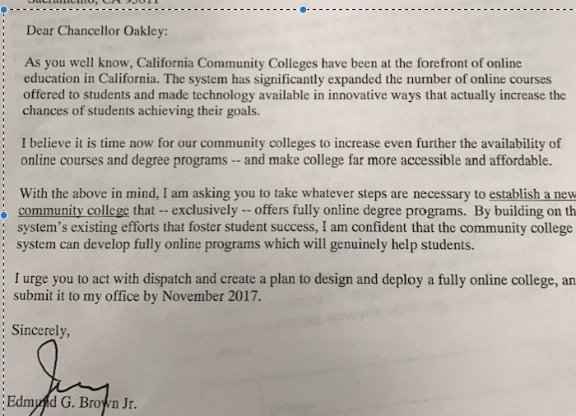
May 11, 2017 – The Letter

Slide 4
The Letter - Highlights
No details
Firm deadline
“it is time now for our community colleges to increase even further the availability of online courses and degree programs”
“take whatever steps are necessary to establish a new community college that – exclusively – offers fully online degree programs”
“By building on existing efforts..”
“create a plan to design and deploy a fully online college, and submit it to my office by November 2017”

Slide 5
FLOW Unveiled
Invitation dated May 31, received July 31
“As you are aware, Governor Jerry Brown has invited Chancellor Oakley to provide him 3 – 5 options (with pros and cons for each) that enable the community colleges of California to better deliver on the student success goals outlined on pages 15-16 in the Vision for Success document recently adopted by the Board of Governors.”
“In order to meet the November deadline established by the Governor, we have engaged the National Center for Higher Education Management Systems (NCHEMS) to work with a group of system stakeholders and online thought leaders to develop these options.”

Slide 6
Who is NCHEMS?
…a private nonprofit organization whose mission is to improve strategic decision making in post-secondary education for states, systems, institutions, and work-force development organizations in the United States and abroad. NCHEMS carries out research, development, dissemination, evaluation activities, as well as technical assistance. NCHEMS is a national and international resource for turning data into usable knowledge for policy makers at all levels.

Slide 7
Who is NCHEMS?
Sally Johnstone – “Before joining NCHEMS as its President, Sally M. Johnstone served as a vice president at the Western Governors University”
Dennis Jones – “A member of the staff since 1969, Mr. Jones is widely recognized for his work in such areas as: developing “public agendas” to guide state higher education policymaking; financing, budgeting, and resource allocation methodologies for use at both state and institutional levels; linking higher education with states’ workforce and economic development needs; aligning the policy levers available to state government with state goals; and developing and using information to inform policymaking.”

Slide 8
“system stakeholders and online thought leaders”
http://nchemsproject.com/cccco-flow
Co-Chairs: Ton-Quinlivan and President Fiero (Cerritos)
ASCCC asked for 3 appointments
1 student/business owner
1 staff (Academic Advising Specialist II)
1 CEO, 1 CIO (EVP), 1 CSSO, 1 CBO, 1 Director of Workforce Development
2 OEI
1 Student Success Center, 1 Department of Finance, 1 Department of Labor, 1 LAO

Slide 9
“system stakeholders and online thought leaders”
External experts offering insights:
Jay Box, President, Kentucky Community and Technical College System
Adrian Sannier, Senior Technology Fellow, Arizona State University
Spencer Stewart, Chancellor, Western Governors University, Nevada

Slide 10
FLOW Unveiled
“Flex Learning Options for Workers (FLOW).”
“Joining the FLOW work group will entail attending two face-to-face meetings in Sacramento and one final review meeting via the web.”
“We plan to create options that will target ‘adults with some college and no certification’ as well as ‘working adults with vocational needs’ to enable them to earn certifications that lead better workforce outcomes.”

Slide 11
Quick Recap
Governor Brown asked Chancellor Oakley to explore options for a new college, a fully online college
Reach more students by using a technology platform
Target: unemployed or underemployed adults, including returning veterans, displaced workers, and working adults with some college but no credential
November is deadline for Chancellor’s Office to submit a proposal to include options for how the online college would be formed and how much it would cost
Vision for Success also calls for CA community colleges to better serve working adults in order to meet CA workforce needs.

Slide 12
FLOW Meeting 1
Target audience identified and stressed
California models and proposals (1 hour total)
OEI
Coastline
San Diego Continuing Education
FHDA Proposal
Other approaches (45 min each)
Kentucky Community and Technical System (45 min)
Arizona State University On-line (45 min)
Western Governors University’s Competency-Based Education model
Discussion of parameters of models to serve target students/Discussion of Options/Next Steps

Slide 13
Principles Discussed
Flexible schedule and pacing
Competency-based education
Entirely online
Subscription-based vs fee-based
Connected to industry
Multi-lingual instruction
Consider suspending all regulations that would otherwise prevent similar efforts at local colleges (charter-like)

Slide 14
Options
New competency-based entity
Design from scratch to meet new, different, and rapidly changing academic and administrative goals/objectives
Consortium based on geography
Respond to local priorities of learners, employers, and transfer institutions
Consortium based on target audience
Focus: Hispanic adults, workers with commutes, apprenticeships
Consortium based on content area
Emerging new college from existing entity
Leverages existing infrastructure (already accredited, has established reputation)

Slide 15
FLOW Meeting 2
Between Meeting 1 and 2 – NCHEMS conducts interviews, synthesizes feedback from 1st meeting
Demonstration of the Supply/Demand Tool
Review of Design Considerations
Essential Employability Qualities (EEQs)
Serving Adults
Options and Financial Issues

Slide 16
Options and Financial Issues
Option 1 – Embed FLOW in an existing college or state-supported entity
Option 2 – Network/Co-operative programs through existing community colleges
Option 3 – Create a new statewide district that would centralize services for students studying with a variety of its online colleges
Based on committee’s previous feedback, each option was presented with pros and cons. While two options had cons out-weighing the pros, one option had 14 pros and just 3 cons (guess which one!)

Slide 17
Sample Cons
Deeply constrained by existing structures, policies, processes, and procedures (1)
Timeline to approve and create new programs may be too long (1)
Co-requisite basic skill development inconsistent with most institutional practice (1 and 2)
Regulatory relief seems unlikely (1 and 2)
Conflicts would likely arise when traditional faculty are not the summative assessors, which may be needed to assure the quality of the programs (1 and 2)
Will require a separate entity at the CCCCO to ensure consistent quality across cultures (2)

Slide 18
Timeline
Committee told that a draft of final report will be available to by 11/19 for a conference call 11/20
Task: review draft, not officially endorse recommendations
But first…
11/9 Consultation Council webinar re: FLOW project
11/13 FLOW on Board of Governors agenda (discussion, no action)
11/16 FLOW on Consultation Council agenda

Slide 19
Next Steps?
Notes:
We’re not sure what will happen with the feedback we have provided thus far…

Slide 20
Related ASCCC Positions
Opposition to Western Governors University California (Spring 2011 13.04)
Faculty not included in a task force called for by AB 851 (2011)
Lack of full-time faculty at WGU
Course development at WGU a “product management responsibility” rather than a 10+1 matter
Oppose Accreditation for Western Governors University (Spring 1998 2.05)
Urge ACCJC to not accredit WGU
Contracted student services from external providers not subject to accreditation
Courses developed and offered by external providers may not be accepted by transfer at other institutions

Slide 21
Needed ASCCC Positions?
Need for actual dialog and consultation?
Need for system recommendations rather than facilitator recommendations?
Support for new fully online college? Or lack of support for new fully online college?
Other?

Slide 22
Thank you!
Cheryl Aschenbach: caschenbach@lassencollege.edu
Michelle Pilati: mpilati@riohondo.edu
info@asccc.org

