Slide 1
FYE at West Valley College: A Growing Collaboration Between Student Services and Instruction
ASCCC Innovation And Instructional Design Institute
Gretchen Ehlers, FYE Coordinator and Math Instructor
Christina Llerena, FYE And Transfer Counselor
Notes:
Presentation: 30-45 mins, depending on questions
Each of us introduces ourselves and how long we’ve been with FYE.

Slide 2
Plan for Today’s Workshop
West Valley’s First Year Experience Program (Please feel free to ask questions during this talk!)
Group discussion of FYE benefits to students
Data from West Valley’s program
Group discussion of challenges we face
Notes:
Christina goes over agenda

Slide 3
First Year Experience College success leads to life success!
FYE at West Valley College provides wrap-around support for first-year college students who place low in English and/or Math.
Students take a College Success Counseling class in addition to an English and/or Math class with other students in the cohort.
Notes:
Overview of FYE

Slide 4
Goals of First Year Experience Program
Provide students placing into Basic Skills classes a structured first college year that guides them towards their educational goals.
Provide Basic Skills students the counseling support to develop an appropriate educational plan.
Help students build connections
between other students,
counselors and teachers on campus.
FIRST YEAR EXPERIENCE…College success leads to life success
Notes:
(After second *) Students take English, Math and Counseling classes, so they receive wrap-around support.
(After third *) Research has found that one of the key indicators of academic success is feeling connected to your institution.

Slide 5
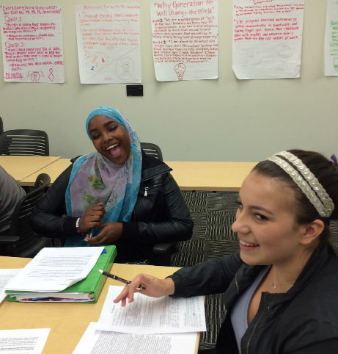
Rationale for FYE
Supports the three mandates of Student Success Act of 2012 (assessment, orientation, ed plan)
Supports WVC’s Mission and Master Plan Strategic Goals
Helps students succeed.
Helps decrease the achievement
gap.
FIRST YEAR EXPERIENCE…College success leads to life success
Notes:
Achievement Gap (You’ll see this in the data we present at the end)
WVC’s Mission about “supporting students along their pathways to reach transfer and career goals” and Master PlanStrategic Goals around shaping a learning community at WVC and Diversity & Inclusion

Slide 6
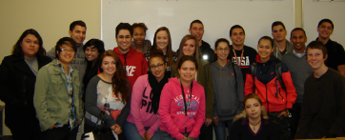
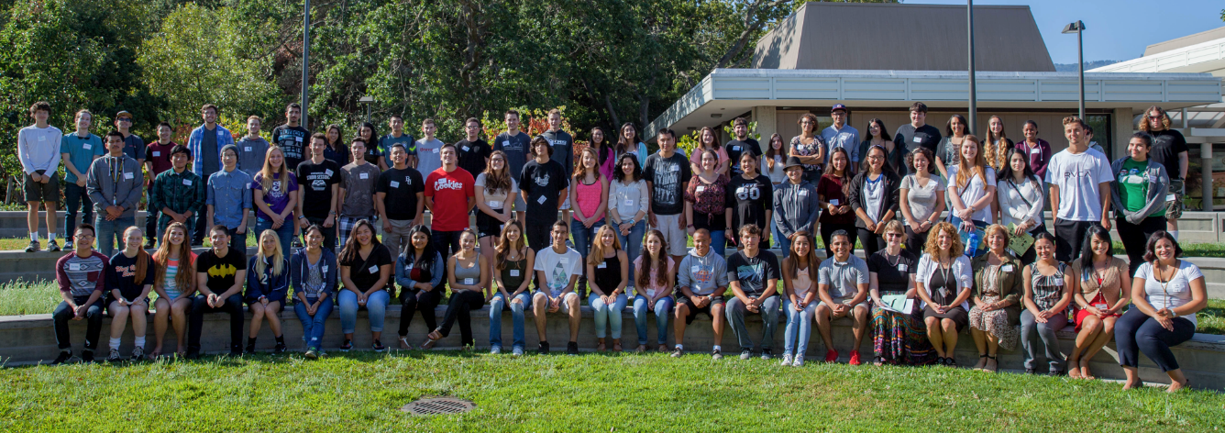
FYE is EXPANDING!
2013-14
2015-16
FIRST YEAR EXPERIENCE…College success leads to life success

Slide 7
FYE is EXPANDING!
YEAR | # OF STUDENTS | # OF INSTRUCTORS
2008 – 2013 | 30 | 4 Math, English, Reading & Counseling
2014 | 60 | 3 Math, English & Counseling
2015 | 87 | 7 2 Math, 2 English, 2 Counseling, 1 Business
2016 (planned) | 110 (approx) | 9 3 Math, 1 English, 2 Counseling, 1 Business, 1 Communications, 1 Biology
FIRST YEAR EXPERIENCE…College success leads to life success
Notes:
We’re adding more transfer-level options for students in their second semester.
We’ ve also found that this is a great learning community for instructors!

Slide 8
FYE CLASS STRUCTURE
Adding More Options for Students
2008 – 2013 | All students took the same Math, English, and Reading classes in Fall and Spring. Students only took Counseling in Fall.
2014/15 | Students chose between Math or English. Allowed more flexibility for students, and allowed program to expand. All students took Counseling both semesters.
2015/16 | Students chose between two Math and two English classes. Students have the option of Business 51 in Spring. Allowed more flexibility and more options for students. Students continue to take Counseling both semesters
2016/17 (planned) | Similar structure as 15/16 with options of Business, Biology, and Communications in Spring semester.
FIRST YEAR EXPERIENCE…College success leads to life success
Notes:
We were receiving positive comments from students, and so we wanted to offer FYE as an option for more students. So, students did not need to place below transfer in BOTH math and English. They could take one of the other. And, they now always take Counseling BOTH semesters.
Next, we expanded to two options in English and two in Math, while keeping Counseling in BOTH semesters. This year, we’re also offering an FYE Intro to Business option in the Spring. Next year, we’ll offer Intro to Business, Bio and Communications as options for FYE students.

Slide 9
STUDENT RECRUITMENT
Students choose to be in FYE
During the first four years, students were recruited via phone call and counselor referral, based on Placement Test Results
The last four years, students were recruited through
Early Admissions events
Summer Orientation classes
Counselor referral
The last three years, FYE student “Recruitment Leaders” have collaborated with the FYE Coordinator to recruit students
FIRST YEAR EXPERIENCE…College success leads to life success
Notes:
At this point, FYE is first-come first-served so that we fill the slots and don’t affect departmental efficiency numbers.
However, it would be nice to have the luxury to reserve spots for students registering in the semester before school starts. These are typically the students who will most benefit from the program.

Slide 10
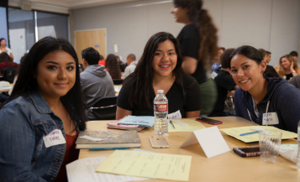
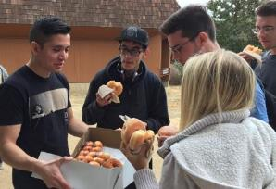
Additional FYE Activities
Workshop of Welcome (WoW!)
Now a full day orientation the week before school starts. Students attend mini-classes, take a campus tour and get to know each other and the FYE faculty
Embedded peer tutors in Math and English classes
College field trips (both mandatory and optional)
End-of-Year Celebration
FIRST YEAR EXPERIENCE…College success leads to life success
Notes:
We’ve now had three Workshops of Welcome. This last year it was expanded to a full day the Wednesday before school started.
We now have peer tutors in each of our academic classes, and these tutors work with students outside of class
We’ll all be going to San Francisco State this year, with options of Santa Clara Univ and possibly UCSC
The students choose what kind of culminating celebration they’d like to have.

Slide 11
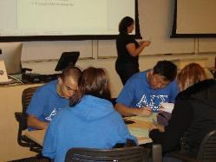
INSTRUCTOR RECRUITMENT
Instructors choose to teach in FYE
Departments and FYE Coordinator collaborate to recruit FYE instructors
Instructors all take On Course training and go to the National On Course Conference
FYE is beginning to expand into transfer subjects outside English and Math for the Spring semester
Business
Communications
Biology
FIRST YEAR EXPERIENCE…College success leads to life success

Slide 12
FYE Funding Model – Low Cost, Big Gain
FYE was originally coordinated by the Dean of Student Services, so no funding for coordination was necessary.
In Summer ‘12, an instructor took on the coordination of FYE.
In ‘12/’13, coordinator was paid an hourly stipend from Basic Skills funds.
From Fall ‘13 through the present, the coordinator receives 40% release time funded through first Basic Skills and now SSSP funds.
Additional funding for instructor stipends to attend meetings, field trips, conferences and supplies comes from the WVC General Fund, Equity Funds and SSSP funds.
FIRST YEAR EXPERIENCE…College success leads to life success
Notes:
We’ve really tried to have a low-cost model so that expansion is financially realistic.

Slide 13
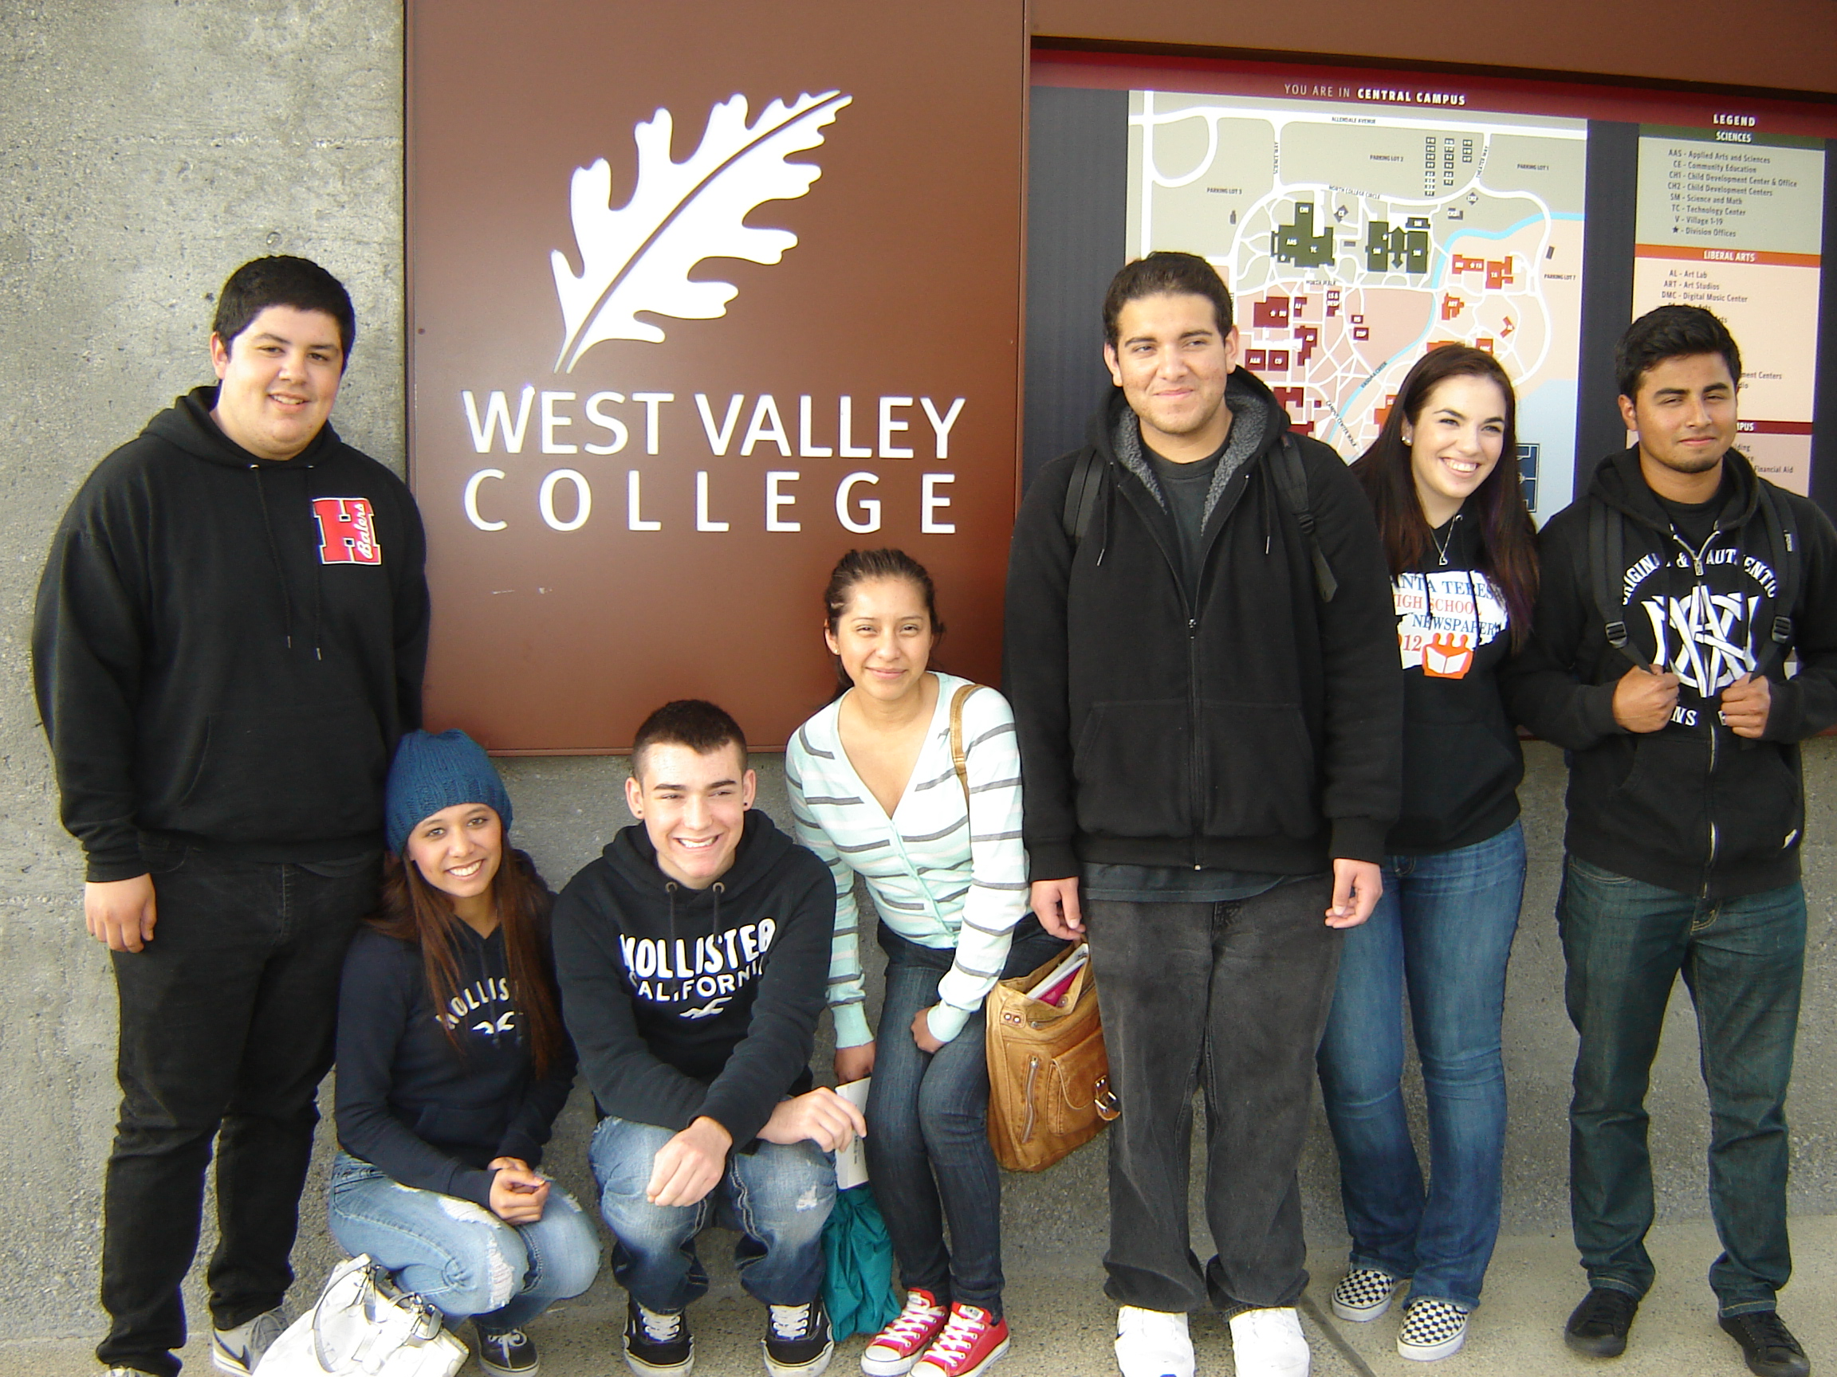
What are your experiences with students?
Why/how will the students with the characteristics on your card benefit from an FYE program?
FIRST YEAR EXPERIENCE…College success leads to life success
Notes:
Christina will have cards….She’ll facilitate. Discuss (7-10 minutes). Share….another 10
Nicole’s suggestions: Part of the group discussion could be "what other information would you like to know about these students?" or another interesting discussion point is for me as an English instructor (and maybe for you as a Math instructor, Gretchen) is what we do with these snippets of information that we wouldn't otherwise have when we don't have counselors in the mix…do we teach/approach some students differently knowing they have trauma in their lives that they didn't tell us about...

Slide 14
What the Data Shows….
FIRST YEAR EXPERIENCE…College success leads to life success
Notes:
Table 1: Cumulative over 8 years for both FYE and WVC.
Table 1: Over the last eight years, a higher percentage of African-American and Hispanic students have chosen to enroll in FYE than the overall percentages at WVC. Many of our students are First Gen.
FYE.

Slide 15
What the Data Shows….
FIRST YEAR EXPERIENCE…College success leads to life success
Notes:
Students liked FYE and they say it helped them!

Slide 16
What the Data Shows….
FIRST YEAR EXPERIENCE…College success leads to life success
Notes:
Table 3: We are seeing improvement in long-term success in the last two years and improvement in GPA just this last year. This is data we want to dig into because it measures what happens after the students leave FYE. This is definitely an area we want to work on.

Slide 17
What the Data Shows….
FIRST YEAR EXPERIENCE…College success leads to life success
Notes:
Table 4: The Comparison Group is all students that placed into the same level classes as the FYE students. This difference is most pronounced for African-Americans and Latinos
Recent research is starting to show that the high-impact practices and pedagogical approaches used in FYE help underserved and underrepresented groups in higher education MORE than the majority populations

Slide 18
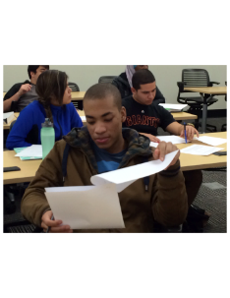
Challenges we’ve faced
Going from small pilot program to institutionalization
How much to expand, and how to expand
Getting instructors on board who are proactive/ intrusive with students, collaborative with instructors, open to professional development
Recruitment of students who will
benefit most from FYE
FIRST YEAR EXPERIENCE…College success leads to life success
Notes:
Many folks have asked “Why can’t we have FYE for ALL students?” Some models of FYE have ALL first-year students take a college-success class, but it’s not paired with academic classes. We feel this integration is critical, and haven’t figured out a way to expand to all students and still maintain the best practices the program has.

Slide 19
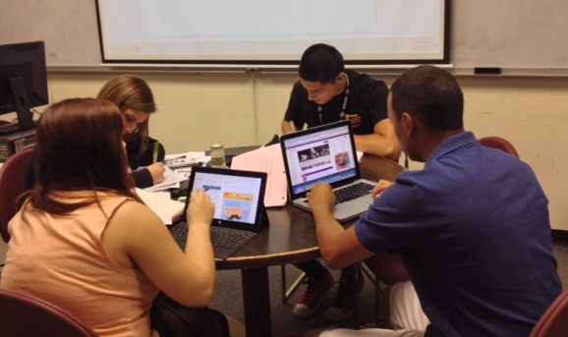
What are challenges you’ve
faced or face with your
programs similar to FYE?
FIRST YEAR EXPERIENCE…College success leads to life success
Notes:
Christina – Have participants talk in groups about this, and then discuss as group…Maybe 20 minutes.

Slide 20
FIRST YEAR EXPERIENCE College success leads to life success
Notes:
More questions?

