Slide 1
Faculty Diversification and Student Success: Facilitating Challenging Conversations
Dr. Dyrell Foster, Vice President of Student Services, Moreno Valley College
Dr. Juana Mora, Student Equity Coordinator, Rio Hondo College
Michelle Velasquez Bean, Area C Representative, ASCCC
Academic Academy
Long Beach Queen Mary
Saturday, September 13 @ 9:30-10:45 a.m.

Slide 2
Session Description
Conversations of identity can be difficult to navigate and most employees of a community college are not formally trained in areas of facilitation or equity-mindedness. And yet, we can all learn to create a space for honest dialog and challenging conversations that move our colleges forward to improving our service to students.
Notes:
1 minute:
Who is in the room?
Faculty
Admin
Students
Human Resources
Staff
Others?

Slide 3
Introductions
Panel
Describe something you treasure or a space that brings you joy.
Participants
Pair Share: NAME and a JOY or TREASURE
Volunteers--Share Out
Notes:
12 minutes

Slide 4
Conversations of Identity
Panel
Why are conversations of identify difficult?
Participants
Volunteers Share
Notes:
10 minutes
Panel Questions:
Why are conversations of identity difficult?
Tell us about a time when you did not feel comfortable in a meeting.

Slide 5
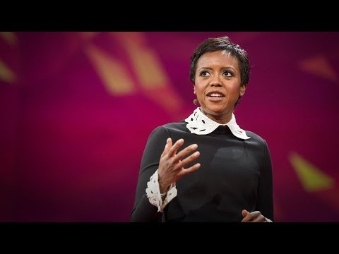
Color Blind vs. Color Brave
Notes:
14 minutes
Introduce video--Michelle:
How does the practice of being color blind and implicit bias hinder faculty diversification?
Aim for cultural competence and open-mindedness for our students’ success, not one just one fit--not just one culture or perspective or ethnicity. Not seeing “color” is not addressing the systemic and institutionalized barriers that perpetuates racism. This video discusses the importance of awareness and being bold enough to discuss the way racial groups have been marginalized and impacted and discriminated against because of the systemic barriers.
Connection to faculty diversification--Dyrell recap:
Our campuses will be better with faculty diversity. We need to bravely address race and barriers.

Slide 6
Faculty Diversification
What is faculty diversification?
Why is faculty diversification needed?
How is faculty diversification going to address the achievement gap for our students?
Notes:
20 minutes:
Panelists volunteer answers

Slide 7
Self-Awareness
How do your experiences of identity, gender, race, and ethnicity help you understand others’ experiences?
Notes:
6 minutes:
Panelists volunteer answers
**Be brave for the students who are dreaming how we dreamed!

Slide 8
Moving to Action
How do you accelerate progress and champion faculty diversification on your campus?
Notes:
9 minutes:
Define solidarity--Juana
Dyrell--support and action from an admin perspective?
Juana--support and action from a faculty role?
Michelle--support and action from a senate role?
**Speak up when you witness exclusionary behavior--call out the bias (bringing from unconscious level to conscious)
**Safe spaces--admit that discomfort is okay.
**Be willing to try new and different approaches. Create dialogue, not debate.

Slide 9
Thank You!
Any Questions?
Contact Information
Michelle Bean at mbean@riohondo.edu
Dyrell Foster at dyrell.foster@mvc.edu
Juana Mora at jmora@riohondo.edu
Notes:
3 minutes:
Any final reflections or take-aways?

Slide 10
Resources
Faculty Diversification Powerpoint: https://asccc.org/content/4th-general-session-faculty-diversification-role-academic-senate-and-senate-presidents
Tools for Difficult Conversations: www.catalyst.org/research/converstaion-ground-rules/
Avoiding Racial Detours Article: http://www.edchange.org/publications/Avoiding-Racial-Equity-Detours-Gorski.pdf
Implicit Bias Powerpoint: https://asccc.org/content/implicit-bias-faculty-diversification
Faculty Diversification Article: https://www.nber.org/papers/w17381.pdf

