Slide 1
State of the Senate Fall Plenary 2020 Dolores Davison, ASCCC President

Slide 2
This Year’s Plenary Theme
Addressing Anti-Blackness and IDEAs (Inclusion, Equity, Diversity, and Anti-Racism) in Academic and Professional Matters

Slide 3
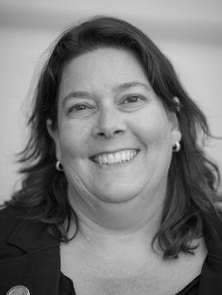
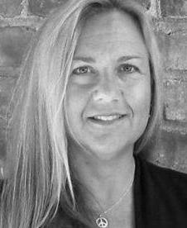
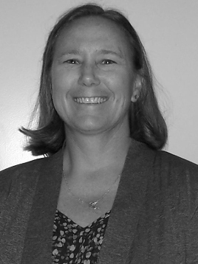
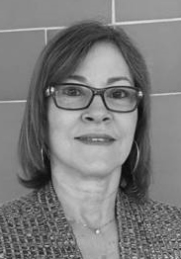
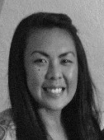
ASCCC Executive Committee 2020-21
Officers
Dolores Davison
President
Virginia May
Vice President
Cheryl Aschenbach
Secretary
Mayra Cruz
Treasurer
Krystinne Mica
Executive Director

Slide 4
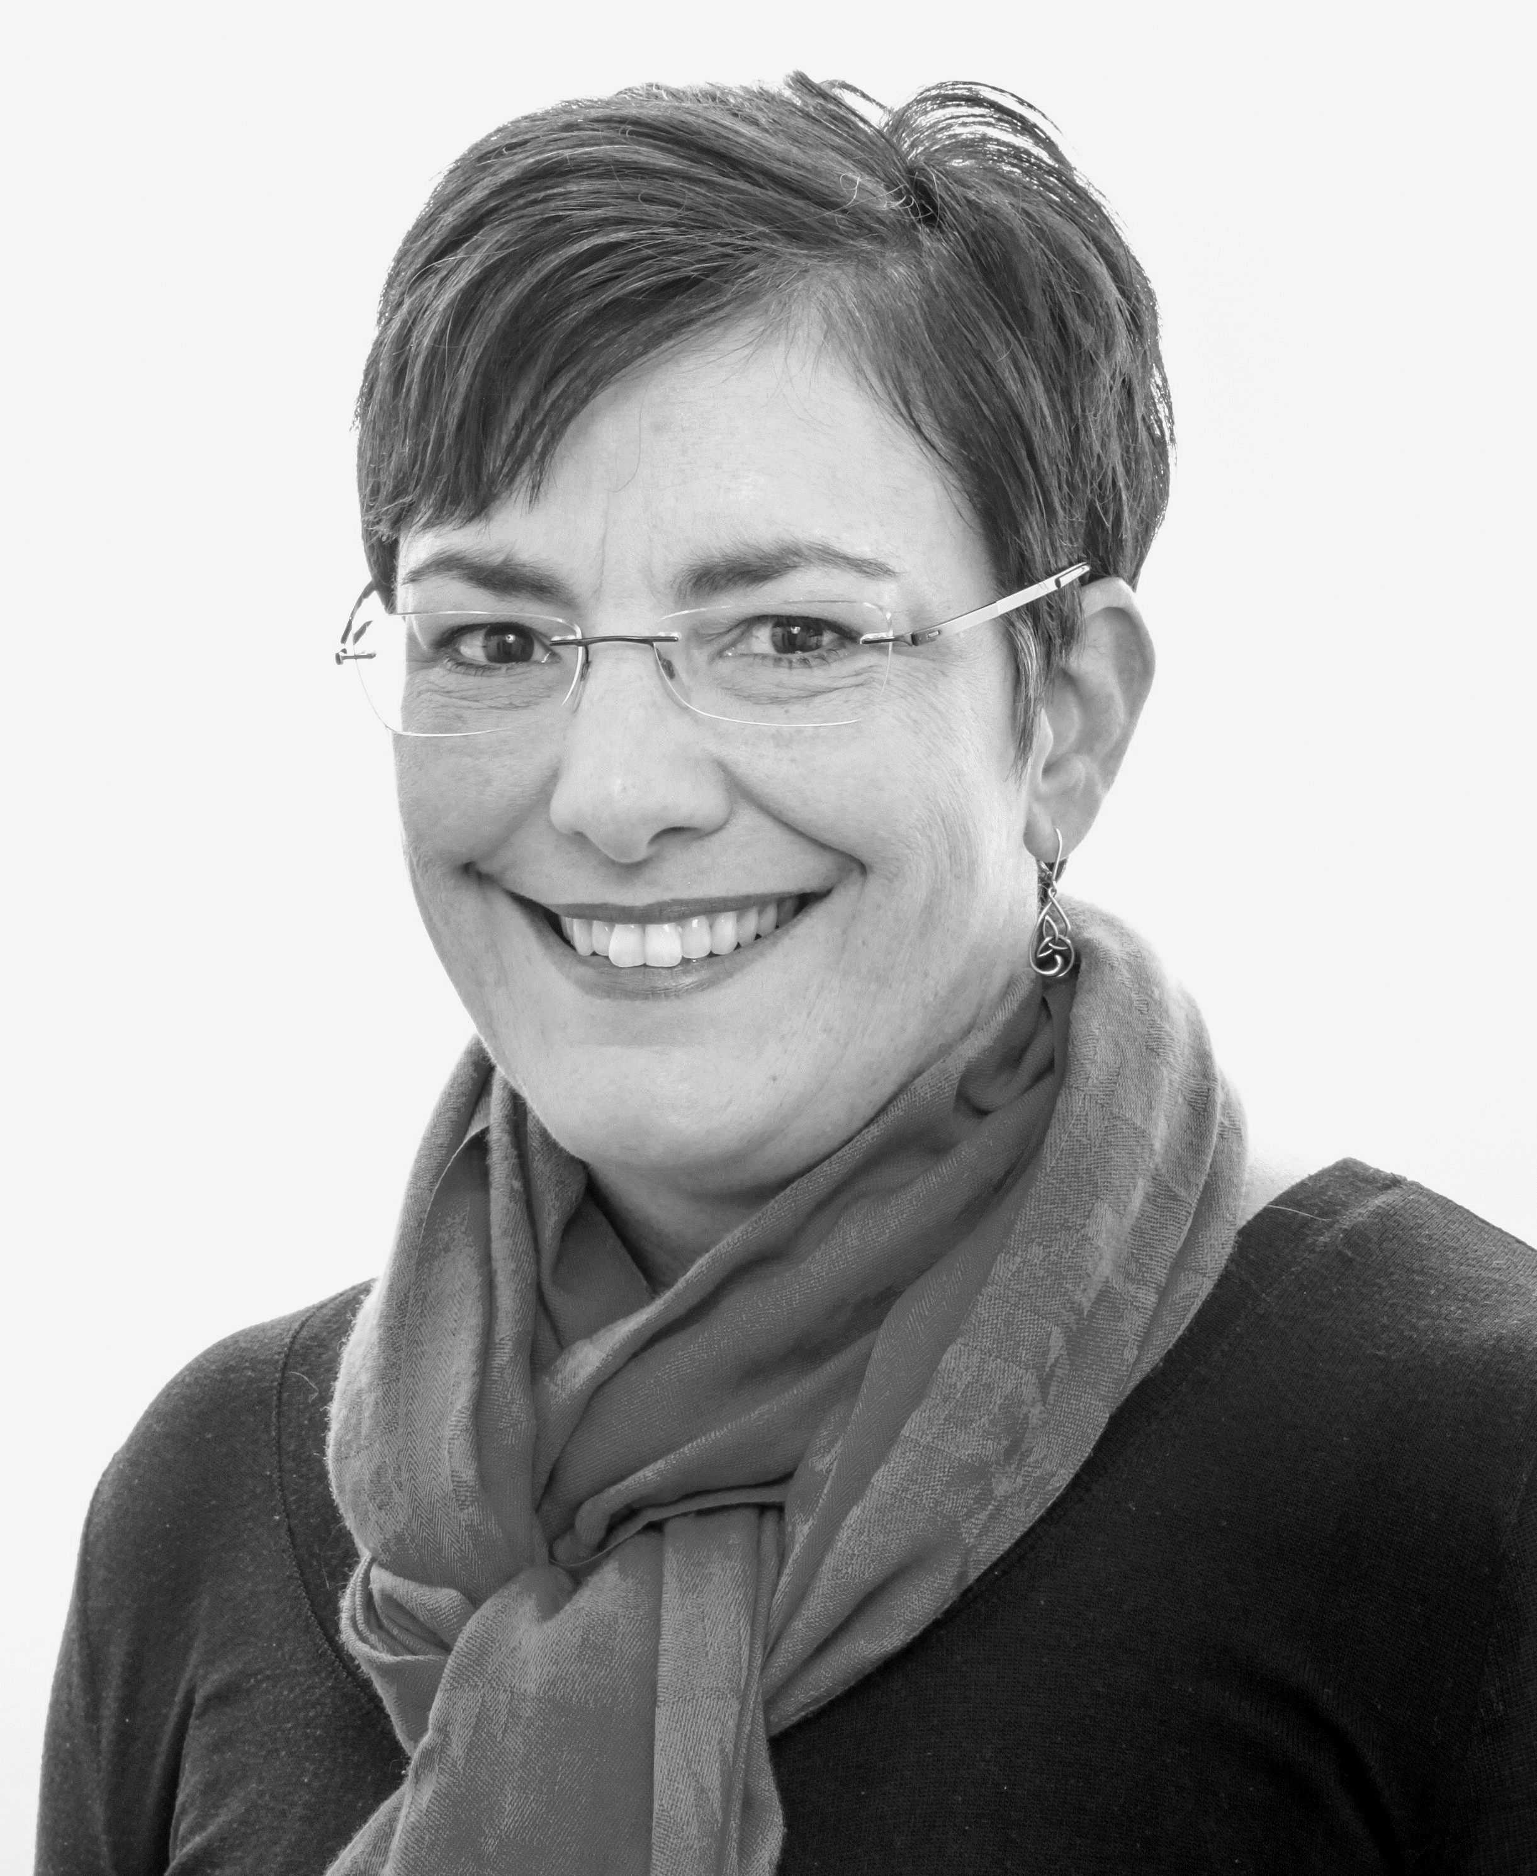
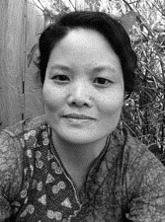
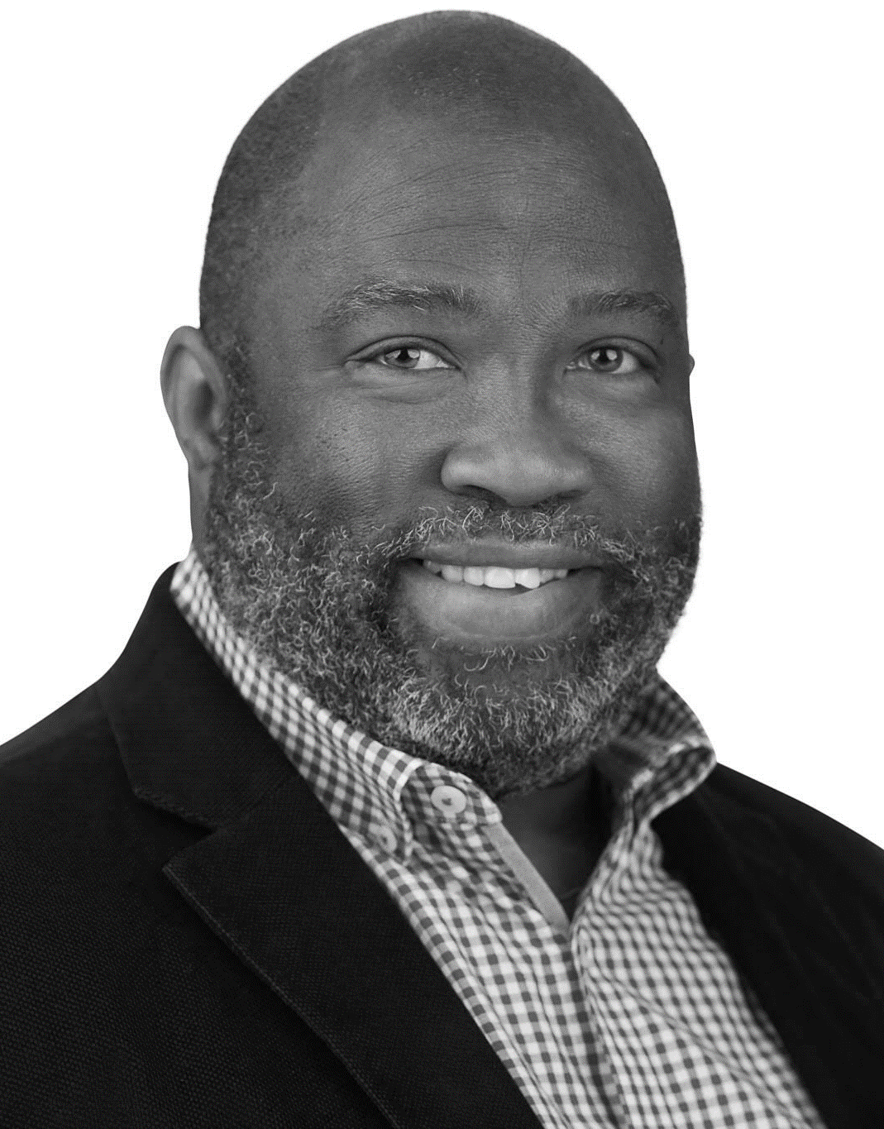
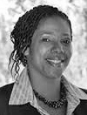
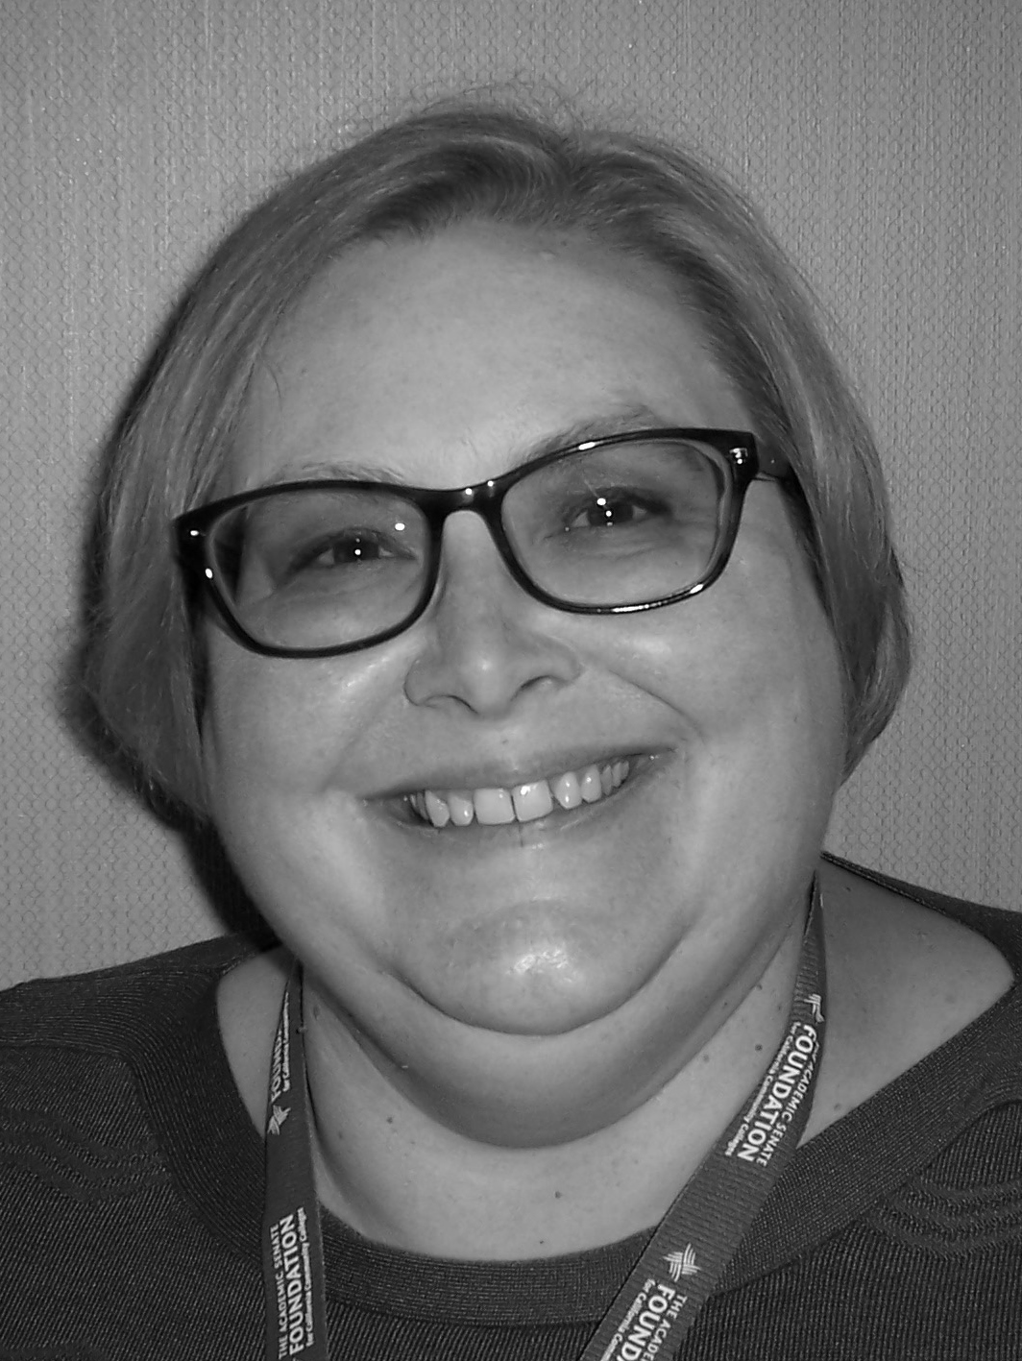
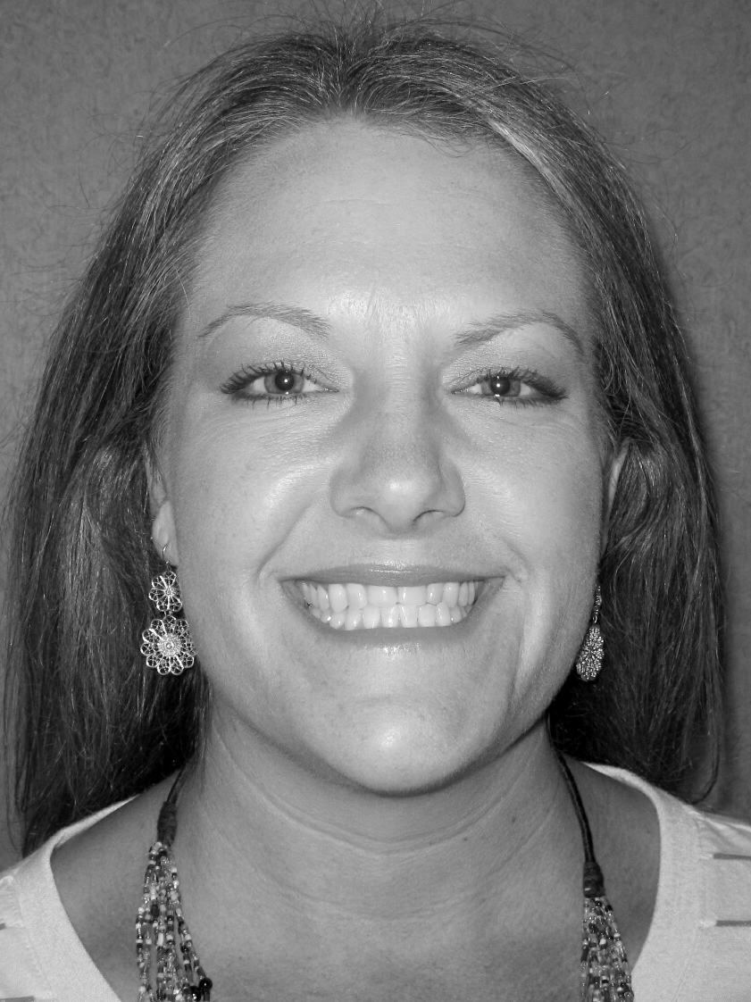
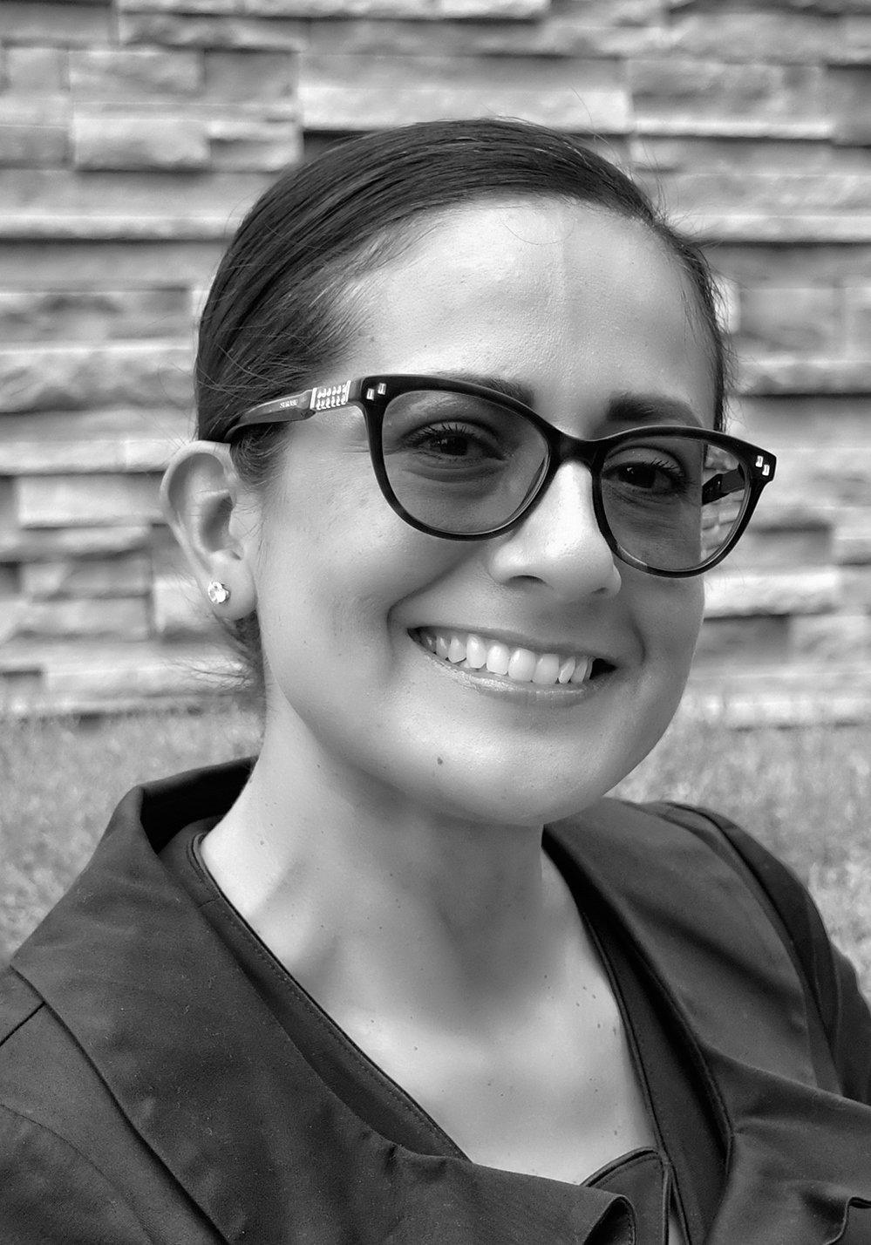
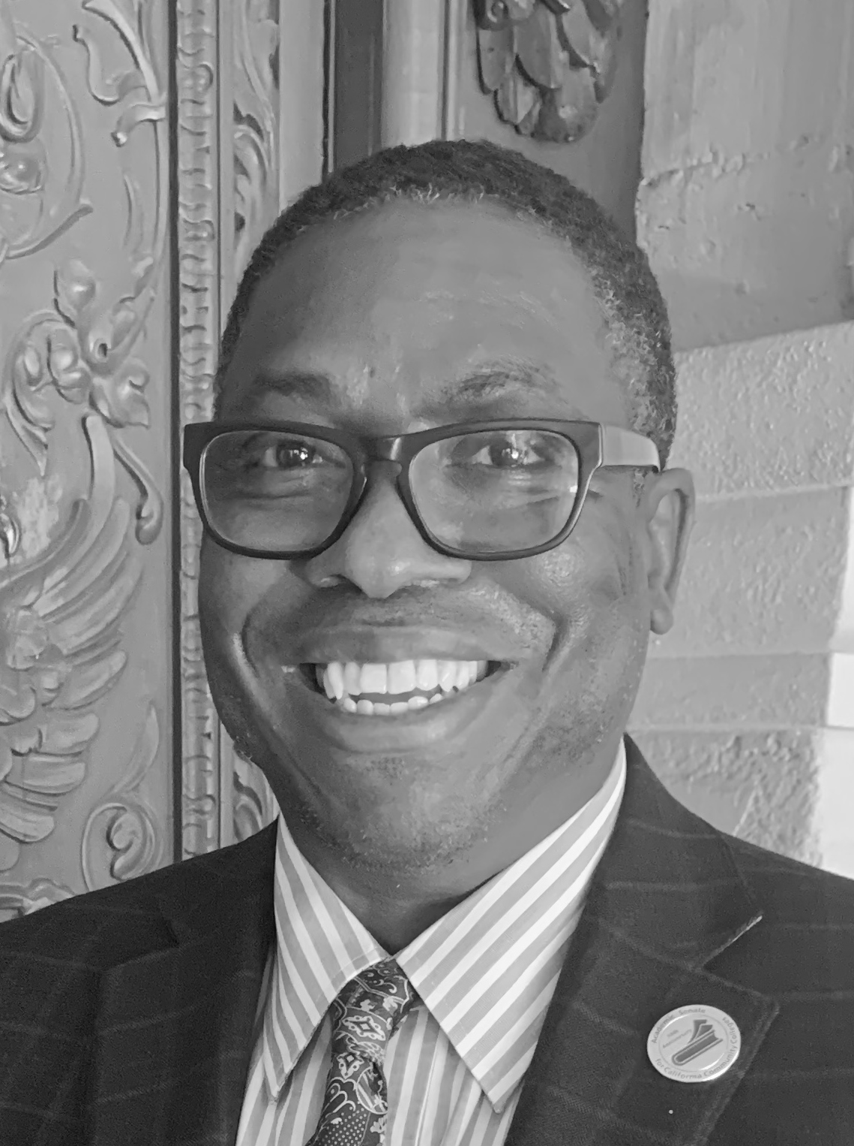
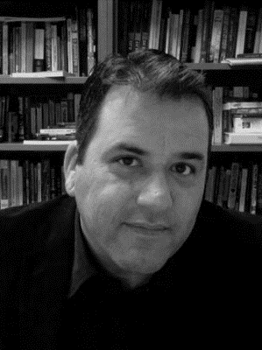
ASCCC Executive Committee 2020-21
Representatives
Julie Oliver
Area A Representative
Karen Chow
Area B Representative
Robert L. Stewart Jr. Area C Representative
LaTonya Parker
Area D Representative
Stephanie Curry
North Representative
Carrie Roberson North Representative
Silvester Henderson
At-Large Representative
Michelle Bean
At-Large Representative
Sam Foster
South Representative
Manuel Velez
South Representative

Slide 5
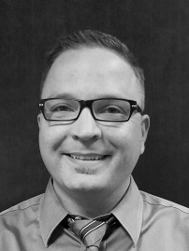
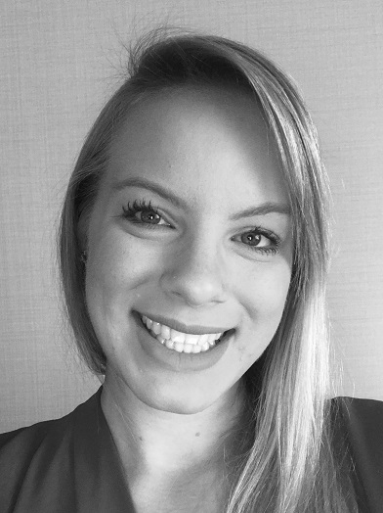
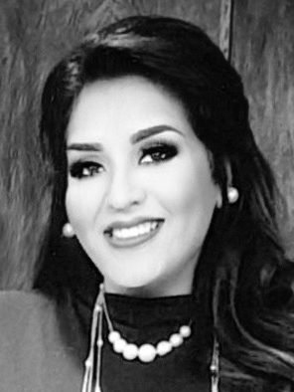
ASCCC Staff
Krystinne Mica
Executive Director
Tonya Davis
Director of Administration
Alice Hammar Director of Finance
Miguel Rother
Director of Grants & Initiatives
April Lonero Executive Assistant
Jennifer Valencia
Program Manager

Slide 6
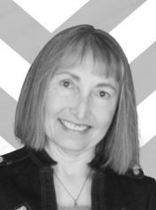
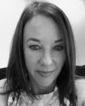
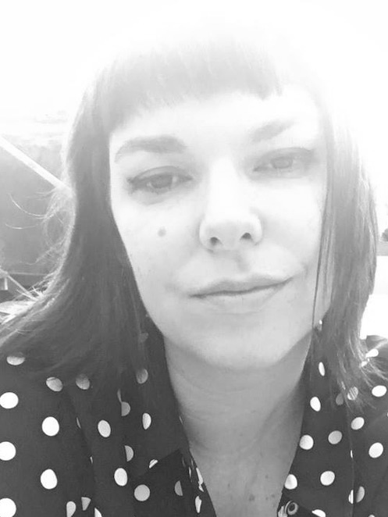
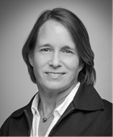
ASCCC Staff
Kyoko Hatano Administrative Assistant
Veronica Rey Administrative Assistant
Selena Silva Program Specialist
Meuy Rosales
Accounting Clerk II
Edie Martinelli Events Manager
Megan Trader Program Coordinator
Katie Nash
Visual Designer

Slide 7
Updates + The ASCCC Areas of Focus
Areas of Focus:
Culturally Responsive Curriculum, Student Services, and Student Services
Equity Driven Systems
Integration and Implementation of Guided Pathways
Updates:
Legislative/Budget
OERI and the PDC
Chancellor’s Office
Transfer

Slide 8
Culturally Responsive Curriculum, Student Services, and Student Support
Decolonize the language in curriculum
Make materials accessible and low/no-cost
Include cultural experiences and student life into curriculum
Be cognizant of the challenges that students face/are facing
Reach out and communicate/be present with regular contact
Be aware of implicit bias
Identify, describe and dismantle structural barriers (racial, socioeconomic)
Humanize materials and instruction

Slide 9
Equity Driven Systems
Examine all systems within the California Community Colleges
Work with the CCCCO’s Diversity, Equity, and Inclusion Implementation Group
Faculty Leadership and Empowerment Academy (FELA) beginning this year
Chancellor’s Call to Action and ASCCC Call to Action
EEO Advocacy Committee Work with other stakeholder groups to pro-actively seek change including updating the hiring processes manual

Slide 10
Integration and Implementation of Guided Pathways
Integration of Guided Pathways into all ASCCC committees
Guided Pathways Webinars and “Coffee, Tea, & GP” workshops will continue through the fall term and into spring
Local GP visits will continue if colleges request them

Slide 11
Legislative Update
AB1460 (Weber) – Makes ethnic studies a graduation requirement for the CSU (lower division).
Currently, discussions regarding the CSU requirements and the impact on the CCCs are taking place within groups with broad representation: the California Community Colleges Curriculum Committee (5C), the Intersegmental Curriculum Workgroup (ICW), C-ID Advisory Committee, and the Intersegmental Committee of Academic Senates (ICAS), but nothing official has come from CSU
As soon as more definitive information is available for colleges, additional input will be sought and guidance will be provided.

Slide 12
Budget Update
Currently, revenue projections are higher than those initially stated by the Governor’s Office
Over half of CCC’s are down in enrollment for the fall term, some by double digits
No anticipated federal stimulus monies until at least January 2021
Budget presentation tomorrow morning about using equity to drive budget discussions and possible reductions

Slide 13
Open Educational Resources Initiative
New resources
ASCCC OER Quick Guides
Articulation, Curriculum, and Open Educational Resources
Recruiting faculty for a variety of roles – see tinyurl.com/OERI4You for details
Discipline leads
Reviewers
And more…

Slide 14
Professional Development College
Curriculum – 5 courses > Certificate
Governance
Orienting New Faculty and Teaching
New Faculty Orientation
Teaching Incarcerated Students
ASCCC Canvas Resources
OERI
Guided Pathways

Slide 15
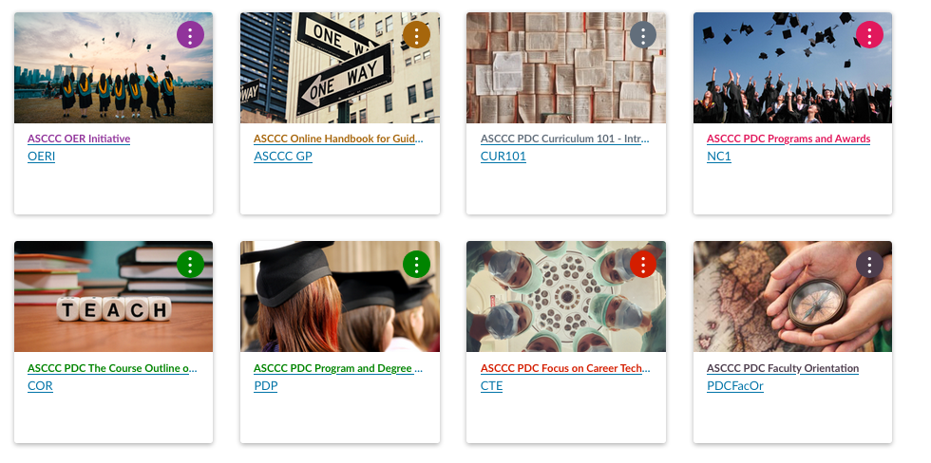
Professional Development College

Slide 16
Chancellor’s Office
Thank you again to Chancellor Oakley for meeting with Areas B and C
Emergency Regulations/Title 5 Changes
Ethnic Studies Work Group of 5C
Labster/Ally/Net Tutor
Library Services Platform (LSP)

Slide 17
Transfer and Transfer Pathways
Transfer = ICAS’s #1 Priority
Alignment of Transfer Pathways between UCTP and TMCs
Convening of discipline groups to discuss transfer requirements
Education for all segments about how transfer works and how it is not working for all students

Slide 18
Upcoming Events
Webinars through fall and spring terms
Weekly Guided Pathways Webinars through December
Part Time Faculty Institute 18-19 February 2021
Area Meetings 26-27 March 2021
Spring Plenary Session 15-17 April 2021
Career and Noncredit Education Institute 30 April – 2 May 2021

Slide 19
Our Special Guest Speaker
Jolena Grande, Board of Governors member and faculty at Cypress College

Slide 20
Remember…
These are unprecedented and challenging times. Doing the necessary work cannot be the job of one senate president or even an executive team. Collective engagement by the entire institution must be the goal for a college to succeed.
Do not try to take all of this on by yourself; delegate, share the responsibilities, and (try to) let go of the outcome
Remember to care for others and to be compassionate whenever possible – others are fighting battles that we can’t see.
Practice self-care – if you don’t take care of yourself, you are not going to be able to help care for others

Slide 21
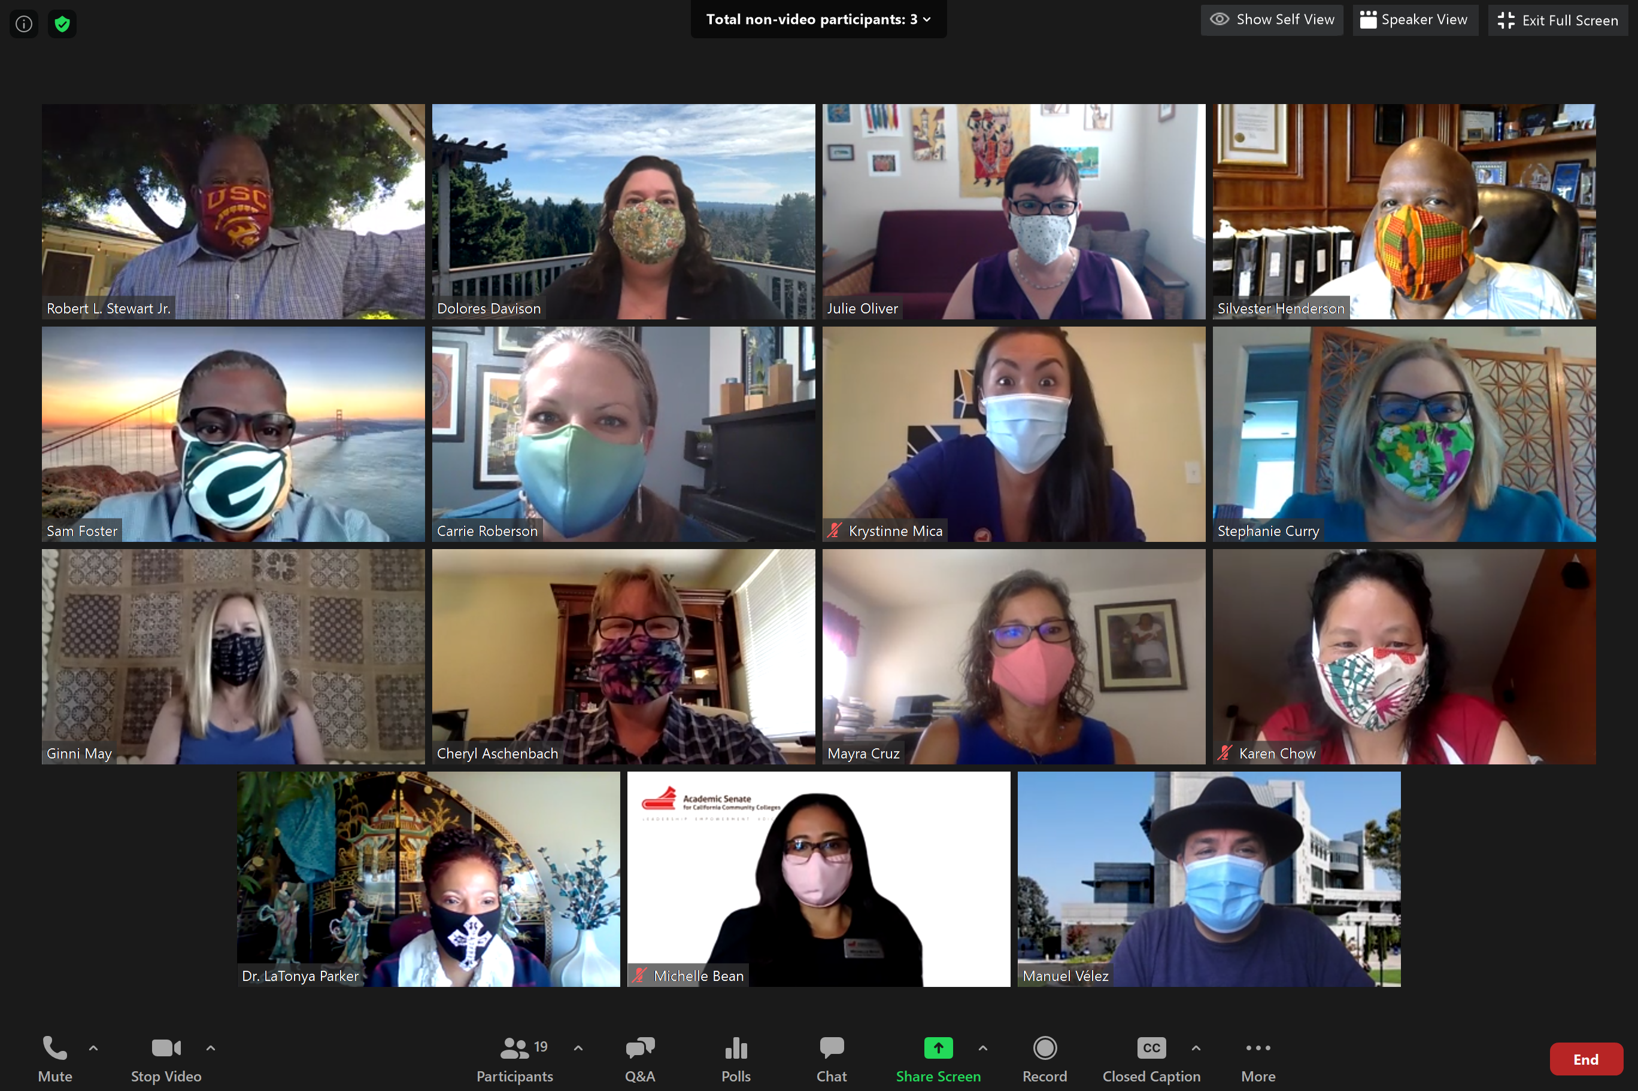
And Finally…
Enjoy Plenary!!

