Slide 1
You Did What? Implementing a College Team Approach to Course Design and Service Delivery

Slide 2
Agenda
Introduction
Background/history
Local POCR process
FastTrack Canvas course & FastTrack process
Support team
Data
Honoring faculty
Summary of benefits
Appreciation & Questions

Slide 3
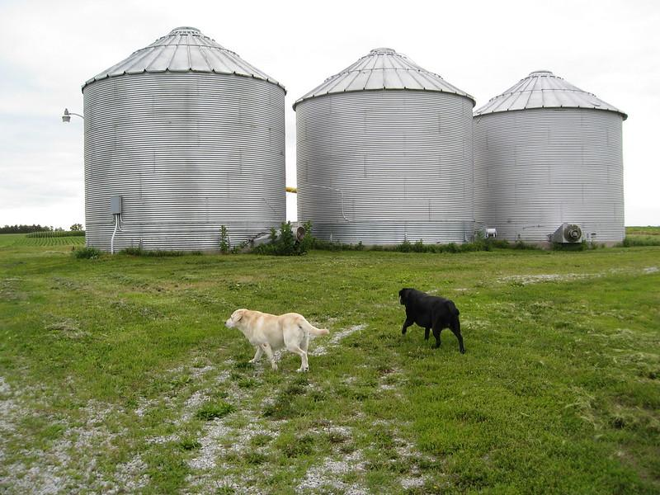
Los Rios Community Colleges
Local POCR
Developed a District Process
Four colleges, one process
Alignment to the CVC-OEI course design rubric
Greater opportunity for sharing and collaboration
Decrease silos
Silos by Chris Yunker is licensed under CC BY 2.0

Slide 4
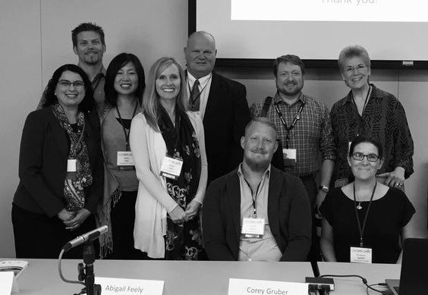
History
How We Got Here
Fall 2015 ARC embraced the OEI Course Design Rubric
Spring 2017 ARC implemented OEI Rubric Academy
Spring 2018 All 4 colleges joined the CVC-OEI Equity Consortium
ARC first Local POCR college
SCC second Local POCR college
Panel presentation at ARC 2017 Can·Innovate

Slide 5
Four College Local POCR Process
Los Rios Colleges Online FastTrack OEI Rubric Academy
Impetus for FastTrack
Admin support
Model developed from OEI process
Paid POCR reviewers
Additions for FastTrack:
Mentor for every instructor
Equal stipend upon submission to OEI
Grant further supported objectives

Slide 6
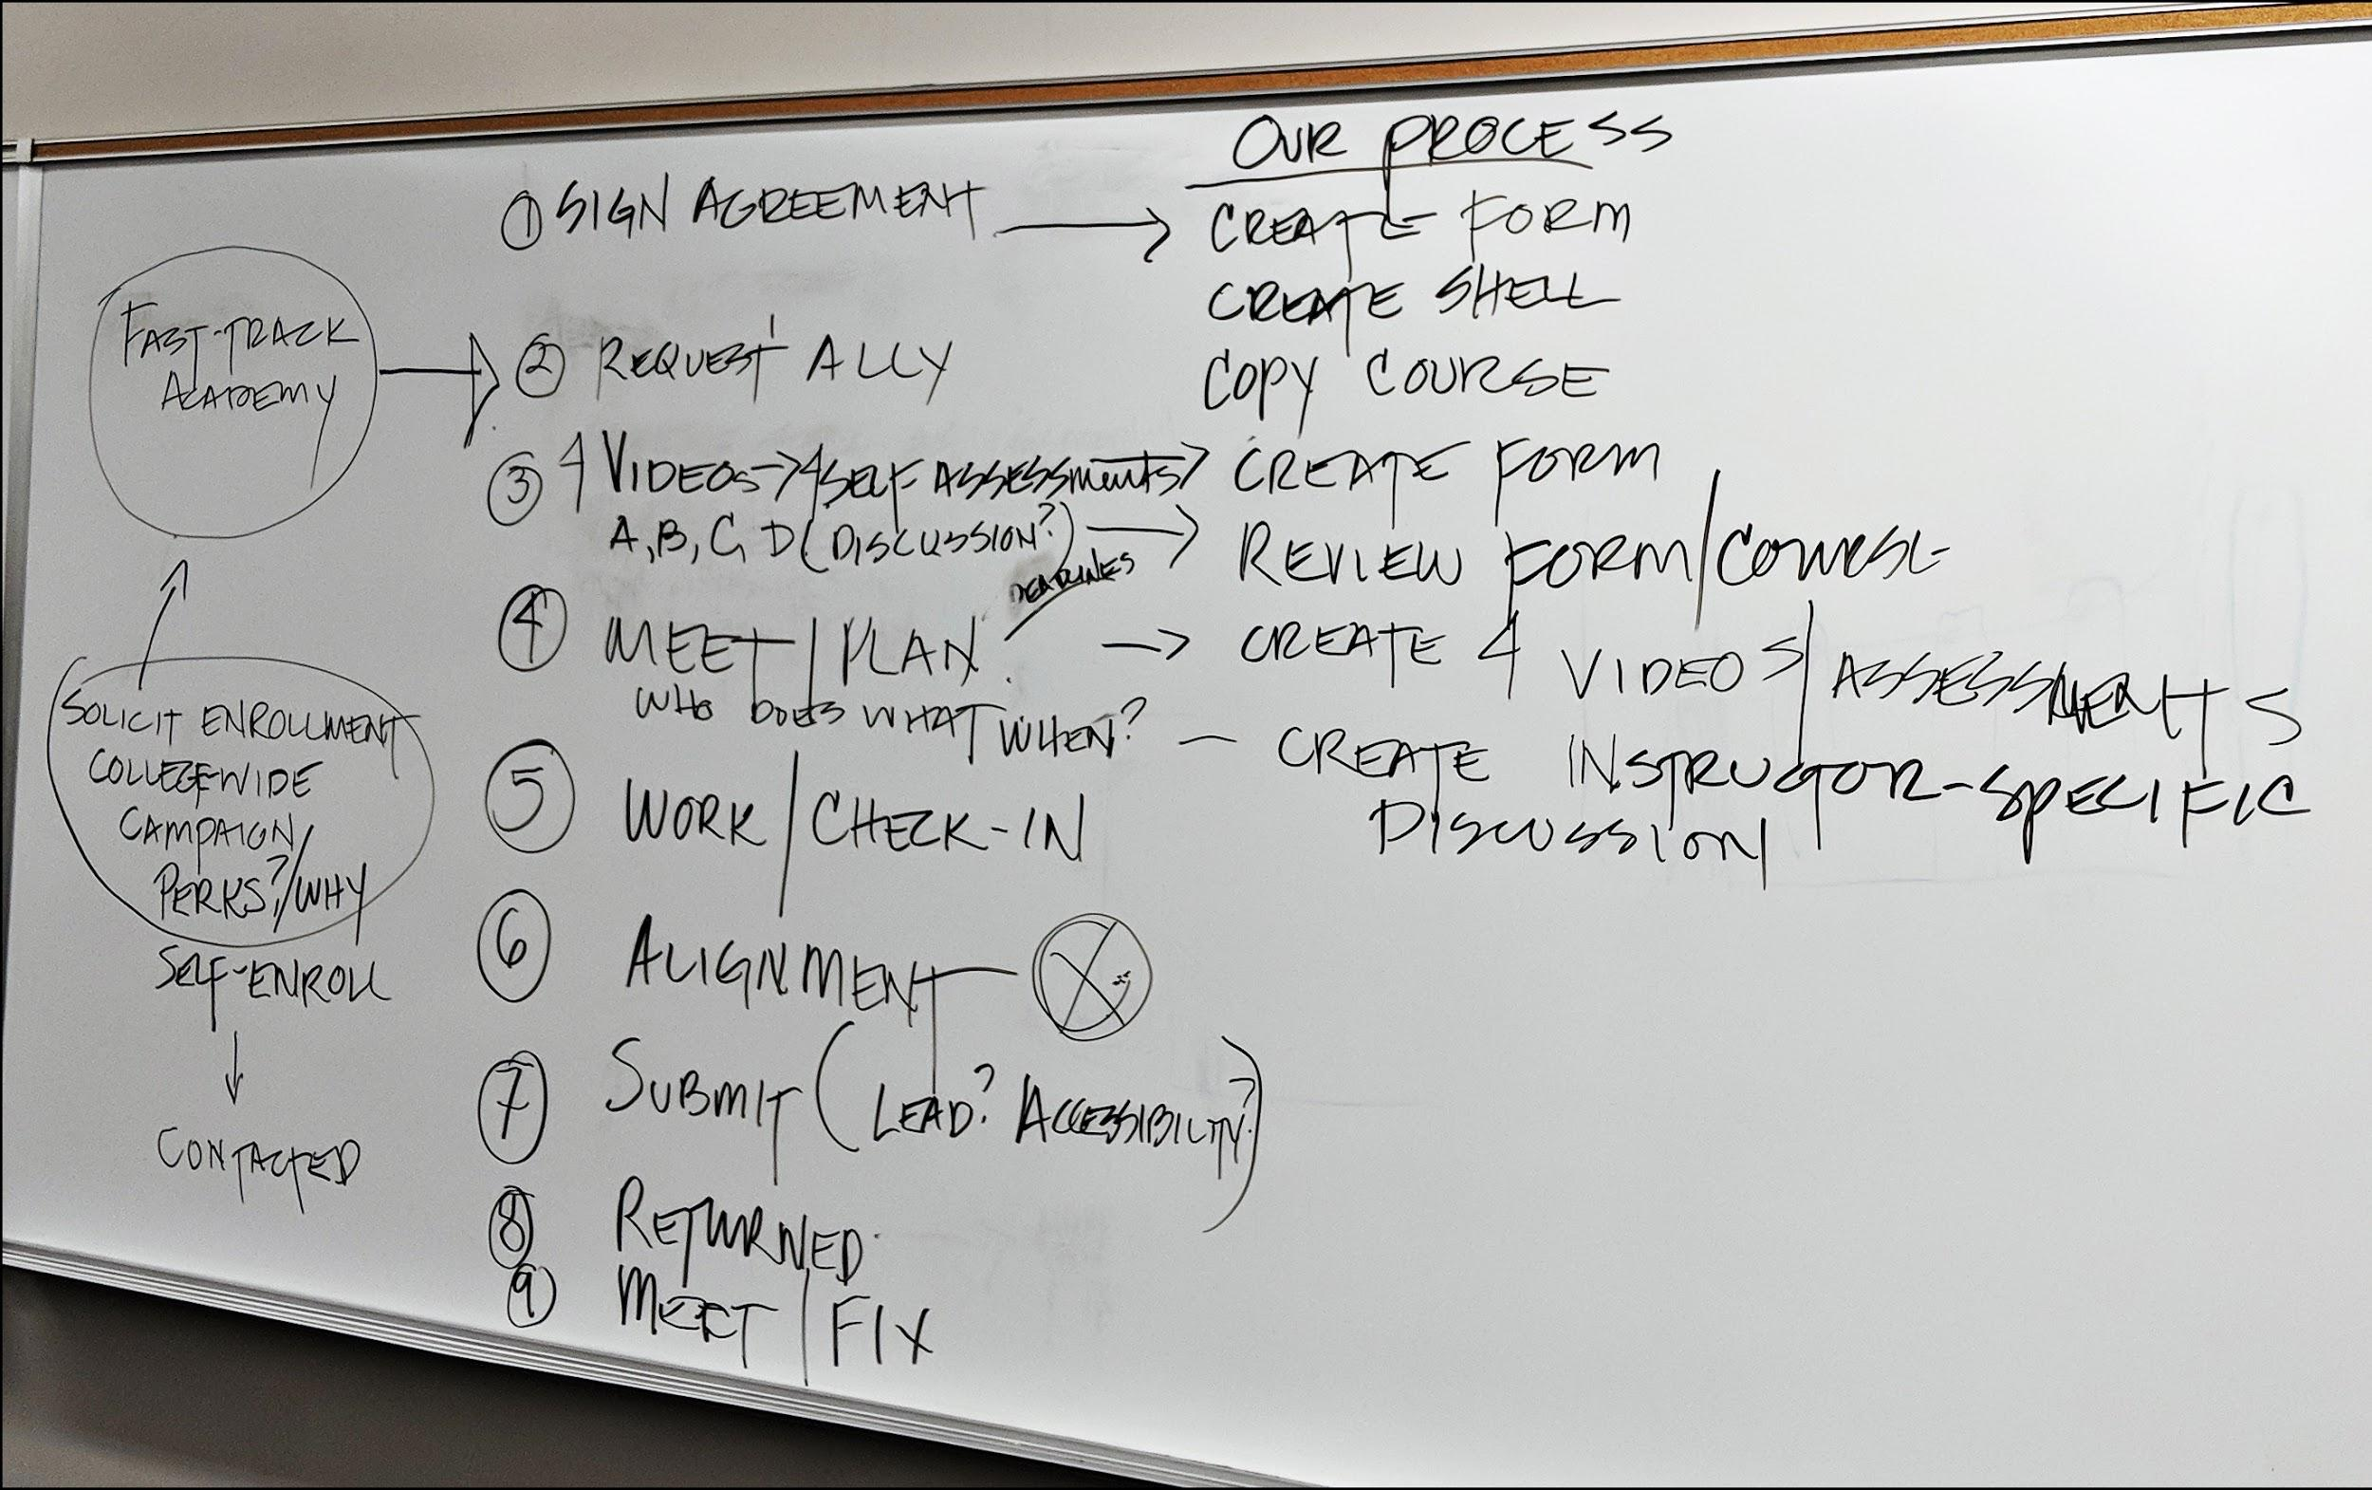
FastTrack
FastTrack Academy
Created Canvas course to guide faculty and provide resources
Based on the ARC model
Added a Section E
Instructors fill out self-assessments
Mentor/Faculty Relationship
Planning FastTrack

Slide 7
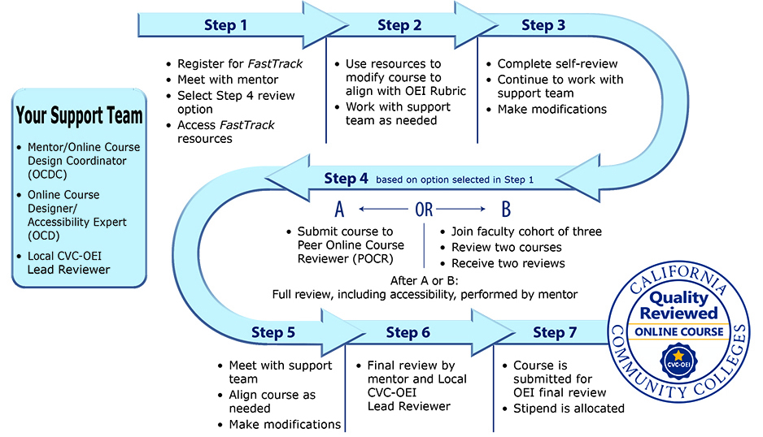
FastTrack Process

Slide 8
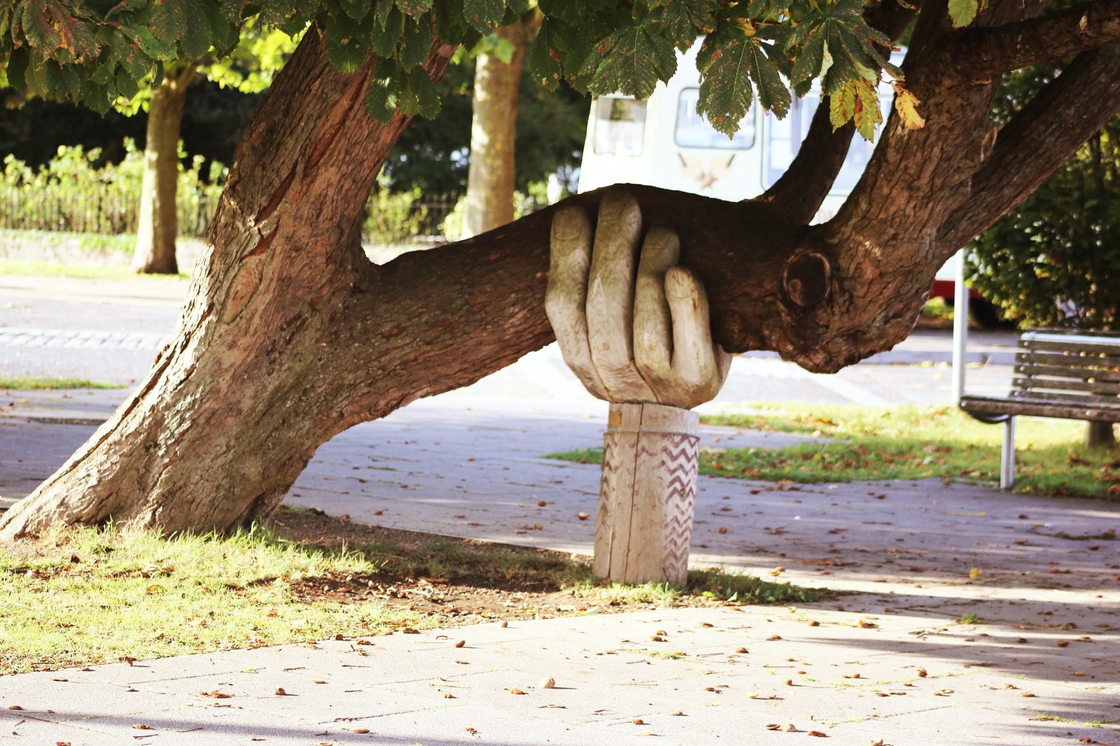
FastTrack Support
Strong Support Team
Mentors/OCDCs
OCD/Accessibility Expert
A-Team
Project Manager^{G}
Web Designer^{G}
Programmers^{G}
Photo by Neil Thomas on Unsplash

Slide 9
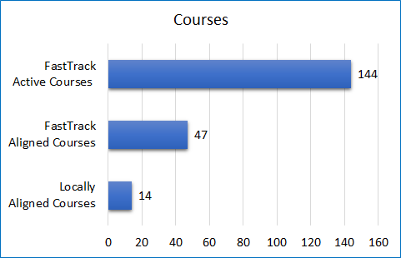
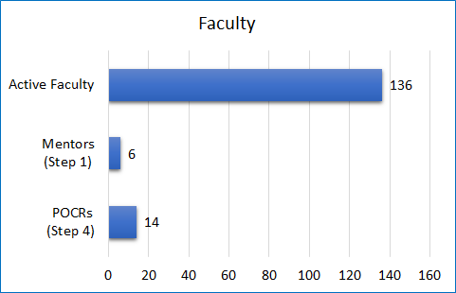
FastTrack Data

Slide 10
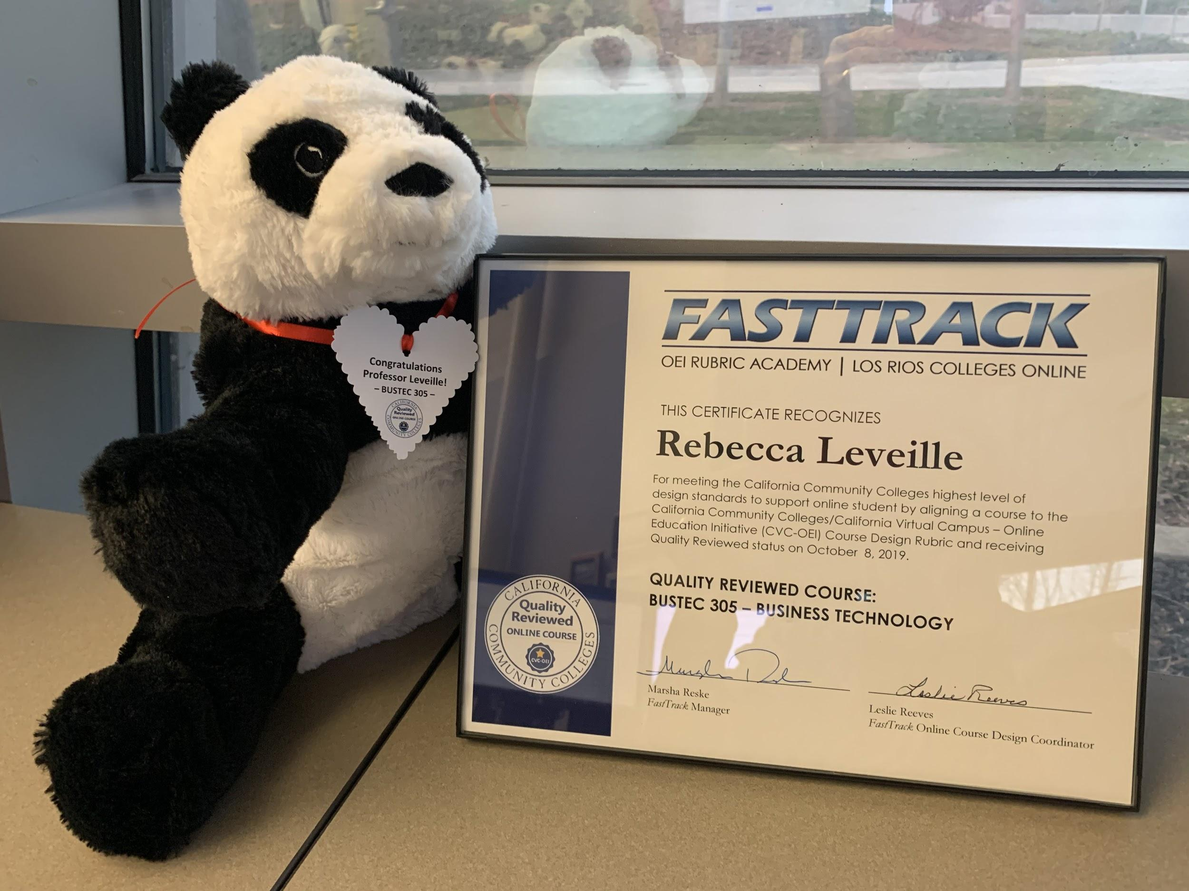
Alignment Recognition
Honoring Our Instructors
Certificates and pandas
Campus newsletters
Website gallery
http://bit.ly/fasttrack-web

Slide 11
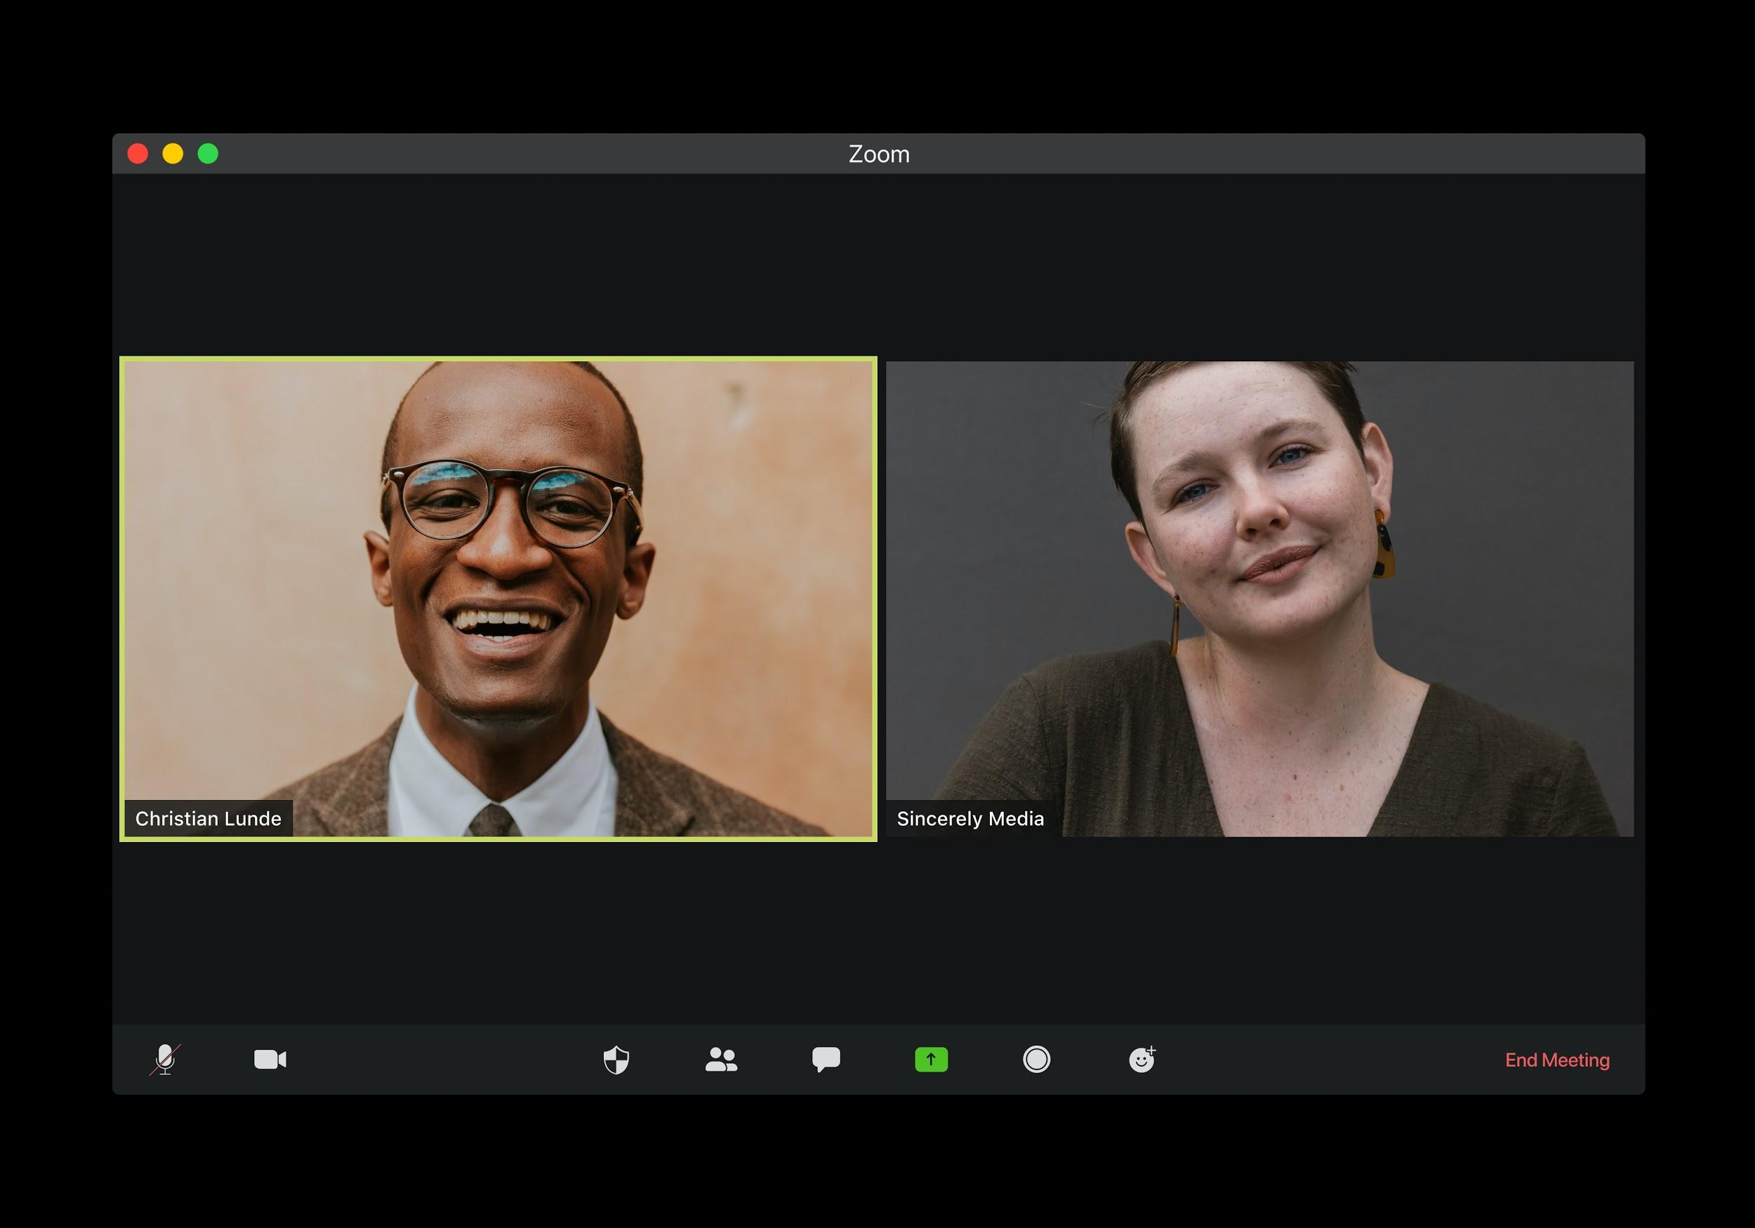
FastTrack Benefits
Benefits of District Process
Cross-college communication
Assignment distribution for mentors & POCRs
Instructors become part of a larger community
Mentors & POCRs develop appreciation for new good ideas
Faster road to 20% alignment
Photo by visuals on Unsplash

Slide 12
Appreciation & Questions

