Slide 1
Curriculum, Financial Aid & Veterans Services

Slide 2

Vision for Success
Vision for Success
Core Commitments
Focus on students’ goals
Design and decide with the student in mind
Pair high expectations and high support
Evidence-based decisions
Own student performance
Enable innovation and action
Cross-system partnership
Increase credential obtainment by 20%
Increase transfer by 35% to UC and CSU
Decrease unit obtainment for a degree
Increase employment for CTE students
Reduce and erase equity gaps
Reduce regional gaps
Notes:
Completion- Most students who enter a community college never complete a degree or certificate or transfer to a 4-year university
Time to Degree-CCC students who do reach a defined educational goal such as a degree or transfer take a long time to do so, often accumulating many excess course credits along the way
Achievement gaps persist across the CCCs and high-need regions of the state are not served equitably

Slide 3
Call to Action for Equity
Systemwide review of police and first responder training and curriculum.
Campus leaders host open dialogue and address campus climate.
Campuses audit classroom climate and create an action plan to create inclusive classrooms and anti-racism curriculum.
District Boards review and update your Equity plans with urgency.
Shorten the time for the full implementation of the DEI Integration Plan
Engage in the Vision Resource Center “Community Colleges for Change.”

Slide 4
Student Learning Outcomes
Understand the process for course approval.
Where and how instruction and financial aid intersect.
How CARES Act and COVID-19 affects financial aid.
Overview of Veterans resources and limitations.

Slide 5
Program Approvals-
Federal regulations require that academic programs eligible for federal student financial aid be approved by the appointed State Authorizing Agency, if the state requires approval.
Title 5 requires that colleges submit all Certificates of Achievement with 16 or more semester units to the Chancellor’s Office for chaptering.
Colleges may submit CoAs that are 8 to fewer than 16 semester units to the Chancellor’s Office for chaptering, and then those CoAs can be noted on the student transcript. HOWEVER, please note that programs that are less than 16 semester units are not eligible for FA.

Slide 6
Current Practice:
Keep Programs in Synch and COMPLIANT

Slide 7
Transparencies & Suggestions for Self-Audit
Colleges are offering programs that do not appear in COCI.
  Why?
    Possible import problem when the CI system was migrated in 2010
    Possible import problem when the CI system migrated to COCI in 2017
    The CI system had a correction feature and some colleges made updates that changed historical records, therefore impacting the alignment of information.
  How to Solve?
    College’s should postpone payment of federal aid to students enrolled in those programs until:
      Program are submitted and approved through the COCI.
      Recertify program eligibility with ED.

Slide 8
Transparencies & Suggestions for Self-Audit
Colleges are offering programs with program titles, TOP codes, and/or unit values which differ as
recorded in COCI versus college catalog and/or the PPA.
    Submit these programs as sub or non-sub changes to the Chancellor’s Office for approval.
    Reconcile changes with catalog and Program Participation Agreement (PPA)
Inactive programs for which students still have catalog rights should be listed on the
documentation sent to ED.
    Working with ED on how to flag these programs as inactive.

Slide 9
Let's Pause and Connect
For this interactive slide, you can participate by using the raise your hand tool or by providing a response in the chat box.
YOUR TURN
What information would assist your college if you were to begin a self- audit?

Slide 10
Resolutions: Checklist
Chancellor’s Office Curriculum Inventory (COCI) College Catalog
Approved program listing in school-based software
Title IV Program Participation Agreement (PPA) Local governing board approvals
Local Curriculum Committee meeting minutes

Slide 11
Outcomes of Local Curricular Processes
Assure Compliance
Local processes and procedures for curriculum should include checks to ensure FA eligible programs:
Have Chancellor’s Office approval, including listing in COCI
COCI matches exactly with--
  College Catalog
  Title IV Federal Financial Aid PPA
  Program listing in school-based software
Collaboration is Key! How do your local processes encourage and verify collaboration between appropriate college personnel?

Slide 12
Curriculum Process
Local Curriculum Process
Chancellor’s Office Curriculum Inventory
College
College Software
College Catalog
College Program Participation Agreement
ACCJC and External Accreditation
Notes:
College Participation Agreement – Financial Aid Form

Slide 13
Curriculum Streamlining and Chancellor’s Office (CO) Responsibilities
Items eligible for Streamlining Process
Modified CTE Certificate of Achievement
New Local A.A. and A.S. Degrees
New Transfer A.A. and A.S. Degrees
Items requiring CO review
  CTE Certificates of Achievement (New)
  CTE AS/AA Degree (New)
  ADTs (New/Sub/Modified)
  CDCP Noncredit (short term vocational) (New)

Slide 14
Curriculum Streamlining – Chancellor’s Office (CO) Responsibilities
CO provides technical assistance and training
CO Curriculum staff are assigned to specific colleges:
  colleges can be served holistically
  one point of contact.
  Reviewers by region can be found on the Chancellor’s office website

Slide 15
Curriculum Team by Region
Patti Blank pblank@cccco.edu | Macro Region A (Northern Inland, Northern Coastal, Lake Tahoe)
David Garcia dgarcia@cccco.edu | Macro Region A (Greater Sacramento) Macro Region E (San Diego/Imperial)
Chantee Guiney cguiney@cccco.edu | Macro Region B (North Bay, Mid-Peninsula, Silicon Valley, Santa Cruz/Monterey)
Zitlali Torres ztorres@cccco.edu | Region B (East Bay)
Kevin Lovelace klovelace@cccco.edu | Region C (Central Valley)
Kevin Olson kolson@cccco.edu | Region D (South Central Coast) Region F (Inland Empire/Desert)
Njeri Griffin ngriffin@cccco.edu | Region G (Los Angeles/Orange County)

Slide 16
Financial Aid and Instruction INTERSECTION
Program & Student Eligibility
  Distance education
  Correspondence courses
Satisfactory Academic Progress
  Qualitative, quantitative/pace, maximum timeframe
Return to Title IV
  Withdrawals
  Incomplete grades
  Last date of attendance
I N S T RC U T I O N
F I N A N C I A L A I D

Slide 17
Program Eligibility
Federal regulations require that academic programs eligible for federal student financial aid be approved by the appointed State Authorizing Agency if the state requires approval.
A student must be enrolled as a regular student in an eligible program at the time of admission, and the school must have a system to notify the financial aid office if the student leaves the program.

Slide 18
Distance Education
A distance education program at a domestic school is considered an eligible FSA program if it has been accredited by an accrediting agency recognized by the Department for accreditation of distance education.
Uses certain technologies to deliver instruction to students who are separated from the instructor and to support regular and substantive interaction between the students and the instructor.
Short-term certificate programs of less than one year offered via distance education are eligible for FSA funds, and they are not considered correspondence programs.

Slide 19
Correspondence Courses
A correspondence program is considered an eligible FSA program if it has been accredited by an accrediting agency recognized by the Department for accreditation of correspondence education.
A student enrolled in a correspondence course can only receive FSA funds if the course is part of a program that leads to an associate’s, bachelor’s, or graduate degree. Correspondence students enrolled in certificate programs are not eligible for FSA funds.
A student taking only correspondence courses is never considered to be enrolled more than half time.
Notes:
.

Slide 20
Satisfactory Academic Progress (SAP)
Specify the qualitative standard (grade point average or GPA) that a student must have at each evaluation
  Students enrolled in a program of more than two academic years must have a GPA of at least a “C” or its equivalent or must have an academic standing consistent with your school’s graduation requirements
Specify the quantitative standard (pace) at which students must progress through their program to ensure that they will graduate within the maximum timeframe.
Maximum timeframe - for an undergraduate program measured in credit hours, a period no longer than 150 percent of the published length of the program.

Slide 21
Return to Title IV (R2T4)
If a recipient of Title IV grant or loan funds withdraws from a school after beginning attendance, the school must perform an R2T4 calculation to determine the amount of Title IV assistance earned by the student.
A school is required to determine the earned and unearned portions of Title IV aid as of the date the student ceased attendance based on the amount of time the student spent in attendance.
Up through the 60% point in each payment period or period of enrollment, a pro rata schedule is used to determine the amount of Title IV funds the student has earned at the time of withdrawal.

Slide 22
Withdrawal Dates for Schools Not
Withdrawal Dates for Schools Not Required to Take Attendance
Withdrawal Type | Circumstance | Student’s Withdrawal Date | School Determination Date
Official Notification | The student begins the school’s withdrawal process, or the student otherwise provides official notification to the school of intent to withdraw. | The date the student begins the school’s withdrawal process, or The date that the student otherwise provides the notification (If both circumstances occur, use the earlier withdrawal date.) | The student’s withdrawal date or the date of notification, whichever is later.
Official Notification Not Provided | Official notification not provided by the student because of circumstances beyond the student’s control All other instances where student withdraws without providing official notification. | The date that the school determines is related to the circumstance beyond the student’s control The midpoint of the payment period or period of enrollment, as applicable. | The date that the school becomes aware that the student has ceased attendance.

Slide 23
CARES Act and COVID-19 Changes
Accreditation Requirements
  Waives the requirement for distance education accreditation (HEROES Act).
Return to Title IV Waiver
  Waives the requirement for schools to return Title IV funds as a result of student withdrawals related to a qualifying emergency.
  Schools are still required to complete a R2T4 calculation if a student withdraws.
Satisfactory Academic Progress (SAP)
  Excludes attempted credits a student was unable to complete as a result of COVID-19 from pace and maximum timeframe calculation.

Slide 24

Chancellor’s Office Veterans Program
Presented by: Jacqueline Chacon

Slide 25

Chancellor’s Office Veterans Program
2019-20 Veteran’s GI Bill® count: 35,368
2019-20 MIS Fall Data: 41,863
113 Veterans Resource Center (VRC)
  West Hills College Coalinga and West Hills College Lemoore share a center
$10 million ongoing California budget allocation
Funds must be used toward meeting or making progress toward the minimum standards associated with a high-functioning VRC

Slide 26
Chancellor’s Office Veterans Program
VRC Services
  Financial Aid Assistance (Required for schools participating in Principles of Excellence)
  Veteran specific tutoring
  Peer to peer mentoring
  Text book loan program and/or book voucher program
  Mental health services for veteran on campus (may include outside organizations)
  Bridge to external services (housing, food etc….)
  Coordination with other campus-based programs like, DSPS, Financial Aid, Health Center, SSSP, Student Equity, etc.

Slide 27
Chancellor’s Office Veterans Program
VRC Minimum Staffing
  1 Certifying Official per 300 certifications/annually
  Dedicated Director/Coordinator
  Academic Counselor with veteran specific training

Slide 28
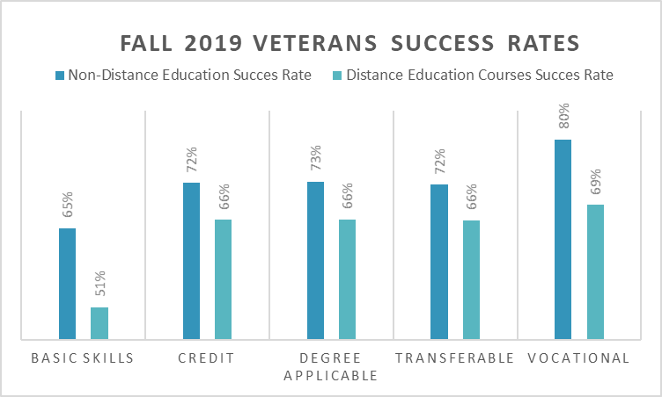
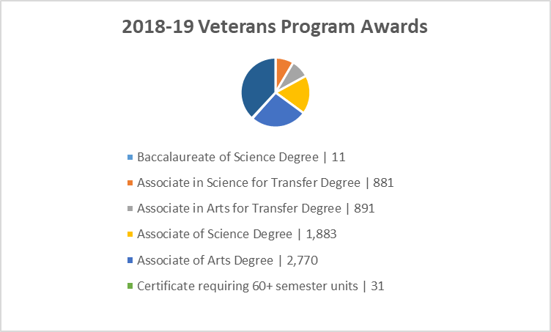

Chancellor’s Office Veterans Program
Veterans Outcomes
Source: CCCCO Management Information System Data Mart
* Success count includes the number of enrollments with grades of A,B,C,P,IA,IB,IC,IPP

Slide 29
Chancellor’s Office Veterans Program
Main Sources of Aid
GI Bill®
Pell Grant
California College Promise Grant
Cal-Vet College Fee Waiver
  Available for dependents of a Veteran with a disability
Other sources:
  EOPs, CalWORKs, CARE, Chafee, work-study, loans, and scholarships
2018-19 Veterans Resources Data
Aid | Student Count | Award Amount
GI Bill | 35,910 | N/A
Pell Grant | 14,662 | $48,212,567
California College Promise Grant | 29,639 | $23,374,619
Grants | 7,079 | $5,513,446
Loans | 1,762 | $6,831,999
Scholarship | 973 | $1,190,221
Work Study | 253 | $768,856
Source: CCCCO Management Information System Data Mart
Data includes duplicate information
One student may qualify for multiple grants/awards

Slide 30
Chancellor’s Office Veterans Program
Novel Coronavirus Guidance - Attendance Accounting Implications and Guidance FS 20-04
The VA classifies course grades as either punitive or non-punitive where a punitive grade is used in determining the student's overall progress toward completion of the school's requirements for graduation. A non-punitive grade does not count as earned credit and is not considered in progress standards for graduation. The VA issues payment for courses with punitive grades only.
Based on these definitions, several of the flexible grading options, such as Excused Withdrawals (EWs) are considered a non-punitive grade and would not be eligible for benefits, triggering a repayment of benefits.
The VA recently approved EWs as eligible for payment of benefits when issued due to COVID-19. EW grade options will continue to be classified as non-punitive when marked as COVID-19 and repayment of benefits will not be triggered.

Slide 31
Chancellor’s Office Veterans Program
Course Modality in Summer & Fall 2020
Colleges providing online distance education courses for Summer or Fall 2020 due to COVID-19 should maintain documentation that distinguishes courses originally approved and scheduled to be offered online versus those courses transitioned online due to social distancing requirements. The VA has indicated they will rely on the School Certifying Officials(SCOs) to accurately report the intended course modality, as such, where possible, colleges should maintain documentation that supports their certifications.

Slide 32
Chancellor’s Office Veterans Program
College Catalogue
Every time the college catalogue is updated, it must be approved by the California State Approving Agency for Veterans Education
  Recommendation: Add amendments to the catalogue and officially update every 2-3 years
Unless stipulated in the college catalogue that students may pursue multiple degrees, a Veteran student will not receive GI Bill® benefits for a double major
Sample language:
A degree may be granted upon successful completion of requirements in a major field of study, appropriate general education courses, and electives to total at least 60 semester units. Students must petition for degrees and may apply for multiple degrees.

Slide 33
Chancellor’s Office Veterans Program
Recommendations from Veterans Program Coordinators/Directors
Invite a Veterans Counselor to participate in curriculum committee
Continue to offer in-residence courses or when possible offer hybrid distance education
  Hybrid courses can be classified as in-residence
Sample GI Bill® benefit payment for a Solano Community College Veteran
  In-residence courses $2,587
  Online only courses: $872
Veterans receiving GI Bill® benefits cannot deviate from their educational planner
  Benefits awarded only for courses required for the objective declared
  Many Veteran students receive Credit for Prior Learning and often this leaves no room for electives

Slide 34
Chancellor’s Office Veterans Program
Veterans Services Advisory Committee 2020-21 Goals
1. Identify measures of success for a VRC
  Vision for Success Core Commitment: Evidence-based decisions
2. Update the certification for the minimum standards of a VRC form
  Vision for Success Core Commitments:
    Take ownership of goals and performance
    Always design with the students end goal’s in mind
    Pairing high-expectations with high support
3. Provide guidance and support for statewide VRCs’ transitions to electronic files
  Vision for Success Core Commitments:
    Pair High Expectations with High Support
    Always design with the students end goal’s in mind
    Cross-system partnership with the VA

Slide 35

Chancellor’s Office Veterans Program
Credit for Prior Learning: What's New and What Can You Do Next?
Thursday, July 9th
9:00 a.m. to 10:15 a.m. Breakout V

Slide 36

Chancellor’s Office Veterans Program
Jacqueline Chacon
Veterans Services Lead
Educational Services & Support Division
veterans@cccco.edu

