Slide 1
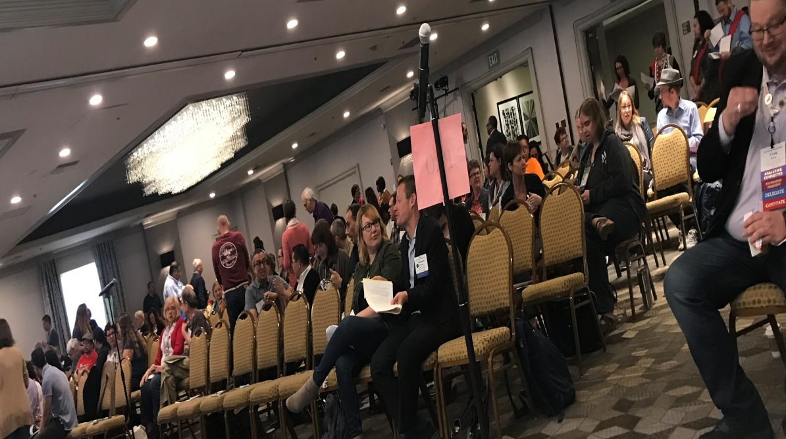
Delegates and First Time Attendees
Information Session
Geoffrey Dyer, Executive Committee
LaTonya Parker, Executive Committee

Slide 2
Topics
Make personal connections with other newbies to the ASCCC Plenary
Define the Role of the ASCCC & Plenary
Develop a breakout session attendance plan
Resolutions, Voting and Discussion: Who participates in each?
Overview of Resolutions Process
ASCCC Awards
Notes:
Cynthia

Slide 3

Answer the Question: Why are You here?
Two-Minute Mixer
Notes:
Cynthia

Slide 4
Mission of ASCCC
The Academic Senate for California Community Colleges
fosters the effective participation by community college faculty in all statewide and local academic and professional matters;
develops, promotes, and acts upon policies responding to statewide concerns;
and serves as the official voice of the faculty of California Community Colleges in academic and professional matters.
The Academic Senate strengthens and supports the local senates of all California community colleges.
Notes:
Julie Bruno

Slide 5
Purpose of Plenary
The general and breakout sessions permit local senates–their officers (who often also serve as their senate's official delegate), curriculum chairs, and other interested faculty–to
be apprised about hot topics,
to receive new training to bolster the effectiveness of their senate,
to select representatives and officers,
and to determine Senate positions and provide the Executive Committee its direction through the resolution and voting processes.
Notes:
Julie Bruno

Slide 6
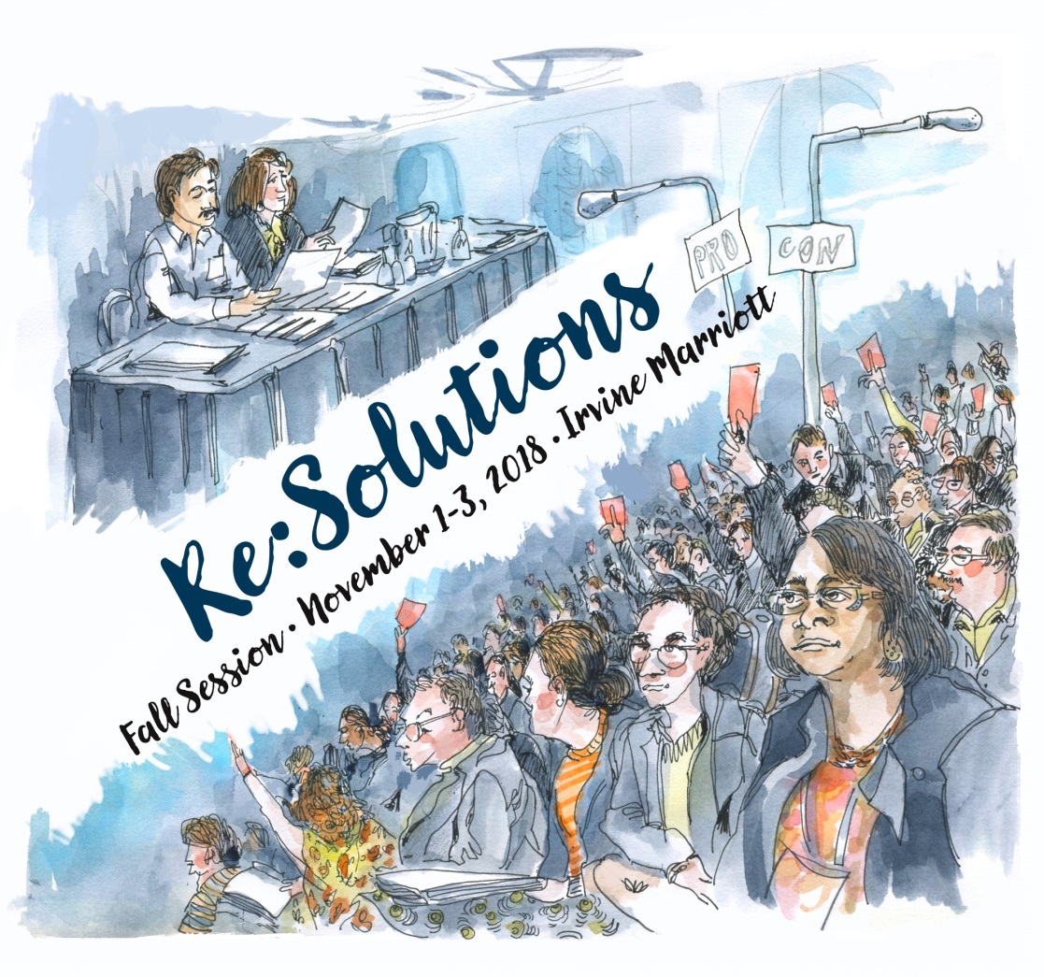
Session Attendance Plan

Slide 7
I’m a new delegate…what do I do at Plenary?
Attend Area meetings at plenary
Read session resolutions packets…they are updated daily.
Debate and vote on resolutions - represent your local senate’s positions
Part of a team? Spread yourselves around to different breakouts
Network!
  Get to know your Area Representative and the entire Executive Committee…we’re here to help!
And remember – have fun!
Notes:
Rochelle

Slide 8

Saturday is Voting Day - Resolutions
Resolutions: the process
Discussion: at the mike
Voting: who votes
Notes:
Rochelle

Slide 9
Resolutions & Amendments Timeline
Resolutions can be pulled from consent until 8:20 on Saturday of Plenary

Slide 10
Required for Contacts Submitting Resolutions
All resolutions and amendments are to be submitted electronically to resolutions@asccc.org by 4:30 today
Signature pages are to be submitted during session to the Resolutions Committee Chair – with signatures from four (4) delegates
Contacts must attend afternoon sessions at plenary to address conflicts

Slide 11
Requirements for Resolutions
Four is the limit for Resolved and Whereas statements
Action must be within ASCCC purview
Facts needed in Whereas statement
Check Resolutions website for previous positions
More specific requirements: https://asccc.org/sites/default/files/07_Resolution_Writing_Advice_0.pdf

Slide 12
Resolutions, Voting & Discussion
Resolutions are debated and voted…anyone can debate
Arguments are made at the pro and con mics.
  Debate continues until no one is at a mic, or until time for debate expires (15 minutes)
Parliamentary mic is for making motions, parliamentary inquiries to the chair, etc.
Votes are voice votes…only delegates vote!
  If voice vote inconclusive, division of the house is done
  If division of the house inconclusive…serpentine vote!
Notes:
Rochelle

Slide 13
Important Senate Resources for Delegates
About the Academic Senate - http://www.asccc.org/about
“Roles and Responsibilities for Delegates”:
  http://www.asccc.org/sites/default/files/Senate%20Delegates%20Roles%20%26%20Responsibilities_0.pdf
Resolutions Handbook: http://www.asccc.org/papers/resolution-handbook
  Senate resolutions web page (searchable): http://asccc.org/resources/resolutions
Session Resources: https://asccc.org/events/2018-11-01-150000-2018-11-03-210000/2018-fall-plenary-session
ASCCC Bylaws: http://asccc.org/about/bylaws
Notes:
Rochelle

Slide 14
ASCCC Awards
Exemplary Program Award: Recognizes outstanding community college programs. Applications due November 5. This year’s theme: Environmental Responsibility:
https://asccc.org/events/exemplary-program-award-0
The Hayward Award: Honors Outstanding community college faculty who have a track record of excellence both in teaching and in professional activities and have demonstrated commitment to their students, profession, and college. Deadline, December 17:
https://asccc.org/events/hayward-award-0
Stanback-Stroud Award: Honors faculty who have made special contributions addressing issues involving diversity.
Deadline, February 11:
https://asccc.org/events/stanback-stroud-diversity-award-0

Slide 15
Questions?
Thank you, and have a great plenary session!
Notes:
Facilitate the questions and answer

