Slide 1
Formerly Known as Freeway Flyers: Addressing the Myths of Balancing the Challenges of Multiple Campuses Friday, February 19 at 2:00-3:00 pm

Slide 2
Presenters
Chelsea Hull, ASCCC Part-Time Committee participant, Santa Monica College (she/her)
John Lynch, Santa Monica College (he/his)

Slide 3
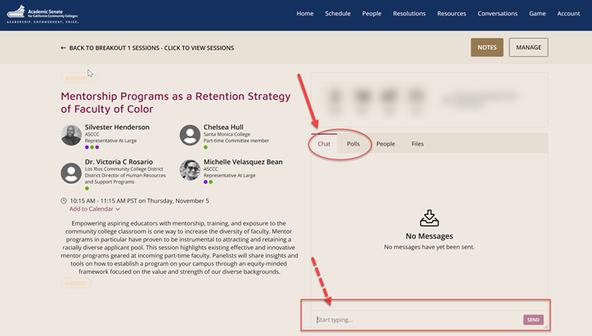
Questions
Use the Pathable platform CHAT box

Slide 4
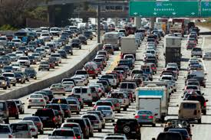
Session Description
Let’s face it--most jobs don’t require you to factor in 3+ hours of commuting between different job sites in a single day. Between sitting in traffic, keeping milk crates in your car to cultivate an office space, or missing your beloved car nap, the “freeway flyer” membership is more common than we think. Join us for this session where we address how to talk about the challenges your job poses with coworkers and family, crafting positive mental health practices for yourself, and reminding you that just because you can travel over 100 miles in a day to teach at three campuses, doesn’t mean you should.

Slide 5
Session Agenda
Myths that we tell
Strategies for changing climates
Read your contract!
Notes:
also called the “false dilemma” // This is looking at perspectives as either-or scenarios.

Slide 6
Do I practice effective time management and set boundaries?
Do my campuses pull me in several directions?
How often do I run out of time during a “workday?”

Slide 7
Myths that we tell
Note in the Pathable Chat if you’ve ever heard these common myths about adjuncts
Teaching more courses means you’re teaching lesser quality courses
Adjunct faculty are less competent than tenure faculty
Adjunct faculty receive PTO, benefits (health, vision, dental), and retirement
The “good adjunct faculty” will always get classes
Being adjunct faculty means you only teach, nothing else

Slide 8
Strategies in Changing Climates
Share Resources
Build a network of adjunct faculty
Build Boundaries
Don’t take it personally if you don’t get classes
Choose professional development wisely
Avoiding burnout
Know what your limits are
Set a work schedule
Ask questions
You don’t have to show up to everything

Slide 9
What campuses deserve your energy?
Give attention to the college’s that provide faculty support
Evaluate campus culture
Consider the commute
Think about where you want to stay the longest, or eventually apply for a tenure position at

Slide 10
Online & Hybrid Courses
Pre-COVID
Were a good alternative option
During & After COVID
Time management is necessary
DL initiatives, MOOCs, OEI all options
Good for side money
Certification was a CV positive
Individualize the experience
It’s okay to not like online education

Slide 12
