Slide 1
From Conflict to Discourse, How to Lead Your Senate Productively
Anna Bruzzese, ASCCC South Representative
Nathaniel Donahue, ASCCC At-Large Representative
Sam Foster, ASCCC South Representative
Fall Plenary Session
Renaissance Newport Beach
November 7-9, 2019
,

Slide 2
Considering the multiplicity of perspectives and the difficult decisions that senates and senate leaders must make, often within time constraints, conflicts are unavoidable. Join us for an interactive session where we will explore strategies on how to transform conflicts we all sometimes face into professional, productive discourse, and how to lead your senate in ways that are conducive to reaching collective goals efficiently.

Slide 3
Conflict? → CONFLICT!
Conflict is inevitable!
WHY?
Assumptions, perceptions, and values
Status quo (institutional practices/norms)/institutional transformation
Ownership/fear of loss
Communication (social/cultural)
Knowledge, experience, expertise
What else?
Notes:
To each their own…
What else? Professional satisfaction, timing, & MORE!

Slide 4
“Initiative fatigue” REALITIES!
WHO: we are a system
WHAT: system driven by legislation and law
WHEN: now…and forever?
WHERE: CCCCO, local college, department/program, other?
WHY: students!
HOW: 114 ways of doing,
114 ways of being

Slide 5
Association of Governing Boards (A.G.B)
AGB (2010) - “Many presidents, governing boards, and faculty members believe that institutional governance is so cumbersome that timely and effective decision making is imperiled; factionalism, distrust and miscommunication, and lack of engagement among the parties can impede the decision-making process.”

Slide 6
Ten plus One Title 5 Section 53200
Curriculum, including establishing prerequisites
Degree and certificate requirements
Grading policy
Educational program development
Standards or policies regarding student preparation and success
College governance structures, as related to faculty roles
Faculty roles and involvement in accreditation processes
Policies for professional development activities
Processes for program review
Processes for institutional planning and budget development
Other academic and professional matters as mutually agreed upon.

Slide 7
Institutional Practices and Differences
Participatory Governance | Shared Governance | Collegial Consultation
Sharing information without “authority”. Creates false imagery. Allows for varying interpretations. | Sharing information with consensus “authority”. Creates clarity. Clear roles and responsibilities. | Rely primarily upon Mutual agreement

Slide 8
Collegial Consultation Title 5 Section 53200
“ Rely primarily upon the advice and judgment of the Academic Senate.”
“The governing board, or its designees, and the Academic Senate shall reach mutual agreement.”
Faculty has been delegated authority.
Clear purviews
Collaboration between faculty and administration.
Consensus

Slide 9
CONFLICT Dynamics…
Power and/or authority implications
Institutional practices and differences
Context
Situation
Information and facts
Interpersonal skills
Notes:
Go round and round with dynamics at play… hard to figure out just what dynamic most influences the constructive or destructive components of conflict management.

Slide 10
Assumptions, communication styles and problem solving
Notes:
What assumptions, perceptions and values do we have? How does non-verbal language contribute to these?
What type of experiences related to social practices that have you encountered that have created conflict?
Example of a social practice related to culture would be use of non-verbal communication to indicate time is up.
How do we resolve those?
Problem solving – listening to perspectives of different people, collaborative problem-solving for equity and justice (6-step model) from EdChange (http://www.edchange.org)

Slide 11
Barriers to Collaboration
Notes:
What type of barriers have you experienced related to collaboration? How have you overcome them?
The need to create safe environments for dialog.

Slide 12
CONFLICT Considerations…
What is the culture around conflict?
Avoidance
Accommodation
Competition
Compromise
Collaboration
Notes:
AVOIDANCE: strategy seeks to put off conflict indefinitely. By delaying or ignoring the conflict, the avoider hopes the problem resolves itself without a confrontation.
ACCOMODATION: strategy essentially entails giving the opposing side what it wants. The use of accommodation often occurs when one of the parties wishes to keep the peace or perceives the issue as minor.
COMPETITION: strategy to operate as a zero-sum game, in which one side wins and other loses.
COMPROMISE: Compromise: strategy typically calls for both sides of a conflict to give up elements of their position in order to establish an acceptable, if not agreeable, solution.
COLLABORATION: strategy integrates ideas set out by multiple people. The object is to find a creative solution acceptable to everyone. Collaboration, though useful, calls for a significant time commitment not appropriate to all conflicts.
NOT GOOD OR BAD! Situation considerations and… (next slide)

Slide 13
Interpersonal SKILLS!
Who said “attitude is everything?!”
Notes:
Focus on SKILLS- must be developed, practiced
A spectrum, not always demonstrated OR surprise yourself!
PARTICIPATORY ACTIVITY:
Have participants ID leadership skills that support conflict resolution (characteristics and behaviors within each of the SKILL areas)

Slide 14
Challenges Surrounding Institutional Transformation
Notes:
Professional Frustration & Career Dissatisfaction
Holding on to status quo
Ownership
Fear of loss

Slide 15
Leadership Conflict Resolution Strategies - Care & Love
Integrity
Creativity
Wisdom
Notes:
Inclusion, integrity, creativity and wisdom

Slide 16
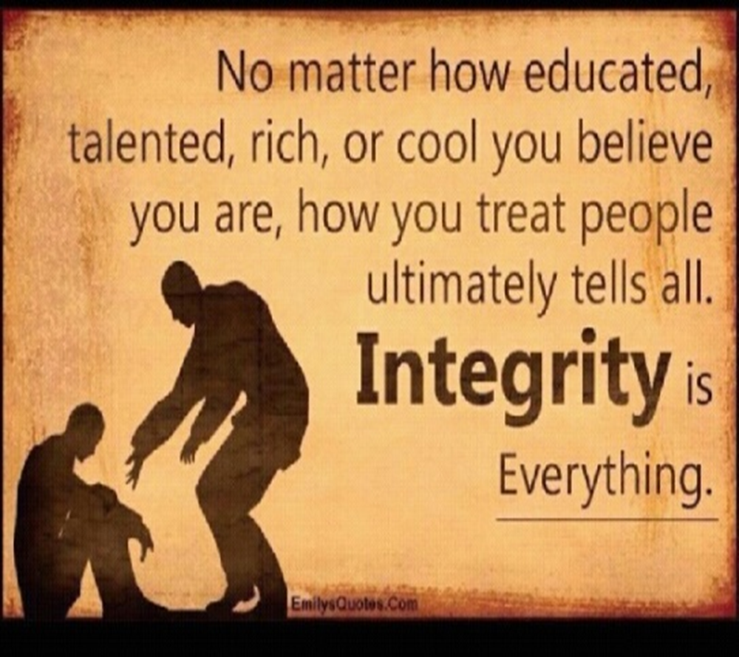
Integrity
Create an accessible environment for honesty and integrity.
Practice fairness, self-reflection, healthy humility and
transparency.
Identify the issue, type of conflict, and focus on common goals.

Slide 17
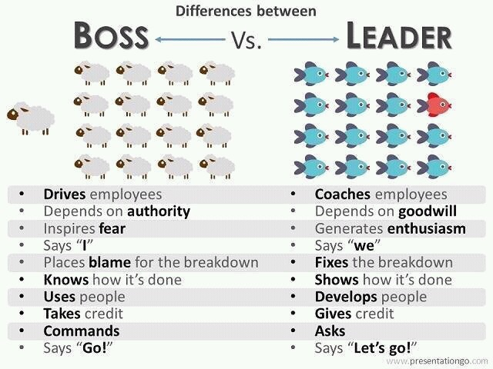
Creativity
Motivate discussions of issues.
Encourage authentic communication.
Practice a diversity of thought.
Remember to be a “Leader” and not a “Boss”.

Slide 18
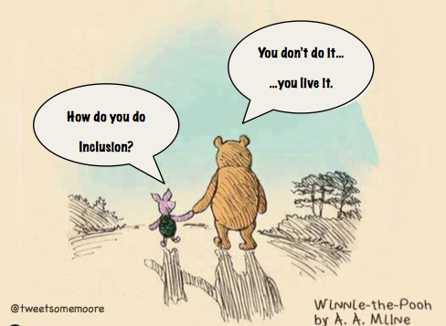
Wisdom
Speak your words with care!
Love and demonstrate respect for human value!
People speak their struggle and feel with their heart!
Trust, love and respect are the greatest tools for managing conflict!
This creates peace and inclusion!

Slide 19
Collaborative Problem-Solving for Equity and Justice: A 6-Step Model by Paul C. Gorski
Problem identification
Perspectives
Challenges and opportunities
Strategies
Solutions/plan of action
Expected outcomes
(http://www.edchange.org)

Slide 20
RE:SOLUTIONS!
One size fits all solutions
Dismissal of others’ ideas, thoughts, perceptions
Ignoring unfavorable variables
Accusations/ assumptions
BEWARE…

Slide 21
RE:SOLUTIONS!
EFFECTIVE STRATEGIES for MANAGING CONFLICT
Understand realities
Identify the “why”
Consider the conflict culture
Recognize conflict dynamics
Enhance intra/ interpersonal skills
Notes:
EVERYDAY WISDOM? Self-awareness
Process for RE:Solutions at the ASCCC
Democracy is messy!
*One way you can support conflict management on your campus?
*I commitment to support yourself in conflict management

Slide 22
Let’s give it a try…
SCENARIO #1:
Two disciplines do not agree about who owns a particular class
SCENARIO #2:
Philosophical and practical disagreement about when a core course within a program is scheduled
Notes:
Participatory Activity
There is more than one size fits all!

Slide 23
Questions & Comments?
Anna Bruzzese
bruzzeaa@piercecollege.edu
Nathaniel Donahue
Donahue_Nathaniel@smc.edu
Sam Foster sfoster@fullcoll.edu

