Slide 1
The Future of Accreditation in the California Community Colleges
Craig Rutan, ASCCC Accreditation Chair
Helen Benjamin, Retired Chancellor, Contra Costa Community College District
Cindy Miles, Chancellor, Grossmont-Cuyamaca Community College District
Richard Winn, Interim President, ACCJC

Slide 2
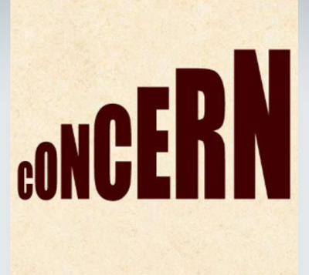
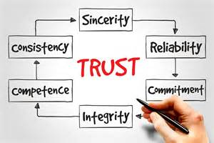
Drivers for Change…

Slide 3
ROLE of CCC Board of Governors in ACCREDITATION
Ed Code requires BOG to define minimum conditions for colleges to get state funding, including accreditation status
Title 5 requires each college to be accredited by accreditor recommended by State Chancellor and approved by BOG (must be recognized by US Secretary of Ed)
Jan 2015 BOG revised Title Regs to remove specific mention of ACCJC

Slide 4
State Chancellor’s Accreditation Task Forces*
2009 Task Force 1.0 - Chancellor Jack Scott
Jan 2010 - 7 Recommendations to ACCJC
2013 Task Force 2.0 - Chancellor Brice Harris
Report not released
2015 Task Force 3.0 - Chancellor Brice Harris
Report August 2015
Nov 2015 - BOG Action
2016 Task Force 4.0 (Implementation Task Force)
Mar 2016 - BOG Action
*With representatives from statewide academic senate, chief executive officers, chief instructional officers, chief student services officers, organized labor, boards of trustees, state chancellor’s office.

Slide 5
November 2015 Board of Governors
BOG accepted Task Force recommendations.
RESOLUTION: “The current structure of ACCJC, along with its lack of credibility as perceived by its peers and the public, no longer meet the current and anticipated needs of California community colleges.”
Directed Chancellor:
Share report with USDE
Work through system’s established consultation process to bring to BOG March 2016 meeting:
A recommendation for action to establish a new model for an accrediting agency
An implementation plan, along with timeline.

Slide 6
CEOs began shifting the Conversation . . .
…to what we need in our accreditor to meet changing needs of our colleges, students, communities, workforce, and public
TAKE RESPONSIBILITY for OUR ACCREDITOR
ADDRESS CHANGING REALITY of higher education
RESPECT our culture of COLLEGIAL CONSULTATION
ENCOURAGE RISK-TAKING and INNOVATION
DRIVE CHANGE THROUGH COLLABORATION and RESPECT

Slide 7
2016
Jan- Feb: Accreditation Implementation Taskforce 4.0
Meetings w/ACCJC, WASC Sr. Commissioners & staff; draft plan to Consultation Council
March - CEO Symposium (~90 CEOs participated, follow-up to all 136)
99 (73%) responded to the survey.
89% opted for change (Option 2/3); 5% opted for no change (Option 1).
March - BOG directed STATE CHANCELLOR:
Notify ACCJC of BOG support for CEOCCC plan
Participate with CEOs in coordinating 2 workgroups:
Recommend immediate changes to IMPROVE existing processes and culture of ACCJC
Pursue a MODEL for regional accreditation that aligns all segments of higher education in the Western region.
Report back to BOG beginning July 2016
April - Workgroup I began meeting; May - Workgroup II began meeting
December - New ACCJC Leadership

Slide 8
Workgroup I: Improving ACCJC Structure, Function & Relations
Led by Dr. Helen Benjamin, retired Chancellor, Contra Costa Community College District
Began meeting on April 21, 2016 after the Chief Executive Officers Meeting on March 13-15, 2016
CEOs from 11 California regions
CEO from private two-year college
2 Academic Senate
2 ALOs
2 ACCJC Commissioners

Slide 9
WORKGROUP I MEMBERS: CALIFORNIA CEOs • Helen Benjamin, Retired Chancellor, Contra Costa CCD, Convener • Michael Claire, President, San Mateo College (San Mateo CCD) • David Wain Coon, Superintendent/President, Marin CCD • Debbie DiThomas, Superintendent/President, Barstow CCD • Kathy Hart, Superintendent/President, San Joaquin Delta CCD •Victor Jaime, Superintendent/President, Imperial Valley College (Imperial CCD) • Kathryn Jeffrey, Superintendent/President, Santa Monica CCD • Jowel LaGuerre, Chancellor, Peralta CCD • Marvin Martinez, President, East Los Angeles College (Los Angeles CCD) • Kindred Murillo, Superintendent/President, Southwestern CCD • Kevin Walthers, Superintendent/President, Allan Hancock CCD John Weispfenning, President, Santiago Canyon College (Rancho Santiago CCD) PRIVATE COLLEGE CEO • John Zimmerman President, MTI College ACADEMIC SENATE LEADERSHIP • David Morse, President, Academic Senate for California Community Colleges • Julie Bruno, Vice President, Academic Senate for California Community Colleges ACCREDITATION LIAISON OFFICERS • Lori Bennett, Executive Vice President, Moorpark College (Ventura CCD) • Meredith Randall, Vice President, Shasta College (Shasta-Tehama-Trinity Joint CCD) ACCJC COMMISSIONER LIAISONS • Raul Rodriguez, Chancellor, Rancho Santiago CCD • Sonya Christian, President, Bakersfield College (Kern CCD)

Slide 10
Workgroup I – Goal/Responsibilities/Timeline
Goal – to work with the ACCJC to undertake significant improvements in the structure and functioning of the Commission to address long-standing concerns of its members, giving special attention to the concerns noted by the U.S. Department of Education requiring compliance by October 2016.
Responsibilities
Develop a plan, timeline and measurable outcomes
Lead and monitor the implementation of changes
Provide regular updates on the group’s activities and progress
Timeline – Report - June 8-10, 2016 ACCJC Commission meeting

Slide 11
Workgroup I – Five Areas of Focus
Training and Selection – Visiting Team Chair/Team Member Selection/Training
Communication – Tone and Quality
Evaluation – Continuous quality feedback loop
Process and Structure of the Visit – Process, Structure
Commission Operations – Financial Transparency, Commission Size/Composition, Nominating Committee

Slide 12
Workgroup I Preliminary report
June 8-10, 2016 ACCJC Commission meeting
Preliminary ACCJC Response August16, 2016 (22 pages)
Several meetings with the ACCJC leadership
Reports online at:
http://www.accjc.org/wp-content/uploads/2016/08/CA_CC_CEOs_Work_Group_1_Preliminary_Report_June_2016.pdf
http://www.accjc.org/wp-content/uploads/2016/08/ACCJC_Preliminary_Response_to_Work_Group_1-August_2016.pdf

Slide 13
Predicting the future, or shaping the future?
What do we know for sure?
Accreditation will continue
Accreditation will change
So, about that change . . .

Slide 14
Near-term Change at ACCJC
At the office:
By next fall, 100% turnover of Senior Staff from last year
Executive Search is underway; June decision, August placement as target
Meanwhile: An Interim President, with endorsement to make some changes

Slide 15
Near-term Change at ACCJC
The Commission Development Workshop in March: – A Mission, Strategic Plan, and Priorities, informed by Workgroup
Ways to make the review process more effective, less burdensome, more safe
A spirit of openness to new directions and diverse opinions

Slide 16
Near-term Changes at ACCJC
The Commission office:
Continued educational engagement
Annual Conference
Improved training events
Professionalize office practices
Build effective partnerships

Slide 17
From the ACCJC perspective: The long-term future of accreditation . . .
From the Washington legislative community, a trend toward federalization, undercutting the peer review process; uneven grasp of community colleges
Update from NACIQI: Positive staff recommendation
Workgroup I: Many recommendations already adopted; strong endorsement of new directions
Workgroup II: Single Accreditor Model proposed
March meeting: Leadership of both Commissions

Slide 18
Workgroup II: Western Region Higher Education Accrediting Model
13 California Community Colleges CEOs
Chancellor, Maui Community College
Private Two-Year College
WASC Senior (WSCUC), Chair of Commission & President
ACCJC, Chair of Commission, Interim President
Goal: Develop framework for assessing the regional higher education accrediting landscape and determining the best approach for regional alignment and implementation steps.
Provide updates to the region beginning September 1, 2016
Meetings May, July, October 2016, January 2017 (plus calls, electronic exchange)

Slide 19
Accreditation Workgroup II Members
California Community College CEOs
Cindy Miles | Chancellor, Grossmont-Cuyamaca CCD, Convener
Lori Adrian | President, Coastline CC (Coast CCD)
Sandra Caldwell | President, Reedley College (State Center CCD)
Constance Carroll | Chancellor, San Diego CCD
Debbie DiThomas | Superintendent/President, Barstow CC
Ron Kraft | Superintendent/President, Napa CCD
Willard Lewallen | Superintendent/President, Hartnell CCD; ACCJC Commissioner
Dena Maloney | Superintendent/President, El Camino CCD
Cheryl Marshall | Chancellor, North Orange CCCD
Brian Murphy | Brian Murphy President, De Anza College (Foothill-DeAnza CCD)
Bill Scroggins | President/CEO, Mt San Antonio CCD
Susan Sperling | President, Chabot College (Chabot-Las Positas CCD)
Joe Wyse | Superintendent/President, Shasta-Tehama-Trinity CCD
University of Hawaii community colleges
Lui Hokoana | Chancellor, Maui College, University of Hawaii
Private Colleges with membership in ACCJC
Jeff Akens | Retired President (Carrington College)
WASC Senior College and University Commission (WSCUC)
Mary Ellen Petrisko | President
William Ladusaw | Professor of Linguistics, UCSC; Commission Chair
Accrediting Commission for Community and Junior Colleges (ACCJC)
Raul Rodriguez | Chancellor, Rancho Santiago CCD; Commission Chair
Richard Winn | Interim President
Ex-officio Member
Brian King | Chancellor, Los Rios CCD
RESOURCE: Jamienne Studley | National Policy Advisor; Former Deputy Under Secretary, NACIQI Chair, US Dept. of Education

Slide 20
Higher Ed Landscape
Segmented accrediting system in Western region
Other 6 regional accreditors = late 19th, early 20th Century
ACCJC =1962 from K-12 system via California Master Plan for Higher Education
Blurring of lines between segments of education
Concurrent enrollment, community college baccalaureate, university colleges, associate degrees for transfer
Increasing demands on accreditors from USDE and Congress
Student achievement, completion rates, college costs, loan default rates, colleges “at risk”

Slide 21
Key Elements for MODEL system
Collegial learning community with accrediting commission as partner
Transparency in all aspects of commission governance and operations
Well-developed infrastructure for training teams and colleges
Highly experienced and qualified technical assistance assigned to each college

Slide 22
Peer evaluation from colleagues who understand the goal of accreditation is to improve institutions and serve the “whole student”
Focus on clearly defined measures of student learning and success that transcend courses and disciplines.
Opportunities for pathways and interactions between leaders, faculty, staff from all segments of higher education
Willingness and ability to respond to changing needs and demands, while remaining grounded in values.

Slide 23
Roadmap of Options
IDENTIFIED steps required, timelines, pros, cons, and other resources needed for 4 options:
Stronger relationship between ACCJC and WASC Senior (WSCUC)
Two-year colleges can choose an Accreditor (ACCJC or WSCUC)
Single Accreditor for Western Region
Relationship with another accreditor

Slide 24
Workgroup II
6 MONTHS DELIBERATION & REVIEW
Compared Processes Northwest Commission, Higher Learning Commission, WASC Senior
Higher Education Landscape & NACIQI National Policy Advisor; Former Deputy Under Secretary, NACIQI Chair, USDE
Feedback from Under Secretary Ted Mitchell & USDE staff
CONSENSUS
LONG-TERM GOAL: Single Accreditor for Western Region

Slide 25
RATIONALE for UNITY :
Community colleges as respected component of the higher education system
Shared goals, standards, students, communities served
Common focus on student success, stewardship, quality, improvement
Strength in unity facing accountability, accreditation changes
Overcome inconsistency in split system of Western region, unlike other 5 U.S. accrediting regions
Increasingly blurred lines between higher education segments (CSU doctorate, community college baccalaureate, university associate degrees; public/private/online)
Growing student & workforce needs for alignment across sectors (Associate Degrees for Transfer, National Completion Agenda)

Slide 26
Assumptions:
Attaining this goal will take a number of years (~10 yrs.)
Many details and steps to be clarified, but expected to involve a process of colleges transitioning from ACCJC to WSCUC over a period of years:
Western region community college consensus
Request to WSCUC
WSCUC request for change of scope to USDE
Transition sequence, likely following natural reaffirmation timelines
Critical to sustain the viability and USDE recognition of ACCJC during transition.

Slide 27
NEXT STEPS…
White Paper
Implementation, Timeline, Communication Plans
Joint CEO Symposium – February 26-28
Must engage all our constituency groups in California, Hawaii, and Western Pacific in developing the best possible plans.
Many constituent discussions…

Slide 28
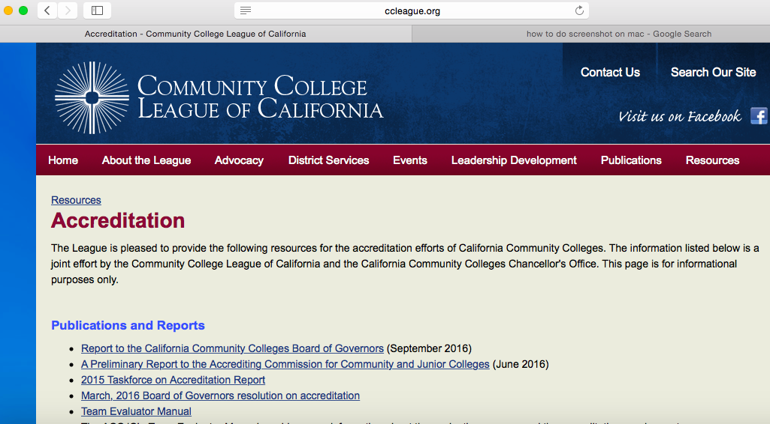
ccleague.org
RESOURCES tab
ACCREDITATION

