Slide 1
Welcome to the 2022 Fall Plenary Session

Slide 2
Agenda
Call to Order
Land Acknowledgement
Action
Adoption of the Procedures
Adoption of the Minutes
Foundation Report
State of the Academic Senate for California Community Colleges

Slide 3
Land Acknowledgement
We begin today by acknowledging that we are holding our gathering on the land of the Nisenan Nations who have lived and continue to live here. We recognize the Nisenan Nations and their spiritual connection to the ocean and the land as the first stewards and the traditional caretakers of this area we now call Sacramento. As we begin, we thank them for their strength, perseverance, and resistance.
We also wish to acknowledge the other Indigenous Peoples who now call Sacramento their home, for their shared struggle to maintain their cultures, languages, worldview, and identities in this diverse city.

Slide 4
Action
Adoption of the
Procedures for
Fall 2022
Plenary Session
Procedures can be found on the Fall 2022 Resolutions Page, linked in the Resources tab of the Fall 2022 Plenary Session webpage
Adoption of Minutes
from Spring 2022
Plenary Session
Minutes can be found under the Resources tab of the Fall 2022 Plenary Session webpage
Also, please review the ASCCC Audit Report available on the Plenary Session Event page at the ASCCC website. We are proud to report there are no findings or comments.

Slide 5
Supporting the Work of the Academic Senate for California Community Colleges
ASCCC Fall Plenary
November 3-5, 2022
Sacramento, CA

Slide 6
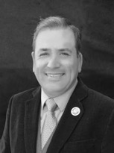
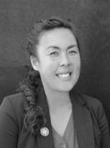
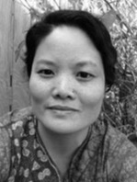
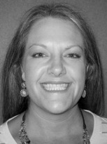
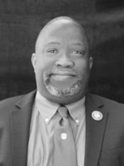
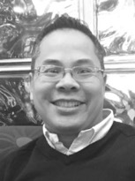
2022-2023 Board of Directors
 | President: Manuel J. Vélez San Diego Mesa College mvelez@sdccd.edu |  | Executive Director: Krystinne Mica Academic Senate for California Community Colleges krystinne@asccc.org
 | Secretary: Karen Chow De Anza College chowkaren@deanza.edu |  | Treasurer: Carrie Roberson Butte College robersonca@butte.edu
 | Director: Robert L. Stewart Jr. Los Angeles Southwest College stewarrl@lasc.edu |  | Director: Van Rider Antelope Valley College vrider@avc.edu

Slide 7
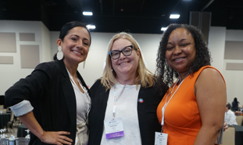
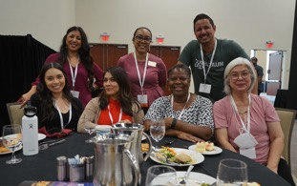
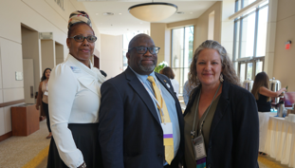
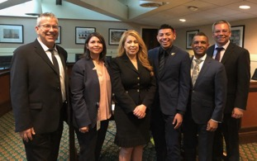
Our Mission and Purpose
Mission
The mission of the Academic Senate Foundation for California Community Colleges (ASFCCC) is to enhance the excellence of the California community colleges by sustained support for professional development of our diverse faculty in the furtherance of effective teaching and learning practices.
Purpose
The specific purposes of this corporation are to benefit, support, and enhance the excellence of California community colleges; to support, design and implement professional development for California community college faculty; to research, develop and communicate effective practices to promote effective teaching and learning in the California community colleges; and to promote a variety of activities and strategies to advance teaching and learning.

Slide 8
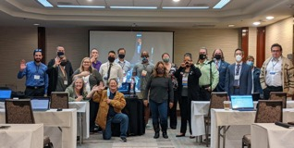
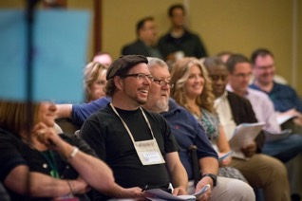
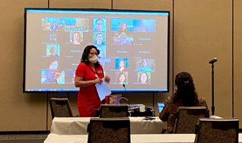
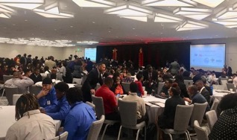
Supporting Professional Development
ASCCC Plenary/Institute Scholarships
The Academic Senate Foundation offers scholarship opportunities to Senate Institutes and Plenary Sessions throughout the year to faculty members.
Last year we offered a total of 30 scholarships to full and part time faculty to attend our Fall and Spring plenaries.
This year we will offer 14 scholarships per plenary:
10 scholarships to cover online attendance registration
4 scholarships to cover in-person registration, flight and hotel (1 scholarship per area)
Innovation Scholarships
Innovation Scholarships provide faculty with funding to attend ASCCC events as well as external events and conferences to expand their understanding of best practices and apply them to their local college and share those results with the field at large.
Faculty can apply for a grant of up to $1,500 to participate in professional development (workshops, classes, webinars, institutes and conferences).
Special consideration will be given to grants that promote and enhance Diversity, Equity, Inclusion, and Anti-racism.
Applications for Innovation Scholarships are accepted throughout the year.

Slide 9
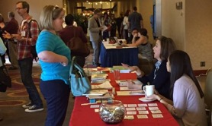
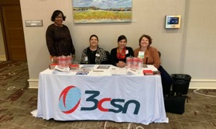
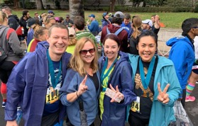
Fundraising Efforts
Last year, the ASFCCC offered over $40,000 in scholarships. We hope to offer more! This year we set a goal of raising $60,000 in order to offer more scholarships and professional development activities directly to you.
Direct Solicitation Campaign: Fundraising campaign targeted at professional academic organizations and companies, as well as college/district administrators
Return of Sponsorship Packages: As we return to in-person events, we want to bring back sponsorship packages which include program ads, event tables, and other exposure opportunities
Area and Local Senate Competitions: Continue to promote ASCCC Area Fundraising competitions and include a statewide local senates fundraising competition
Return of Silent Auctions/Raffles: Include a silent auction or raffle opportunity at ASCCC plenaries and institutes

Slide 10
How Can You Support the ASFCCC?
10+1 Campaign: Contribute monthly to the 10 + 1 program to support the professional development of part-time faculty, the Professional Development College, and research in the area of Academic and Professional Matters
Giving Tuesday: During our first Giving Tuesday, we raised $4,200, which provided scholarships for four faculty members to attend professional development events and programs. Our goal this year is to raise $6,000.
Amazon Smile: Support the Academic Senate Foundation by Shopping at AmazonSmile. When you shop at AmazonSmile, Amazon will donate .5% of your purchase to the Foundation. Support us every time you shop.
General Donations: Donations made at Academic Senate events and through the link above are used for scholarships, events, and additional Academic Senate Foundation activities. Donors can also choose to donate directly to our Innovation Scholarships.
Plenary Mixers: Enjoy the company of your colleagues at our plenary fundraisers to support the ASFCCC. This Fall the mixer will take place Friday, November 4th at the Coin-Op, located at 908 K Street in Sacramento. All proceeds will go to support scholarships for faculty. Fun games, food, and drinks!

Slide 11
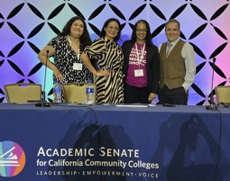
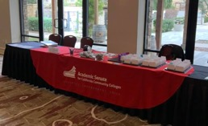
ASFCCC 2022-’23 Plans
Aside from our fundraising efforts, the ASFCCC has also committed to the following plans for the coming year:
Support for ASCCC Keynote and General Session Speakers: The ASFCCC has committed to raising funds in order to provide direct financial assistance to the ASCCC to be used for honorarium costs related to payment for keynote speakers ($1,000 each per plenary, Curriculum Institute, and Faculty Leadership Institute)
Increase Exposure of ASFCCC through Social Media Presence: In the coming year the ASFCCC will begin to establish our presence through Twitter and other social media outlets.
Promote ASFCCC Scholarships at ASCCC and Other Academic Related Events: This year we hope to increase awareness of our resources by proactive promotion via advertisements and QR Codes.
Promote the ASFCCC Through “Swag”: In order to increase awareness of our foundation and grants we plan to distribute “swag” at ASCCC and other Academic related events

Slide 12
Financial Statement (y/e June 2022)
Revenues
Sponsorships $26,500
Donations Revenue $22,691.31
Other Revenue $13.52
Total Revenue $49,204.83
Expenditures
Professional Fees $283.34
Charitable Contributions $21,426.61
Dues/Subscriptions $43.50
Office Supplies $71.85
Total Expenditures 21,825.30
Change in Net Assets ($116,063.37 f/y 2021) $27,379.53
End-of-Year (June ‘22) Total Net Assets $143,442.90

Slide 13
Introducing Our New Logo!

Slide 14
Thank you!
On behalf of the AS Foundation Board of Directors, thank you for your generous support and contributions!
Visit us at asfccc.com for more information on our scholarships and how you can support our work!

Slide 15
State of the Academic Senate for California Community Colleges Thursday, November 3 | 9:00-10:00

Slide 16
Welcome!
Notes:
Recognize Dignitaries

Slide 17
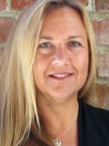
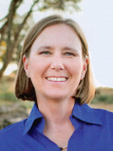
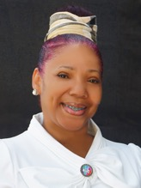
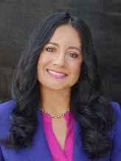
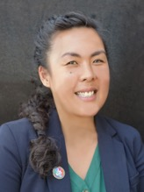
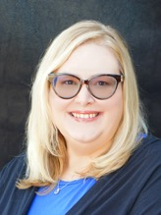
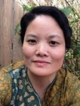
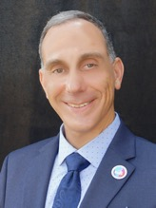
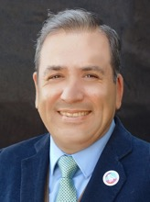
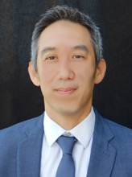
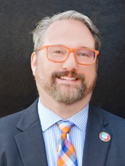
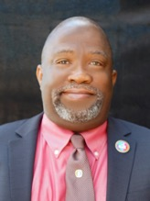
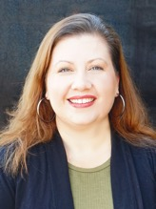
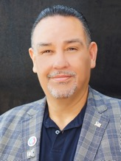
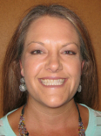
2022-23 Executive Committee Members
President
Ginni May
Vice President
Cheryl Aschenbach
Secretary
LaTonya Parker
Treasurer
Michelle Bean
Executive Director
Krystinne Mica
Area A Rep
Stephanie Curry
Area B Rep
Karen Chow
Area C Rep
Erik Reese
Area D Rep
Manuel Vélez
North Rep
Eric Wada
North Rep
Christopher Howerton
South Rep
Robert L. Stewart Jr.
South Rep
Amber Gillis
At-large Rep
Juan Arzola
At-Large Representative
Carrie Roberson
Notes:
Introduce each member and share the committee they chair

Slide 18
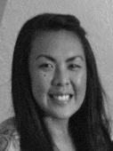
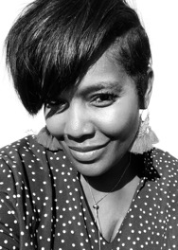
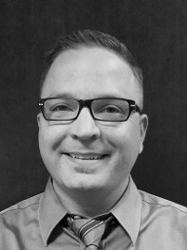
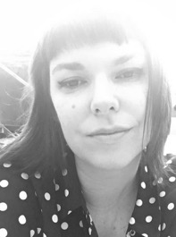
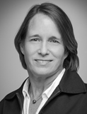
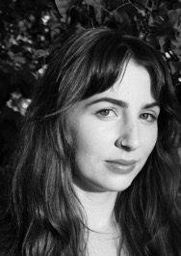
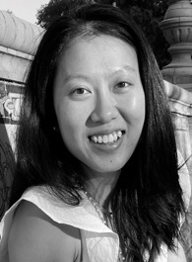
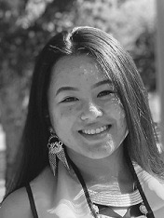
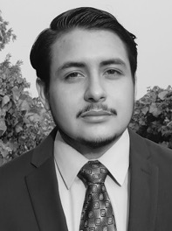
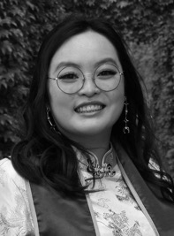
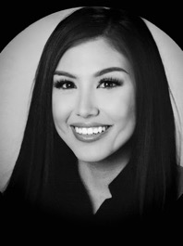
ASCCC Office Staff
Executive Director
Krystinne Mica
Director of Administration
Tonya Davis
Director of Finance
Alice Hammer
Administrative Assistant
Kyoko Hatano
C-ID Program Manager
Miguel Rother
Program Manager
Selena Silva
Program Coordinator
Megan Trader
Visual Designer
Katie Nash
Communications Coordinator
Emily Nicol
Research Associate
Gina Lam
Events Planner
Kayla Vue
Accounting Clerk
Brando Jimenez
Administrative Assistant
Amy Liao
Executive Assistant
Patricia Carrillo

Slide 19
Overview of the 2022 Fall Plenary Session
Centering Authentic Voices and Lived Experiences in 10+1
New structure: Seeking to provide access and keep costs down
No printed program: QR Code to access; At-a-glance program
9 General Sessions
2 Blocks of 6 Breakouts Sessions: 1 Thursday, 1 Friday
President’s Reception Thursday night: 6:00-7:30, cosponsored by FACCC
Foundation Mixer Friday night: 7:00-10:00 at Coin-Op
New way to submit resolutions – let us know what you think
Saturday debate and voting – Still the same!

Slide 20
Recent Publications and Online Resources
ASCCC November 2022 Senate Rostrum
Report on Executive Committee Demographic Data 2018-2022
IDEAA Tools and Resources – Resources for local academic senates and other looking for practices and tools to advance inclusion, diversity, equity, anti-racism, and accessibility
DEI in Curriculum: Model Principles and Practices
OERI Student Impact Toolkit: Measuring Student Impact and Capturing Student Voices in OER/ZTC
ASCCC Website

Slide 21
Upcoming Events
2022 Part-time Faculty Symposium: FACCC event in partnership with ASCCC – December 9, Virtual 2:00-5:00
2023 Academic Academy – February 16-17, Virtual
2023 Spring Plenary Session – April 20-22, Hilton Hotel Anaheim
2023 Faculty Leadership Institute – June 15-17, Westin San Francisco Airport Hotel
2023 Curriculum Institute – July 12-15, Riverside Convention Center
Webinars, webinars, webinars…check ASCCC Events Page for events hosted by ASCCC committees

Slide 22
Awards – Recognize Your Colleagues!
Exemplary Program Award – Due November 6, 2022
Recognizes outstanding community college programs.
Up to two awards of $4000 each.
Theme: Walk a Mile in Someone Else’s Shoes: An Ethnic Studies Approach to California Community Colleges Curriculum
Hayward Award – Due December 18, 2022
Honors full-time and part-time faculty with highest level of commitment to their students, colleges, and professions.
Up to four recipients (two full-time, two part-time faculty).
Regina Stanback Stroud Diversity Award – Due February 25, 2023
Honors committed faculty who continue to rise to meet the challenges faced by students. All faculty are welcome to apply.
One award of $5000.

Slide 23
Faculty Empowerment Leadership Academy (FELA)
Seeking mentors and mentees
Applications due November 8, 2022
Read about FELA here
Focus on development of faculty from underrepresented groups
Celebrated last class of FELA graduates at Faculty Leadership Institute in June 2022
Rostrum article in November 2022 edition

Slide 24
End of two-year 2021-22 session
Some passed bills:
AB 1187 (Irwin, 2022) – Tutoring for foundational, degree-applicable, and transfer-level courses
AB 1705 (Irwin, 2022) – Place and enroll most students in transfer-level English and mathematics
AB 2315 (Arambula, 2022) – Preferred or affirmed names and gender on records where legal names are not required by law
A failed bill:
AB 1505 (Rodriguez, 2022) – Fulltime Obligation Number
See full ASCCC Legislative Report at Executive Committee Agenda Item III.A
Legislation – Summary of Key Items
Notes:
General Session on Legislation

Slide 25
Legislation – AB 928 (Berman, 2021)
Student Transfer Achievement Reform Act of 2021
Singular lower division GE Pathway for transfer to both CSU and UC; only GE pathway to determine transfer eligibility by 2025-26 (details later today)
Students to be placed on ADT pathway if one exists for their declared major
Implementation Committee will consider raising the 60-unit limit for ADTs in STEM
$65 million to implement provided through budget bill
Associate Degree for Transfer Intersegmental Implementation Committee:
Met October 13, 2022
Next meetings: January 26, 2023 and April 25, 2023
Website
Notes:
General Session on the Singular lower division GE pathway

Slide 26
Legislation – AB 1111 (Berman, 2021)
Common Course Numbering
Adopt Common Course Numbering System for GE and transfer pathways by July 2024
Each CCC must adopt the Common Course Numbering System
$115 million to implement provided through budget bill
AB 1111: Common Course Numbering Project
Task Force met September 29, 2022
History of legislation on Common Course Numbering:
SB 851 (1983) – report that cost was prohibitive
SB 450 (Solis, 1995) – led to ASCCC paper: good idea but not feasible
SB 1415 (Brulte, 2005) – led to the C-ID Course Identification Numbering System implemented in 2007

Slide 27
Legislation – AB 927 (Medina, 2021)
ASCCC went from oppose in 2010 to support in 2019
Baccalaureate Degree Program
In consultation with the CSU and UC, the CCC Board of Governors may authorize district baccalaureate degree programs
The baccalaureate programs are based on workforce needs
Districts may not offer a baccalaureate program already offered by the CSU or UC
A maximum of 30 baccalaureate programs may be approved in the CCC system per year
10 proposals submitted January 15, 2022
9 are moving through the process with various stages of approval
1 will be resubmitted by January 13, 2023
Memo just out with request for next round of proposals
Notes:
Example of faculty changing their mind

Slide 28
Other Legislative Actions
Zero Textbook Cost – $115 million in budget bill
Burden Free Instructional Materials Task Force being formed to address ZTC and OER
Breakout today at 3:30
SR 45 (Min, 2021) – Academic Freedom
Equitable Placement and Enrollment – $64 million one-time funding for professional development
Notes:
Breakout session on ZTC/OER and Rising Scholars

Slide 29
Accreditation
Accrediting Commission for Community and Junior Colleges (ACCJC)
ACCJC Standards Review
Draft 2024 Accreditation Standards – updated 9/23/22 following feedback from the field
Town Hall Listening Session with ACCJC today at 3:30 during Breakout Session 1
New formative/summative comprehensive peer review process

Slide 30
Chancellor Search
California Community Colleges has Interim Chancellor until a new Chancellor is selected
The CCC Board of Governors is conducting a national search for a new Chancellor
Search Committee has been formed: 7 members for the Board of Governors, 1 ASCCC, 1 SSCCC
Executive Search Firm selected
First meeting of Search Committee: September 12, 2022 – see Board of Governors meetings
Listening Session with Search Firm throughout October 2022: desired and required qualities
Input Survey to inform creation of a position profile

Slide 31
Chancellor Search
October 28, 2022 – Release of Chancellor Search Profile
Search Committee Closed Session
November 15, 2022 – Application Review
December 13, 2022 – Semi-finalist Selection
January 6-7, 2023 – Semi-finalist Interviews
Board of Governors Meeting Closed Session
January 26-27, 2023 – Finalist Interviews

Slide 32
ASCCC Strategic Plan
Strategic Plan 2018-23 – Approved by delegates in Resolution S18 1.01
Assert the faculty voice and leadership in local, state, and national policy conversations
Engage and empower diverse groups of faculty at all levels of state and local leadership
Assert ASCCC leadership in all faculty professional development for the California Community College system regarding academic and professional matters
Enhance engagement, communication, and partnerships with local senates and system partners, and other constituent groups
Secure resources to sustain and support the mission and the work of the ASCCC
Sustain, support, and expand the ASCCC Course Identification Numbering System (C-ID)
Next Strategic Plan
Planning in early stage
Plan to be brought to delegates for consideration at 2023 Spring Plenary Session
Breakout Session tomorrow 11:00-12:15

Slide 33
ASCCC Legislative Priorities for 2023
Academic Freedom
Partnered with FACCC in Academic Freedom Conference on October 7
At risk…again or still?
ASCCC Position Paper: Protecting the Future of Academic Freedom in a Time of Great Change
Florida attempting to control university curricula on gender and race—college teaching a form of government speech?
Open Educational Resources Initiative
Ongoing funding
Supports Zero Textbook Cost programs
Key for creating student-centered institutions and unconditional belonging
Supporting Students impacted by COVID-19 global pandemic and changes in curricular offerings

Slide 34
Resolutions
A new way to submit resolutions using Google forms
More information on Resolutions Fall 2022 webpage
Send questions to resolutions email or resolutions@asccc.org
New resolutions due today, Thursday at 1:30
Amendments and Urgent Resolutions due tomorrow, Friday at 1:00
Voting on Saturday:
Using Poll Everywhere
More information can be found on the ASCCC Resolution Voting Guide

Slide 35
Remember…
Faculty have worked and continue to work hard meeting students where ‘students are’.
Academic senates have been key in transforming classrooms and colleges into culturally responsive and student-centered learning environments.
We have a lot of work to do in implementing recent initiatives AB 928, AB 1111, AB 1705, and more…
Our work must be grounded in the tenets and principles of inclusion, diversity, equity, anti-racism, and accessibility (IDEAA).
We are 57,000 strong...you do not have to do this alone:
Work as a team
Take care of yourself
Care for others

Slide 36
Over the next 3 days, take time to:
Center on authentic voices and lived experiences in the 10+1,
Acknowledge or support the good work of a colleague,
Self reflect on your personal growth over the last few years, and
Enjoy this time with colleagues!
Thank you!

