Slide 1
“Out of a Multitude of Tongues:”
Academic Freedom and the Importance of Diverse and Inclusive Discourse
Julie Bruno, ASCCC Past-President
Juan Arzola, ASCCC At-Large Representative
Erik Reese, ASCCC Area C Representative
Manuel J. Velez, ASCCC Area D Representative

Slide 2
“Our Nation is deeply committed to safeguarding academic freedom, which is of transcendent value to all of us, and not merely to the teachers concerned. That freedom is therefore a special concern of the First Amendment, which does not tolerate laws that cast a pall of orthodoxy over the classroom.”
-Justice William Brennan Jr.
The classroom is peculiarly the 'marketplace of ideas.' The Nation's future depends upon leaders trained through wide exposure to that robust exchange of ideas which discovers truth 'out of a multitude of tongues, (rather) than through any kind of authoritative selection.
-United States v Associated Press

Slide 3
Academic Freedom and Freedom of Speech
Freedom of Speech
1st amendment right for faculty AND students
Restricts the right of a public institution, including a public college or university, to regulate expression
Instructors are not to required to provide class time for students to voice views that contradict the material being taught however, instructors are required to allow students to express opposing views and values to some extent where the instructor invites expression of students’ personal opinions and ideas
In the classroom, speech must be germane to the subject matter and advances an academic message (stick to your subject)
Private institutions first amendment protections are often limited and do not have the same protections as public institutions
Email on district server, electronic communications, and faculty pages are not necessary protected under “free speech”
Notes:
Manuel

Slide 4
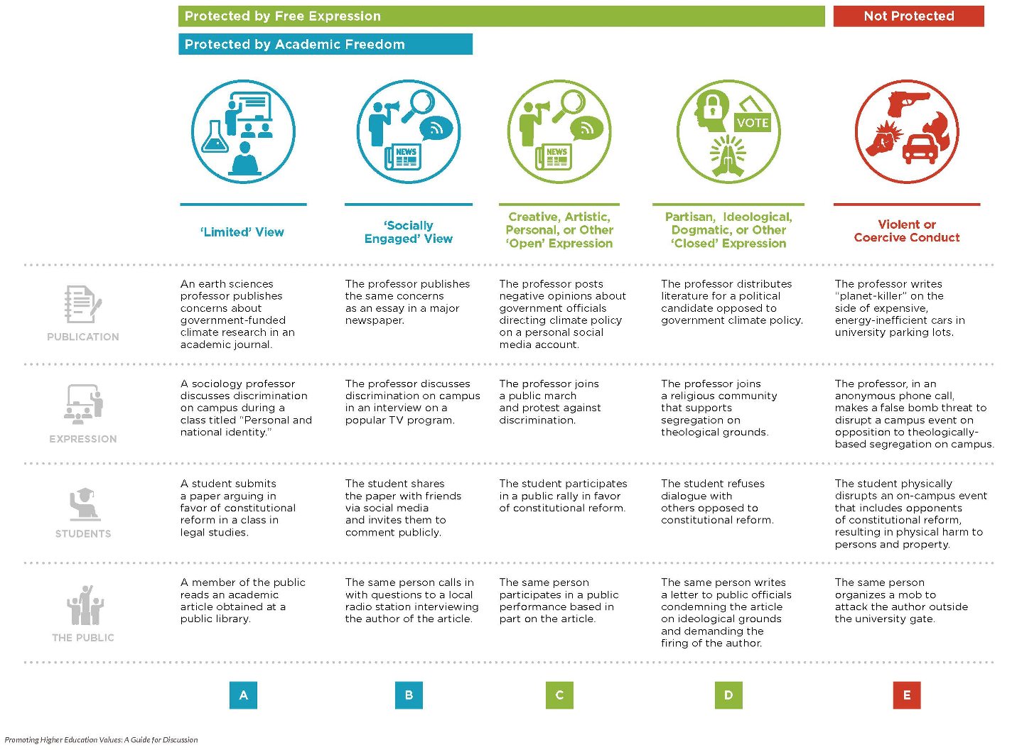

Slide 5
Academic Freedom, Equity, and Inclusivity
The Connection between academic freedom and equity is fundamental.
Without the rights of faculty to speak, research and pursue diverse ideas, equity is not possible.
Academic Freedoms allow faculty to academically challenge racist ideologies and structures in the context of their expertise
Academic Freedom allows students to be introduced to a diverse range of ideas that often contrast and compete with each other within an academic framework and invites them to participate in a rigorous analysis, the development of a independent critical judgement
Allows faculty members the freedom to shape their courses in a way that allows for their subjects to be viewed, analyzed from different and specific lenses, particularly when the contrast with more traditional established theories
Notes:
Manuel

Slide 6
Equity, Curriculum and Academic Freedom
Role of the COR
Instructors must teach to the COR
Use of Academic Freedom to develop COR
Equity in the COR.
Resolution 9.01 Fall 2021
Resolved, That the Academic Senate for California Community Colleges work with the California Community Colleges Chancellor’s Office to revise California Code of Regulations Title 5 including section 55002 titled “Standards and Criteria for Courses” to include a component of culturally responsive curriculum, equity mindedness and anti-racism integrated into the COR that allows for local control on how that requirement is fulfilled;
Role of the Curriculum Committee
Review local Academic Freedom Policy
Provide/Support Academic Freedom Professional Development
Support open conversations about equity and academic freedom.

Slide 7
Challenges to Academic Freedom Today
Sustained effort to legislate educational curriculum
Thirty-eight out of fifty states either have passed or have active proposed pieces of legislation that impact academic freedom;
Focused primarily on an Anti-CRT (Critical Race Theory); and
Opposes social justice, equity, and anti-racist curriculum that teaches students to “hate everything that makes America great.” (Greene, 2022).
Notes:
Juan

Slide 8
Academic Freedom Policy Required by Title 5
§ 51023. Faculty.
The governing board of a community college district shall:
(a) adopt a policy statement on academic freedom which shall be made available to faculty;
(b) adopt procedures which are consistent with the provisions of sections 53200-53206, regarding the role of academic senates and faculty councils;
(c) substantially comply with district adopted policy and procedures adopted pursuant to subdivisions (a) and (b).
Notes:
Julie
53200 Definitions—Academic Senate, academic and professional matters
53201 Academic Senate or Faculty Council
53202 Formation; Procedures; Membership
53203 Powers—
53204 protection of due process and collective bargaining
53206 ASCCC

Slide 9
Academic Freedom Policy Required for Accreditation
ACCJC’s Standard I.C.7 formalizes this requirement
In order to assure institutional and academic integrity, the institution uses and publishes governing board policies on academic freedom and responsibility. These policies make clear the institution’s commitment to the free pursuit and dissemination of knowledge, and its support for an atmosphere in which intellectual freedom exists for all constituencies, including faculty and students.
Notes:
Julie

Slide 10
Academic Freedom in California Education Code
Notes:
Julie

Slide 11
Protecting Academic Freedom: What can Senates do?
Review and revise college governance policies to ensure that academic freedom is protected for all faculty
Provide professional development on the privileges and responsibilities of academic freedom for all faculty, administrators, and board members
Adopt a statement regarding the parameters and practice of academic freedom in a variety of areas such as:
evaluations
the implementation of diverse and innovative pedagogies
curriculum
grading policies
Notes:
Julie

Slide 12
Strengthening Academic Freedom: Recommendations for Local Senates
Local senates should create a statement on academic freedom, in addition to local board policy, that delineates the specific issues and parameters of academic freedom for faculty.
Local senates should provide consistent and ongoing professional development for full- and part-time faculty and senate leaders—curriculum, program review, policy chairs, senators, etc.—in the principles and tenets of academic freedom, including onboarding new faculty.
Local senates should work to review, revise, and strengthen shared governance processes, policies, and procedures in relation to academic freedom so that shared governance protects dissenting opinions in the decision-making process.
Notes:
Julie (and Erik?)

Slide 13
Policies and Collective Bargaining Agreement
Academic Freedom is an area of overlapping purview between the Senate and the Union
In support of academic senates and unions working together, the 2005 AAUP statement goes on to say that “[s]trong senates and strong union chapters can work together to preserve and protect academic freedom on campus. Together, they establish the institutional terrain and precedents on which individual rights are defined, defended, and sometimes adjudicated.”
Recommend the Senate and Union have a joint understanding
Notes:
Erik

Slide 14
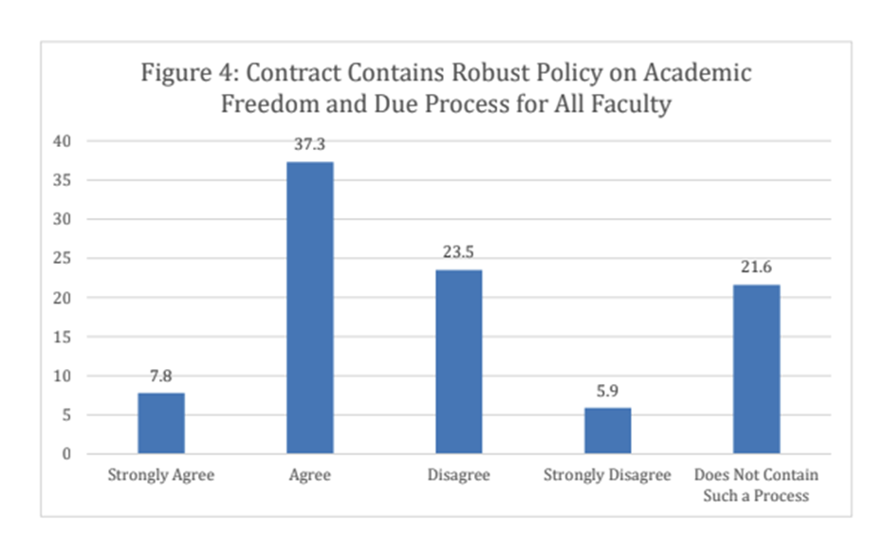
Academic Freedom in Collective Bargaining
Collective Bargaining Agreement (Faculty union contracts)
Less than 50% of the faculty CBAs at the CCCs have mention of academic freedom (ASCCC Survey 2020)
If academic freedom is mentioned in the contact, the majority simply reference the district policy
In order to protect academic freedom, the collective bargaining agreement should strive to assert the unique right of academia particularly in the areas of:
tenure
evaluation
due process
Notes:
Erik
Also shared/participatory governance is another critical component of safeguarding free intellectual exchange without influence of external agencies and special interest groups

Slide 15
Common example of Academic Freedom
in the Collective Bargaining Agreements
“The Faculty shall have the academic freedom to seek the truth and guarantee freedom of learning to the students.”
Notes:
Erik

Slide 16
Exemplar –
There is one district CBA with extensive protections and definitions that includes Academic Freedom in evaluations.
A12.1.6 Academic freedom and freedom of expression afford the faculty to speak freely, pursue research and write without unreasonable restrictions or prejudices; and to evaluate and be evaluated fairly and objectively, based on academic merit…
BP 4030 link
A15.1.9.3 Reviewers must strive to maintain objectivity, and to assure that decisions regarding tenure or promotion do not contravene established principles of academic freedom, appropriate sections of Title 5, and/or departmental standards
Notes:
Erik
Academic freedom threaded throughout CBA (15 instances)
Article VII - Workload: course syllabi
A4.6.2 Standards for Tenure: candidate shall have demonstrated respect for colleagues, for the traditional concepts of academic freedom…
A12.1 The Pursuit of Truth The District and guild agree that academic freedom is essential to the teaching-learning process
Appendix I: They [faculty] protect the academic freedom of students
Appendix I: As citizens engaged in a profession that depends upon freedom for its health and integrity, faculty members have a particular obligation to promote conditions of free inquiry and to further public understanding of academic freedom.
A12.1.6 Academic freedom and freedom of expression afford the faculty to … and to evaluate and be evaluated fairly and objectively, based on academic merit…
BP 4030 link
A15.1.9.3 Reviewers must strive to maintain objectivity, and to assure that decisions regarding tenure or promotion do not contravene established principles of academic freedom, appropriate sections of Title 5, and/or departmental standards

Slide 17
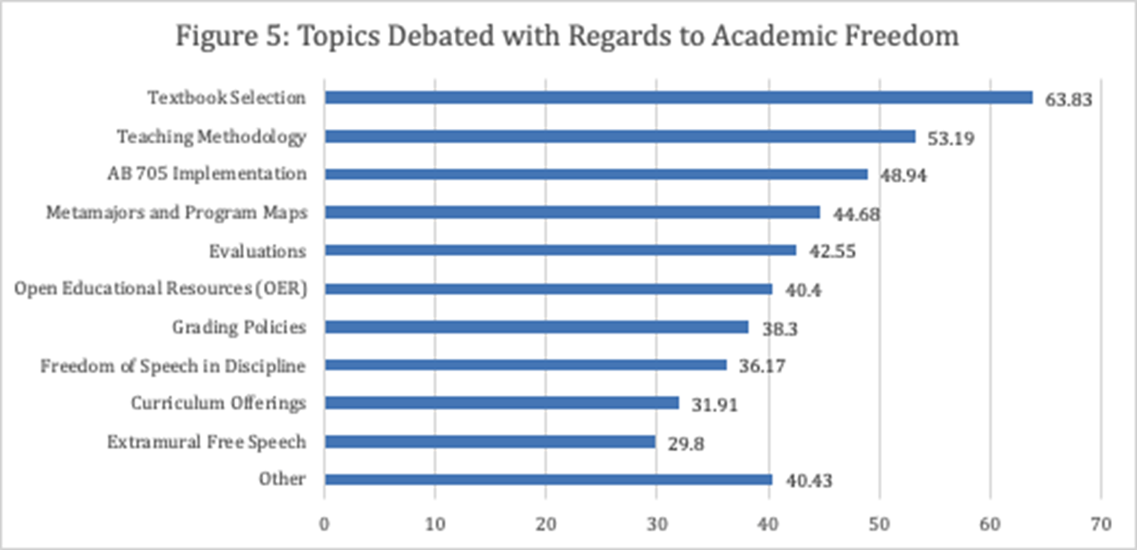
Academic Freedom in Collective Bargaining
Notes:
Erik

Slide 18
Before issues arise… stronger together
Notes:
Erik
Often senate and union work in silos;
We are all faculty; faculty are part of senate and part of unions
We are stronger together; including in safeguarding academic freedom during evaluations
Developing close ties between Academic Senates and Unions will benefit us all
àIt might be a bit glitchy at times, much like this animation; worth the effort to provide the best environment for students to thrive

Slide 19
Before issues arise… stronger together
Notes:
Erik
Can we shift this a bit? Is there a better graphic where each entity retains it’s purview? Not so much overlap. :)

Slide 20
Be Prepared
Have the policy and a process in place to resolve violations of academic freedom.
ASCCC Adopted position: Local academic senates should work with union colleagues to develop due process around violations or perceived violations that involve academic freedom issues, including a duly constituted—appointed or elected—faculty committee to review and recommend action.
Possible models for making recommendations to the college president
Academic Senate Academic Freedom committee
Union Academic Freedom committee
Joint Academic Senate and Union Academic Freedom committee
Notes:
Julie

Slide 21
Example of be prepared:
Academic Freedom Review Committee (AFRC)
Academic Senate President/designee
CCFT Grievance Officer
CCFT unit member selected by the grievant
Dean/designee
Vice President of Instruction/designee
Dean of Student Services/designee
Notes:
Julie

Slide 22
Example of be prepared:
Academic Freedom Committee
Three faculty appointed by Senate
Strive to include full time and adjunct faculty to the extent possible
President of Full-time Faculty Association or designee
President of Part-time Faculty Association or designee
Possible non-voting member with relevant expertise or specialized training, at request of Senate
Notes:
Julie

Slide 23
Best Practices:
Collegiality and conversation
Mutual understanding of purview between Senate and Unions
Written agreement between Senate and Union
Draft when both bodies are not stressed by RIF or other major concerns
Familiarity with local board policies and collective bargaining agreement
Ensure all faculty (full and part time) are represented and considered
Notes:
Julie
What is RIF? Reductions in force (layoffs)
Clearly more overlap than we likely realized! So its key that senate and union work together
Local policy and contract can sometimes conflict
Both should be reviewed regularly
Both can be revised or changed
And in the end, contract will win out.
Example – faculty transfer policy
All represented by the collective bargaining agreement (whether member or not) and all represented by senate
Being in opposition creates problems for both union and senate
Collegiality and conversation – go out for coffee
Mutual understanding of purview between Senate and Unions
Written agreement between Senate and Union
Draft when both bodies are not stressed by RIF or other major concerns
Familiarity with local board policies and collective bargaining agreement
Include all faculty (full and part time)
Do your homework and research
Look to other colleges for examples
Read local policy/procedures and collective bargaining agreement
Research - “Ed code says...” said by Admin all the time
Ask ASCCC/Union Affiliate
Know your elected representatives – your board members
Educate them! Our BOT didn’t know that the senate and union had authority under law
Don’t be afraid to speak up, ask questions, and document
Willingness to seek input, but good solutions take time
ASCCC Ed Pols Committee working on Academic Freedom paper – importance of Union and Senate supporting each other

Slide 24
Protecting Academic Freedom: What Senates and Unions can do Together?
Educate administrators, board members, and the community on the importance of academic freedom, tenure, and part-time faculty seniority, and shared governance as the most effective methods in ensuring the integrity of the institution and enduring public trust
Include explicit language on protecting academic freedom in the evaluation tools
Advocate for increases in tenure positions and expand tenure & part-time seniority protections
Provide joint training on how to conduct evaluations that includes honoring the academic freedom of our colleagues
Notes:
Erik

Slide 25
Trifecta
Academic Freedom
Shared Governance
Tenure
Notes:
Erik
Combination of Academic Freedom, Shared Governance, and Tenure are critical components to safeguarding free intellectual exchange without influence of external agencies and special interest groups so that institutions of higher education are conducted for the common good

Slide 26
Adopted Positions of the ASCCC
Local academic senates should collaborate with union colleagues on codifying the protection and parameters of academic freedom in contract in light of faculty evaluations, curriculum, online instruction, dual enrollment, open educational resources, guided pathways, and other relevant issues.
Local academic senates should work with union colleagues to train faculty on engaging in faculty evaluations in light of academic freedom.
Local academic senates should clearly delineate and provide justification for adjunct faculty participation in shared governance in order to support union efforts to negotiate appropriate compensation.
Local academic senates and union colleagues should review AAUP resources and recommendations.
Notes:
Erik

Slide 27
Strengthening Academic Freedom Through IDEAA: ASCCC
IDEAA-related publications on Academic Freedom
Academic Freedom Paper
Academic Freedom and Equity
Other IDEAA-related publications
Anti-Racism Education in California Community Colleges: Acknowledging Historical Context and Advancing Effective Anti-Racism Practices for Faculty Professional Development
Equity-Driven Systems: Student Equity and Achievement in the California Community Colleges
Past ASCCC Events on Academic Freedom
Equity and Anti-racism in Academic Freedom
Notes:
Juan

Slide 28
Resources/Links
Protecting the Future of Academic Freedom During at Time of Significant Change (2020)-- ASCCC Paper
Academic Freedom and Equity- Rostrum Article, November 2020
AAUP 1940 Statement of Principles on Academic Freedom and Tenure
https://www.aaup.org/report/1940-statement-principles-academic-freedom-and-tenure
AAUP Academic Unionism Statement
https://www.aaup.org/academic-unionism-statement
Assembly Bill 1725 Vasconcellos (1988)
https://www.asccc.org/sites/default/files/1988%20AB%201725%20Community%20College%20Reform%20Act%20%28Vasconcellos%29.pdf
Notes:
Juan

Slide 29
Resources (cont.)
AAUP Red Book – Policy Documents and Reports, American Association of University Professors, 2015 - https://www.aaup.org/reports-publications/publications/redbook
https://www.asccc.org/events/april-25-2022-200pm/equity-and-anti-racism-academic-freedom
Academic Freedom in the 21st-Century College and University: Academic Freedom for All Faculty and Instructional Staff
https://www.aft.org/sites/default/files/academicfreedomstatement0907.pdf
AAUP Statement on Academic Government for Institutions Engaged in Collective Bargaining
https://www.aaup.org/report/statement-academic-government-institutions-engaged-collective-bargaining
Greene, Peter “Teacher Anti-CRT Bills Coast to Coast: A State by State Guide”, FORBES (February 12, 2022) (https://www.forbes.com/sites/petergreene/2022/02/16/teacher-anti-crt-bills-coast-to-coast-a-state-by-state-guide/)

Slide 30
Resources (cont.)
Messier, John “Shared Governance and Academic Freedom: Yes, This Is Union Work” 2017, NEA
https://www.nea.org/assets/docs/TA2017S_Messier.pdf
Reichman, Henry “Professionalism and Unionism: Academic Freedom, Collective Bargaining, and the American Association of University Professors” AAUP Journal of Academic Freedom, 2015
https://www.aaup.org/sites/default/files/Reichman_0.pdf
Reichman, Henry, The Future of Academic Freedom, John Hopkins University Press, 2019

