Slide 1
Increasing Access to Local Academic Senate Meetings Supports Inclusion, Diversity, and Equity in Faculty Leadership

Slide 2
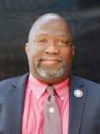
Session Facilitators
Christopher Howerton, ASCCC North Representative
Robert L Stewart Jr, ASCCC South Representative
Michelle Velasquez Bean, ASCCC Treasurer

Slide 3
Session Description
As representative and decision-making legislated bodies, it is critical that local academic senates and the discussions and decisions made are accessible by all of the college’s faculty, full- and part-time. This is true whether the local academic senate is truly representative, in which faculty members are elected or selected as representatives by departments or divisions, or roles or the local academic senate is a senate-of-the-whole, in which all faculty members are encouraged to engage in academic senate discussions and decisions. As we seek to “Center Authentic Voices and Lived Experiences in 10+1”, please join us in a dialogue around how access to local academic senate meetings can increase the voice of all faculty on academic and professional matters.

Slide 4
Session Objectives
Discuss the relationship of increased access to academic senate meetings and the effect on inclusion, diversity and equity in faculty leadership
Have a courageous dialogue around faculty who may be missing out on opportunities to engage the academic senate and lead its activities on your campuses because of decreased access to academic senate meetings
Discuss the influences of legislation on access to local academic senate meetings
Inspire local academic senate leaders to consider some aspects of what access to academic senate meetings involves and how that access is related to inclusion, diversity and equity in faculty leadership

Slide 5
Relationship Between Increased Access to Academic Senate Meetings and Inclusion, Diversity & Equity
Access
Inclusion
Diversity
Equity
Making sure that everyone can attend the meeting – space, location, time, communication to all faculty
This leads to increased inclusion = attendance AND participation
Once inclusion is increased and wide open, diversity can be achieved; different types of faculty are present, with differing authentic voices, that can lead to more enriched conversation and decision-making, and academic senate experience that is spread more evenly among faculty that differ in many ways
Increased inclusion and diversity can then lead to increased equity. The idea that every faculty member, regardless of race, gender, sexual orientation/identity, ability/disability has the same opportunity to not only attend, but participate on all levels of the academic senate.

Slide 6
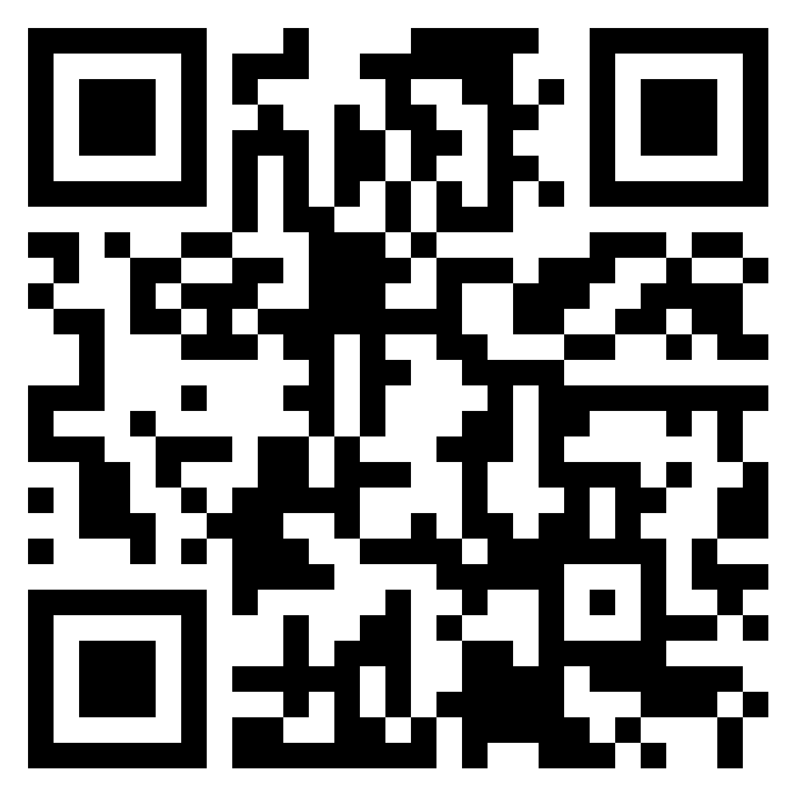
Authentic/Courageous Dialogue
Who is missing in action at your academic senate meetings? Why?
What steps can local academic senates take to do a better job of increasing authentic voices at their academic senate meetings and activities?
How can Academic Senate Presidents be more inclusive in how he/she/they lead the meeting? How can this affect the diversity and equity of local academic senates and its leaders and activities?
Activity: Open dialogue and Padlet journaling.
https://padlet.com/stewarrl/61hvm3ezd7u4zdj4

Slide 7
What About The Push Back?
Change can be a challenge
Acknowledge the fear and emotion
Consider working through the Cultural Humility Toolkit
Use resources for courageous conversations and call-in activities (ASCCC Canvas Hiring modules folder)
Practice using leadership strength phrases to respond to microaggressions with empathy Rostrum article
Pour into others but take good care of yourself
Turn to your huddle, rest, and get back at it!
Remember: HOPE WITHOUT ACTION IS JUST FANTASY!

Slide 8
Influence Of Legislation On Access To Local Academic Senate Meetings
AB361 Rivas
AB2449 Rubio
Taking advantage of these laws, while they last, can increase access to your local academic senate meetings. A virtual option helps with space limitations, location as a barrier, timing/scheduling issues, among others.

Slide 9
Resources
ASCCC Website
ASCCC Local Senates Handbook
https://www.asccc.org/asccc-inclusion-diversity-equity-anti-racism-and-accessibility-ideaa-tools
https://www.asccc.org/resolutions/increase-participatory-governance-colleges%E2%80%99-satellite-campuses
https://diversity.nih.gov/blog/2022-02-24-how-virtual-convenings-can-enhance-diversity-equity-inclusion-and-accessibility
https://hbr.org/2019/09/to-build-an-inclusive-culture-start-with-inclusive-meetings
https://nexus.od.nih.gov/all/2022/02/24/how-virtual-convenings-can-enhance-diversity-equity-inclusion-and-accessibility/
https://www.hr.com/en/magazines/all_articles/remote-in-person-or-hybrid-models-what-do-they-mea_ktfp3di7.html
https://leginfo.legislature.ca.gov/faces/billTextClient.xhtml?bill_id=202120220AB361
https://leginfo.legislature.ca.gov/faces/billTextClient.xhtml?bill_id=202120220AB2449
info@asccc.org
https://www.asccc.org/faculty-empowerment-and-leadership-academy
https://www.asccc.org/content/new-faculty-application-statewide-service

Slide 10
Questions?
Thanks for joining us!

