Slide 1
Authentic Leadership: Collaboration Between Administration and Faculty Leaders in the California Community College System 3:00pm – 3:45pm General Session Friday, November 4, 2022

Slide 2
Presenters
Dr. LaTonya Parker, ASCCC Secretary
Amber Gillis, ASCCC South Representative
Dr. Karen Chow, ASCCC Area B Representative
Dr. David Williams, Vice President of Academic Affairs, Solano Community College

Slide 3
Session
Description
The student experience at our local colleges starts with intentional and deliberate leadership strategies to provide access and unconditional belonging to support students on their academic journey. While perspectives between senate leaders and administrators may differ, many strategies to meeting local institutional strategic plans overlap. This session seeks to define collective impact and provide information relevant to using collaborative practices and models between faculty leaders and administrators in order to serve students. Join us to explore collaborative methods to work with administrators and other college stakeholders to provide high quality programs and services and to pursue shared aspirations.

Slide 4
Session
Outcomes
Outcomes by the End of the Session:
Attendees will demonstrate an increased understanding of authentic leadership.
Attendees will gain practical strategies for engaging in authentic leadership through the Collective Impact framework.

Slide 5
Poll - Relationships with Administrators
Describe your relationship with your administrator:
Fantastic: We’re discussing college processes and making plans over coffee.
Okay: We meet periodically and things go well for the most part.
Wait, what?: We’re supposed to work together with our college admin?

Slide 6
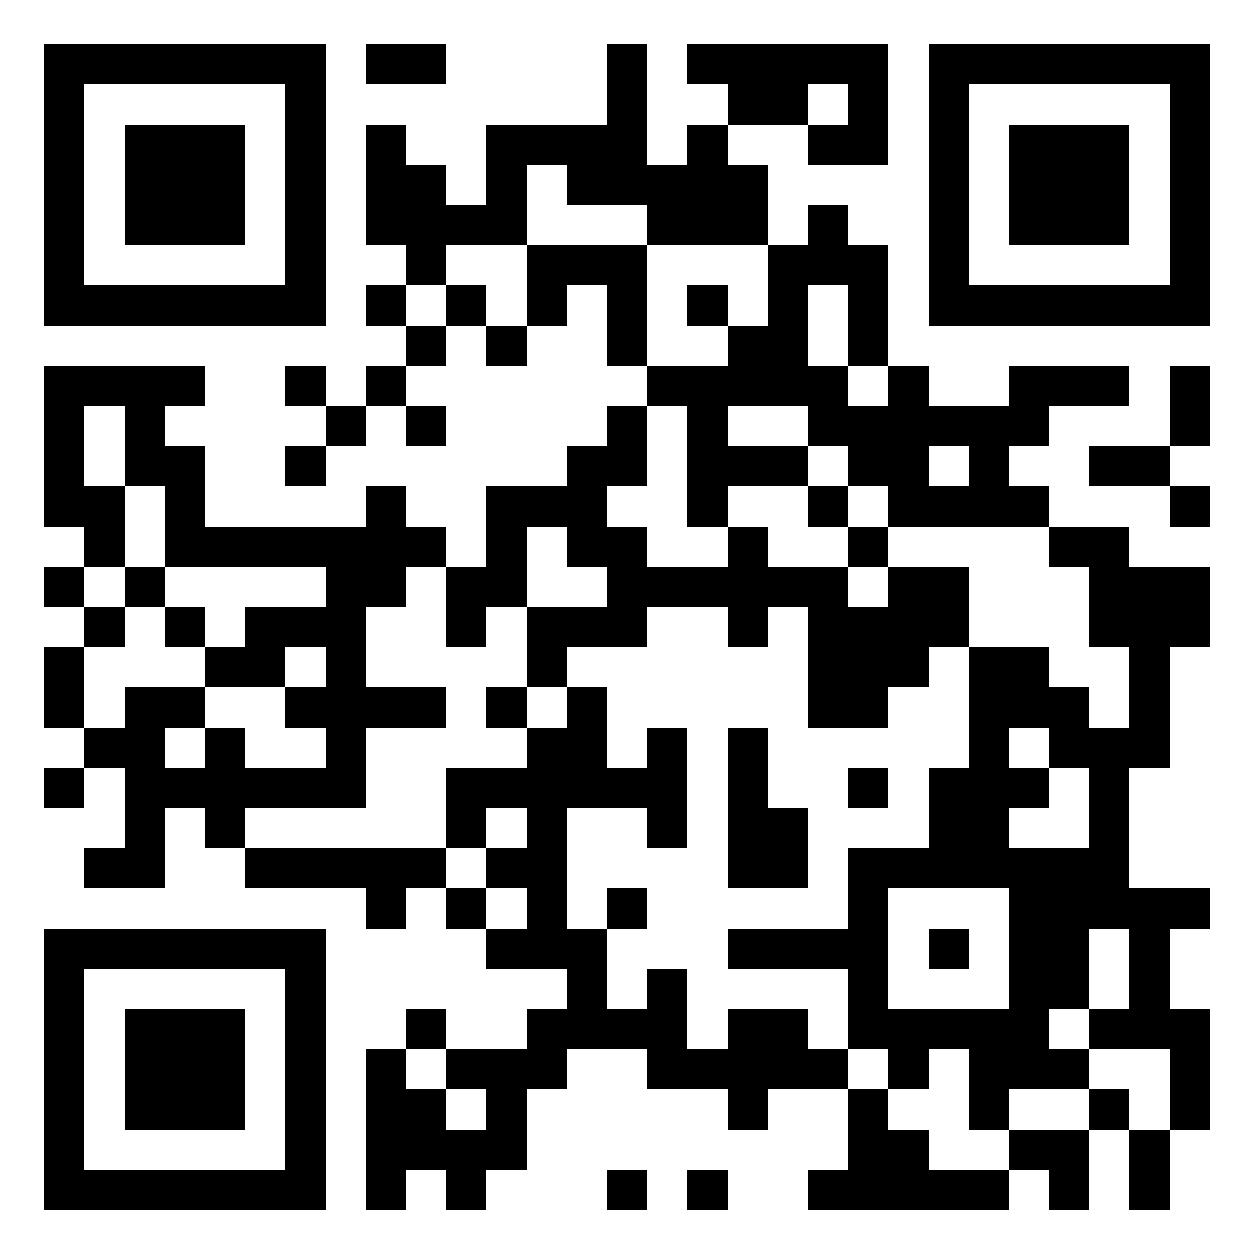
Describe, in a few words, what authentic leadership is to you.
Use the QR Code to go to Padlet.
*All responses are anonymous.*

Slide 7
Presenters on Authentic Leadership
Amber: Authentic leadership is cultivating collegial relationships with others through transparency and values-based principles, while simultaneously both acknowledging your own gaps in knowledge or limitations and uplifting the content knowledge and potential of others.
David: Authentic leadership involves being transparent and ethical, respecting and encouraging other viewpoints, and keeping your promises. Lead with love.
Karen: Authentic leadership looks and sounds like leaders who: 1) listen carefully and echo what people say to ensure they’ve heard them, and value a transparent, inclusive, and equity centered shared governance structure ; 2) explain how and why they make decisions; are open to input about factors constituents would like them to consider, and dialogue openly about whether those factors can be incorporated or not and why; 3) are interested in collaborative problem-solving and give credit and acknowledgement to collaborators; 4) are not afraid to say “I don’t know” and follow up on things they agree to follow up on.
LaTonya: Authentic leaders know who they are and lead with a sense of purpose. Their leadership actions are genuine with respect for other cultures and diverse perspectives. They build relationships through intentional engagement. They work collaboratively with others in bringing about transformational change with emotional intelligence.

Slide 8
Leadership Meets Collaboration with Collective Impact
Collective Impact is the commitment of a group of important actors from different sectors and the community to a common agenda for solving a specific social problem at scale.

Slide 9
The Five Conditions of Collective Impact
Common Agenda | All participants have a shared vision for change including a common understanding of the problem and a joint approach to solving it through agreed upon actions.
Shared Measurement | Collecting data and measuring results consistently across all participants ensures efforts remain aligned and participants hold each other accountable.
Mutually Reinforcing Activities | Participant activities must be differentiated while still being coordinated through a mutually reinforcing plan of action.
Continuous Communication | Consistent and open communication is needed across the many players to build trust, assure mutual objectives, and create common motivation.
Backbone Support | Creating and managing collective impact requires a separate organization(s) with staff and a specific set of skills to serve as the backbone for the entire initiative and coordinate participating organizations and agencies.
J. Kania & M. Kramer, 2011

Slide 10
Getting to High Quality Programs and Services Through Collective Impact
Collective Impact is the commitment of a group of important actors from different sectors and the community to a common agenda for solving a specific social problem at scale.
Collective impact also requires a highly structured process that leads to effective decision making.
Creating a common vocabulary is vital to success but takes time, and this common vocabulary is an essential prerequisite to developing shared measurement systems and establishing trust and rapport between constituent leaders.

Slide 11
Getting to High Quality Programs and Services Through Collective Impact
“Exploring the marginalization of people along multiple identities can also create space for taking an intersectional approach to the work, recognizing that those holding multiple identities (e.g., women of color) are often worse off than others.”
“Centering equity requires rethinking the supposed facts that define the problem by recognizing that marginalized populations within any community have experiences that are very different from those of many individuals and organizations who work to help them.”
“Collective impact has lasting effectiveness only if it is focused on changing underlying systems, not just adding new programs or services.”
Kania, J. et al. 2022

Slide 12
Three Conditions for Change
According to Kania, et al. (2011), three conditions must be in place before launching a collective impact initiative at an institution. You need:
An influential champion,
Adequate financial resources,
And a sense of urgency for change.

Slide 13
Who are We Collaborating With?
Design and implement the initiative with a priority placed on Diversity, Equity, and Inclusion.
Include community members in the conversation (Students, Faculty, Administrators, Staff, K-12 Partners and Community).
Institutional Researchers are priceless allies in DEI work: Utilize data to continuously learn, adapt, and improve processes and functions as well as streamline college strategic planning efforts.
Remember to consider who is not a part of the conversation. Be mindful and intentional about including myriad diverse voices across the campus community.

Slide 14
Strategies for Successful Collaborations
Cultivate leaders with unique system leadership skills.
Focus on Integrated Strategic Plans, Curriculum, Programs, Hiring.
Processes/Procedures and Professional Development.
Continue to build a culture that fosters trust, team development, leadership, empowerment, voice and respect.
Customize forums for crucial and robust conversations around IDEAA work and intersectionality.
Use the “call in” approach versus the “calling out” approach.

Slide 15
Strategies & Examples of Calling-In For Inclusion, Diversity, Equity, Anti-Racist, Accessibility (IDEAA)
Working together to ensure IDEAA and intersectional, student-centered decision making requires authentic collaboration and leadership. Authentic leadership is rooted in “calling in” versus “calling out.” For example:
“Can you say a bit more about what you mean by [insert statement, process, or word you want to understand]?”
“I appreciate your intent and I’d like to talk about the impact this has on…”
“I can see where you’re coming from and I don’t want us to…”
“Thanks for sharing your perspective on this topic. I want to revisit [insert word or statement] because …”
“You mentioned that we’ve been doing this process for a while and it’s been successful which is great. I also wonder what we can do differently that can further support our diversity efforts? For example…”
Notes:
David also to give example here

Slide 16
Addressing Challenges in Leadership
No matter our best efforts, challenges in leadership can and will occur. However, maintaining open lines of communication is essential for leaders. Common challenges include concerns around:
Governance Structures
Participatory Governance versus Shared Governance.
Relying primarily upon versus mutual agreement.
Policy and Process Creation
Varied impact on respective constituent groups (new policies and processes).
Revision of existing policies and processes related to the 10+1 academic senate purview.
Other Campus Matters
Hiring prioritizations
Enrollment management
Academic freedom and right of assignment
When working through challenges, remember who we’re working for.

Slide 17
Self Care and Fatigue in Leadership
Maintaining authenticity as a leader is hard work.
Remember to take breaks and engage in self-care routines.
Check-in and seek advice from mentors outside your institution.
Reflect on your personal definitions of leadership and college governance norms; revisit governance norms at college council meetings on a quarterly basis.
Lead with compassion and grace.
Forgive yourself and others; let go of grudges.

Slide 18
Thank You!
Questions?

Slide 19
References
Kania, J. & Kramer, M. (2011). “Collective impact.” Stanford Social Innovation Review. DOI: 10.48558/5900-kn19.
Kania, J. et al. (2022). “Centering Equity in Collective Impact.” Stanford Social Innovation Review. DOI: 10.48558/rn5m-ca77

