Slide 1
GE and Guided Pathways: Sequencing and Scheduling of GE Courses to Facilitate Student Success
Rebecca Eikey, ASCCC Area C Representative
LaTonya Parker, ASCCC South Representative
Thais Winsome, ASCCC Curriculum Committee, Mission College
Curriculum Institute, Riverside, July 13, 2018

Slide 2
Overview
Guided Pathways
Student Success
General Education (GE)
Requirements
Unit Value Considerations
Course Sequencing
Requirements
Scheduling
Discussion throughout…

Slide 3
Guided Pathways (GP)
America Association of Community Colleges (AACC) describes its pathways model as “an integrated, institution-wide approach to student success based on intentionally designed, clear, coherent and structured educational experiences, informed by available evidence, that guide each student effectively and efficiently from her/his point of entry through to attainment of high-quality postsecondary credentials and careers with value in the labor market.”
The Four Dimensions or “Pillars” of GP

Slide 4
CCC Guided Pathways (GP)
State grant program
$150 million in one-time funds available to all CCCs
First allocations received spring 2018
Progress towards Guided Pathways implementation expected to be made by early 2020s
All 114 colleges eligible to participate and receive funding
Completed self-assessment
Submitted a GP Workplan
Guided Pathways is not a “one-size-fits-all” initiative…

Slide 5
CCC Guided Pathways
Create clear
curricular
pathways to
employment
and further
education.
Help students
choose and
enter their
pathway.
Help students
stay on
their path.
Ensure that
learning is
happening
with
intentional
outcomes.

Slide 6
General Education Requirements (Title 5)
Title 5 §55063 (b)
(1) Students receiving an associate degree shall complete a minimum of 18 semester or 27 quarter units of general education coursework which includes a minimum of three semester or four quarter units in each of the areas specified in paragraphs (A), (B) and (C) and the same minimum in each part of paragraph (D). The remainder of the unit requirement is also to be selected from among these four divisions of learning or as determined by the local option:
(A) Natural Sciences.
(B) Social and Behavioral Sciences.
(C) Humanities.
(D) Language and Rationality.
(2) Ethnic Studies will be offered in at least one of the areas required by subdivision (1).

Slide 7
General Education Requirements (Accreditation)
Standard II.A.12:
The institution requires of all of its degree programs a component of general education based on a carefully considered philosophy for both associate and baccalaureate degrees that is clearly stated in its catalog. The institution, relying on faculty expertise, determines the appropriateness of each course for inclusion in the general education curriculum, based upon student learning outcomes and competencies appropriate to the degree level. The learning outcomes include a student’s preparation for and acceptance of responsible participation in civil society, skills for lifelong learning and application of learning, and a broad comprehension of the development of knowledge, practice, and interpretive approaches in the arts and humanities, the sciences, mathematics, and social sciences.

Slide 8
General Education: Unit-Value Considerations
Title 5 §55002 (a)(2)
(B) Units. The course grants units of credit based upon a relationship specified by the governing board between the number of units assigned to the course and the number of lecture and/or laboratory hours or performance criteria specified in the course outline. The course also requires a minimum of three hours of student work per week, including class time for each unit of credit, prorated for short-term, extended term, laboratory and/or activity courses.

Slide 9
General Education: Unit-Value Considerations
High-unit courses may include more content and in-class time for practice and review, but this comes at a cost to students
Difficult to complete all requirements
Consume financial aid resources
Make it difficult for students to juggle work, family, school
Good data will help in addressing this issue: Review history of courses that have increased units over the years; what was the rationale and has it contributed significantly to success/retention?

Slide 10
Course Sequencing
Requirements – Accreditation
Standard II.A.5: The institution’s degrees and programs follow practices common to American higher education, including appropriate length, breadth, depth, rigor, course sequencing, time to completion, and synthesis of learning. The institution ensures that minimum degree requirements are 60 semester credits or equivalent at the associate level, and 120 credits or equivalent at the baccalaureate level.

Slide 11
Course Sequencing
Scheduling – Accreditation
Standard II.A.6: The institution schedules courses in a manner that allows students to complete certificate and degree programs within a period of time consistent with established expectations in higher education.

Slide 12
Would Program Mapping Help Clarify Requirements?
Academic or Program Mapping
Maps sequence of courses required to complete the degree
Term-by-term or
Unit-based
Middlesex Community College, MA

Slide 14
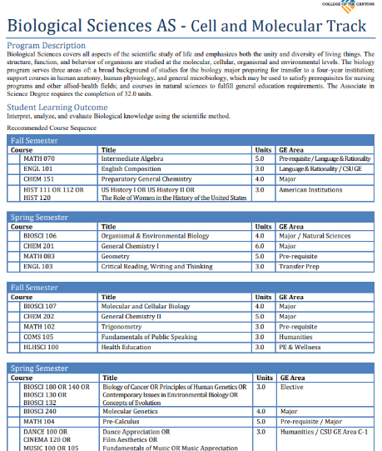

Slide 16
Considerations for Program Mapping
Who will lead the creation & implementation?
Committee? Taskforce?
Who should be involved?
How do you bring in student voice?
Which other stakeholders need to know about this?
How does the college’s broader environment (e.g., state or college policy) support or inhibit the work?

Slide 17
Analysis for Program Mapping
What is the full scope of programmatic offerings at the college?
Do the college’s programs align to the local labor market and/or university transfer partner?
Which GE courses align best to each major and/or meta-major?
What are the common courses across all programs?
What is the required core within a particular meta-major that allows students to branch off into various majors without losing any credits?

Slide 18
Analysis and Implementation Questions
Which courses will introduce students to relevant faculty and career information early in their academic careers?
Which courses might not be included, and who needs to be involved in that decision?
How will the college present mapped pathway requirements to students?
Will mapped pathways be presented to students as their default registration?

Slide 19
Course Sequencing and Program Mapping
Essential questions regarding Scheduling…
Can a student easily complete GE requirements within a reasonable period of time, while completing major requirements as well?
Does the scheduling of a significant number of GE courses in one area overlap with those in another?
For a given program of study or group of programs, do the GE offerings coordinate with one another or are they scheduled independently of one another?

Slide 20
Course Sequencing
More questions regarding Scheduling…
How are course schedules generated?
Who oversees the process?
How are conflicts resolved?
Faculty Involvement
ASCCC Resolution 17.01 (F17) Faculty Involvement in Scheduling of Courses
“Resolved, That the Academic Senate of California Community Colleges urge local senates to continue to assert their purview in the development of procedures for scheduling classes and the faculty role in determining which courses are offered within programs to support student achievement of their academic goals.”

Slide 21
Questions?

Slide 22
Resources
Accrediting Commission for Community and Junior Colleges (ACCJC): http://accjc.org
Rebecca Eikey (Rebecca.eikey@canyons.edu)
LaTonya Parker (LaTonya.Parker@mvc.edu)
Thais Winsome (thais.winsome@missioncollege.edu)

