Slide 1
Guided Pathways: Connecting and Reconnecting with Students
Randy Beach, ASCCC Guided Pathways Task Force Derek Majors, LA Trade Tech Pathway Counselor Gwyer Schuyler, ASCCC Guided Pathways Task Force Counselor

Slide 3
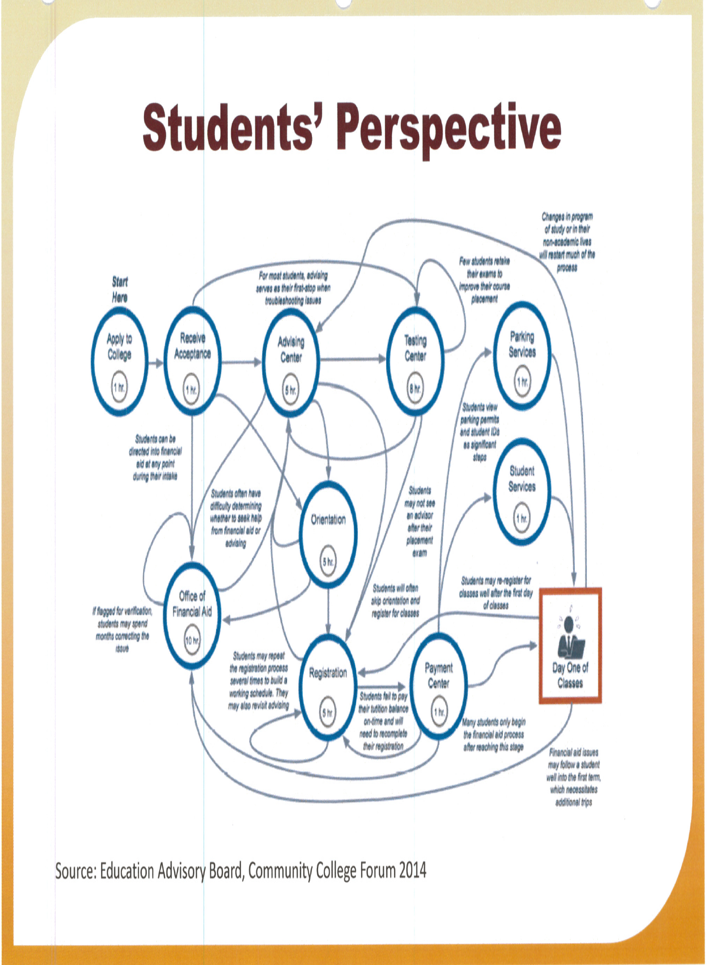

Slide 4
What Does it Take to Help a Student Persist?
What are the institutional out-reaches and in-reaches that help students engage and persist?
How can faculty and the institution support this engagement?
How does the engagement differ based on a student's goal?
What does this engagement look like in a guided pathways framework?

Slide 5
Which Student Services Are Involved?
Easier question is “Which ones are NOT?”
Counseling
Admissions and Application Process
Assessment
Financial Aid
Outreach
Transfer Centers
Tutoring and Supplemental Learning
Others?

Slide 6
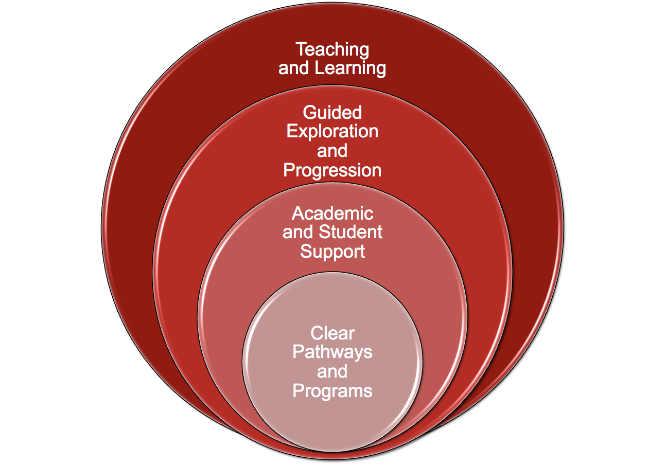
2018 ASCCC Career and Noncredit Education Leadership Institute Westin South Coast Plaza

Slide 7
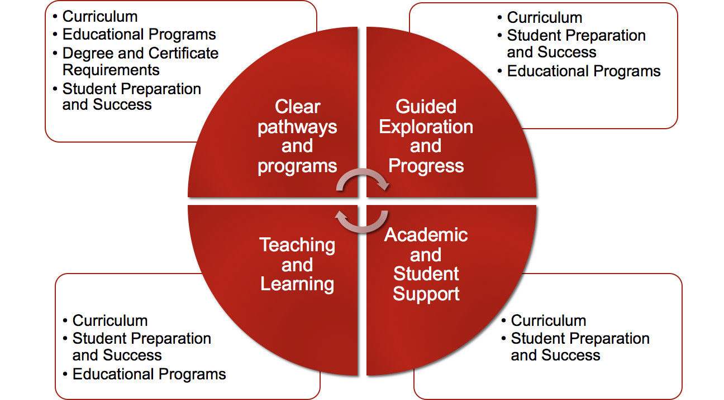

Slide 8
Designing the Framework; Talking to Students
Focus Groups
Student surveys
Data collection
Keep students’ needs at the forefront
Making the case

Slide 9
Clarify the Path: Begin with the End
Create the shortest path of courses the students will take from their first day of attendance to their graduation by designing curriculum with the end goal of their program’s outcomes in mind
Requires discussion across traditional discipline boundaries and sacred cows
Considers Employment and further education opportunities targeted by each program in the beginning
Makes sense of general education
Introduces the concept of “Meta Majors” sorting of programs for clarity and to design support services
AACC, “Guided Pathways: Planning, Implementation, Evaluation.” Diagram. https://www.aacc.nche.edu/wp-content/uploads/2017/09/PathwaysGraphic462017.pdf

Slide 10
Enter the Path: Student Services
Expanded and early Career Counseling
Career counseling coursework linked to areas of interest
Use of multiple measures to assess students’ needs
First-year experiences to help students explore the field and choose a major
Full program plans based on required career/transfer exploration
Contextualized, integrated academic support to help students pass program gateway courses
K–12 partnerships focused on career/college program exploration (Outreach)
AACC, “Guided Pathways: Planning, Implementation, Evaluation.” Diagram. https://www.aacc.nche.edu/wp-content/uploads/2017/09/PathwaysGraphic462017.pdf

Slide 11
Stay on the Path: Student Services
Work with discipline faculty to identify student habits relevant to their course-taking habits
Ongoing, intrusive counseling intervention strategies
Systems for students to easily track their progress
Technology (EPI, Early Alert, e-SEP, Degree Works, Starfish, GradesFirst)
Systems/procedures to identify students at risk and provide needed supports
Capacity to help students redirect and change their goals without amassing significant numbers of units.
AACC, “Guided Pathways: Planning, Implementation, Evaluation.” Diagram. https://www.aacc.nche.edu/wp-content/uploads/2017/09/PathwaysGraphic462017.pdf

Slide 12
Ensure Learning: Student Services
Enhanced or supplemental instruction practices to support project-based learning, collaborative learning, and other applied learning experiences
Embedded counseling-counselors developing stronger relationships with program faculty to bring students across the finish line
Collaboration with library faculty, faculty involved in tutoring and supplemental instruction to maximize meta-cognitive skills
Systems/procedures for the college and students to track mastery of learning outcomes that lead to credentials, transfer, and/or employment
AACC, “Guided Pathways: Planning, Implementation, Evaluation.” Diagram. https://www.aacc.nche.edu/wp-content/uploads/2017/09/PathwaysGraphic462017.pdf

Slide 13
Next Steps
Assert faculty leadership and purview in 10 + 1 areas
Determine planning and design structures that put faculty heavily involved in decision-making
Talk to students; find out where they need help
Look to GP for inspiration, not an off-the-shelf model
Be cautious of faculty taking sides and pointing fingers
Keep students’ needs at the forefront

Slide 14
Connecting and Reconnecting: Defining Connection
“Communicating information is a one-way, self-contained event. The individual for whom the information is intended may or may not receive it, understand it, care about it, or act on it. Connecting is an interactive, iterative series of events that is personal and creates a sense of presence.” from the Center for Community College Student Engagement report, Making Connections: Dimensions of Student Engagement, 2009.

Slide 15
The Importance of Connection: Telling Stories
What stories do you have (positive or negative) that demonstrate connection between faculty and students?
How do these stories demonstrate effective practices?

Slide 16
The Importance of Connection: Telling Stories
What are the common elements in our stories?
How can we build these elements into our Guided Pathways work?

Slide 17
Thank you!
Questions

