Slide 1
Guided Pathways: Focusing on the Part-time Faculty Perspective
Randy Beach, Southwestern College, ASCCC Guided Pathways Task Force
Dolores Davison, ASCCC Vice President
Michelle Pilati, ASCCC Guided Pathways Tool Development Lead
Notes:
DD

Slide 2
Overview
What are “Guided Pathways”?
Why Guided Pathways?
What role should part-time faculty play in the implementation of guided pathways?
Notes:
Dolores

Slide 3
REMEMBER…
…this all about the students!
Notes:
DD

Slide 4
What are “guided pathways”?
Has guided pathways been introduced at the college(s) at which you teach?
Have you been a part of defining guided pathways?
How is guided pathways defined?
Notes:
MP - Ask the audience…

Slide 5
Examples
“Guided pathways reform is a student-centered approach that can dramatically increase the number of students earning community college credentials, while closing equity gaps. Rather than work with a subset of students, guided pathways are a college-wide undertaking that provides a framework for integrating California-based initiatives such as SSSP, Equity, Basic Skills Transformation, the Strong Workforce Program, and California College Promise.” (Foundation for California Community Colleges)
Notes:
MP - Some definitions that are “out there”

Slide 6
Examples
The Guided Pathways framework creates a highly structured approach to student success that:
Provides all students with a set of clear course-taking patterns that promotes better enrollment decisions and prepares students for future success
Integrates support services in ways that make it easier for students to get the help they need during every step of their community college experience. (CCCCO Guided Pathways)
Notes:
MP

Slide 7
Why define Guided Pathways?
Allows for local emphases.
Facilitates local communication.
Ownership.
GP is a “framework” – you determine how it is implemented locally.
Notes:
MP

Slide 8
What are Guided Pathways?
AACC Pathway Project (National)
CA Guided Pathways Project (State-20 colleges)
CCCCO Guided Pathway Award Program (CA-all eligible)
Local college-designed programs
Notes:
MP

Slide 9
CCCCO Guided Pathways Award Program
(g) Participating community colleges may use grant funds to implement guided pathways programs for various purposes, including, but not limited to any, or any combination, including all, of the following:
(1) Faculty and staff release time to review and redesign guided pathways programs, instruction, and support services.
(2) Professional development in areas related to guided pathways.
(3) Administrative time to coordinate, communicate, and engage college stakeholders in the process of developing and implementing guided pathways programs.
(4) Upgrades to computer and student information systems to improve tracking of student progress.
Notes:
MP

Slide 10
GUIDED PATHWAYS FRAMEWORKS
CLARIFY THE PATH
ENTER THE PATH
STAY ON THE PATH
ENSURE LEARNING
How can faculty consolidate or enhance what they already do to contribute to the success of students in relation to the frameworks?
Notes:
Randy

Slide 11
CLARIFY the Path
Simplify choices to show students a clear pathway to completion, further education, and/or employment
Establish transfer pathways to optimize applicability of community college credits to university majors
Notes:
Randy

Slide 12
ENTER the Path
Bridging K-12 to higher education
Redesign the pathways that lead to programs of study
Redesign pathways through the college experience
Integrate and contextualize instruction to build foundational skills.
Notes:
Randy

Slide 13
STAY ON the Path
Support students with ongoing advising mechanisms to support *informed choices, strengthen clarity about opportunities, develop an academic plan with a predictable schedule, monitor progress, and intervene if they go off track
Embed academic and nonacademic support services throughout programs to promote student learning, persistence, and retention
*an informed choice COULD be choosing a different path
Notes:
Randy

Slide 14
ENSURE LEARNING
Establish program-level learning outcomes aligned with the requirements for success in employment and/or further education
Apply the results of learning outcomes assessments to improve the effectiveness of instruction across programs
Ensure incorporation of effective teaching practice throughout the pathways
Notes:
Randy

Slide 15
Guided Pathways Principles
Teaching and Learning
Guided Exploration and Progression
Academic and Student Support
Clear Pathways and Programs
Notes:
Randy

Slide 16
What are you doing well?
Have you already started the implementation of guided pathways and you don’t even know it?
Notes:
Randy
Ask each table to see if they can come up with a list of things they see happening at the colleges that they teach at that would be examples of those colleges doing something well.

Slide 17
Challenge 1: FOCUS
California Career Pathways Trust (CCPT)
STUDENT SUCCESS AND SUPPORT PROGRAM (SSSP)
Basic Skills and Student Outcomes Transformation Program
Notes:
Randy
These slides need to be viewed in slide show and the initiatives enter on this slide then are organized on the following slide.

Slide 18
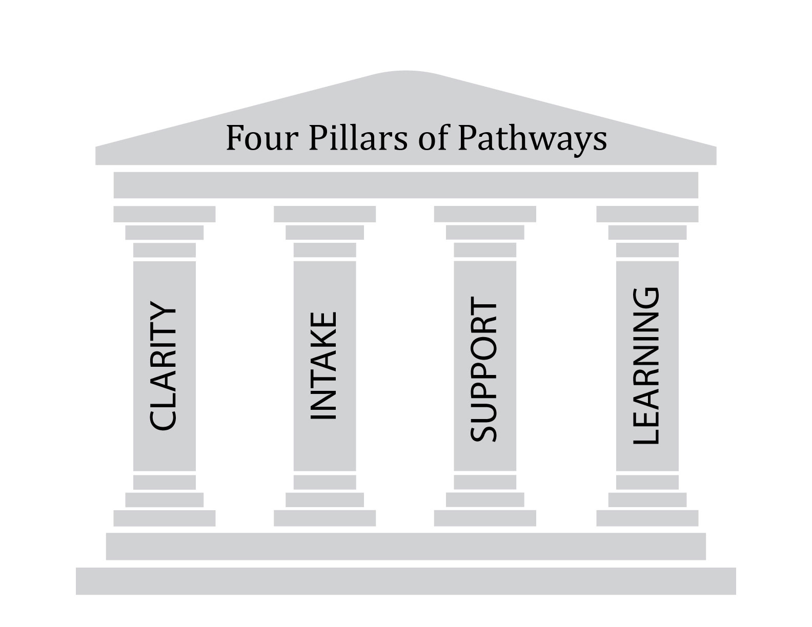
Guided Pathways
Defining Competencies
EQUITY
Assessing
Competencies
SSSP
EQUITY
EQUITY
SSSP
California Career Pathways Trust (CCPT)
Co-Requisites
Noncredit
Supplemental Instruction/Tutoring
Contextualized Learning
BSI e-Resource
Equity, Social Mobility, Economic Health
California Pathways – Redesigning California’s Community Colleges
Notes:
Randy

Slide 19
Why Guided Pathways?
Notes:
Randy

Slide 20
Why Guided Pathways?
Funding
Equity
Locally, your “why” and “how” needs to be determined
How do you “make the case” for your college?
Notes:
Randy

Slide 21
Faculty and the 10 + 1(§ 53200)
curriculum, including establishing prerequisites and placing courses within disciplines;
degree and certificate requirements;
grading policies;
educational program development;
standards or policies regarding student preparation and success;
district and college governance structures, as related to faculty roles;
Notes:
DD - Title 5 53200 - (b) “Academic senate,” “faculty council,” and “faculty senate” means an organization formed in accordance with the provisions of this Subchapter whose primary function, as the representative of the faculty, is to make recommendations to the administration of a college and to the governing board of a district with respect to academic and professional matters. For purposes of this Subchapter, reference to the term “academic senate” also constitutes reference to“faculty council” of “faculty senate.”(c) “Academic and professional matters” means the following policy development and implementation matters:

Slide 22
Faculty and the 10 + 1(§ 53200)
faculty roles and involvement in accreditation processes, including self-study and annual reports;
policies for faculty professional development activities;
processes for program review;
processes for institutional planning and budget development; and
other academic and professional matters as are mutually agreed upon between the governing board and the academic senate.
Notes:
DD - Title 5 53200 - (b) “Academic senate,” “faculty council,” and “faculty senate” means an organization formed in accordance with the provisions of this Subchapter whose primary function, as the representative of the faculty, is to make recommendations to the administration of a college and to the governing board of a district with respect to academic and professional matters. For purposes of this Subchapter, reference to the term “academic senate” also constitutes reference to“faculty council” of “faculty senate.”(c) “Academic and professional matters” means the following policy development and implementation matters:

Slide 23
The 10+1 and Guided Pathways
Clear pathways and programs
Curriculum
Guided Exploration and Progress
Curriculum
Academic and Student Support
Curriculum
Teaching and Learning
Educational Programs
Degree and Certificate Requirements
Student Preparation and Success
Student Preparation and Success
Educational Programs
Student Preparation and Success
Educational Programs
Student Preparation and Success
Curriculum
Grading Policies
Notes:
DD

Slide 24
The 10+1 and Guided Pathways
If Guided Pathways is truly about institutional transformation then these areas of the 10+1 will also be affected:
…college governance structures, as related to faculty roles;
faculty roles and involvement in accreditation processes..;
policies for faculty professional development activities;
processes for program review;
processes for institutional planning and budget development;
Notes:
DD

Slide 25
The Value of Part-Time Faculty
What is the benefit to the college of involving part-time faculty in local guided pathways implementation?
What is the role of part-time faculty in the implementation of the four principles of guided pathways?
Do guided pathways benefit part-time faculty?
Notes:
MP

Slide 26
The Role of Part-Time Faculty
After a long hot summer, the academic senate of Cactus College (part of Death Valley CCD) have realized that their part-time faculty must be involved in their local guided pathways efforts. As a consequence, the college has put out a call to recruit part-timers to serve on six of its critical participatory governance committees. Unfortunately, no one has stepped up. The senate president has asked you, in your role as a part-time senator, to come up with a plan for engaging your part-time colleagues.
Notes:
MP

Slide 27
Engaging Part-Time Faculty
What steps can Cactus College take to engage their part-time faculty?
Is there guidance that you can offer to the college to ensure that it does not unintentionally cause those faculty to disengage?
Notes:
MP

Slide 28
Common Concerns
“Guided Pathways Demystified”
https://www.irsc.edu/uploadedFiles/FacultyStaff/Pathways-Demystified.pdf
Is this just the latest fad?
Will I still get to teach _______?
This does not make sense for my students.
Shouldn’t students be able to explore?
Are guided pathways, AB 705, and performance-based funding a plot to fundamentally change our colleges?
Notes:
Randy

Slide 29
Approaches to Implementation
Guided Pathways is the mechanism for you to implement the institutional change that is specific to your institution.
Does your college understand – or has it identified - the “Why?” for Guided Pathways?
Does your college have a sense of urgency around student success, completion, and equity?
Notes:
Randy

Slide 30
ASCCC & Guided Pathways
Resolutions
Rostrum Articles
ASCCC Guided Pathways Task Force
Liaison
Resource Team

Slide 31
RESOURCES
ASCCC Guided Pathways
IEPI Guided Pathways
AACC Pathways Project
California Guided Pathways Project
CCC Guided Pathways Grant Program Trailer Bill Language

