Slide 1
Certification Training & Training Local Committees

Slide 2
Description
Colleges are required to train curriculum committees annually to be eligible for continued local approval certification. This session will highlight elements of local approval certification for 2020-2021. In addition to using this session as a template for committee members, presenters will share additional resources that may be helpful in training local curriculum committee members and curriculum developers.

Slide 3
OVERVIEW
Local Approval Certification 2020-2021
Recommended Training Elements
Available Training Resources

Slide 4
Local Approval Certification

Slide 5
Local Approval Certification
First local approval certification was due December 2016 and included local approval for credit courses, including new courses for approved programs, modified courses, and stand-alone courses.
2019-2020 Local Approval Certification (Memo AA 19-35) included all credit and noncredit course proposals, modified credit programs, local credit programs, CTE C-ID aligned credit programs, and noncredit CDCP programs (except for short-term vocational).
It did not include ADTs, noncredit CDCP STV programs, and new CTE programs not C-ID aligned
Required Annual Certification Form signed by Chief Executive Officer, Chief Instructional Officer, Academic Senate President, and Curriculum Chair
Required Copy of local board policy defining standards for credit hour calculations

Slide 6
For 2019-2020, signatories acknowledged and certified that:
Course hours and units are correct in accordance with CCCCO Course Calculations;
The college/district course outline of record has been approved by the District Governing Board;
The college has developed local policy, regulations, or procedures specifying the accepted relationship between contact hours, outside-of-class hours, and credit for calculating credit hours to ensure consistency in awarding units of credit;
Credit cooperative work experience plan has local board approval and is on file;
Credit and noncredit courses and programs that are submitted to the Chancellor’s Office Curriculum Inventory (COCI) system are accurate and compliant with California Education Code, California Code of Regulations, title 5, and the current CCCCO Program and Course Approval Handbook (PCAH);
Credit and noncredit programs have the required attachments in accordance with the current CCCCO PCAH; and
Mandatory training for curriculum committees and responsible administrators regarding curriculum rules and regulations to ensure compliance ((CCR, §55002(a) (1)).

Slide 7
Annual Certification Approval Policy
The Chancellor's Office requires each college to annually submit:
Annual Certification
Chief Executive Officer
Chief Instructional Officer
Academic Senate President, and
Curriculum Chair
Local Governing Board Policy
Policy must define the standards for credit hour calculations
Submit as PDF
Non-submission of the Annual Certification will result in a deactivation of “auto-approval” status

Slide 8
Local Approval Certification 2020-2021
The periodic review process will be ongoing
The Chancellor’s Office is here to help. College curriculum specialists are encouraged to work closely with assigned CCCCO regional curriculum staff members (regional assignments posted to CCCCO Curriculum web page)
Ongoing information updates will be shared periodically (listservs, curriculum training venues, guidance memos, etc.)

Slide 9
Periodic Review Process – Sample
Sample Timeline*
2/1/2020 - CO conducts periodic review, annotates findings, and notifies college of required revisions (discrepancies requiring corrective action)
College receives periodic review discrepancy notification from CO and has 60 days to respond to CO (response by 4/1/2020)
College corrects discrepancies and submits amended curriculum via COCI (by 10/1/2020)
CO reviews corrected curriculum and notifies college
Non-punitive process; goal is to assist colleges in aligning curriculum with policy through technical assistance and guided support
*Note: does not include AD-Ts; see separate guidelines

Slide 10
Who should be trained?
Curriculum committees
Curriculum specialists
Deans or other curriculum developers
Chief Executive Officer
Chief Instructional Officer
Academic Senate President
Others?

Slide 11
Reminders
Make sure course hours and units are correct
Development of local policy for consistency in awarding units of credit
Course outline of record approved by district governing board
Cooperative Work Experience (CWE) plan has local board approval and is on file
Accuracy of credit curriculum submitted to COCI
Credit programs have the required attachments in accordance with the current PCAH
Mandatory training for curriculum committees and responsible administrators regarding curriculum rules and regulations to ensure compliance (CCR title 5, §55002(a) (1))

Slide 12
Recommended Training Elements

Slide 13
Courses
Credit
All curriculum components will be reviewed
COCI proposal fields for data elements
Course outline of record meets standards in title 5, § 55002 (a) (b), and approved by the district governing board
Refer to PCAH 7, Part II, credit curriculum standards and criteria
Noncredit
All curriculum components will be reviewed
COCI proposal fields for data elements
Course outline of record meets standards in title 5, § 55002 (c), and approved by the district governing board
Refer to PCAH 7, Part III, noncredit curriculum standards and criteria

Slide 14
Certificate Programs
Credit
Certificate of Achievement
All curriculum components will be reviewed
Narrative (with all components)
CORs for all courses
Appropriate supporting documentation for “Local” (non-CTE) certificates
Appropriate supporting documentation for CTE certificates
Refer to PCAH 7, Part II, Section 3 for credit certificate program standards and criteria
Noncredit
Certificate of Completion
Certificate of Competency
All curriculum components will be reviewed
Narrative (with all components)
CORs for all courses
Appropriate supporting documentation for short-term vocational (“CTE”) certificates
Refer to PCAH 7, Part III, Section 3 for noncredit program criteria and standards
Adult High School Diploma (AHSD) and apprenticeship see PCAH 7, Part III, Section 3 (pp. 135 – 137)

Slide 15
AA/AS Degree
Compliance standards for associate degrees, as set forth in title 5, § 55063
All curriculum components will be reviewed
CORs for all courses
Narrative (with all components)
Appropriate supporting documentation for CTE associate degrees
Refer to PCAH 7, Part II, Section 3 for all credit degree program standards and criteria
CTE AA/AS Degrees: PCAH 7, pp. 79 - 84
Local AA/AS Degrees (non-CTE): PCAH 7, pp. 84 – 89

Slide 16
Associate Degree for Transfer (AD-T)
The AD-T program is a partnership between the CCC and CSU system
AD-Ts must be compliant with applicable legislation, title 5, and PCAH requirements
Periodic review will include compliance of:
Current TMC (Transfer Model Curriculum)
All CORs attached (CORs will be reviewed to ensure current standards are met)
All courses included on TMC meet the requirement listed on the TMC C-ID Articulation, AAM (Articulation Agreement by Major), BCT (CSU Baccalaureate Level Course List by Dept.) or GECC (CSU GE Certification Course List by Area)
Review of unit count and double count totals
Review of Narratives including the catalog descriptions with random checks against the current school catalog to confirm they are the same
For AD-Ts, colleges will be asked to respond to revision request within 60 days. Once the college responds they will have an additional 6 months from the response date to make necessary revisions for approval.
If a colleges does not meet the corrective parameters described above, the AD-T program will be deactivated in COCI.

Slide 17
Available Training Resources

Slide 18
PCAH 7th Edition
PCAH 7th Edition…
PART I: OVERVIEW
PART II: CREDIT CURRICULUM
PART III: NONCREDIT CURRICULUM
Posted to the Educational Services & Support Division webpage [Curriculum and Instruction]
https://www.cccco.edu/-/media/CCCCO-Website/Reports/CCCCO_Report_Program_Course_Approval-web-102819.pdf?la=en&hash=06918DD585E9F8C0805334FEA3EB1E6872C22F16

Slide 19
Chancellor’s Office Guidance
Guidelines for Title 5 Regulations Section 55003 Policies for Prerequisites, Corequisites, and Advisories on Recommended Preparation (March 2011)
California Community Colleges Guidelines for Community Services Offering (September 20120)
Guidelines for Required Instructional Materials in the California Community Colleges (January 2013)
Credit Course Repetition Guidelines (November 2013)
Division of Educational Services and Support: Curriculum and Instruction
Chancellor’s Office COVID-19 Resources – includes Executive Orders and Guidance

Slide 20
Other Documents
TOP-CIP Crosswalk (June 2020)
California Education Code
CCR, Title 5
Program and Course Approval Handbook - “PCAH”, 7th Edition
Taxonomy of Programs “TOP Code” Manual, 6th Edition
Chancellor’s Office MIS: Data Mart | Research & Data Analytics | Data Element Dictionary
The Course Outline of Record: A Curriculum Reference Guide Revisited (ASCCC, 2017)

Slide 21
ASCCC Resources
www.asccc.org
Papers, Rostrum articles, resolutions (use search)
Presentation slide decks
Events -> Past Events -> select type of past event -> Program Materials
Email: info@asccc.org
Listservs
Chancellor’s Office Curriculum Assistance Listserv: http://listserv.cccnext.net/scripts/wa.exe?SUBED1=CURRICASSIST
“Unofficial” Curriculum Chairs listserv” Request to join: CCCCurriculumChairs+subscribe@groups.io
Yahoo Curriculum Specialists Listserv: Email cacurricstaff-subscribe@yahoogroups.com

Slide 22
Sponsors

Slide 23
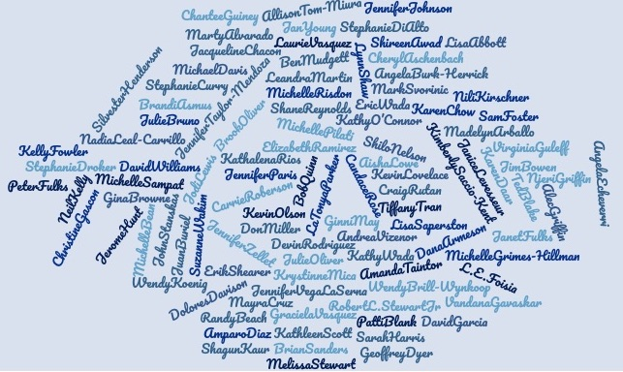
2020 Presenters

Slide 24
Collaborations
California Community College Chief Instructional Officers
California Community Colleges
Chancellor’s Office
Accrediting Commission for
Community and Junior Colleges
California Community Colleges
Success Center

Slide 25
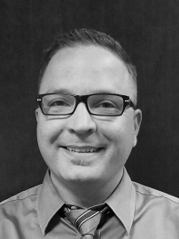
ASCCC Staff
Tonya Davis
Director of
Administration
Alice Hammar Director of Finance
Miguel Rother
Director of Grants
& Initiatives
April Lonero Executive Assistant
Jennifer Valencia
Program Manager
Edie Martinelli Events Manager
Megan Trader Program Coordinator
Kyoko Hatano Administrative Assistant
Selena Silva Program Specialist
Veronica Rey Administrative Assistant
Katie Nash
Visual Designer
Meuy Rosales
Accounting Clerk II

Slide 26
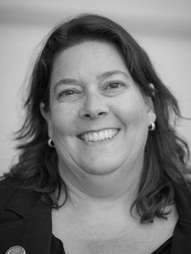
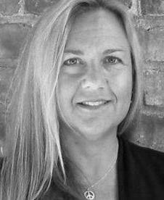
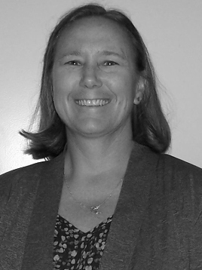
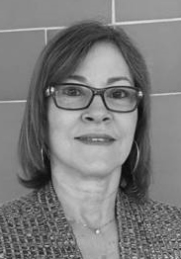
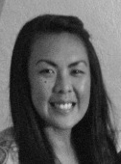
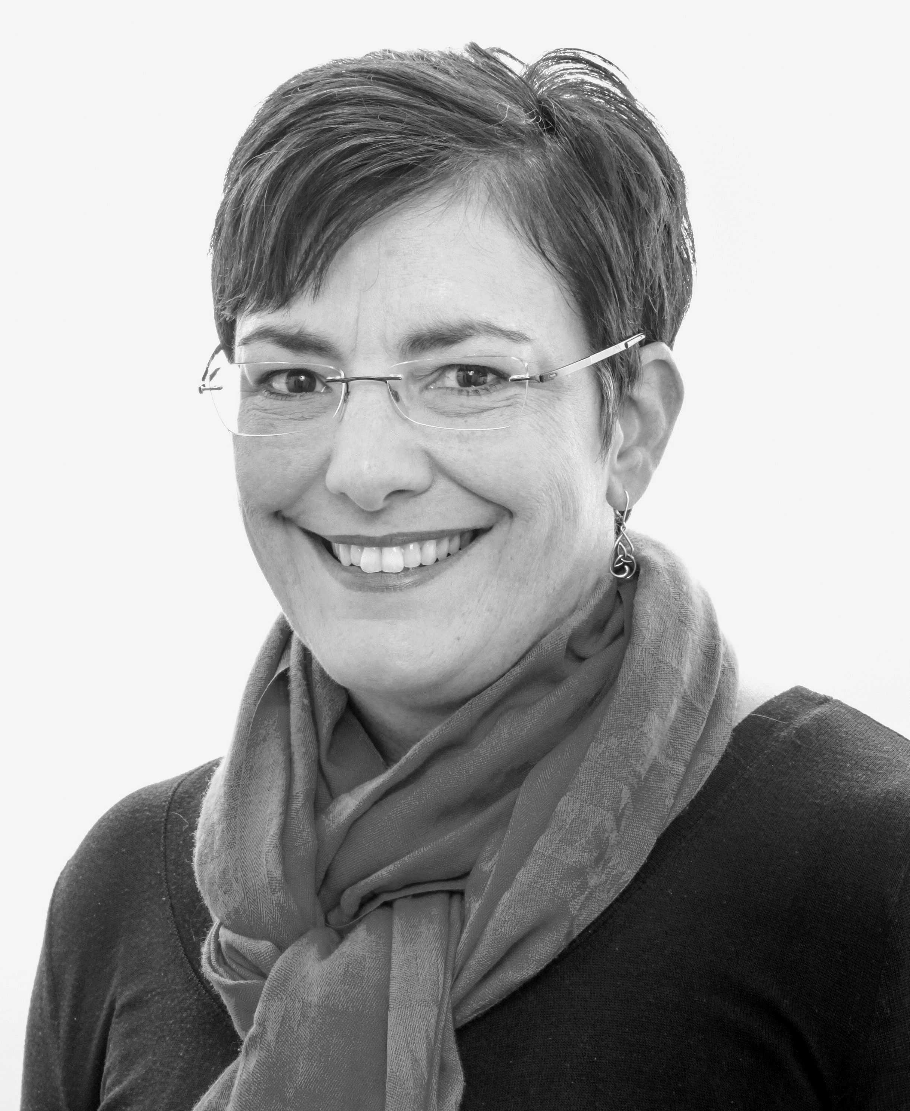
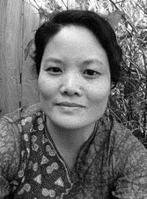
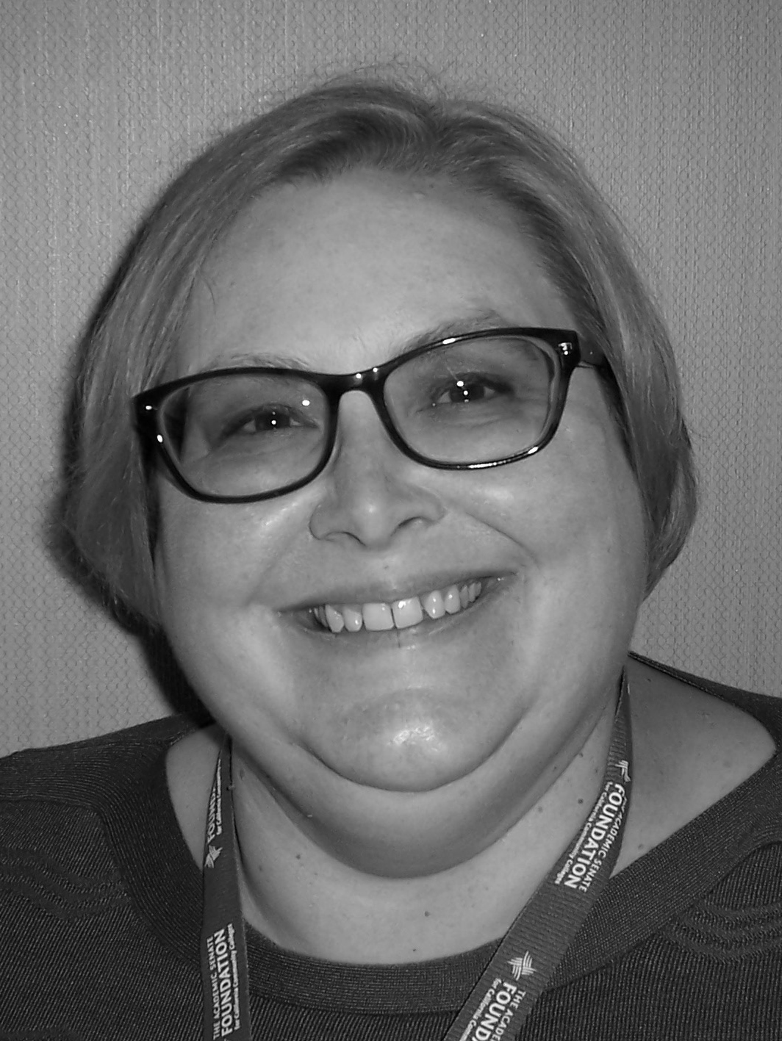
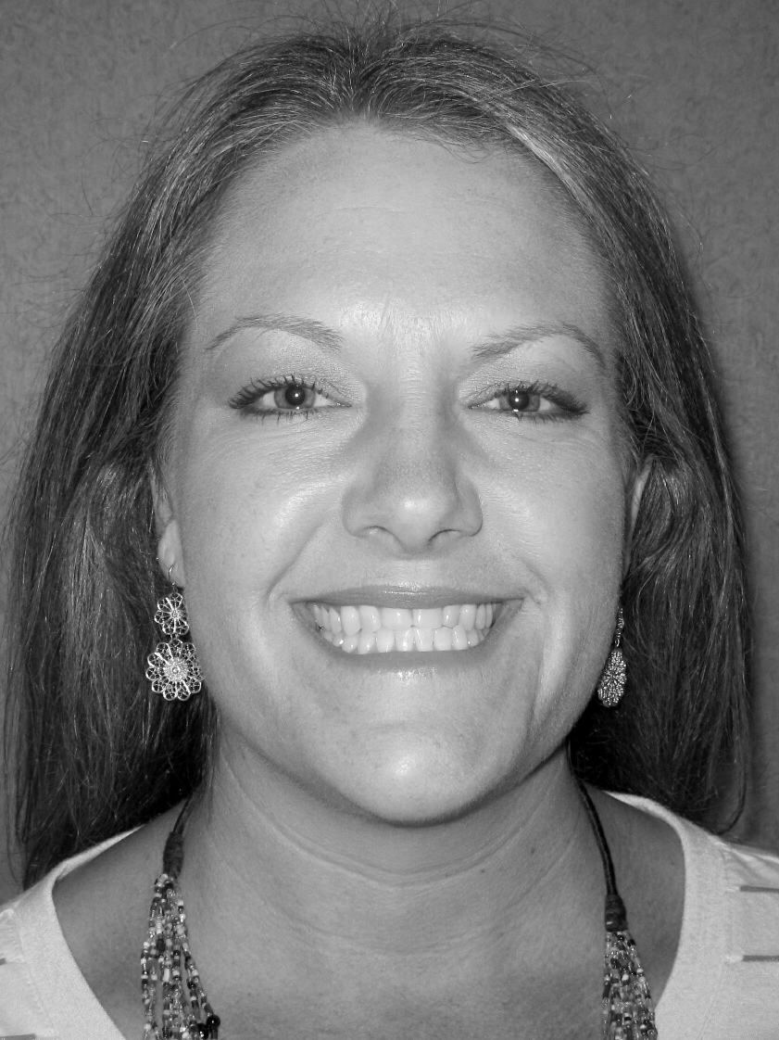
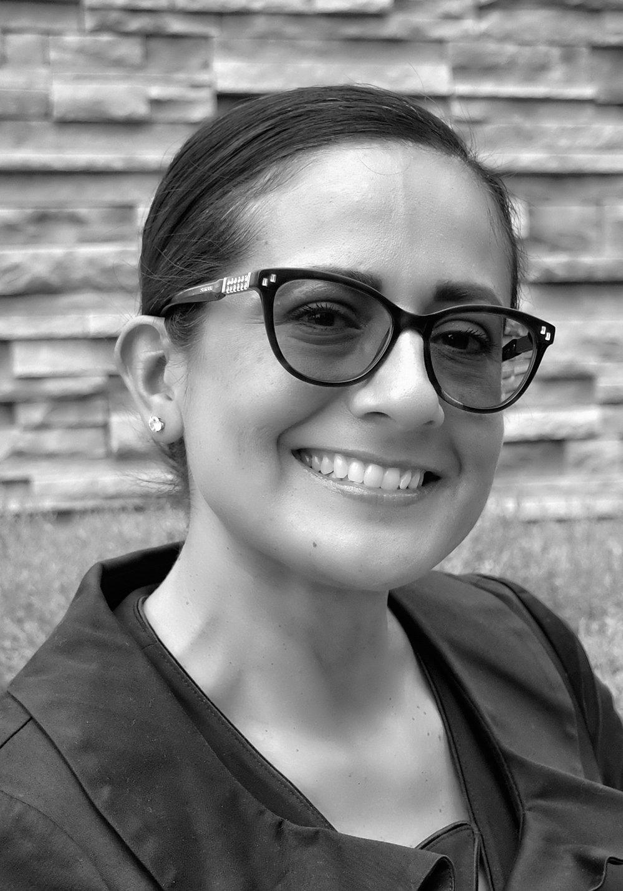
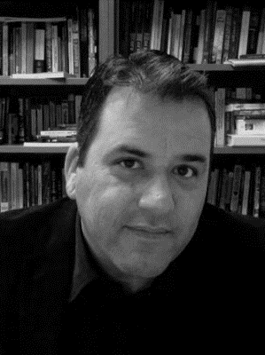
ASCCC Executive Committee 2020-21
Dolores Davison
President
Virginia May
Vice President
Cheryl Aschenbach
Secretary
Mayra Cruz
Treasurer
Krystinne Mica
Executive Director
Julie Oliver
Area A
LaTonya Parker
Area D
Karen Chow
Area B
Robert L. Stewart Jr. Area C
Stephanie Curry
North Representative
Carrie Roberson North Representative
Silvester Henderson
At-Large Rep
Michelle Bean
At-Large Rep
Sam Foster
South Representative
Manuel Velez
South Representative

Slide 27
ASCCC Curriculum Committee 2019-2020
Jimmie Bowen
Antelope Valley College
Silvester Henderson
ASCCC At-Large Representative
Nili Kirschner
Woodland College
Shilo Nelson
Los Angeles Pierce College
Donna Necke
Mt. San Antonio College
Elizabeth Ramirez
Rio Hondo College
Lisa Saperston
Los Angeles City College
Erik Shearer
Napa Valley College
Jennifer Taylor-Mendoza
Skyline College
CIO Representative

Slide 28
Responsive Curriculum & Collective Impact
Action will show they really care about us.
-Dr. Nyree Berry
Los Angeles Community College District
This will require collective efforts of deliberative engagement, authentic dialogic interaction, with inter-organizational, interdivisional, and interdisciplinary alignment. The future of this country will be decided in our classrooms . The future of this country will be shaped by you.
It . Is . Time . To . Care .
-Nadiyah Herron
San Bernardino Valley College
Senate Rostrum, Summer 2020

Slide 29
2021 Curriculum Institute July 7-10 Pasadena Convention Center 2020-2021 ASCCC Curriculum Chair Carrie Roberson

