Slide 1
Faculty Diversification Lori Adrian, Coastline College President Ned Doffoney, Chancellor Emeritus NOCCCD Daisy Gonzales, Deputy Chancellor Cindy Vyskocil, President of ACHRO John Stanskas, ASCCC President Fall 2018 Plenary Session Friday General Session 4, November 2, 2018
Notes:
Association of Chief Human Resources Officers

Slide 2
Overview
Data and Goals
Systems and Pressures
Introductions and perspectives
What academic senate presidents can do
Questions
Notes:
This has been a longstanding desire of the faculty: to help lead or system’s diversification efforts

Slide 3
Notes:
Emphasize that we are talking first about racial and ethnic diversity because it the the area we see the greatest disparity. That does not mean that other forms of diversity are not important, just not the focus of this effort today

Slide 4
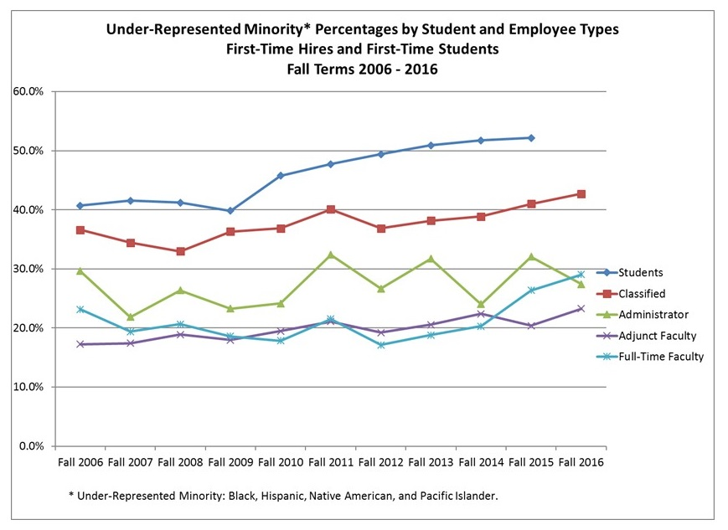

Slide 5
Why is Faculty Diversification Important?
All qualified individuals should have equal opportunity to be hired by our system
Diversifying any workforce is healthy and spurs a richer dialog about service to our communities and provides insights into problem solving from a variety or lenses
Students respond to reflections of themselves and can be more successful when they recognize a similarity between their lived experience and that of figures of authority

Slide 6
Systems and Bureaucracies
Systems tend to be self-sustainable and resist change by either conscious or unconscious design.
We can examine our systems – district or college – to find the unconscious design flaws, the implicit bias, that prevents us from ensuring that all qualified individuals have the opportunity to join us
Notes:
Implicit Bias examples by the panelists on the next two slides?

Slide 7
Systems and Bureaucracies
HR Application process
Construction of the job announcement
Appointment and convening of the hiring committee
Initial screening of applicants
Interview
Second level interview
Notes:
This should look familiar to everyone

Slide 8
Perspectives
Daisy Gonzales, Deputy Chancellor
Cindy Vyskocil, President of ACHRO
Lori Adrian, Coastline College President Ned Doffoney, Chancellor Emeritus NOCCCD John Stanskas, ASCCC President
Notes:
Perhaps leave the previous slide up if it is helpful to address different parts of the process

Slide 9
Take Aways: What you can do
Examine processes and procedures for hiring through the lens of equity – rewrite them as needed
Partner with your CEO and/or CIO and CSSO to lead honest and open dialog about diversity and hiring processes
Support HR in revamping and spending money on recruitment and advertising, evaluation of the application processes

Slide 10
Take Aways: What you can do
Appointment of hiring committees – senate presidents appoint all faculty, exercise that duty with equity in mind
Recruit and Mentor diverse part-time faculty
Insist on professional development for hiring committee members specifically and the college community in general regarding diversity and hiring processes
Understand that this is a decade long endeavor, not something that will be solved in one session or one year. Future focus needs to include efforts to retain employees and shift the culture

Slide 11
Take Aways: What you can do
Attend and send representatives to
BUILDING DIVERSITY SUMMIT
February 8-9, Los Angeles
TRAINING FOR HIRING COMMITTEE APPOINTEES
February 21, Bakersfield College
February 25, Butte College
February 28, Norco College
You can always request a technical visit from the ASCCC tailored to your needs by emailing info@asccc.org

Slide 12
Notes:
If there aren’t any questions, perhaps we ask individuals to write down on index cards what they can do when they get back to their college and ask for volunteers to share?

