Slide 1
Going Deep: Using The Cultural Humility Tool in Your Racial Justice Journey
Thursday, April 7 at 1:00 p.m. – 2:15 p.m.

Slide 2
Session Description
You ready? Is your senate ready to actualize the antiracism pledge you committed to two years ago? Maybe you have started the work and want to know how to dig deeper? Come to this session to hear about the Cultural Humility Tool we developed to help you plan next steps in your antiracism and social justice journey, both for the development of a local plan and for self-reflection and action. The tool is a framework to support groups and individuals at deeper levels to engage in courageous conversations that may be needed to start the cultural humility work. We will also provide resources and recommendations that could serve as models for transformation and action.

Slide 3
First Things
Virtual
Go to FILES in Pathable.
Print or open the Cultural Humility Inventory.
In-Person
Find a pen.
Take a handout: the Cultural Humility Inventory.
Notes:
MB - 1 minute

Slide 4
Presenters
Michelle Velasquez Bean, ASCCC Treasurer and EDAC Chair
Nadia Khan, ASCCC EDAC member
Hermelinda Rocha, ASCCC EDAC member
Notes:
Each presenter tell their social justice journey (4 min)
A tapestry of diversity; a quit of collectivism

Slide 5
Background
ASCCC Strategic Plan Objective 2.2. section #A calls for a review and revision of the ASCCC cultural competency plan
ASCCC Resolutions
Antiracism Pledge (Fall 2020 Resolution 3.01)
IDEA Liaison (Spring 2021 Resolution 3.02)
Reporting Cultural Competency Plan (Spring 2014 Resolution 3.01)
Infuse Cultural Competency and present a model to local senates (Spring 2010 Resolution 1.02)
2021/22 EDAC created the Cultural Humility Toolkit
Notes:
MB - 2 mins
Toolkit Objectives:
To use the Cultural Humility Toolkit to guide the ASCCC Executive Committee in action planning and committing to a cultural humility plan.
To provide the Cultural Humility Toolkit to local academic senates as a model for cultural humility planning in beginning or in continuing the work of developing a plan for an institutional cultural humility journey.

Slide 6
Cultural Humility Toolkit
Why do we need a toolkit?
Intentionality and the need to dig deeper–going beyond compliance
Impact is acknowledging
the baseline–minimum requirements for student success
need to start somewhere–with no shame or blame
sustainable practice in cultivating cultural humility
Let’s work on building a culturally competent (Bennett, J. 2003)
mindset (knowledge)
heartset (attitude)
skillset (skills)
Notes:
NK- 2-3 mins
Why do we need cultural humility?
Sustainable practice in cultivating cultural humility

Slide 7
Notes:
Youtube: https://youtu.be/c_wOnJJEfxE
MB- 3 mins

Slide 8
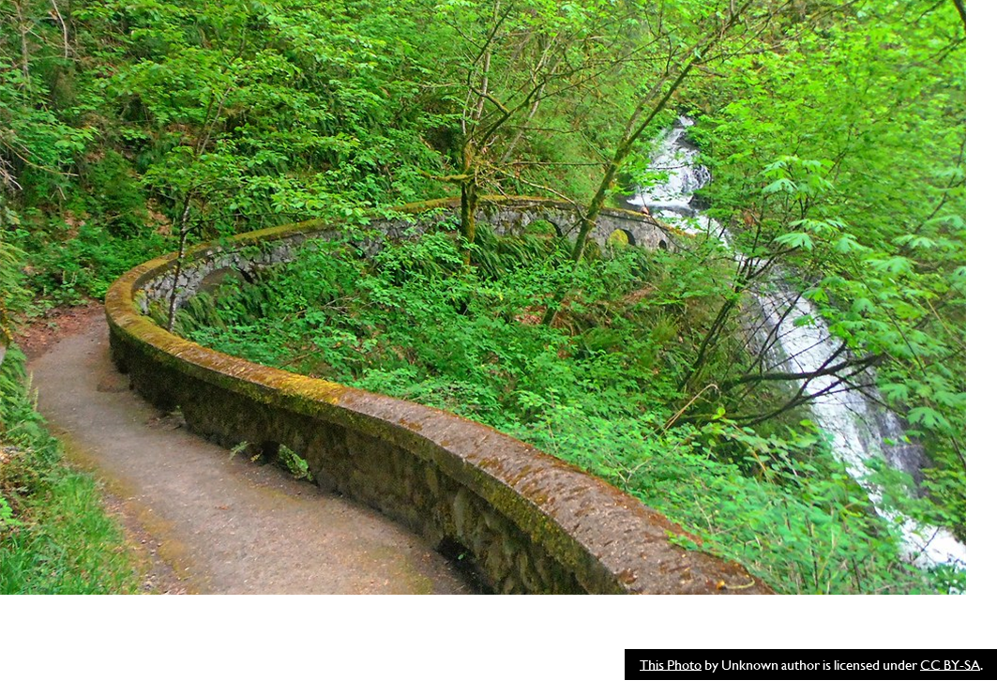
The Journey Is Ongoing!
What is race and what are the impacts of race neutrality?
Social construct
Systemic barriers
What does the social justice journey entail?
The struggle is part of the path
The work requires intentionality to level the playing field
We all win when we all have equity
Where can I get common definitions?
CCC DEI Glossary
ASCCC Equity-driven Systems Paper
ASCCC Antiracism Paper
Notes:
MB to discuss race, race neutrality (3 mins)
Race: A social construct that artificially divides people into distinct groups based on characteristics such as physical appearance (particularly skin color), cultural affiliation, cultural history, ethnic classification, and the social, economic and political needs of a society at a given period of time. There are no distinctive genetic characteristics that truly distinguish between groups of people. Race presumes human worth and social status for the purpose of establishing and maintaining privilege and power. Race is independent of ethnicity.
Racism: Is the intentional or unintentional use of power to isolate, separate and exploit others on the basis of race. Racism refers to a variety of practices, beliefs, social relations, and phenomena that work to reproduce a racial hierarchy and social structure that yield superiority, power, and privilege for some, and discrimination and oppression for others. It can take several forms, including representational, ideological, discursive, interactional, institutional, structural, and systemic. Racism exists when ideas and assumptions about racial categories are used to justify and reproduce a racial hierarchy and racially structured society that unjustly limits access to resources, rights, and privileges on the basis of race.
Cultural Competence: Is the ability to honor and respect the beliefs, language, interpersonal styles and behaviors of those receiving and providing services. Individuals practicing cultural competency have knowledge of the intersectionality of social identities and the multiple axes of oppression that people from different racial, ethnic, and other minoritized groups face. Individuals striving to develop cultural competence recognize that it is a dynamic, on-going process that requires a long-term commitment to learning. In the context of education, cultural competence refers to the ability to successfully teach students who come from cultures o and interpersonal awareness and sensitivities, learning specific bodies of cultural knowledge, and mastering a set of skills for effective cross-cultural teaching.
The National Institutes of Health (NIH) defines cultural humility as “a lifelong process of self-reflection and self-critique whereby the individual not only learns about another’s culture, but one starts with an examination of her/his own beliefs and cultural identities.” The term was first coined in 1998 by healthcare professionals Melanie Tervalon and Jann Murray-García, who originally described cultural humility as a tool to educate physicians to work with culturally, ethnically, and racially diverse populations in the United States. The concept, however, carries meaning for any clinical researcher or social advocate who is studying and/or working with someone different from themselves – in terms of race, ethnicity, gender, religion, sexual orientation, socioeconomic status, or geographic location – in any cultural context and in any part of the world.
Source: https://hogg.utexas.edu/3-things-to-know-cultural-humility
Helpful handout on Whiteness and Social Justice: https://drive.google.com/drive/folders/1l9MWCZofMIsX-VyRi_9pNVpcSC0VwmVq
Definitions at the end of this toolkit: https://drive.google.com/drive/folders/1Qwoh40jLw7FawRQ0GDNXTMCM_kKJqMVP

Slide 9
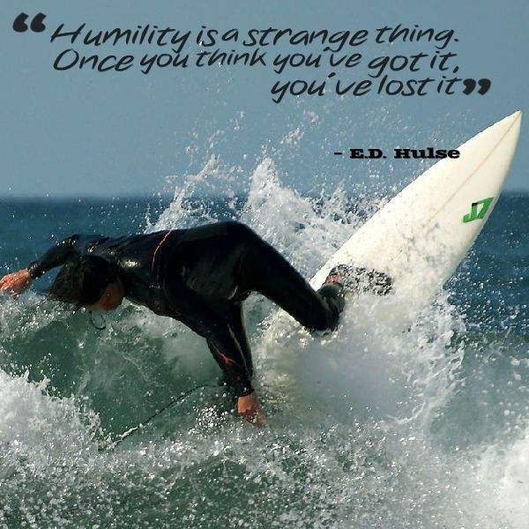
The Journey is Ongoing!
What is cultural humility?
“a lifelong process of self-reflection and self-critique whereby the individual not only learns about another’s culture, but one starts with an examination of her/his own beliefs and cultural identities.”
`National Institute of Health
Notes:
NK to discuss self-awareness and cultural humility - (1 min)

Slide 10
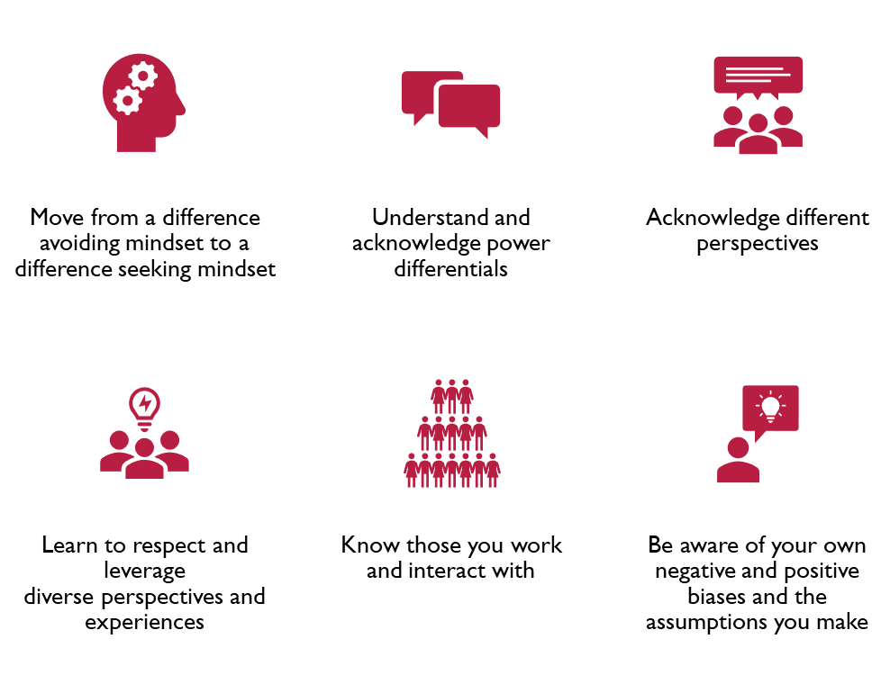
Self-Awareness
.
Notes:
NK (2-3 mins)

Slide 11
Cultural Humility Toolkit Design
Directions and Guidance:
Reflect and Analyze–using the decision tree
Explore and Grow–using the inventory
Take Action and Manage Goals–using the journey map
Notes:
NK - (1 min)

Slide 12
Cultural Humility Decision Tree
How ready are you and your group to engage in antiracism and cultural humility planning?
Depending on how ready you are, the decision tree provides suggestions for path to take and the next steps.
Once groups are ready to take action, they can use left side to engage in the work.
Notes:
NK - (2 mins)
Show the Cultural Humility Inventory
DOWNLOAD for fillable version: https://drive.google.com/file/d/1bik0kmS_thSPgBp4gNeijMs0BfA5IUf6/view?usp=sharing

Slide 13
Cultural Humility Inventory
Key Info:
Transformative work through self-assessment and self-awareness
Courageous conversations will likely be needed
Criteria used in the inventory provide framework to cultural humility supported by resources to begin transformative work for each criteria (domain)
Inventory Criteria:
Awareness of Bias
Inclusion, Diversity, Equity, Anti-Racism, & Accessibility
Acknowledgement of Diverse Perspectives of Thinking
Understanding of Race Consciousness
Commitment to Disrupt Microaggressions
Commitment to Behavioral & Policy Change for IDEAA & Antiracist Practices
Commitment to Relate to Diverse Lived Experiences
Notes:
NK - 3 mins
Show the Cultural Humility Inventory
DOWNLOAD for fillable version: https://drive.google.com/file/d/1bik0kmS_thSPgBp4gNeijMs0BfA5IUf6/view?usp=sharing

Slide 14
Cultural Humility Inventory: Self-Reflection and Awareness
Do the inventory as an individual (left side column):
Engage in honest self-reflection
Reach out to local IDEAA initiative groups/committees with questions
Review resources given and then retake the self-assessment after some time
Don’t stop here–commit to transformative action
Notes:
NK (virtual) and MB (in-person): 5 mins (self-reflection activity)
Change screen to show cultural humility inventory

Slide 15
Cultural Humility Inventory: Organization Reflection and Institutional Awareness
Right side column–complete with your group/organization/senate:
Engage in courageous conversations
Have skilled facilitators help you lead
Use collaborative groups, sharing out, and consensus
Don’t assume; set community/group norms/agreements before the activity
Notes:
NK and MB- picture on next slide; ask participants to look at the handout/downloaded file.
(1 min)

Slide 16
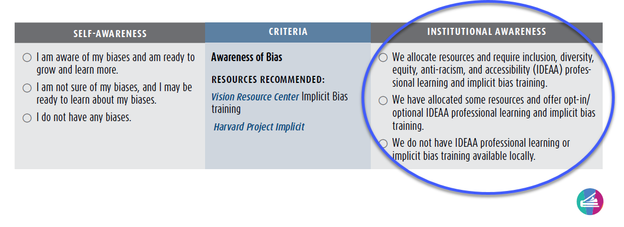
Institutional Awareness Column

Slide 17
Sample Scenario for Organization Inventory
Openview College created and passed an antiracism and no hate resolution at its board meeting in 2020. Openview local academic senate asked the Student Equity Coordinator (SEC), who is one of the few faculty of color tenured at the college, to help write the resolution and asked if they could lead a book club to read Minding the Obligation Gap. There were about 25 people who attended the first book talks but by the end of the semester only about 7 equity champions remained in the book club. The SEC did not continue the book club due to limited funds and a lack of support. A few concerned faculty also told the senate president that the talks seemed divisive. When the senate president asked an administrator for support and resources, they said that no one on the campus has the expertise to lead such work and there is no budget for training.
Notes:
MB

Slide 18
Facilitating Courageous Conversations
Small groups: 3-5 max
Roles: Recorder, Presenter, Timekeeper, Materials Manager, Cheerleader
Give clear directions before anyone moves to groups
Set a time limit
Remind of the prompt
Connect back to the goal of the group and/or established community norms
Don’t forget to have group introduce selves
Ask for roles again
Notes:
MB (2-3 mins): Dialogue Tool from SF City College: https://docs.google.com/presentation/d/1heJ6IwQZbE5kcPcpNtdAM4spAa76Yz4r/edit#slide=id.p11
Goals for the session:
Our overarching goal for today is to use this space to open a dialogue between you, as colleagues, about topics, conflicts and issues that have been difficult to discuss.
I am not here to resolve past conflicts.
I am not here to assign blame or take sides or provide justification to the side of any dispute.
I am not here to tell you how to do your job.
I am here today to help you to recognize the value of collegial com camaraderie.
Review definitions of thematic terms:
Reflection: establish intent- to open a dialogue between colleagues in recognizing each other’s JOURNEY to their roles as educators
Reconciliation: listening and hearing each other; validation is communal and reciprocal
Healing past conflicts: recognizing and validating each other’s journey allows us to empathize through our own daily struggles.
Emphasize this concept.
Collegial camaraderie: working through difficultly and conflict with masters of their craft for a common goal. How can we progress beyond “isms” to open discussion beyond individual issues?

Slide 19
Discussion Circle Guidelines
Sit in a circle/use virtual breakout rooms: GIVE 3 minutes to review tool
Time limit for GROUP CONVERSATION: 1 minute per person
Introduce self
State why you’re here
Say one thing about one criteria/domain of the sample college
Pass the talking piece/use raise hand feature
This is an exercise in listening as well as sharing
Every person speaks once before someone goes twice
Remember to stay focused on the prompt
Sharing out as a group back in larger group
Notes:
MB in person; NK virtual: (ASCCC Office to project screen to breakout rooms/ Office will create breakout rooms) (3-mins)
Review these guidelines with the group.
Language parameters:
"Today, as we begin our discussion, I want to reiterate that this is a space that has been intentionally set aside to have these difficult discussions. While I insist that we remain respectful of each other and aware of over generalized statements about social and ethnic groups, I do want you to share your authentic thoughts, and not get bogged down in “what” words you use, or how you organize your phrase.
This is the space to navigate through WHAT you say and what you MEAN to say.”
Explanation of Guidelines of the Discussion Circle:
Why we sit in a circle: Equity- a circle has no beginning and no end; provides the ability to see each other as equals in the conversation; allows you to focus on what is being said
What is the talking piece: indicated who is speaking. It moves clockwise to each person in turn. It does not skip or move backwards. You cannot speak unless you are holding the talking piece.
Emphasis: this allows you to focus on listening instead of just waiting for your turn to talk.
Time: response time is limited to allow everyone the same opportunity to share.
Prompts: prompted questions give direction to the conversation, not limitations. They are intended to the overall goal of having a space to speak and listen.
Sharing: allows for a summary of the responses for contemplation.
Remember:
Roles: Recorder, Presenter, Timekeeper, Materials Manager, Cheerleader

Slide 20
Use the Right Column
Check boxes to determine where you believe the Openview College is for each domain/row/criteria
Group Convo–7 minutes!
Openview College created and passed an antiracism and no hate resolution at its board meeting in 2020. Opeview local academic senate asked the Student Equity Coordinator (SEC), who is one of the few faculty of color tenured at the college, to help write the resolution and asked if they could lead a book club to read Minding the Obligation Gap. There were about 25 people who attended the first book talks but by the end of the semester only about 7 equity champions remained in the book club. The SEC did not continue the book club due to limited funds and a lack of support. A few concerned faculty also told the senate president that the talks seemed divisive. When the senate president asked an administrator for support and resources, they said that no one on the campus has the expertise to lead such work and there is no budget for training.
Notes:
MB
(project this slide during the activity- (7-mins)

Slide 21
Cultural Humility Journey Map
This journey map is circular to indicate that we need to revisit our work, our thoughts, and our actions.
This is a lifelong journey involving self-reflection. The work continues as we continue to build on the progress or the lessons learned.
Set goals and take action.
Commit to your plan and the action.
Review and revisit your commitment; refine and adjust your actions and plan as and when needed.
It’s and ongoing journey (moving towards sustainability)--look back to be informed of how to move forward.
Notes:
NK - 2 mins
Show the journey map on next slide

Slide 22
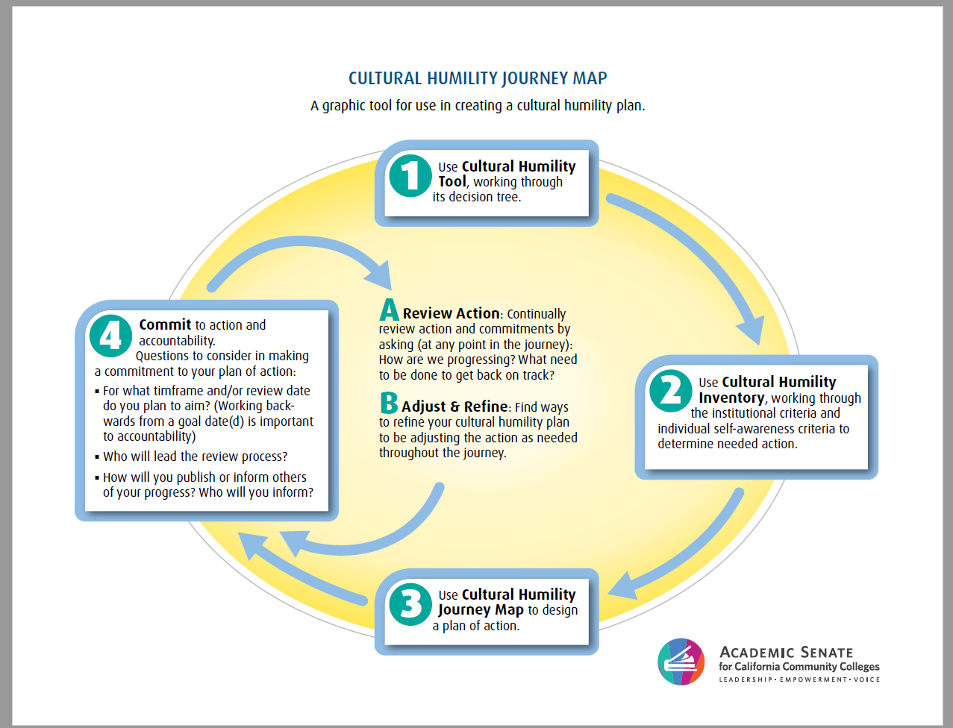
Accessible Journey Map

Slide 23
RISE: A Tool To Check Your Bias
•Recognize your own biases and limitations
•Identify other possible explanations based on your cultural understanding of others
•Seek common ground – bridge your differences
•Evolve your practice
-Bow Valley College 2016
Notes:
NK- 2mins
Apply RISE to your self-assessment

Slide 24
What’s Next?
Social justice and antiracism is an ongoing process!
EDAC’s hopes
ASCCC Executive board training
Local academic senates use the toolkit
Take a breathe. You got this! RISE
WHAT’S YOUR COMMITMENT?
Use JAMBORD (virtual) https://jamboard.google.com/d/1Zoa4g58as4Mj4MTFfpGp0F8wGV5GfWy7R_ip1XYG5X8/viewer?f=0
OR POST-ITS (in person)
Notes:
MB: Michelle needs to take POST-ITS! Place on chairs ahead of time. And designate a post it wall.
(6-mins including sharing out)

Slide 25
Q&A
Notes:
You can have a debrief if there are no questions

Slide 26
ASCCC Resources
Anti-Racism Education in California Community Colleges: Acknowledging Historical Context and Advancing Effective Anti-Racism Practices for Faculty Professional Development (2020)
Rostrum-Black Voices and Perspectives (Summer 2020) 18 Articles
Decolonizing Your Syllabus, an Anti-Racist Guide for Your College (ASCCC Rostrum, Nov 2020)
Our Obligation to Equitable Hiring Practices: A Partnership Approach to Ensuring an Equity-Minded Selection and Recommendation Process (Rostrum, Nov 2020)
Anti-Racism and Guided Pathways Implementation (Rostrum, Nov 2020)
Academic Freedom and Equity (Rostrum, Nov 2020)

Slide 27
Resources
Deangelo, Robin. (2018) White Fragility: Why It's So Hard to Talk About Racism. Boston: Beacon Press.
Alexander, Michelle. (2012) The New Jim Crow: Mass Incarceration in the Age of Colourblindness
Oluo, Ijeoma. (2019) So You Want to Talk About Race. New York: Seal Press.
Kendi, Ibram X. (2019) How to Be An Anti-Racist. New York: One World
Singh, Anneliese A. (2019) The Racial Healing Handbook. Oakland: New Harbinger
Anti-Racism Action Plan. Retrieved from https://www.monroecc.edu/inclusion-diversity/plans-policies/anti-racism-action-plan/
Center for Urban Education Equity Tools

Slide 28
Thank you!
info@asccc.org

