Slide 1


Guided Pathways
Julie Bruno
Academic Senate for California Community Colleges
Darla Cooper
The RP Group
Theresa Tena
Institutional Effectiveness Partnership Initiative
Notes:
Jeff

Slide 2
Guided Pathways
I know...
I wonder...

Slide 3
Questions to Ponder
Why now?
What is the Guided Pathways Framework?
Why Guided Pathways?
Who’s doing what?
What’s next?

Slide 4
The Challenge
CCCs originally designed to increase access to public higher education at relatively lower costs than four-year institutions.
Resulted in many classes in a variety of disciplines that are seen as a confusing menu of choices that students must navigate with often limited guidance and support.
Systemwide strategic investments to help students realize their educational goals have not improved student success.
Unfortunately, only about half of degree-seeking students achieve their educational goal; rate is even lower for African-American and Latino students.

Slide 5
A Call to Action
Bold changes are needed to improve completion rates, narrow the achievement gap and keep pace with an economy that is increasingly demanding more college-educated workers.

Slide 6

Enter Guided Pathways
The Guided Pathways framework creates a highly structured approach to student success that:
Provides all students
with a set of clear course-taking patterns that
promotes better enrollment decisions and prepares students for future success.
Integrates support services in ways that make it easier for students to get the help they need during every step of their community college experience.

Slide 7

Key Elements of Guided Pathways
Programs that are fully
mapped out and aligned with
further education and career advancement while also providing structured or guided exploration
for undecided students.
Redesigning and integrating basic skills/developmental
education classes to accelerate students to college-level classes.
Proactive academic
and career advising
from the start through
completion and/or transfer,
with assigned point of
contact at each stage.
Structured onboarding process
including improved placement tests
and co-requisite instruction that provide students with clear, actionable, and usable information they need to
get to the right start in college.
Early alert systems
aligned with interventions
and resources to help
students stay on the pathway,
persist, and progress.
Instructional support and
co-curricular activities
aligned with classroom learning
and career interests.

Slide 8


California Based Initiatives
Clarify the Path
Strong Workforce Program
Priority Enrollment
Dual Enrollment
Student Equity Planning
Student Transfer Achievement Reform Act (ADT)
California Promise
Enter the Path
Basic Skills Initiative
Education Planning Initiative
Adult Education Consortium Program
Prior Learning Credits
Student Success Initiative
Common Assessment Initiative
Multiple Measures Assessment Project

Slide 9


California Based Initiatives
Stay on the Path
College Scorecard
Institutional Effectiveness Partnership Initiative (IEPI)
Innovation Grants
Ensure Learning
Online Education Initiative
Strong Workforce Program
Institutional Effectiveness Partnership Initiative (IEPI)

Slide 10
What Guided Pathways Means for Students
Less confusion and more clarity
More guidance (especially for undecided students)
Accelerated time to and greater likelihood for completion as a result of:
  Improved placement
  Basic skills/developmental education reform
  Fewer credits that are not directly tied to educational goal
Improved opportunities for transfer and career placement

Slide 11
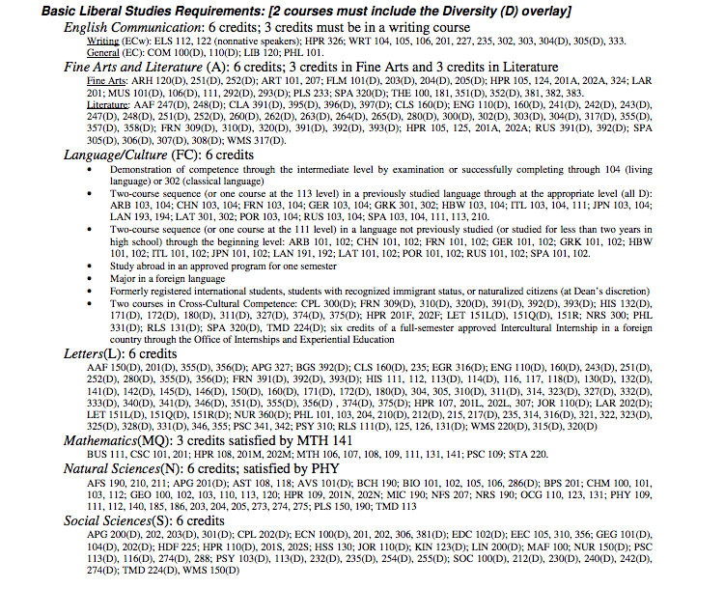
GENERAL EDUCATION REQUIREMENTS
(Select 12 courses from this list of more than 300)
The Challenge of GE

Slide 12
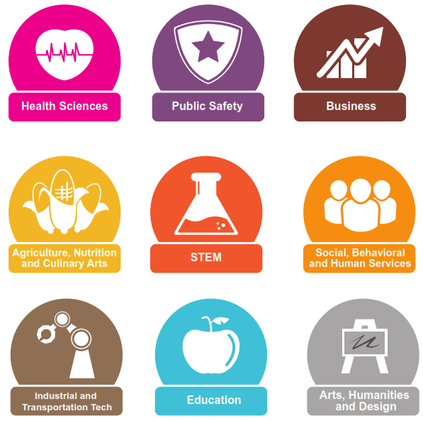
Meta Majors

Slide 13
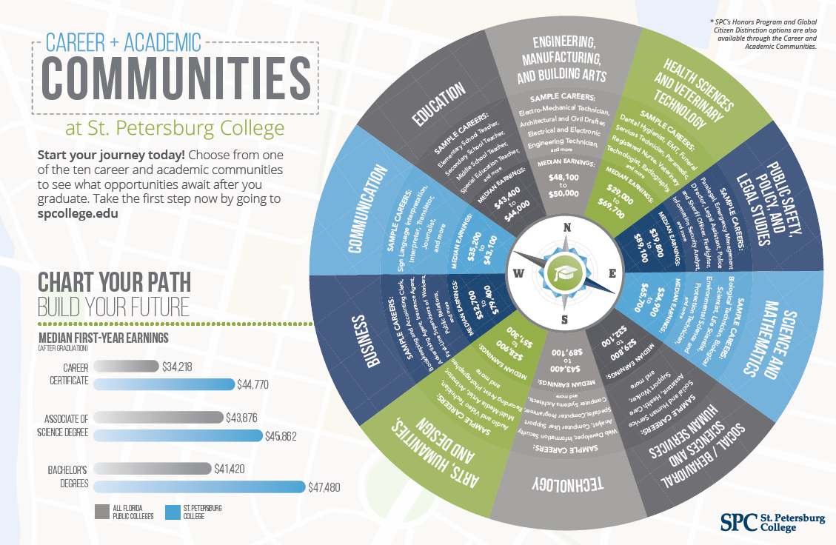
St. Petersburg College: An Example

Slide 14
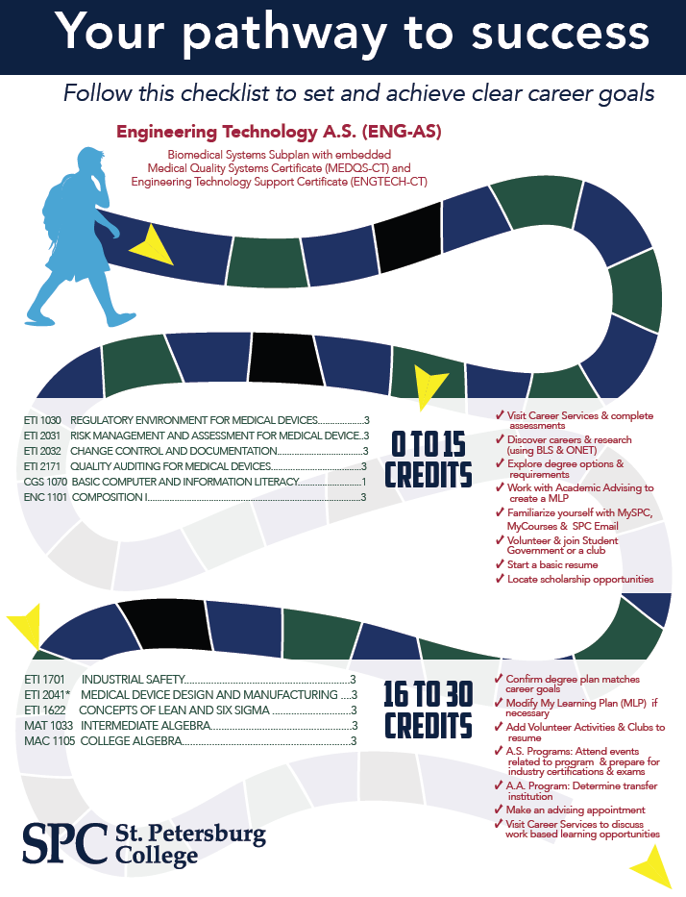
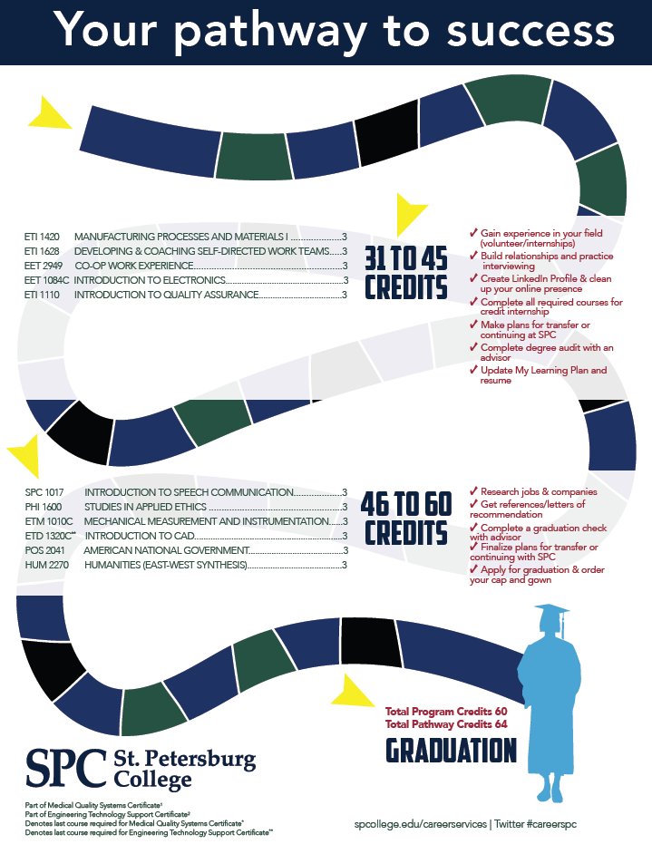
St. Petersburg College: An Example

Slide 15
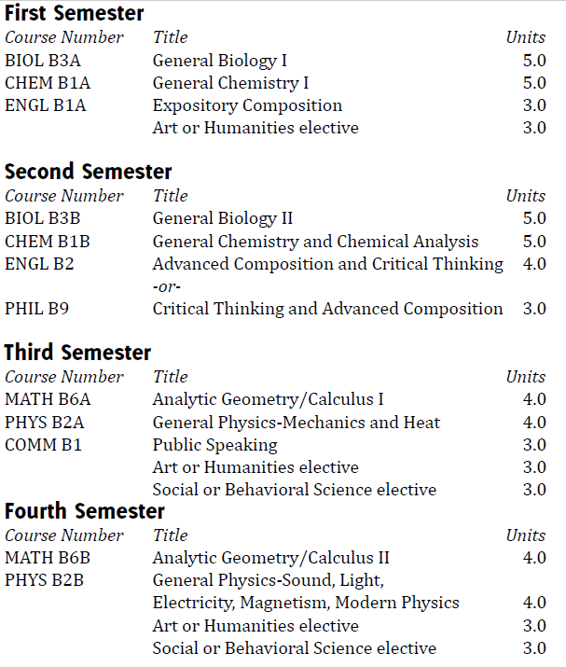
Simplifying Programs with Default Options
(Biology)
Programs with Default Options

Slide 16
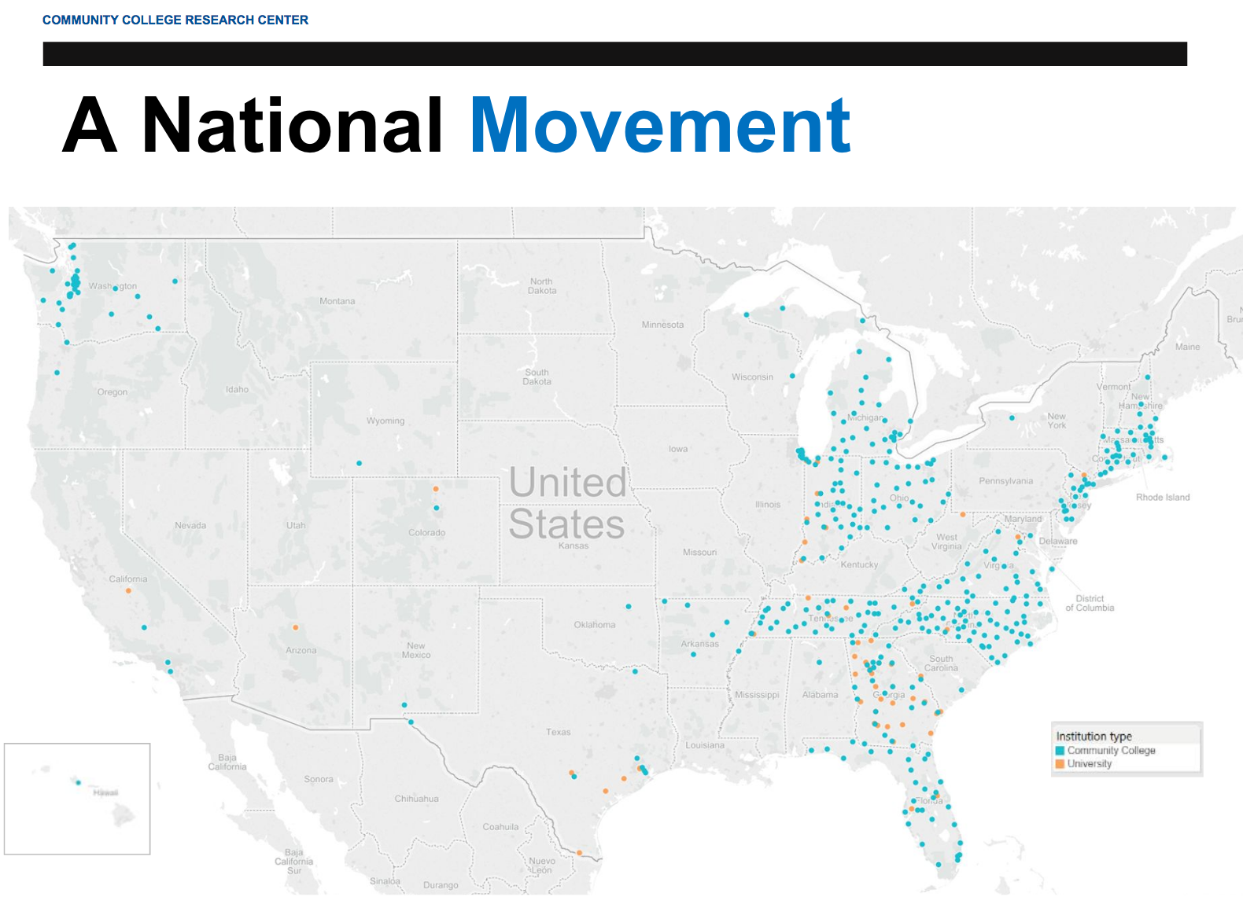
Part of a Larger Movement
National Project:
American Association of
Community Colleges (AACC)
Bakersfield College
Irvine Valley College
Mt. San Antonio College

Slide 17

California Guided Pathways
American River
Butte
Cabrillo
Canyons
Cosumnes River
Chaffey
Cuyamaca
LA Trade Tech
Long Beach City
Miracosta
11. Modesto Junior
12. Norco
13. Reedley
14. Rio Hondo
15. Riverside
16. San Joaquin Delta
17. Santa Ana
18. Santa Barbara
19. Southwestern
20. Yuba

Slide 18
Guided Pathways
Are any of your colleges moving towards implementing Guided Pathways?
What efforts are underway?
How is the guided pathways effort perceived at your college?

Slide 19
R4S at Sierra College
  Winter 2016 - Data disaggregation showed that 50% of SC students were dropping out their first year
  SC recognizes that implementing pathways is a “moral imperative”
  Spring 2016 - Reengineering for Success (R4S) Task Force developed
  SC plans for graduation rates to double by 2021 as a result of creating Academic Maps and Interest Areas, structured onboarding processes, proactive academic and career counseling, enhancement of the early alert system, and Instructional support and professional development

Slide 20
Skyline College Promise
  Comprehensive Diversity Framework
  “Facing the Brutal Facts” with “Fierce Urgency”
  Skyline Promise: 75% of students will
  “Get In, Get Through, Get Out . . . On Time!”
      Remove financial barriers: Promise Scholarship
      Address Remediation: Summer Scholars Institute; Multiple Measures; Co-Requisite instruction.
      Redesign curriculum and programs
      Integrate intrusive support services
      Integrate comprehensive technology infrastructure
      Launch Guided Pathways in FA 2018
      Offer courses based on student demand

Slide 21
Faculty Involvement
Involve Faculty from the beginning.
Areas of focus of guided pathways fall within academic senate and faculty purview: student preparation and success, degree and certificate requirements, program development and of course, curriculum.
Academic Senates must be in the lead on the effort.
Use governance structure and committees to keep faculty involved and engaged.
Administrators must support faculty efforts with time and resources.

Slide 22
Classified Staff Involvement
Involve Classified staff from the beginning
Recognize and utilize Classified for their expertise – ask them to participate
Organize activities to gather input from Classified
Invite Classified staff to participate in work groups
Ask managers to encourage their Classified staff to become involved in the work
Provide updates regular updates to Classified Senate
Keep communication open with regular updates

Slide 23

Looking Ahead
Legislature appropriated $150 million in
one-time funds, in addition to ongoing resources, uniquely positions California to implement Guided Pathways on
all CCC campuses.

Slide 24
California Guided Pathways Program
State grant program
$150 million in one-time funds available to all CCCs
Up to 10% for technical assistance
Progress towards Guided Pathways implementation expected to be made by early 2020s

Slide 25
California Resources Supporting Student Success 2016-17
Student Success and Support Program $ 285 million
Student Equity Plans $ 155 million
EOPS $ 123 million
DSPS (disabled student services) $ 115 million
Basic Skills Initiative $ 50 million
CalWORKS Student Services $ 44 million
IEPI $ 28 million
Technology Projects (CAI/EPI) $ 14 million
Fund for Student Success $ 6 million

Slide 26
What Guided Pathways Means for California Community Colleges
Integration, Integration, Integration
Clarity for colleges in focusing classroom & support services
Strategic vision for CA Community Colleges to deliver the accountability / outcomes needed by the State
Alignment with administration and legislative partners

Slide 27
California Guided Pathways Program
Build on IEPI to create system infrastructure to support GPs
  Capacity building for centralized professional development & technical assistance
Integrations at all levels – Chancellor’s Office & colleges/districts
Five Year Time Horizon
  Colleges annual allocation dependent upon measure of progress in coordination with professional development and technical assistance resources

Slide 28

IEPI / Professional Learning Network
RESOURCES
Promising Practices
Emerging Practices
Lynda
Skillsoft
Applied Solution Kits
  Integrated Planning
  Strategic Enrollment Mgmt.
  Data Disaggregation
  Change Management
  Guided Pathways

Slide 29
Next Steps for State Guided Pathway Program
  Assess colleges’ readiness to implement Guided Pathways reforms
  Develop and provide technical assistance to aid colleges where they are
  Determine indicators to ensure colleges are staying the course
  Evaluate activities – “is it working?”

Slide 30
Questions?
What excites you about Guided Pathways?
What concerns you about Guided Pathways?
What are the challenges to moving toward GPs?
How can we build on the all the work you’ve done?
What roles do you see for faculty and classified staff in the planning and implementation of GPs?

Slide 31
Thank You!

