Slide 1
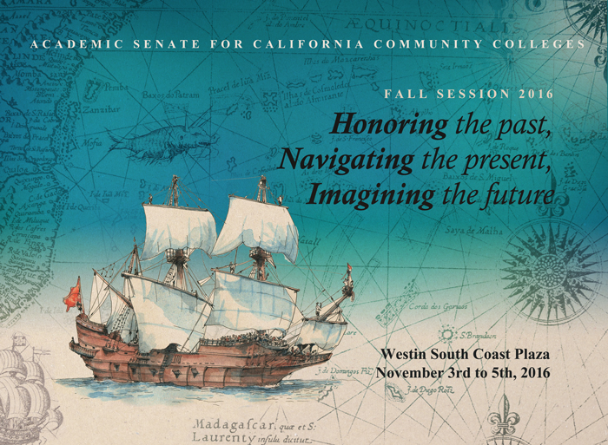
Thank you!

Slide 2




Guided Pathways
Presented by:
October 7, 2016

Slide 3

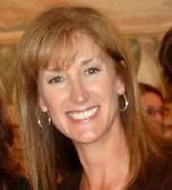
Julie Bruno
President
Academic Senate for California Community Colleges

Slide 4

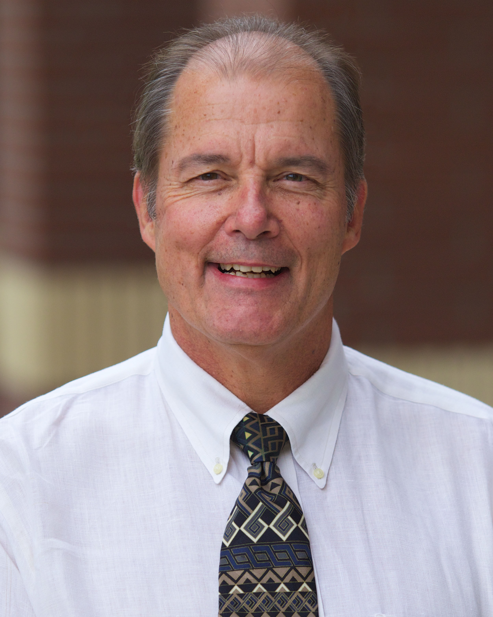
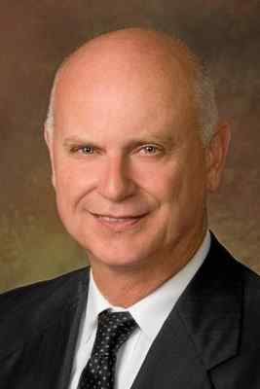
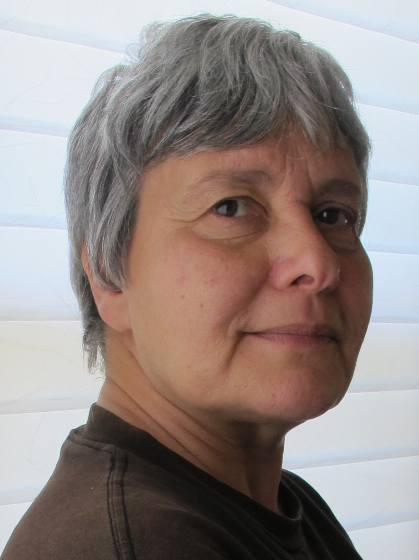
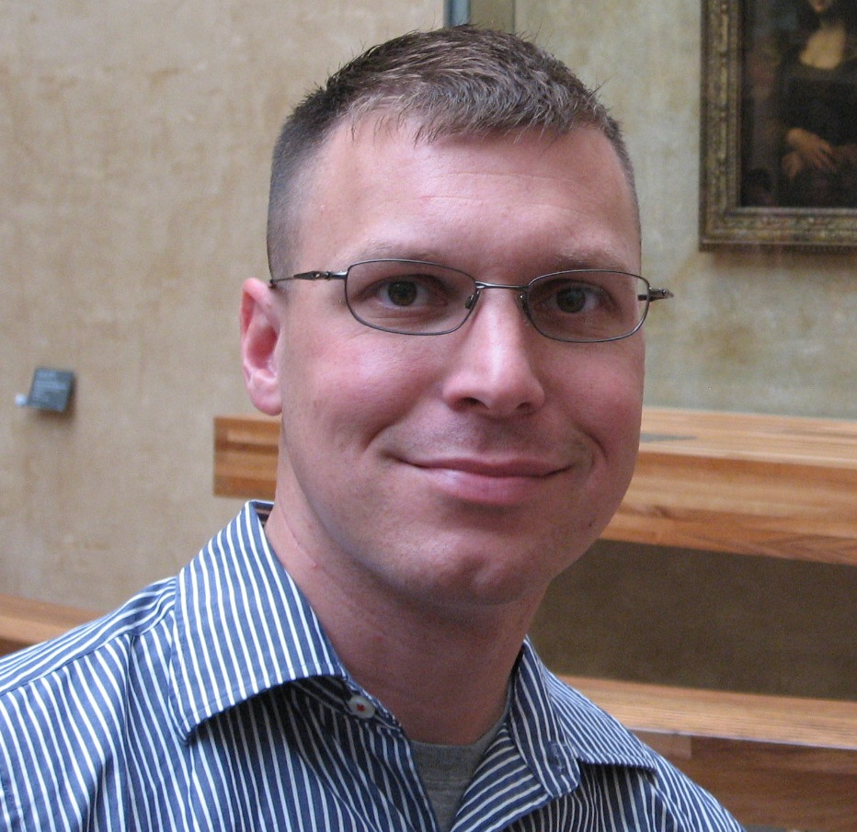
Presenters
Craig Justice
Vice President for Instruction (Ret.)
Bill Scroggins
President
Sonya Christian
President
Bakersfield College
Jeff Archibald
Faculty - Communication
Kathy Schmeidler
Professor
October 7, 2016

Slide 5




Sonya Christian
President
Bakersfield College
sonya.christian@bakersfieldcollege.edu
bcpresidentblog.com
sonya.christian.96
@sonyachristian

Slide 6
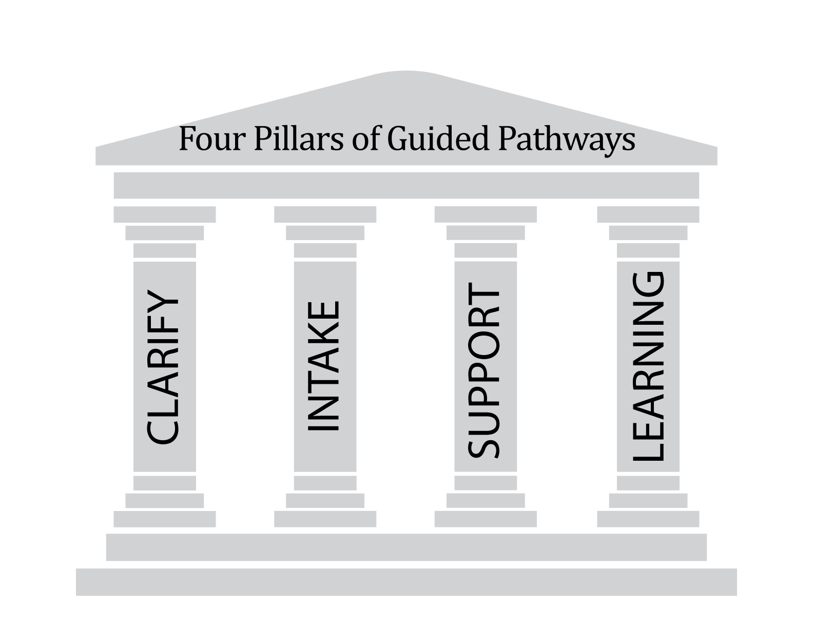
Guided Pathways

Slide 7
AACC Guided Pathways
Process
30 schools selected
6 institutes –
titles with teams working most of the time on planning
Get out of it what we put into it

Slide 9







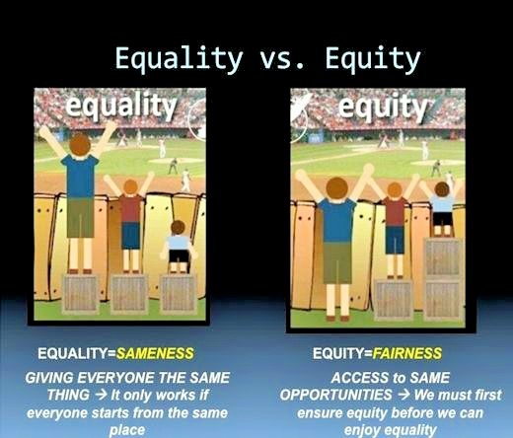


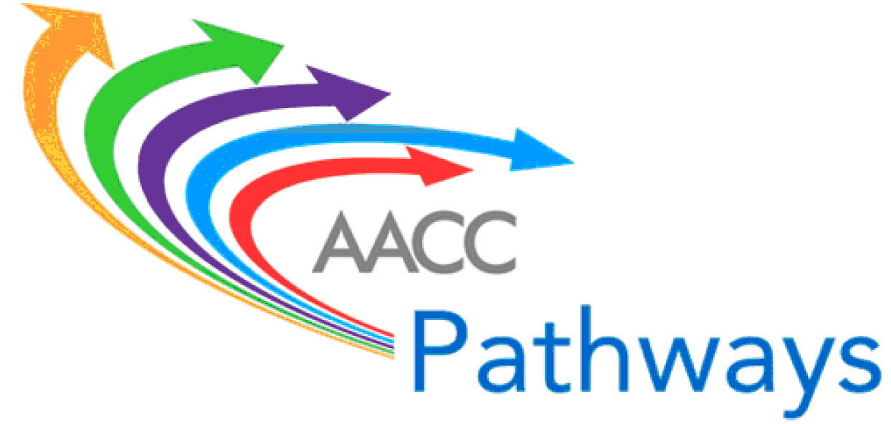







Challenge : FOCUS
California Career
Pathways Trust (CCPT)
STUDENT SUCCESS AND SUPPORT PROGRAM (SSSP)
Basic Skills and Student Outcomes Transformation Program

Slide 10






Guided Pathways
California Career
Pathways Trust (CCPT)
Equity, Social Mobility, Economic Health
California Pathways – Redesigning California’s Community Colleges

Slide 11



Guided Pathways
SSSP
Equity, Social Mobility, Economic Health
California Pathways – Redesigning California’s Community Colleges

Slide 12
Guided Pathways
SSSP
Supplemental Instruction/Tutoring
Contextualized Learning
BSI e-Resource
Noncredit
Equity, Social Mobility, Economic Health
California Pathways – Redesigning California’s Community Colleges

Slide 13

Guided Pathways
Equity, Social Mobility, Economic Health
California Pathways – Redesigning California’s Community Colleges

Slide 14
Guided Pathways
Defining Competencies
Assessing
Competencies

Slide 15

Jobs
Social Mobility
Civic Engagement
Healthy Community

Slide 16
Craig Justice
Vice President for Instruction (Ret.)
Kathy Schmeidler
Professor

Slide 17
IVC EXPERIENCE
Guided Pathways Approach Resonated with Several IVC initiatives (SEP, AANAPISI, Basic Skills Transformation)
Pathways Offered Strength of Being Holistic in Its Approach
Data About Guided Pathways vs. Cafeteria Style Student Choice Patterns Was Convincing Enough to Warrant a Serious Exploration
Numerous Caveats Emerged: Are We Restricting Students’ Freedom to Explore? Impact on Programs?

Slide 18
IVC DIALOG
Dialog Across the Campus
Faculty Attendance at the AACC Guided Pathways Conferences Included Skeptics and Believers
Continuing Conversations in the Academic Senate, Instructional Council, et al. Helped to Address Concerns Along the Way
Concerns Include How to Adapt to the California Environment, Role of Breadth and Exploration in General Education, How to Break Down Silos

Slide 19
IVC TODAY
Dialog to Ensure Academic Integrity
Training and Education – Match or Mismatch?
Moving Forward

Slide 20
Bill Scroggins
President
Jeff Archibald
Faculty - Communication

Slide 21
MT. SAC TIMELINE
October/November 2015 – Senate Approval to Participate Requested
February 2016 – First Institute – faculty leaders
March 2016 – Pathways Implementation Group formed
April 2016 – Second Institute – mapping faculty

Slide 22
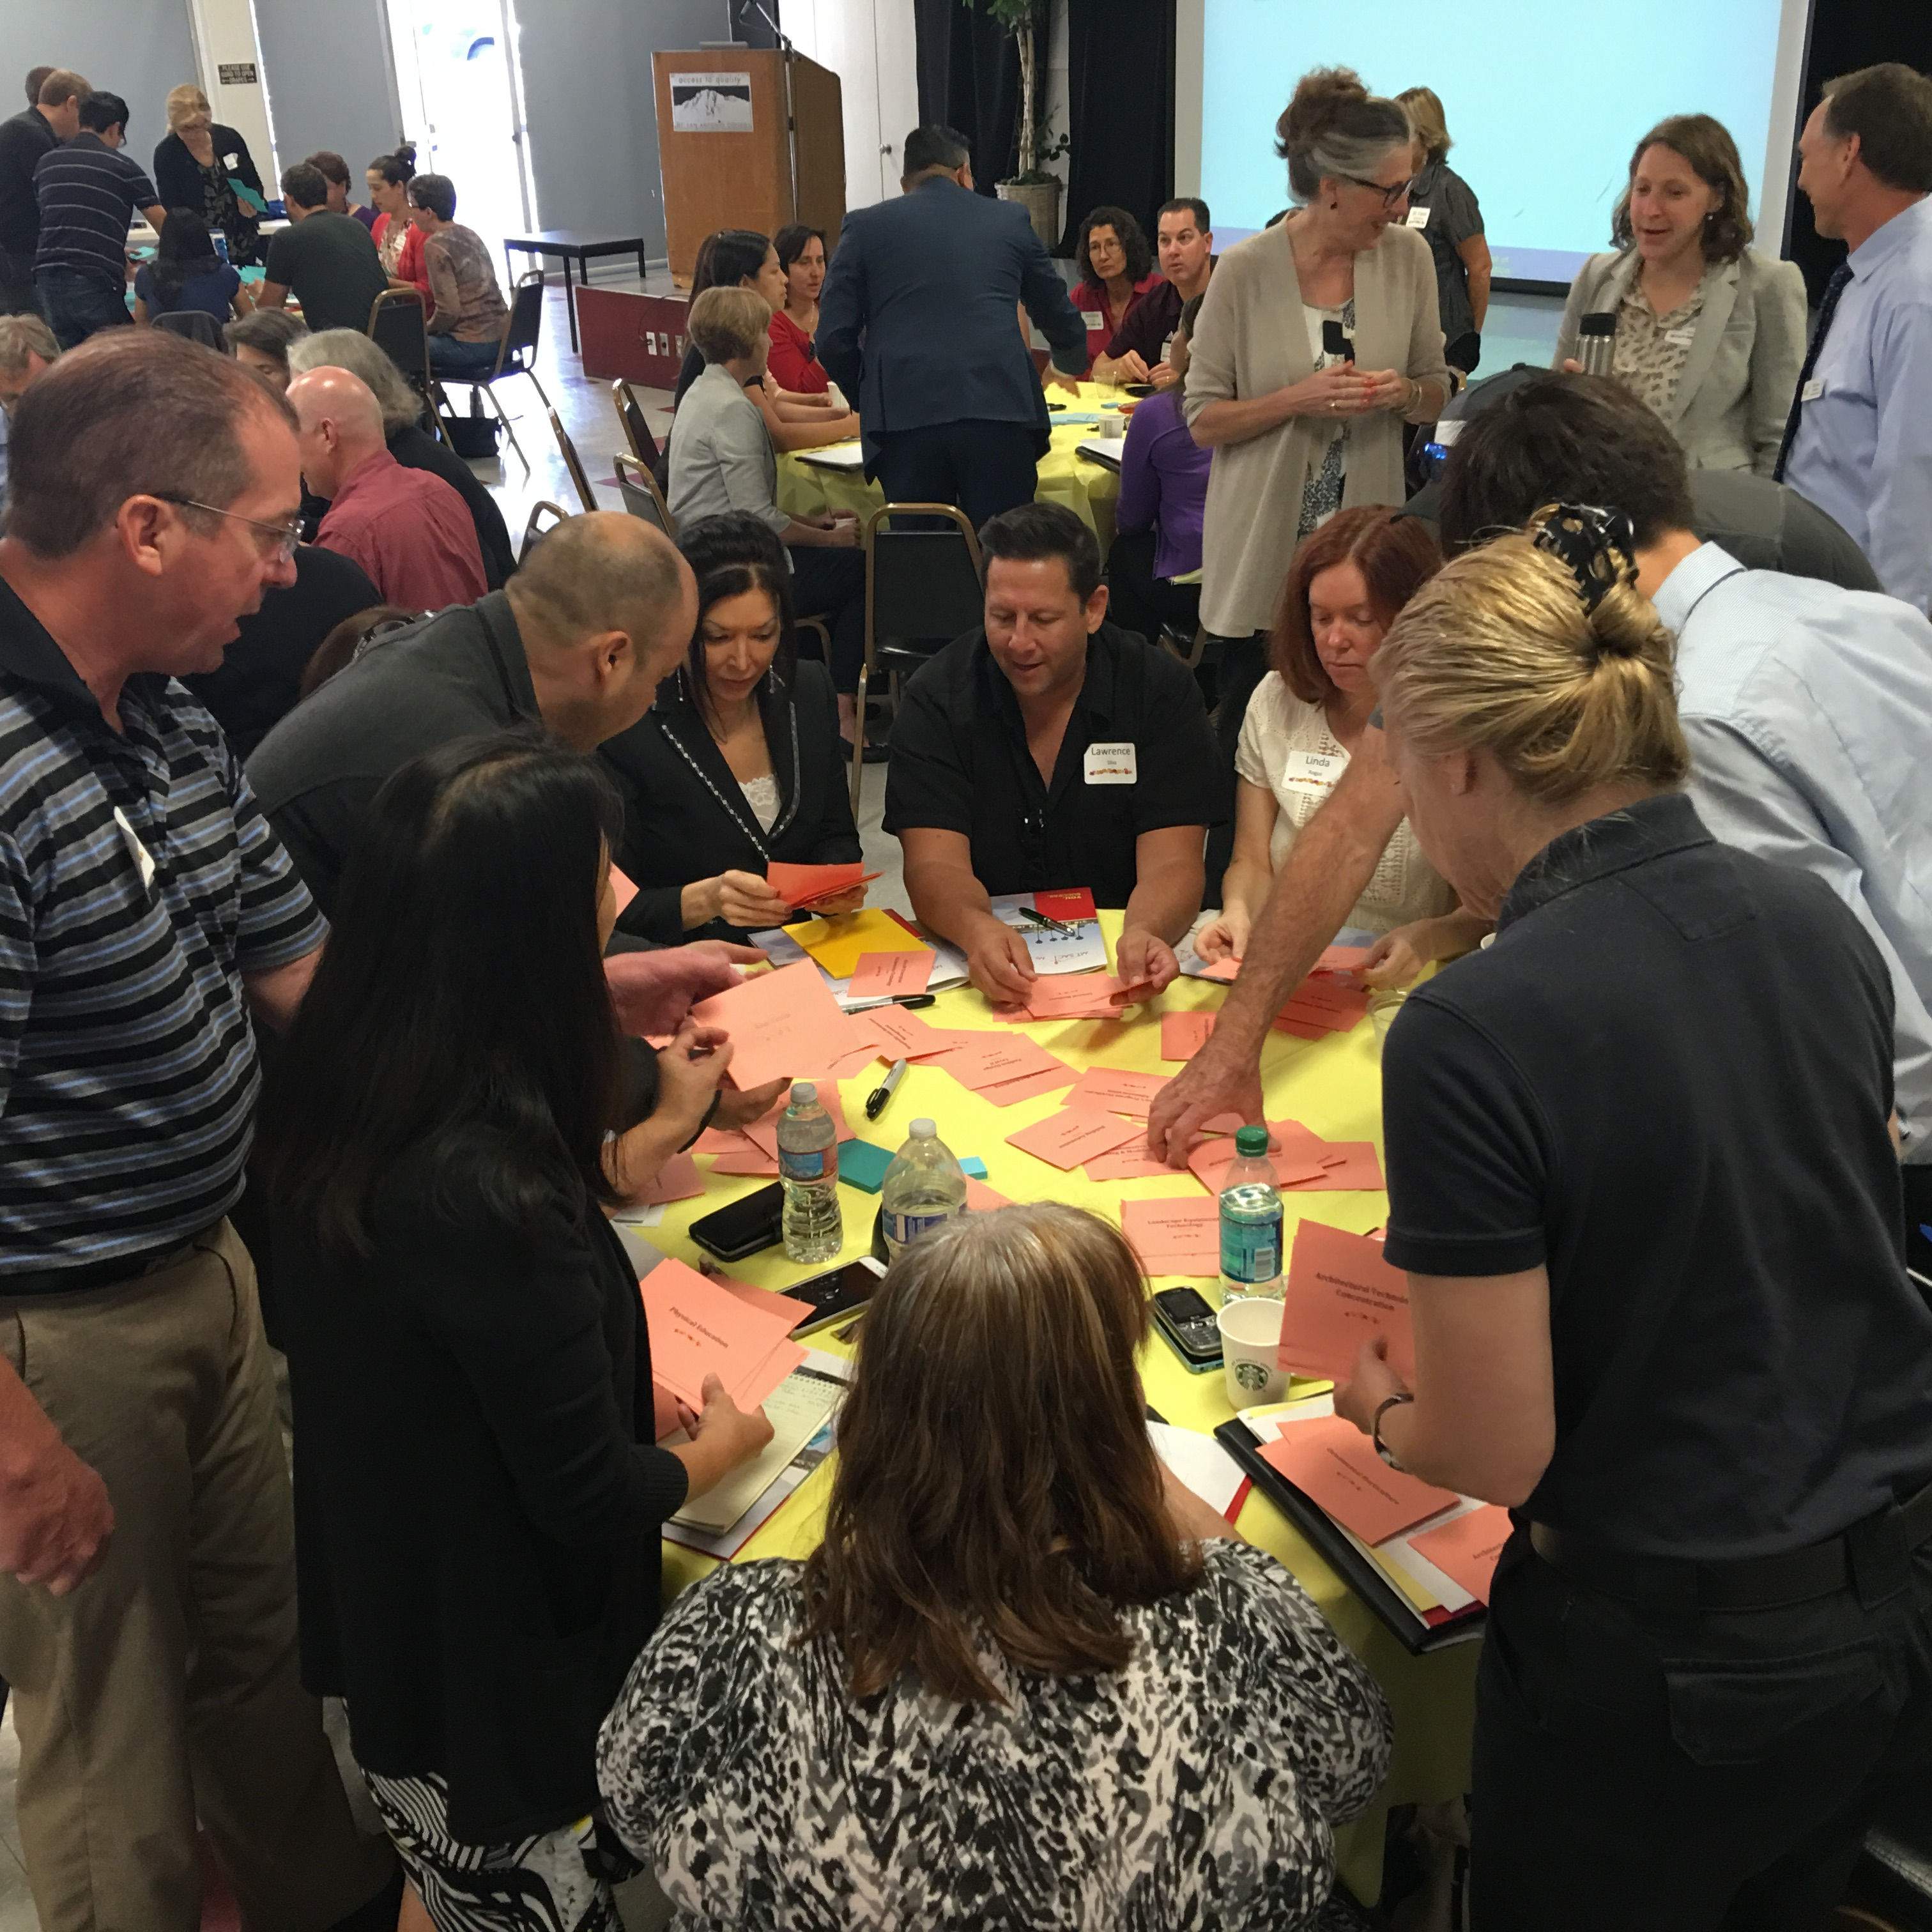
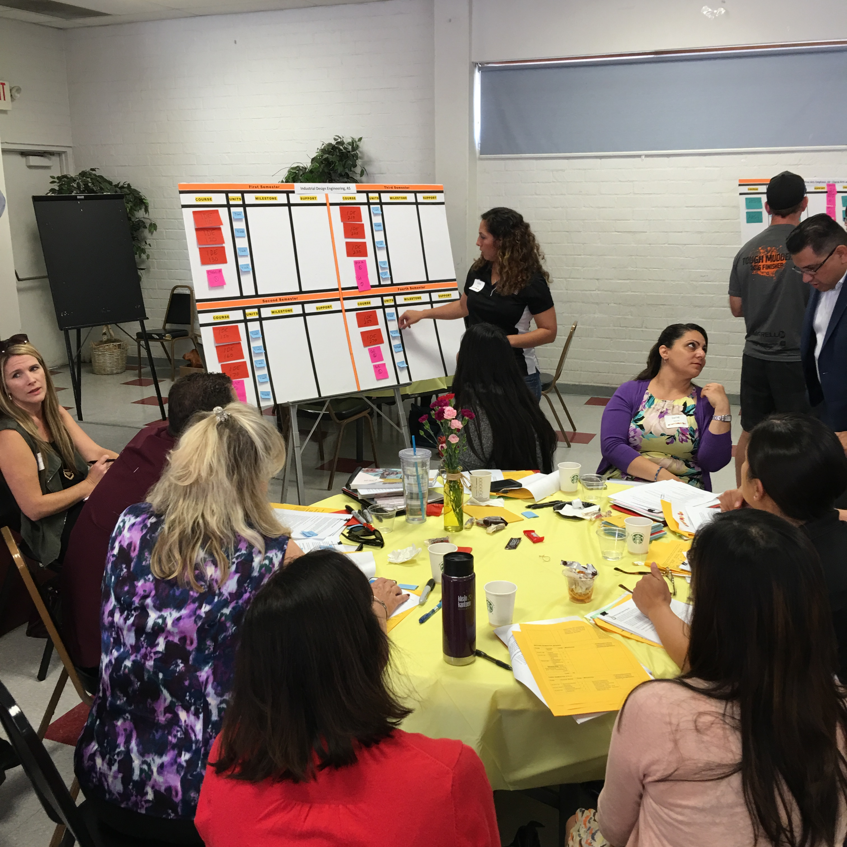
MT. SAC TIMELINE
May 2016 – Pathways Summit

Slide 23
MT. SAC TIMELINE
Summer 2016 – Student Focus Groups
August 2016 – Pathways Summit II
October 2016 – Third Institute – Counseling and Basic Skills faculty
October 2016 – Pathways Summit III

Slide 24
MT. SAC EXPERIENCE
Highlights good work we are already doing
Encourages looking at the College/programs from the student perspective
Produces a critical self-examination of programs
Departments examining scheduling practices
Dialogue between counseling faculty and program faculty
Collaboration between campus groups done the
      “Mt. SAC way”

Slide 25
What guided pathways is NOT
Pathways is NOT a boutique program but rather a transformation to make college ready for students.
Pathways does NOT limit student choice rather guides students to make informed choices.
Pathways is NOT curriculum reform but rather an integration of students’ college experiences.
Pathways is NOT a management driven reform but rather a collegial and faculty driven process.

Slide 26
Thank You!

Slide 27
Resources
California Guided Pathways Project
AACC Pathways Project

