Slide 1
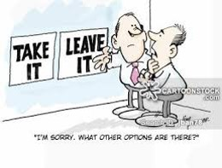
Guided Pathways and Curriculum
Randy Beach, ASCCC Guided Pathways Task Force, Southwestern College
Ginni May, ASCCC Treasurer, 2018-19 ASCCC Curriculum Chair

Slide 2
Description
Curriculum serves as the centermost catalyst for the guided pathways movement. With so much change happening in our system affecting course and program development, colleges are experimenting with new innovations and approaches to learning. This workshop is intended for faculty with all levels of curriculum knowledge to discuss the impacts of the guided pathways principles on their curriculum, as well as how recent changes connect to a college’s framework.
ASCCC Academic Academy September 14-15, 2018 San Francisco, CA

Slide 3
What Will We Cover?
Curriculum and Guided Pathways
The Role of the Curriculum Committee
Impact of Guided Pathways on Curriculum
Course level
Program level
Curriculum approval processes
What’s new?
What’s coming…
What’s on your mind…?
ASCCC Academic Academy September 14-15, 2018 San Francisco, CA

Slide 4
What brings you to this breakout?
What is your role with curriculum?
What do you hope to learn?
ASCCC Academic Academy September 14-15, 2018 San Francisco, CA

Slide 5
Curriculum and Guided Pathways
…the fundamental problem with the community college is the “…structure of its curriculum and the institutional assumptions that undergird that structure. In its attempt to serve all members of an area, the typical community college has allowed to proliferate a wide range of academic, occupational, general interest and service courses and programs.” Though some type of guidance is available, many students can’t and don’t use these services at all.
https://www.insidehighered.com/views/2016/06/23/essay-challenges-facing-guided-pathways-model-restructuring-two-year-colleges
ASCCC Academic Academy September 14-15, 2018 San Francisco, CA

Slide 6
Curriculum and Guided Pathways
“the cafeteria-style, self-service model”
“Students, many of whom are the first in their families to go to college, might enroll without a clear goal, get inadequate or incomplete advising, and take courses that don’t lead to a specified outcome, are out of sequence or that they’ve already taken.” https://www.insidehighered.com/views/2016/06/23/essay-challenges-facing-guided-pathways-model-restructuring-two-year-colleges
ASCCC Academic Academy September 14-15, 2018 San Francisco, CA

Slide 7
The Role of the Curriculum Committee
in a Guided Pathways Framework...
ASCCC Academic Academy September 14-15, 2018 San Francisco, CA

Slide 8
Role of the Curriculum Committee: Clarify the Path
The clustering of programs (aka meta-majors, areas of interest, fields of study) for the purpose of communicating pathways
Clear alignment of programs with related outcomes
Considers relevant industry and career focuses
May have catalog/website impact
ASCCC Academic Academy September 14-15, 2018 San Francisco, CA

Slide 9
Role of the Curriculum Committee: Clarify the Path
Involvement in program mapping
Simple choices of course sequencing to show students (full-time, part-time, evening) a clear pathway to completion, further education, and/or employment
The relevance of general education
Critical courses, embedded credentials, and progress milestones
Determining the “right math” and other aligned coursework, including general education
ASCCC Academic Academy September 14-15, 2018 San Francisco, CA

Slide 10
Role of the Curriculum Committee: Enter the Path
Use of multiple measures to assess students’ needs and interests
First-year experiences to help students explore the field and choose a major
Full program plans based on career/transfer requirements
Contextualized, integrated academic support to help students pass program gateway courses
K-12 partnerships focused on career/college program exploration
ASCCC Academic Academy September 14-15, 2018 San Francisco, CA

Slide 11
Role of the Curriculum Committee: Stay on the Path
Embedded academic support built into the curriculum
Learning communities and other interventions
Faculty familiarity and engagement with program requirements across disciplines
Awareness of program design that helps students redirect and change their goals without amassing significant numbers of units
Inescapable student engagement, opt out model
ASCCC Academic Academy September 14-15, 2018 San Francisco, CA

Slide 12
Role of the Curriculum Committee: Ensuring Learning
Program-specific learning outcomes aligned with the requirements for success in employment and/or further education
Project-based, collaborative, and applied learning experiences
Faculty-led improvement of teaching practices throughout the pathways
Respond to the results of learning outcomes assessments to improve the effectiveness of instruction across programs
Ensure incorporation of effective teaching practice
ASCCC Academic Academy September 14-15, 2018 San Francisco, CA

Slide 13
Guided Pathways and Courses
Mapping and other discussions may lead to discoveries:
Courses that are not offered with frequency or consistency
Courses in need of revision
Courses lacking meaningful SLOs or SLO assessment
Courses lacking connection to any program
Courses with a dubious connection to a program
Cross-institution conversations may call for more professional development on cross-disciplines or between silos
ASCCC Academic Academy September 14-15, 2018 San Francisco, CA

Slide 14
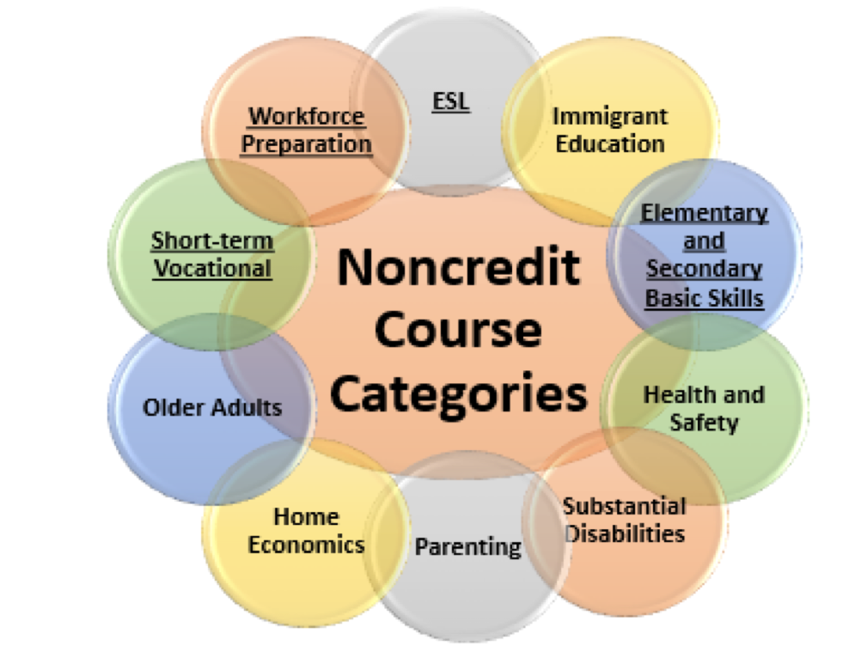
Noncredit Courses: Ten Categories
English as a Second Language (ESL)*
Immigrant Education
Elementary and Secondary Basic Skills*
Health and Safety
Substantial Disabilities
Parenting
Home Economics
Courses for Older Adults
Short-term Vocational*
Workforce Preparation*
*Areas (1), (3), (9), (10) are eligible for Enhanced Funding if associated with an approved noncredit program.
ASCCC Academic Academy September 14-15, 2018 San Francisco, CA

Slide 15
Guided Pathways and Courses
Will mapping lead to a reduction in courses?
Will providing general education recommendations lead to reduced choice?
Are the courses in each program critical for success/lower division preparation?
Will pathways work lead to fewer choices, more choices, or different choices?
What is the relevance of GE courses to students in the program and the faculty?
ASCCC Academic Academy September 14-15, 2018 San Francisco, CA

Slide 16
Guided Pathways and Programs
Helps faculty laser-focus a program’s goal to guide and prepare students to enter further education or employment
Helps identify extraneous or duplicative programs during mapping, sorting, cross-discipline discussions, including with counseling
Encourages faculty to talk about their programs with other stakeholders (counselors, students, admin) to understand the bigger picture
Recognizes milestone, including maximizing the use of “stackable” certifications?
Looks for “bridges” to facilitate movement between programs for students who change their focus
ASCCC Academic Academy September 14-15, 2018 San Francisco, CA

Slide 17
The Curriculum Landscape to Support Pathways
ADTs are a form of pathways
IGETC transfer agreements in Physics and Chemistry
Title 5 change for Certificate of Achievement from 18 to 16 minimum (semester) units
What about local degrees and certificates?
ASCCC Academic Academy September 14-15, 2018 San Francisco, CA

Slide 18
Curriculum Approval Processes
Did you know?
Colleges are permitted to self-certify certain types of curriculum:
All credit courses
Modified credit programs with the exception of ADTs
New credit programs with a goal of local program with the exception of new CTE credit programs and Apprenticeship
ASCCC Academic Academy September 14-15, 2018 San Francisco, CA

Slide 19
Curriculum Approval Processes
Discipline faculty develop and submit
Senate 10+1 – faculty purview
Local curriculum committee reviews and approves
May include separate tech review, DE review, requisite review, etc.
Local governing board approves
Chancellor’s office reviews, chapters, and issues Control Numbers
ASCCC Academic Academy September 14-15, 2018 San Francisco, CA

Slide 20
Curriculum Approval Processes
Curriculum can now be published in catalog, schedule, etc.
eligible for apportionment
sent for external articulation and transfer agreements (may take an additional year; coordinate with your AO)
ASCCC Academic Academy September 14-15, 2018 San Francisco, CA

Slide 21
So What is COCI?
Chancellor’s Office Curriculum Inventory: https://coci2.ccctechcenter.org/
New system, home grown by CCC Tech Center at Butte
Replaced old CIV-2 system by Governet
Allows submission of courses and programs for either review and approval, or auto-approval
Provides chaptering of college curriculum, but college will be the primary record keepers
This leads us to the certification process…
ASCCC Academic Academy September 14-15, 2018 San Francisco, CA

Slide 22
College Certification Process for Auto-Approval
In order to be given auto-approval rights, colleges certify annually that the local curriculum development, review and approval process follows statutes and regulations:
California Education Code
California Code of Regulations, Title 5
CCCCO Program and Course Approval Handbook (PCAH)
ASCCC Academic Academy September 14-15, 2018 San Francisco, CA

Slide 23
College Certification Process for Auto-Approval
Even though COCI has fewer “required” fields for submission, colleges are still expected to have a robust local process.
College certification is signed by the CIO, curriculum chair, academic senate president and CEO
Colleges are permitted to self-certify certain types of curriculum:
All credit courses
Modified credit programs with the exception of ADTs
New credit programs with a goal of local program with the exception of new CTE credit programs and Apprenticeship
ASCCC Academic Academy September 14-15, 2018 San Francisco, CA

Slide 24
What is Auto Approval?
Automated through COCI, but not automatic
New COCI will validate certain fields such as CB codes
Courses submitted correctly will get an automatically generated course control number (CCN)
Good news—Much faster approval, plus a shorter queue for everything else
Caveat—More important than ever to make sure local process is aligned with Title 5 and PCAH
ASCCC Academic Academy September 14-15, 2018 San Francisco, CA

Slide 25
Title 5 Changes are coming...
Considerations leading to changes:
Pathways may bring systemwide regulation change
The implementation of AB 705
Key performance metrics include completion of transfer-level English and math in the first year
Metrics of the new funding formula
Other equity metrics based on Guided Pathways as an equity initiative
ASCCC Academic Academy September 14-15, 2018 San Francisco, CA

Slide 26
Questions?
Randy Beach, ASCCC Guided Pathways Task Force, Southwestern College, rbeach@swccd.edu Ginni May, ASCCC Treasurer, 2018-19 ASCCC Curriculum Chair, MayV@scc.losrios.edu
info@asccc.org
ASCCC Academic Academy September 14-15, 2018 San Francisco, CA

